Slide 1






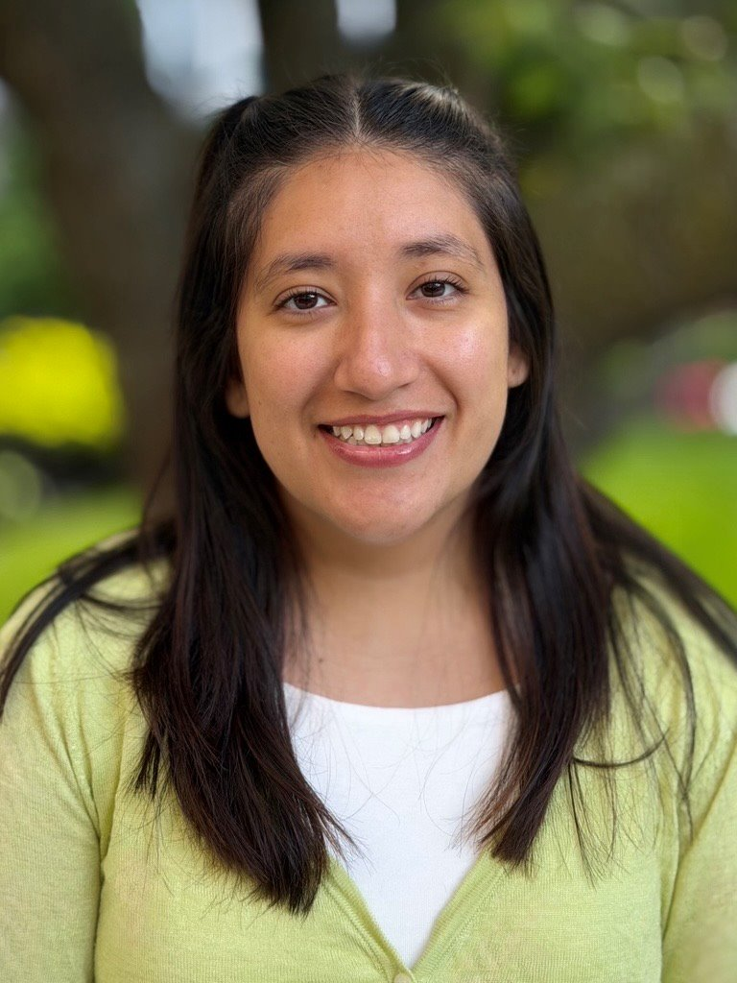


Does Freezing Change the Mechanical Behavior of Aortic Tissue?
Soft Tissue Biomechanics Research Laboratory
Anjali Misra, YSP Student, Weston High School
Kunal Shanbhag, YSP Student, North Andover High School
Guadalupe Garcia​, Mechanical Engineering, Northeastern University
Sean Harrington, Mechanical Engineering, Northeastern University
Professor Rouzbeh Amini, Electrical and Computer Engineering, Northeastern University​

Slide 2

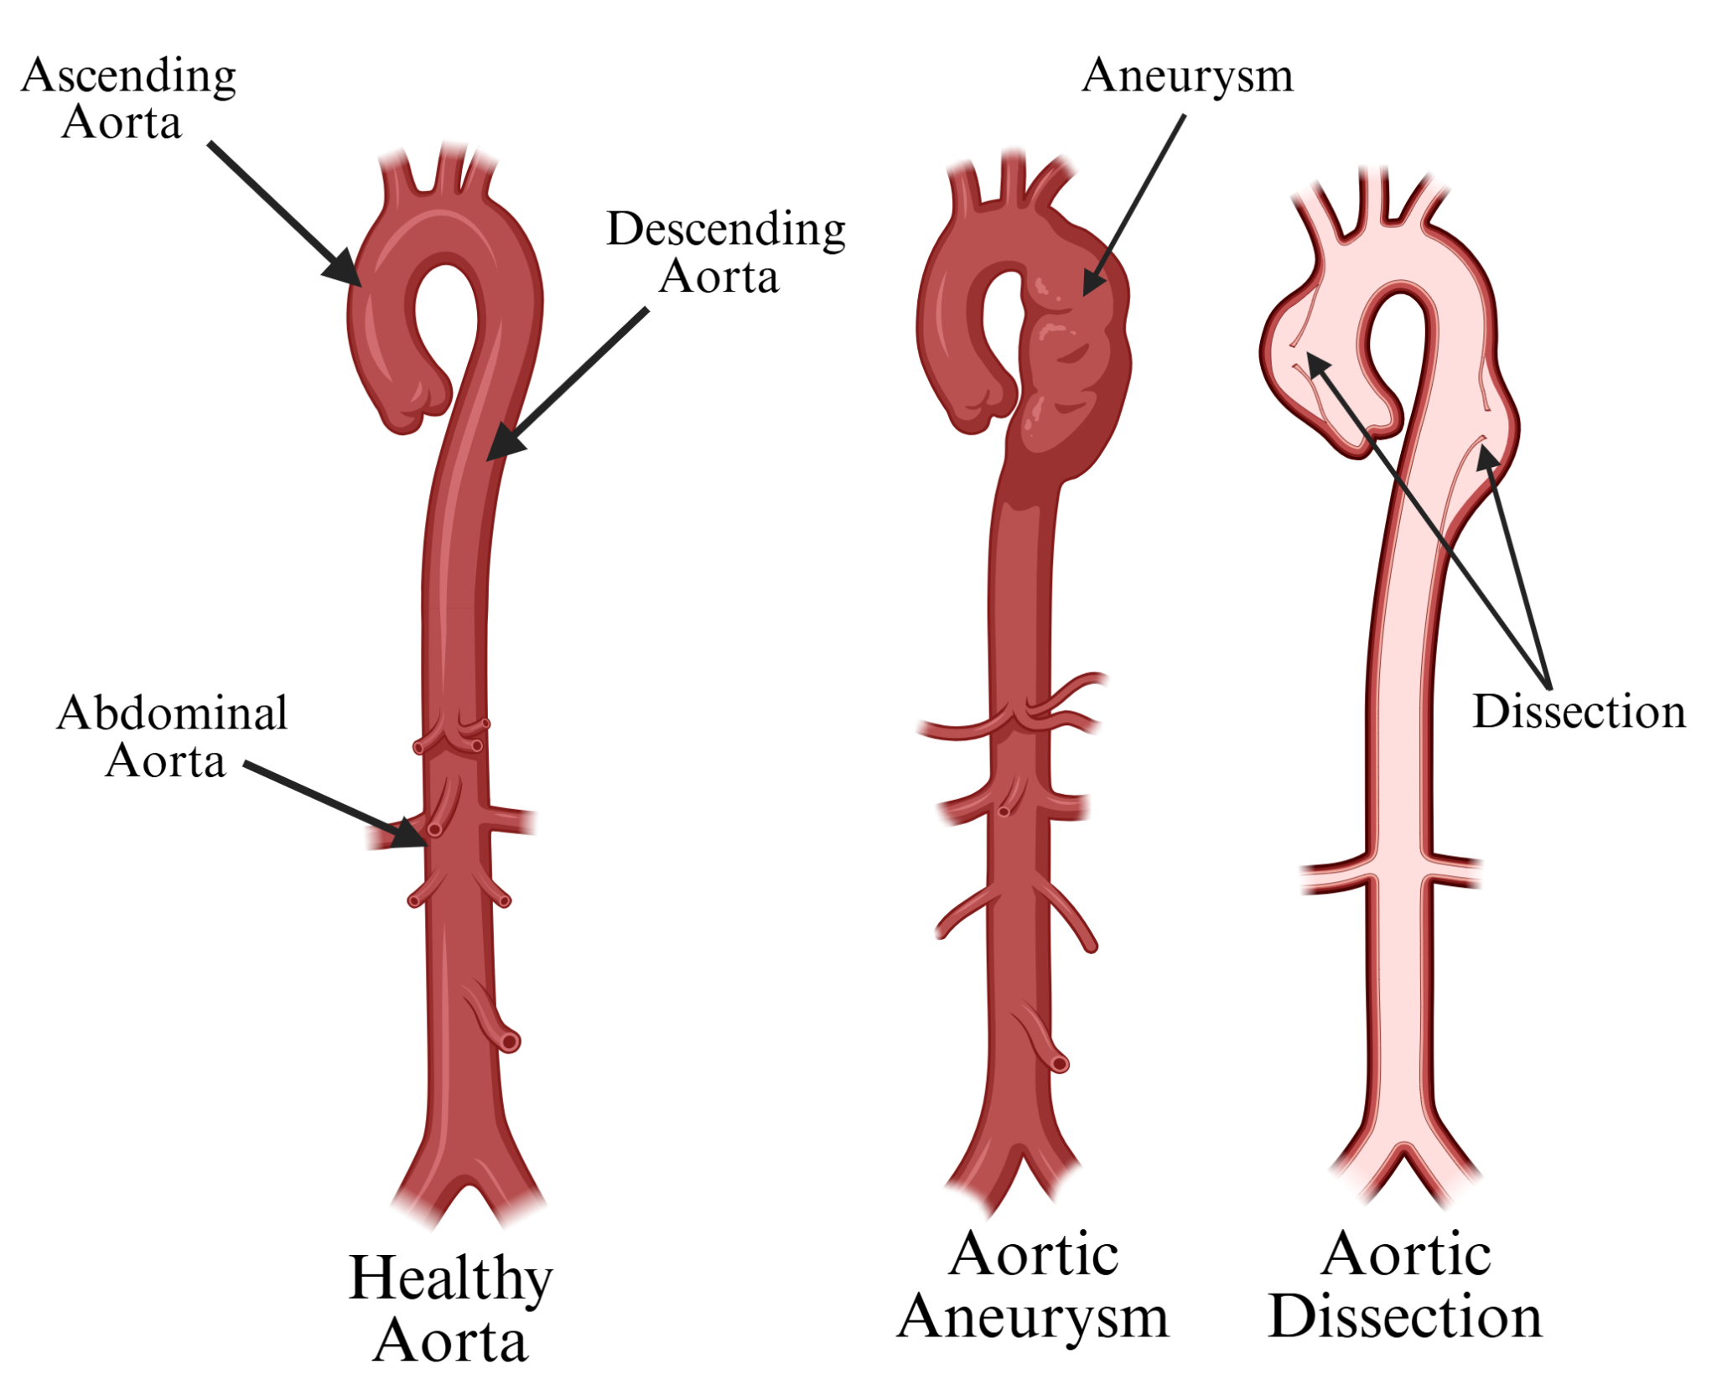

Soft Tissue Biomechanics ​Research Lab
Problem
It is important to research the aorta as to fully understand the development of cardiovascular diseases (CVD) like aneurysms and dissections
The Aorta is commonly cryopreserved at subfreezing -80°C to preserve tissue sample.
Our study aims to find whether freezing descending thoracic aortic (DTA) sample tissue changes the mechanical properties of the sample
Figure 1. Diagram of healthy aorta, Aortic aneurysms, and aortic dissections
Does Freezing Change the Mechanical Behavior of Aortic Tissue?
Slide 02 / 16 - NEU Young Scholars Program 2026 - July 30, 2026
Notes:
Anjali (reword if you want):
So what is our problem? Before I talk about the main focus of our research it is important to understand the basic mechanical properties of the aorta. Its stiffness and elasticity are integral to its function. As the cardiovascular systems operates the aorta is constantly being put under stress biaxially. Studies on heart and main artery diseases must use tissue samples that match real living bodies. And therefore, to preserve their samples, many researchers resort to storing tissue in -80 degrees. Our study aims to determine whether the freezing of the tissue has any affect on the mechanical behavior of the aorta.

Slide 3
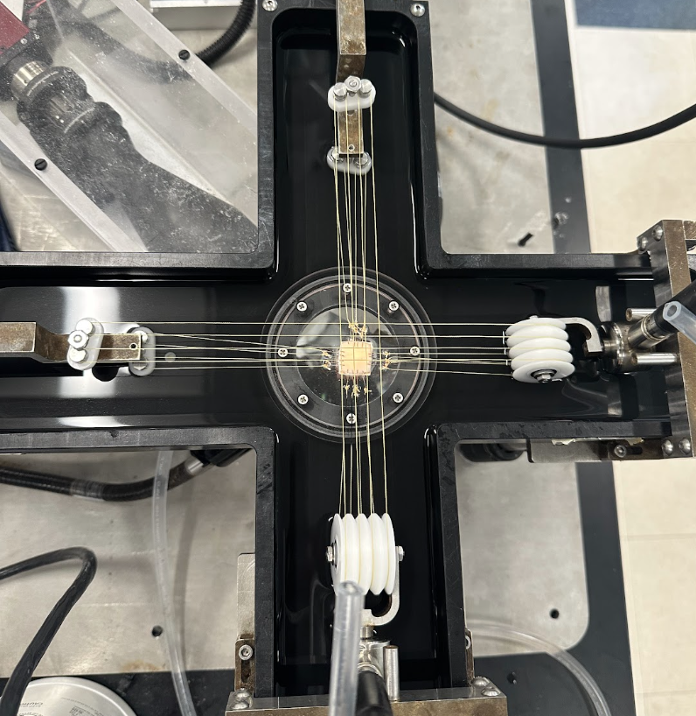
Soft Tissue Biomechanics ​Research Lab
Overview
The effect of freezing is tissue dependent
Previously the Amini lab has tested the tricuspid valve and found negligible difference in mechanical properties, after biaxial testing.
Our Research Activity: Fresh porcine tissue will be tested using biaxial load testing, frozen at -80°C, gradually thawed, and then retested
→ compare fresh and frozen stress-strain behavior, including both circumferential and axial strain
Warning: next slide has a picture of heart sample
Does Freezing Change the Mechanical Behavior of Aortic Tissue?
Slide 03 / 16 - NEU Young Scholars Program - July 30, 2026
Notes:
Kunal: Our Lab is a follow up to a 2022 study which researched the effect of -80° C on the tricuspid valve: the flap like tissue in the heart which controls flow of blood from the right atrium chamber to the right ventricle chamber. That study found negligible difference in the mechanical properties post biaxially testing.
Similarly, we used Biaxial testing, stretching the two axes of the aorta at different stress target values, to compare the stress-strain behavior of samples when they were fresh and post frozen.

Slide 4
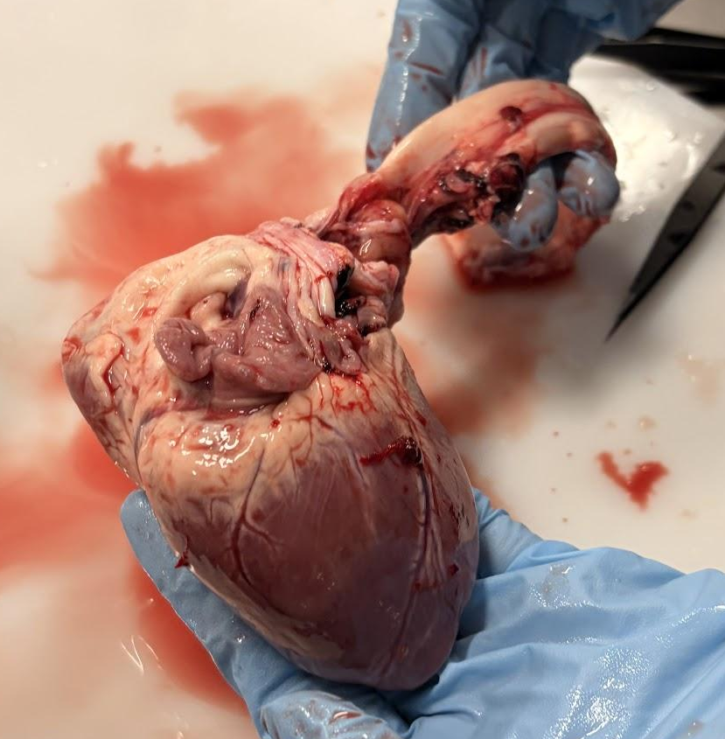
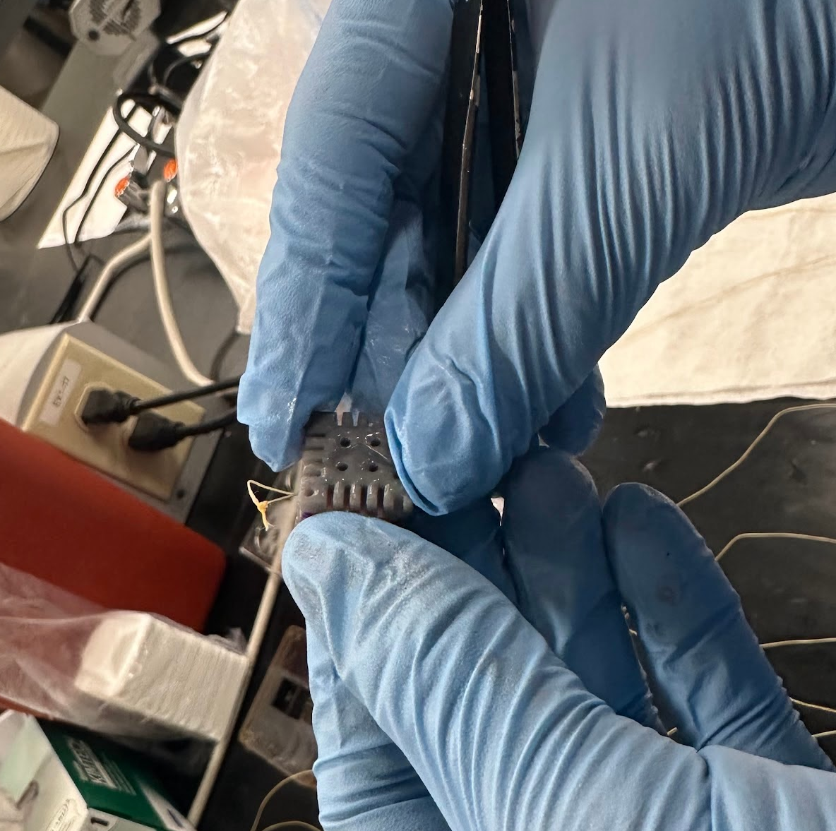
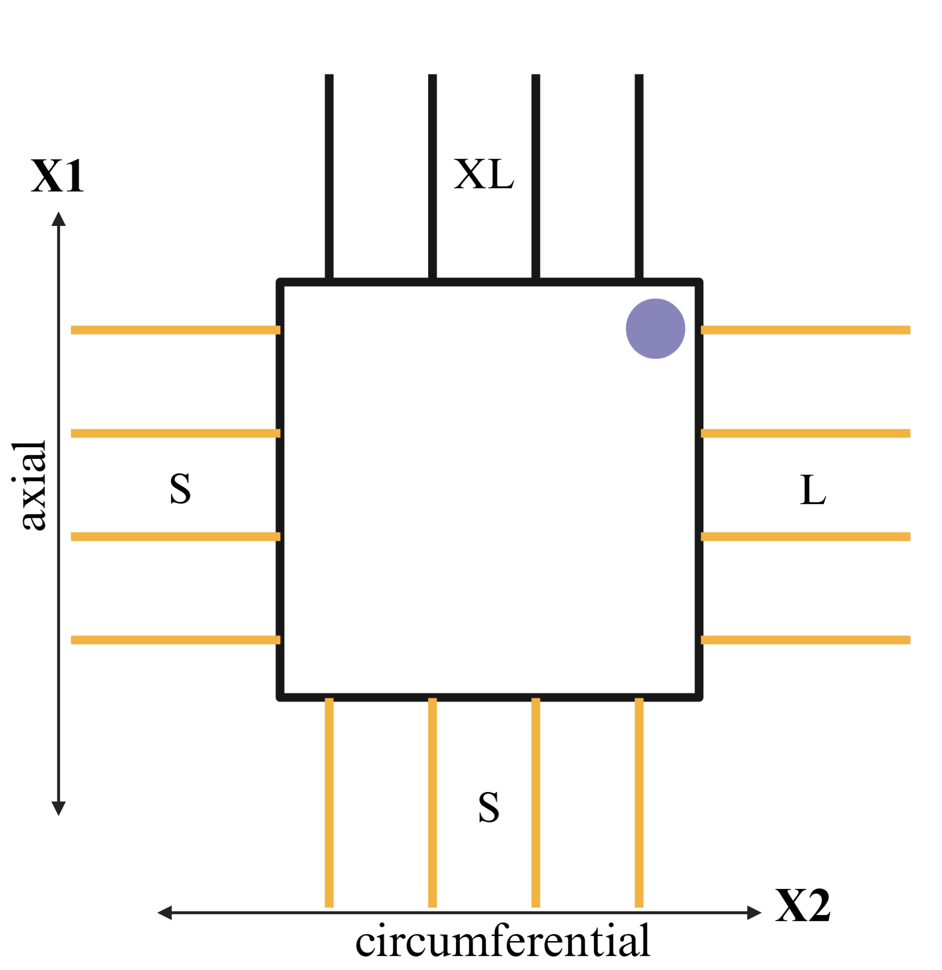
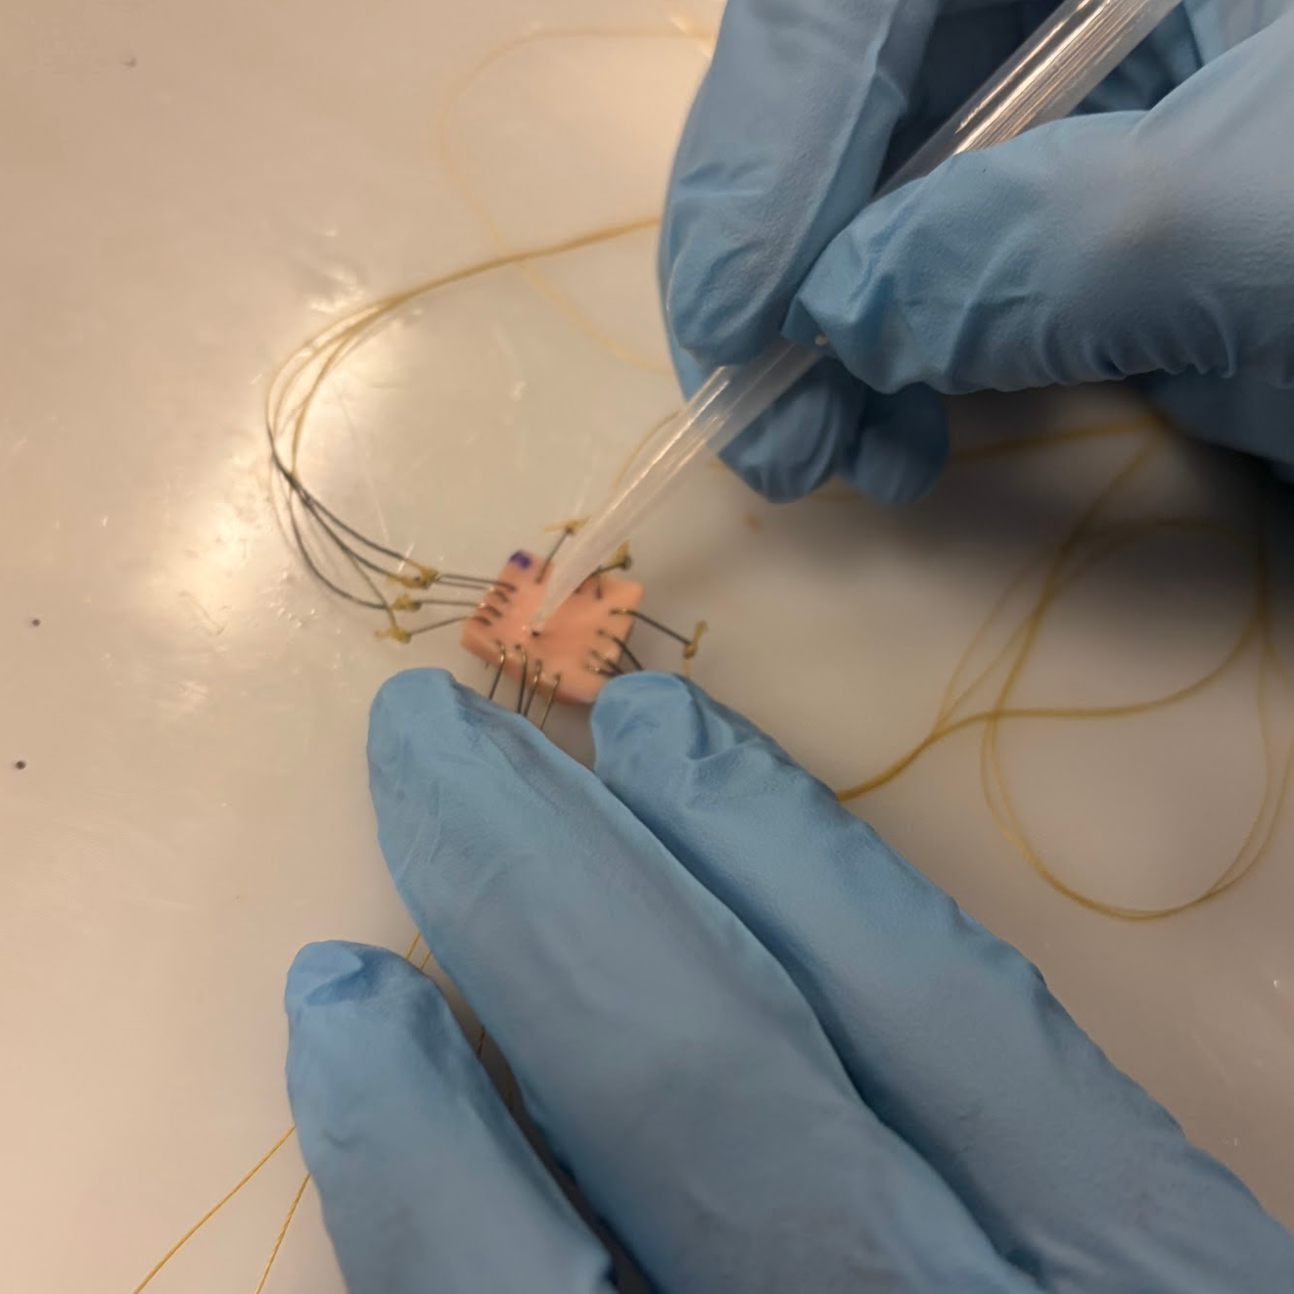
Soft Tissue Biomechanics ​Research Lab
Tissue Prep Workflow
Receive aorta sample
Cut desired segment and stamp
Measure thickness
Attach suture lines
Attach fiducial markers
Figure 3. Suture placement
Does Freezing Change the Mechanical Behavior of Aortic Tissue?
Slide 04 / 16 - NEU Young Scholars Program 2026 - July 30, 2026
Notes:
Anjali (reword if you want):Transitioning to our procedure, we first need to prep the tissue sample for the biaxial machine and obtain necessary information for the program. Additionally, It is important that throughout the procedure we spray Phosphate Buffer saline or PBS on the sample, this maintains the osmotic properties of the sample while it is in an un-frozen state. First, we receive the sample and clean it thoroughly by draining out the blood and removing excess connective tissue using sheers. Next, we cut out a piece of the tube for the desired sample; we also cut the tube radially so that the sample is flat with the inner lining facing up. After that, we use a hammer and stencil to cut out a 11 x 11 mm square sample. We then use a skin marker to identify the x: circumferential axis and y: Axial axis. Next, We use a thickness gauge to measure the thickness of all four sides of the sample, recording the average in the end. Following this, we apply sutures (essentially fish hooks attached on two sides of string) to the designated axes on the sample. four sets of sutures are needed: XL sutures 26.75 inches, large sutures are 26 inch, and 2 sets of small sutures are 7 inches. Next, we record the distance between the outer sutures on each side of the sample using a caliper. Finally, we apply glass fiducial markers in the mid-section of the sample using a pipette and glue.

Slide 5
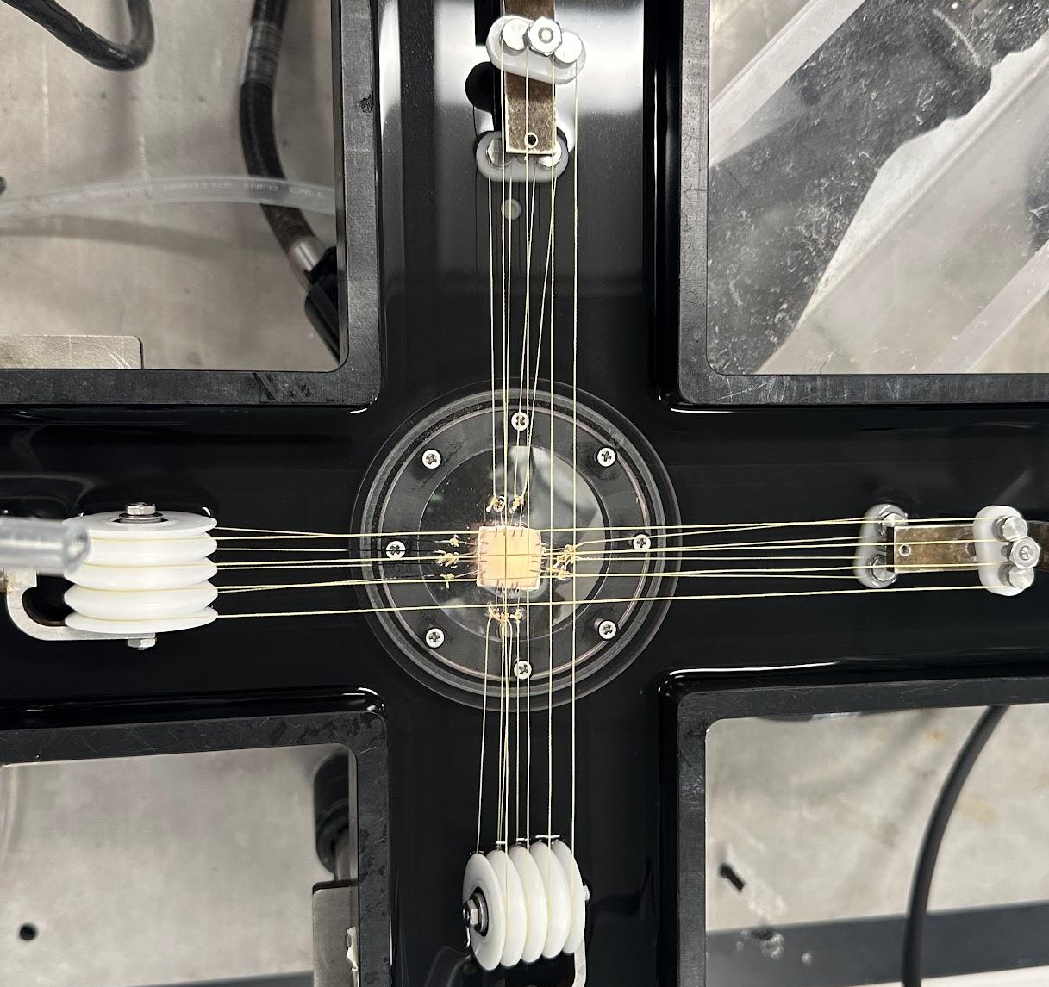
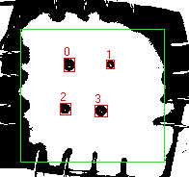
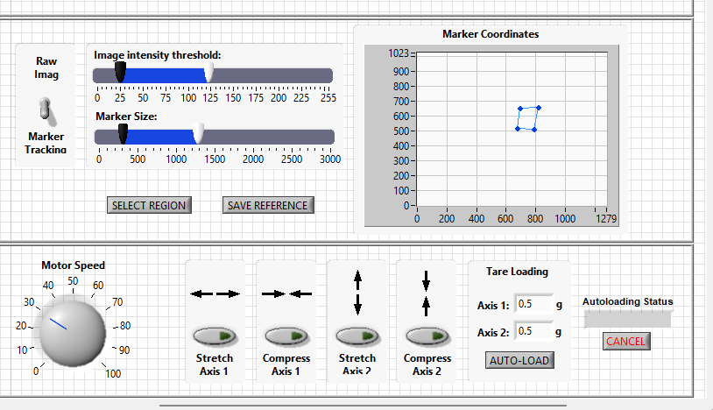
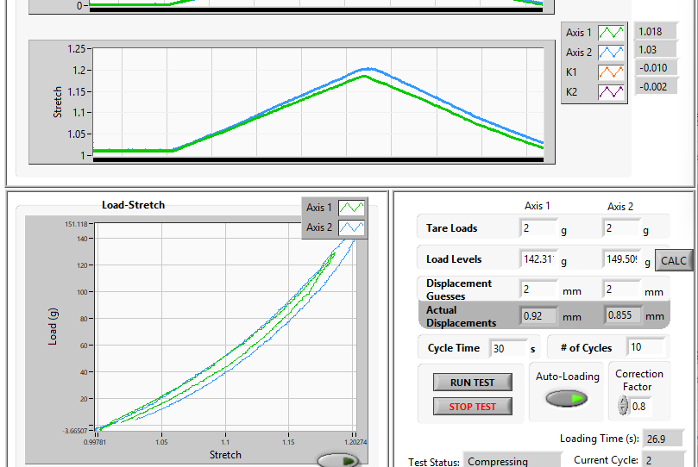
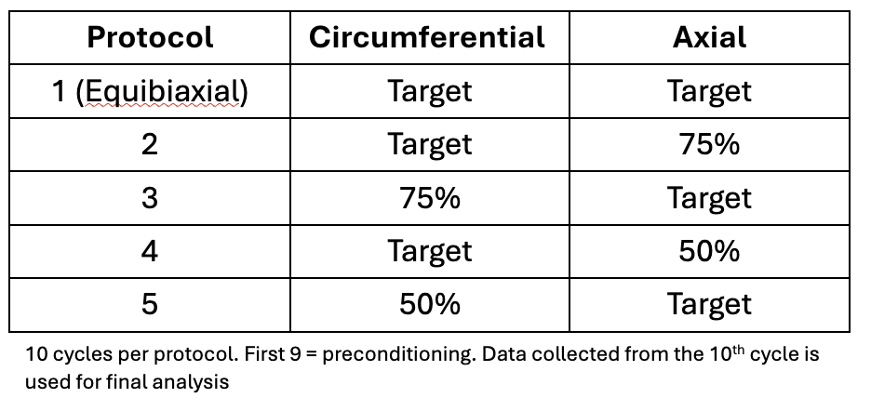
Soft Tissue Biomechanics ​Research Lab
Biaxial Testing Workflow
Attach suture lines to biaxial machine
Biaxial machine with sample mounted
Use LabView software to identify reference
Use second LabView software to activate biaxial testing
LabView sample setup
Run 10 cycles for each stress value combination
Figure 2. Chart showing Biaxial procedure stress values
LabView cycle run and stress value chart
Does Freezing Change the Mechanical Behavior of Aortic Tissue?
Slide 05 / 16 - NEU Young Scholars Program - July 30, 2026
Notes:
Kunal: After, tissue prep is complete we immediately start fresh testing. To begin, we secure the suture lines on the biaxial machine by hooping the string on linear actuators (which are responsible for stretching the tissue), the tissue is secured so that the fiducial markers face down. The circumferential side is secured on axis 2 of the machine while radial is secured on axis 1. We also fill the tank enclosure in the biaxial machine with 700 mL of PBS. Next, we open up a Labview program which records the initial reference for the data to go off of. Under the biaxial machine a glass window permits a camera to have a view of the tissue, and more importantly the markers. We adjust the image intensity threshold and marker size variables in the program so that the reference can identify the fiducial markers, as shown by a red highlight. After saving the reference, we open up our second Labview program which is responsible for the stretching procedure. We first input the thickness and length data taken during tissue prep, and then we input our stress values for each axis. Following this, we run 10 cycles of the program where the linear actuators repeatedly stretch to the desired output and then retretract; in our data analysis, we only take the 10th cycle of all 5 stress value combinations. After all 50 cycles are completed, we remove the sample from the machine and begin the freeze thaw protocol, preparing the sample for frozen testing

Slide 6
Soft Tissue Biomechanics ​Research Lab
Freeze-Thaw protocol
Fresh Sample test is done
Sample stored at -80°C
Sample moved to -20°C for 8-12 hours
Ready to test
Transfer to room temp PBS for 3 hours
Night before test sample moved to 4°C
Does Freezing Change the Mechanical Behavior of Aortic Tissue?
Slide 06 / 16 - NEU Young Scholars Program - July 30, 2026
Notes:
Anjali:

Slide 7
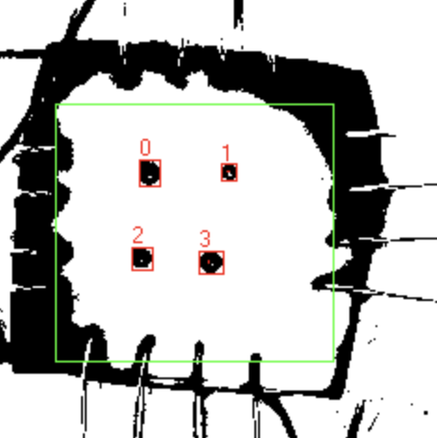
Soft Tissue Biomechanics ​Research Lab
Mechanical Analysis
Marker movement is used to measure how much tissue deforms during biaxial testing
λ= original length/current length​ = stretch
→ λ_{x} - horizontal stretch
→ λ_{y} - vertical stretch
Deformation gradient, F, maps the original marker positions to their stretched positions:
x = FX + c
[ ]
[ ]
[ ]
[ ]
F =
λ_{x} ​0
0 λ_{y}
1.5 ​ 0
0 1.2
10
10
15
12
Ex:( λ_{x}=1.5), (λ_{y}= 1.2)
Original position
(10,10)
New
Position
(15, 12)
Does Freezing Change the Mechanical Behavior of Aortic Tissue?
Slide 07 / 16 - NEU Young Scholars Program - July 30, 2026
Notes:
Kunal:

Slide 8
Soft Tissue Biomechanics ​Research Lab
Mechanical Analysis
Green Strain, E
C = F^{T}F → removes any rotational information, giving only stretch information
E = ½ (C - I) → subtracts the “no deformation” baseline, so E = 0 when nothing has happened
→ this works out to E = (λ² - 1)
Using our example…
X-direction E₁₁ = ((λ_{x})² - 1) / 2 = (2.25 - 1) / 2 = 0.625
Y-direction E₂₂ = ((λ_{y})² - 1) / 2 = (1.44 - 1) / 2 = 0.22
2
Does Freezing Change the Mechanical Behavior of Aortic Tissue?
Slide 08 / 16 - NEU Young Scholars Program 2026 - July 30, 2026
Notes:
Kunal:

Slide 9
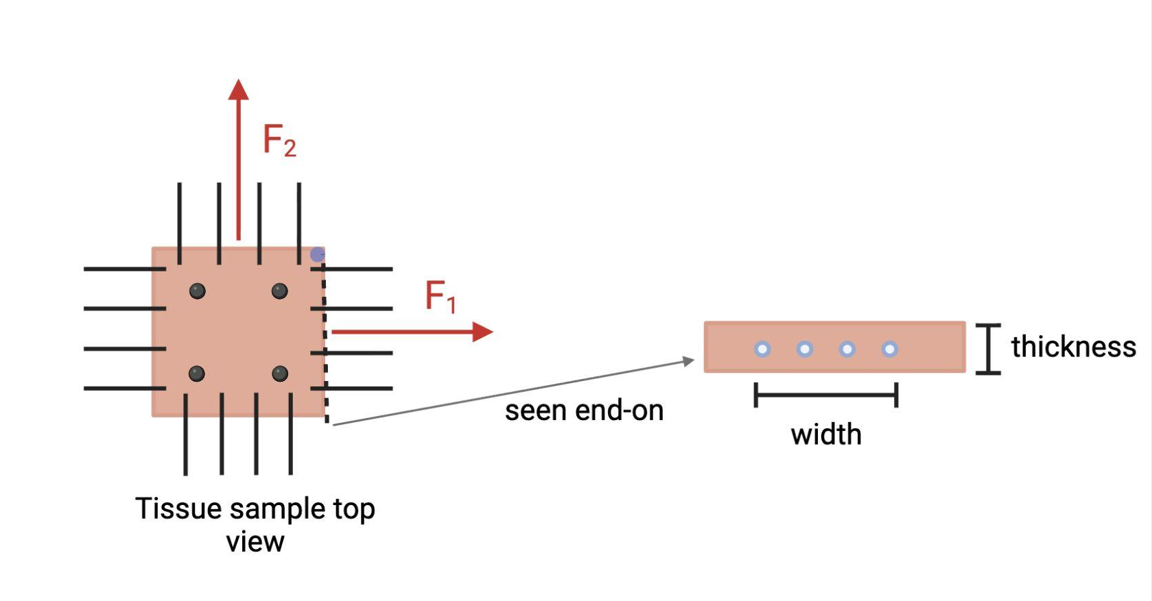
Soft Tissue Biomechanics ​Research Lab
Stress Calculation
1st Piola-Kirchhoff stress, P:
P₁₁ = F₁ / A₀ , P₂₂ = F₂ / A₀
A₀ = (tissue width) x (thickness)
Stress = force / the area it acts on
F₁, F₂ = forces measured by the load cells, one per axis
Convert to 2nd Piola-Kirchhoff stress: S = F⁻¹P → pairs with Green Strain, E, in the energy equation.
A₀ = width x thickness
Figure 4. Shows calculation of cross section area which is used to calculator Piola-Kirchhoff stress
Does Freezing Change the Mechanical Behavior of Aortic Tissue?
Slide 09 / 16 - NEU Young Scholars Program - July 30, 2026
Notes:
Anjali Stress is just force divided by area. Our load cells give us the pulling force on each axis, and we divide by the tissue's original cross-section — its width times its thickness. That's called the first Piola-Kirchhoff stress, and 'first Piola-Kirchhoff' just means we're using the undeformed area, the size before we stretched it.We then convert it to a second version, S, because that's the form that pairs correctly with the strain measure.

Slide 10
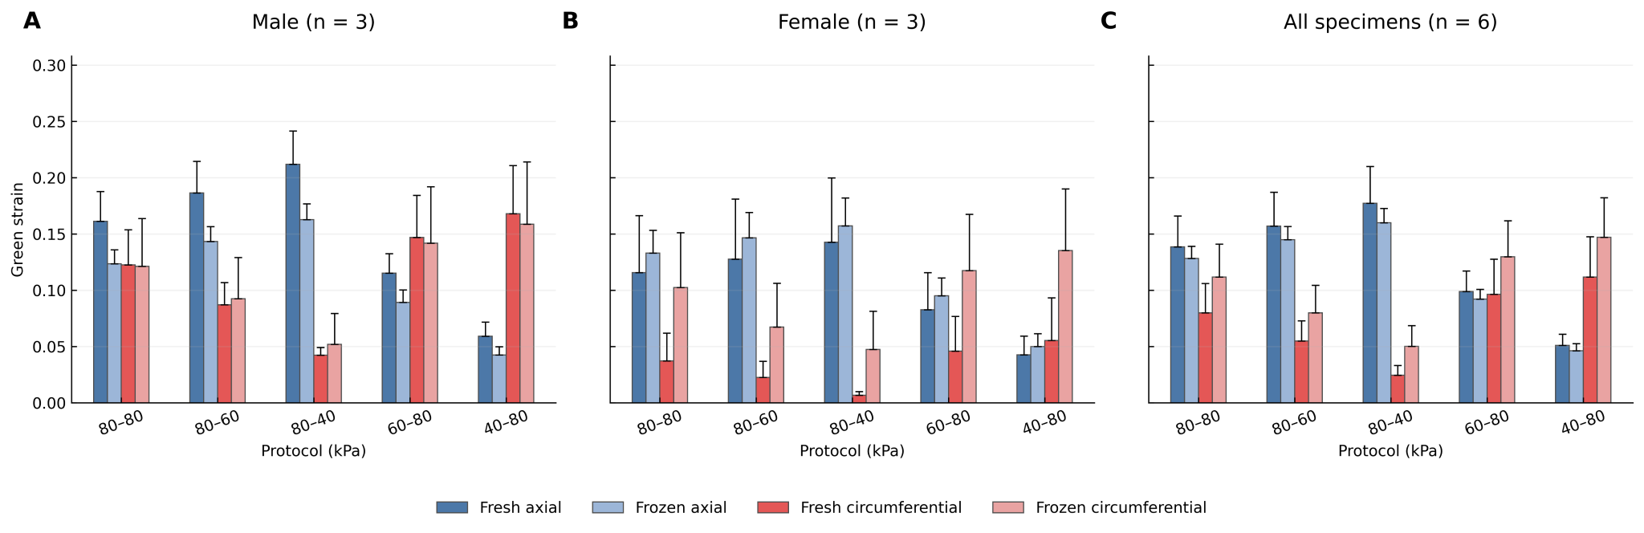
Soft Tissue Biomechanics ​Research Lab
Results
Figure 5. Three bar-charts which show the strain of test samples at different conditions and stress values: chart on the left, male samples; middle chart, female samples; and chart to the right, both female and male samples.
Does Freezing Change the Mechanical Behavior of Aortic Tissue?
Slide 10 / 16 - NEU Young Scholars Program - July 30, 2026
Notes:
Kunal

Slide 11
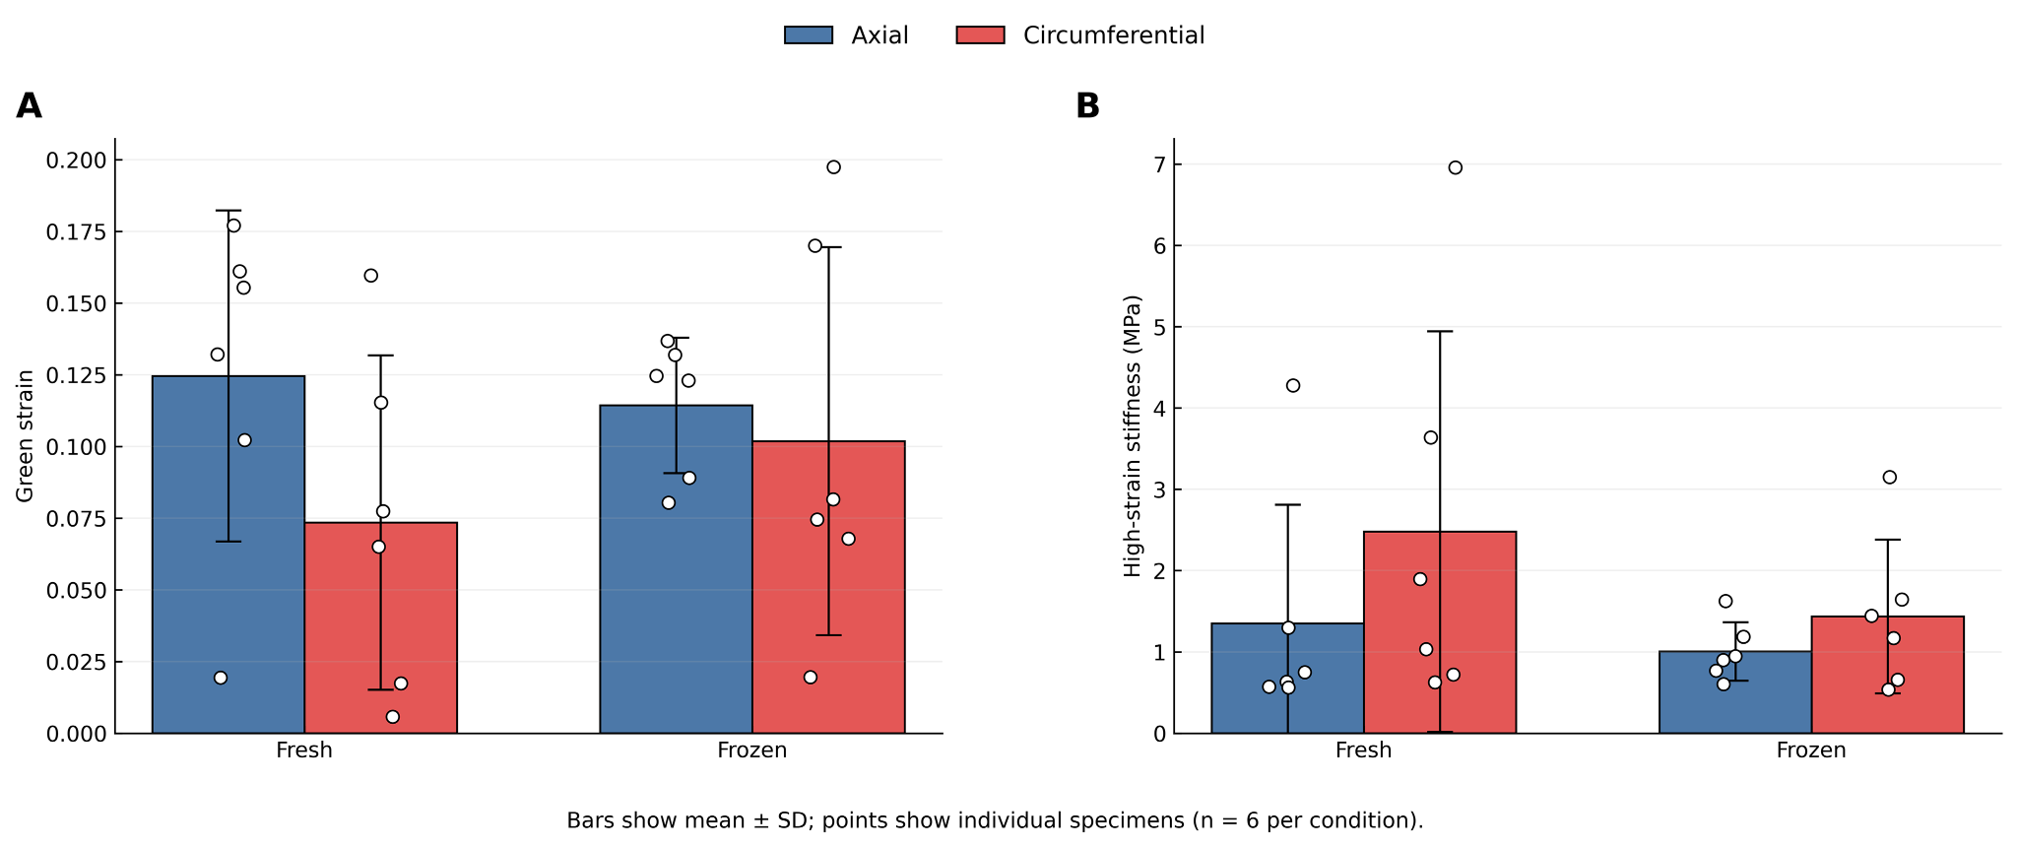
Soft Tissue Biomechanics ​Research Lab
Results
Figure 6. Chart A and B show data of the mechanical properties of the tissue when fresh and frozen: chart A depicts the green strain of Axial and Circumferential axis and chart B compares the stiffness of the axes when they were fresh and frozen.
Does Freezing Change the Mechanical Behavior of Aortic Tissue?
Slide 11 / 16 - NEU Young Scholars Program - July 30, 2026
Notes:
Kunal

Slide 12
Soft Tissue Biomechanics ​Research Lab
Conclusion and Next Steps
Conclusion
Short-term freezing at -80°C did not significantly change the mechanical behavior of descending thoracic aortic tissue
Data found negligible difference between green strain and stiffness of fresh vs frozen samples
This suggests frozen sample may be viable for future testing when fresh tissue is unavailable
Some variation found possibly suggesting greater strain in frozen tissue for female samples
Does Freezing Change the Mechanical Behavior of Aortic Tissue?
Slide 12 / 16 - NEU Young Scholars Program - July 30, 2026
Notes:
Anjali:

Slide 13
Soft Tissue Biomechanics ​Research Lab
Next Steps
Testing the ascending thoracic aorta versus only the descending thoracic aorta
Testing whether longer term storage has a similar effect in comparison
Testing with a larger sample size to conclude if specific detail variation occurs.
  We saw variation that may suggest that there is great strain in female samples post cryopreservation
Figure 7. bar-charts which show the strain of test samples at different conditions and stress values for female samples
Does Freezing Change the Mechanical Behavior of Aortic Tissue?
Slide 13 / 16 - NEU Young Scholars Program - July 30, 2026
Notes:
Anjali:

Slide 14
Soft Tissue Biomechanics ​Research Lab
References
[1] Salinas, S. D., Clark, M. M., & Amini, R. (2020). The effects of −80 °C short-term storage on the mechanical response of tricuspid valve leaflets. Journal of Biomechanics, 98, 109462. https://doi.org/10.1016/j.jbiomech.2019.109462
[2] Vargas, A. I., Tarraf, S. A., Fitzgibbons, T. P., Bellini, C., & Amini, R. (2023). Biomechanical remodeling of the murine descending thoracic aorta during late-gestation pregnancy. Current Research in Physiology, 6, 100102. https://doi.org/10.1016/j.crphys.2023.100102
[3] Vargas, A. I., Tarraf, S. A., Jennings, T., Bellini, C., & Amini, R. (2024). Vascular remodeling during late-gestation pregnancy: An in-vitro assessment of the murine ascending thoracic aorta. Journal of Biomechanical Engineering, 146(7). https://doi.org/10.1115/1.4064744
References:
Does Freezing Change the Mechanical Behavior of Aortic Tissue?
Slide 14 / 16 - NEU Young Scholars Program - July 30, 2026

Slide 15



Soft Tissue Biomechanics ​Research Lab
Acknowledgements:
Department of Mechanical Engineering
Professor Rouzbeh Amini
Guadalupe Garcia, Ph. D. Candidate
Sean Harrington, Ph. D. Candidate
Center for STEM Education
Claire Duggan, Executive Director
Jennifer Love, Associate Director
Frances Corcell, Kenneth Santizo, and Ahmed Othman,
YSP Coordinators
Nicolas Fuchs, Program Manager
Mary Howley, Administrative Officer
Soft Tissue Biomechanics Research Laboratory
This work has been funded by the National Science Foundation (NSF)
Does Freezing Change the Mechanical Behavior of Aortic Tissue?
Slide 15 / 16 - NEU Young Scholars Program - July 30, 2026

Slide 16
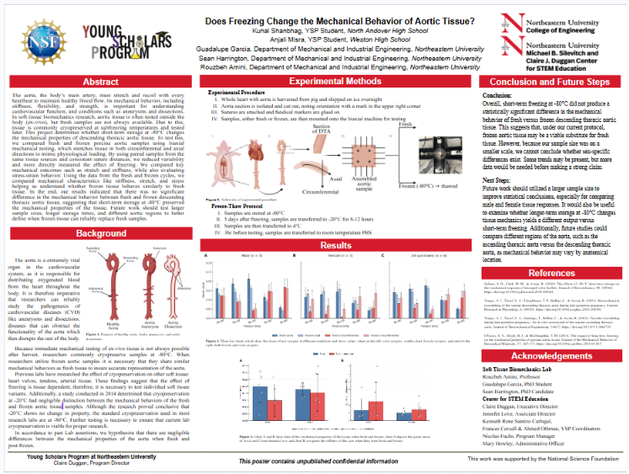
Soft Tissue Biomechanics ​Research Lab
Does Freezing Change the Mechanical Behavior of Aortic Tissue?
Slide 16 / 16 - NEU Young Scholars Program - July 30, 2026

