Slide 1








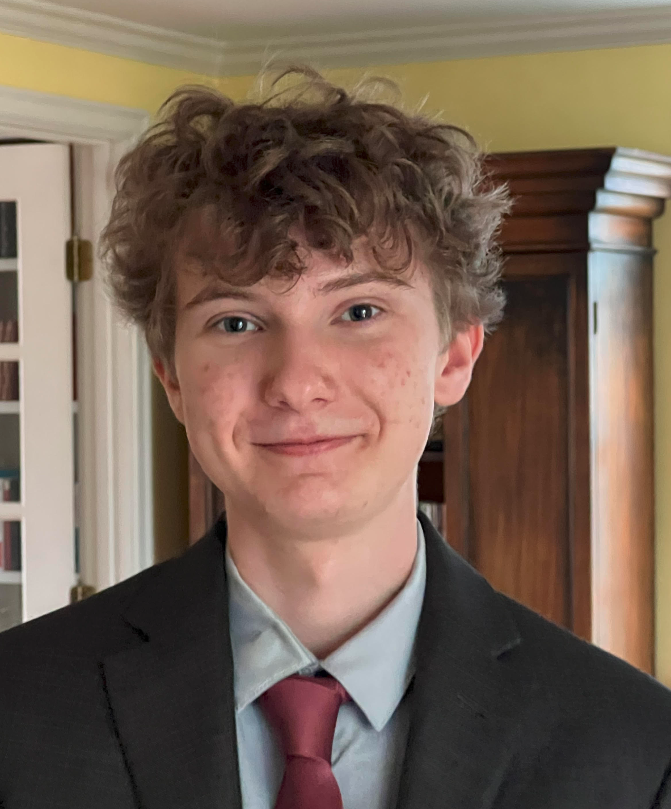




Evaluating Segment Anything Model 3 Against Adversarial Perturbations
Matthew Sokoloff
Low-Latency AI Execution Systems for Resource-Constrained Devices
Arihant Rangoli
Mobile Embedded NeTworked Intelligent Systems
Arihant Rangoli, YSP Student Researcher, St. John’s Preparatory School
Matthew Sokoloff, YSP Student Researcher, Cambridge Rindge and Latin School
Shahriar Rifat, Ph.D. Candidate, Electrical and Computer Engineering, Northeastern University​
Mohammad Abdi, Ph.D. Candidate, Electrical and Computer Engineering, Northeastern University​
Francesca Meneghello, Principal Research Scientist, Electrical and Computer Engineering, Northeastern University​
Francesco Restuccia, Associate Professor, Electrical and Computer Engineering, Northeastern University​
​

Slide 2


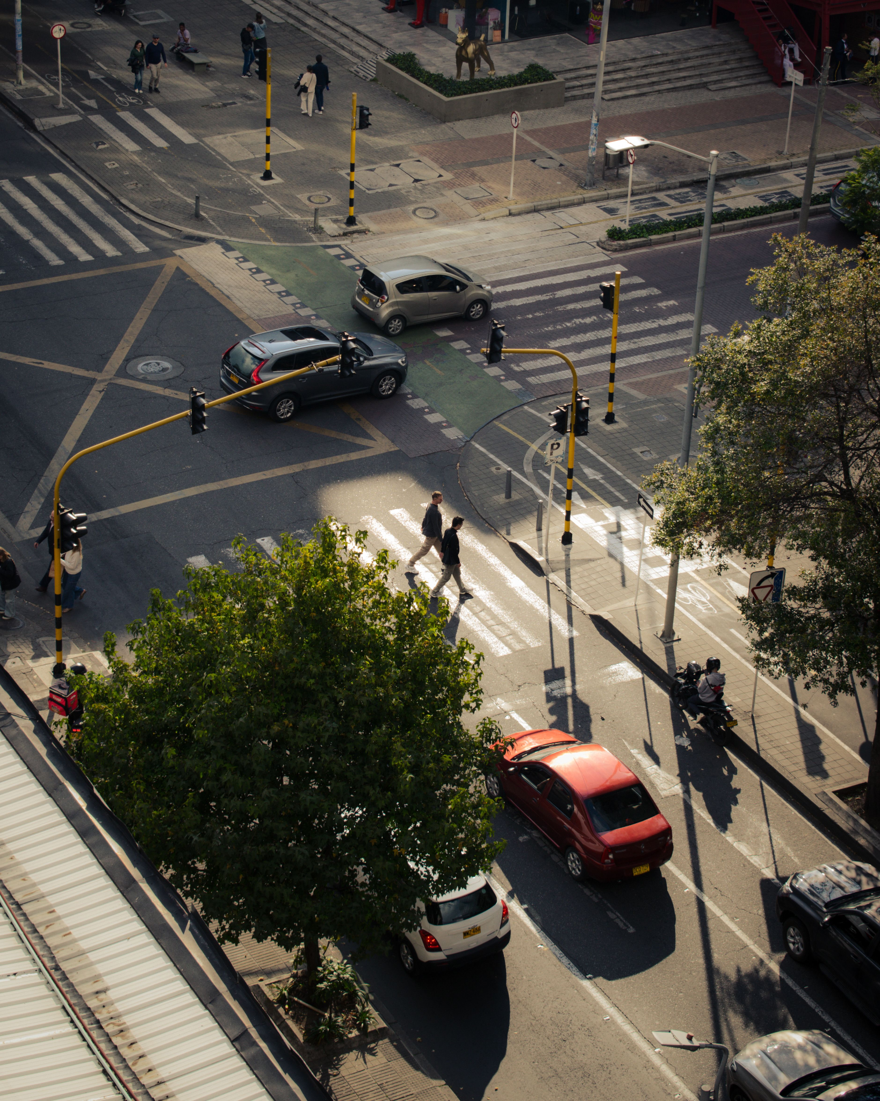
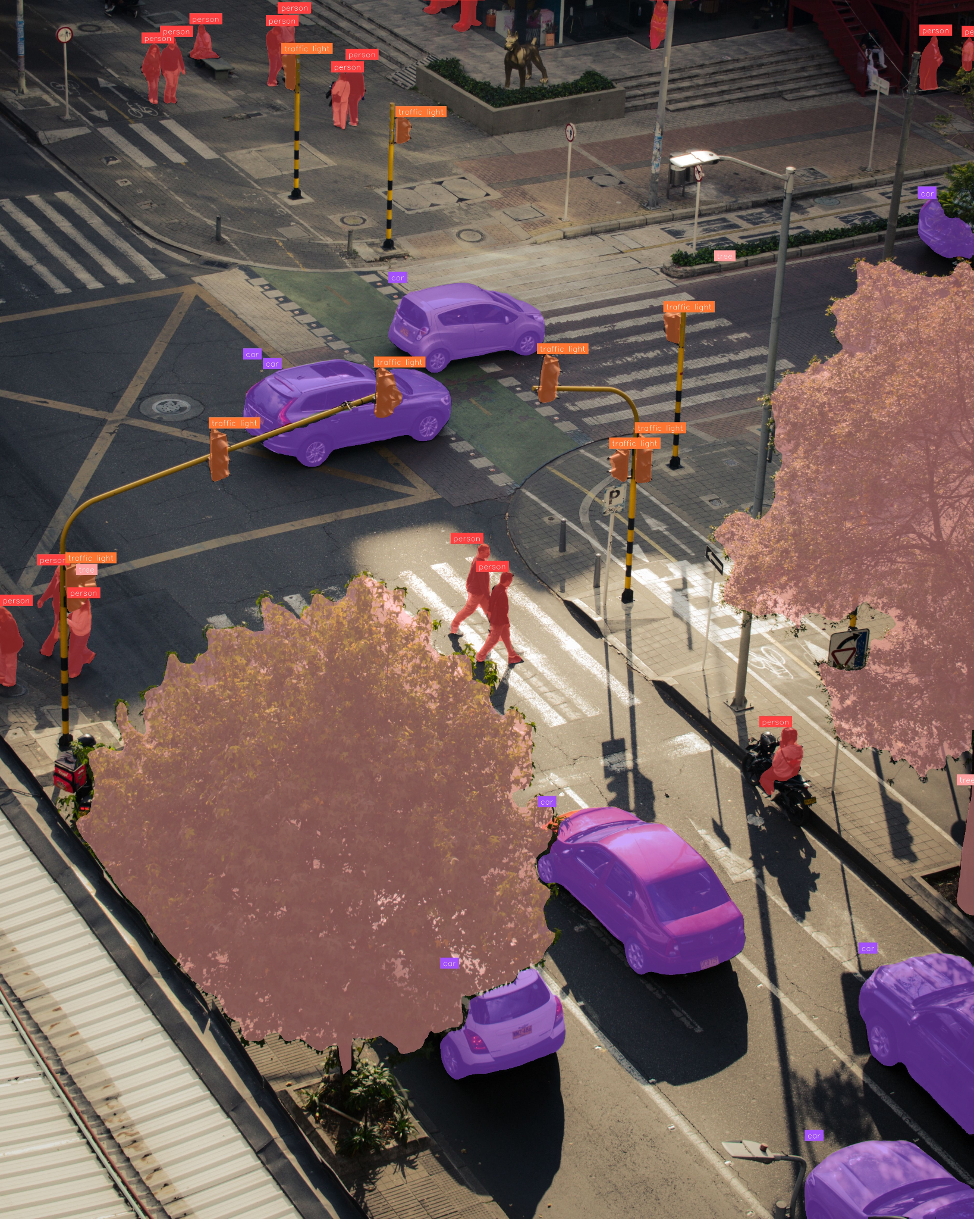
Segment Anything Models
Example Input
SAM 3 Model
Example Output
(Segmented Image)
perception
encoder (PE)
multimodal detector
Image
presence
token
object queries
instance masks
Text
Prompt
Decoupling:
“car, person, tree, traffic light”
Separating understanding what an object is (presence tokens) from where it is in the image (object queries).
Evaluating Segment Anything Model 3 Against Adversarial Perturbations
Slide 02 - NEU Young Scholars Program - July 30, 2026
Notes:
ai sys: find + outline obj in imgs using txt and img exemplars
important for autonomous vehicles, medical robotics
thus we must understand its vulnerabilities

Slide 3
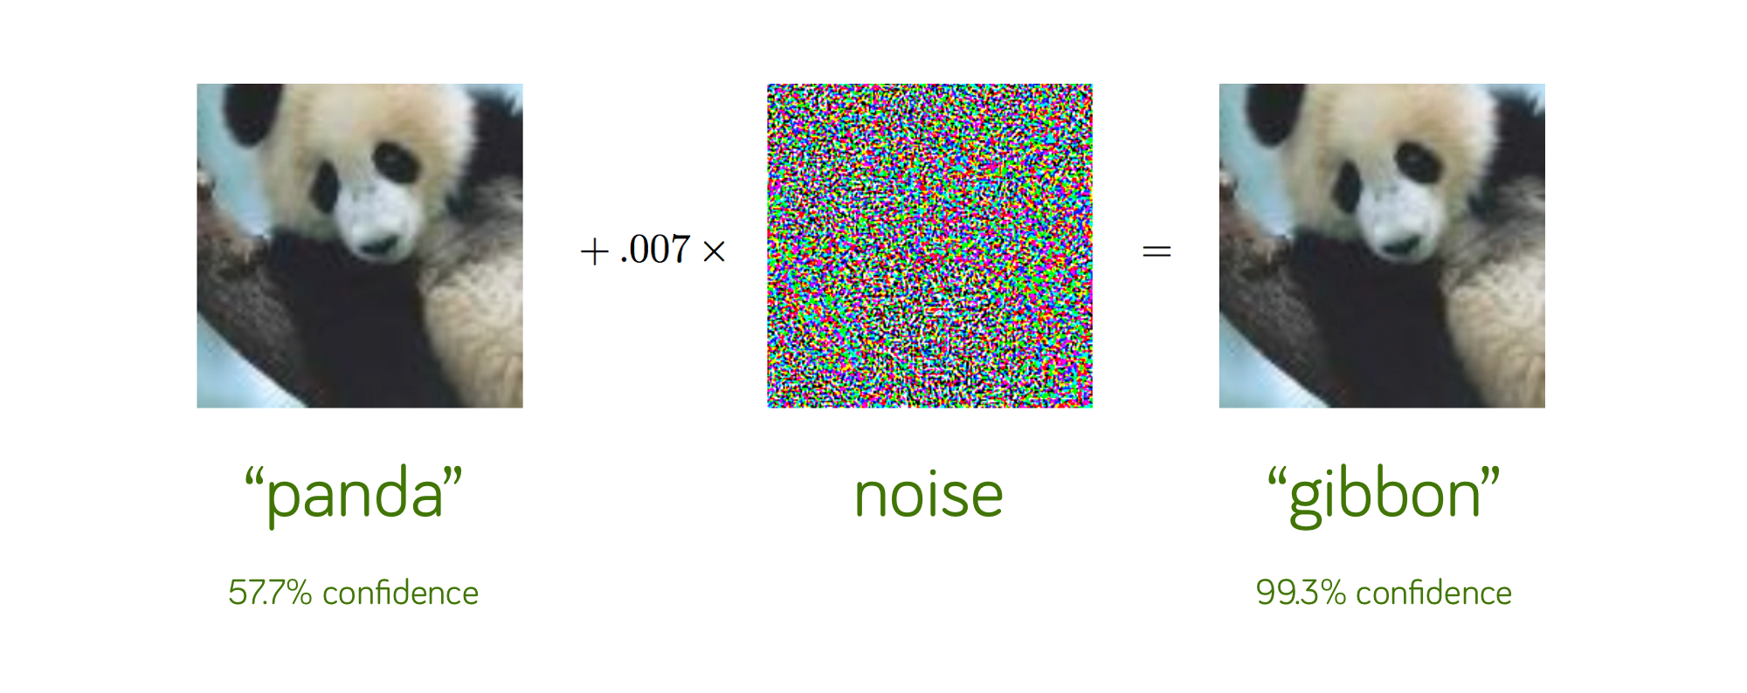
Adversarial Attacks
optimize small perturbation δ
visually similar adversarial image
clean image
ε (epsilon)
“panda”
57.7% confidence
noise
“gibbon”
99.3% confidence
image is misidentified or missed altogether
Evaluating Segment Anything Model 3 Against Adversarial Perturbations
Slide 03 - NEU Young Scholars Program - July 30, 2026
Notes:
small, specific change to an img (added noise) to cause the ai to fail
mine not with classification, but i wanted sam 3 to not see traffic signs it normally would
my attack on obj localization + segmentation rather than classification

Slide 4
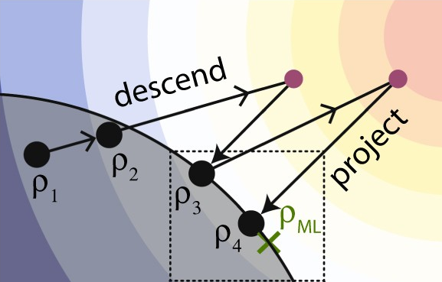
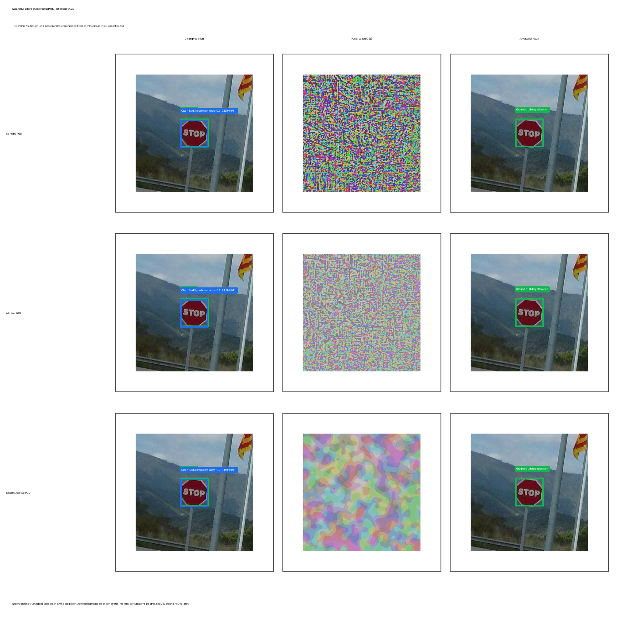
Attacking & Results
PGD = Projected Gradient Descent
clean failure rate of 24.9%
clean prediction
perturbation (amplified for visibility)
adversarial result
standard PGD
96.0%
additive PGD
brighten only
smooth-additive PGD
brighten only + spatially smooth
standard PGD
brighten or darken
additive PGD
97.3%
smooth-additive PGD
76.7%
Evaluating Segment Anything Model 3 Against Adversarial Perturbations
Slide 04 - NEU Young Scholars Program - July 30, 2026
Notes:
pgd = proj grad descent
i used 3 types: standard, additive, and smooth-additive
smooth-additive most similar to something that could be recreated with physically projected light
but it was thus the hardest to optimize
state failure rates (the attacks were only performed on images that did not fail to be cleanly recognized)

Slide 5
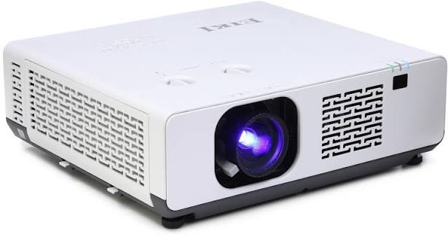

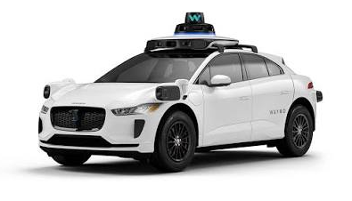
Conclusion and Next Steps
+
We find that even at small epsilon values, SAM 3 is vulnerable to digital adversarial attacks!
project physical (light) adversarial pattern
compare clean and physical attack success
perform inference through SAM 3
camera captures scene
Evaluating Segment Anything Model 3 Against Adversarial Perturbations
Slide 05 - NEU Young Scholars Program - July 30, 2026
Notes:
so, sam 3 is vulnerable to these adversarial attacks, even at small epsilon values
next step is to try to recreate the experiment physically, using a laser projector
i’ll compare sam 3’s success for clean vs physical projection

Slide 6
References
Bolya, D., Huang, P.-Y., Sun, P., Cho, J. H., Madotto, A., Wei, C., Ma, T., Zhi, J., Rajasegaran, J., Rasheed, H., Wang, J., Monteiro, M., Xu, H., Dong, S., Ravi, N., Li, D., Dollár, P., & Feichtenhofer, C. (2025). Perception encoder: The best visual embeddings are not at the output of the network [Preprint]. arXiv. https://doi.org/10.48550/arXiv.2504.13181
Brown, T. B., Mané, D., Roy, A., Abadi, M., & Gilmer, J. (2017). Adversarial patch [Preprint]. arXiv. https://doi.org/10.48550/arXiv.1712.09665
Carion, N., Gustafson, L., Hu, Y.-T., Debnath, S., Hu, R., Suris, D., Ryali, C., Alwala, K. V., Khedr, H., Huang, A., Lei, J., Ma, T., Guo, B., Kalla, A., Marks, M., Greer, J., Wang, M., Sun, P., Rädle, R., . . . Feichtenhofer, C. (2025). SAM 3: Segment anything with concepts [Preprint]. arXiv. https://doi.org/10.48550/arXiv.2511.16719
Ertler, C., Mislej, J., Ollmann, T., Porzi, L., Neuhold, G., & Kuang, Y. (2020). The Mapillary traffic sign dataset for detection and classification on a global scale. In A. Vedaldi, H. Bischof, T. Brox, & J.-M. Frahm (Eds.), *Computer vision—ECCV 2020* (Lecture Notes in Computer Science, Vol. 12368, pp. 68–84). Springer. https://doi.org/10.1007/978-3-030-58592-1_5
Eykholt, K., Evtimov, I., Fernandes, E., Li, B., Rahmati, A., Tramèr, F., Prakash, A., Kohno, T., & Song, D. (2018). Physical adversarial examples for object detectors. In *12th USENIX Workshop on Offensive Technologies (WOOT 18)*. USENIX Association. https://www.usenix.org/conference/woot18/presentation/eykholt
Goodfellow, I. J., Shlens, J., & Szegedy, C. (2014). Explaining and harnessing adversarial examples [Preprint]. arXiv. https://doi.org/10.48550/arXiv.1412.6572
Kirillov, A., Mintun, E., Ravi, N., Mao, H., Rolland, C., Gustafson, L., Xiao, T., Whitehead, S., Berg, A. C., Lo, W.-Y., Dollár, P., & Girshick, R. (2023). Segment anything [Preprint]. arXiv. https://doi.org/10.48550/arXiv.2304.02643
Madry, A., Makelov, A., Schmidt, L., Tsipras, D., & Vladu, A. (2017). Towards deep learning models resistant to adversarial attacks [Preprint]. arXiv. https://doi.org/10.48550/arXiv.1706.06083
Nichols, N., & Jasper, R. (2018). Projecting trouble: Light based adversarial attacks on deep learning classifiers [Preprint]. arXiv. https://doi.org/10.48550/arXiv.1810.10337
Evaluating Segment Anything Model 3 Against Adversarial Perturbations
Slide 06 - NEU Young Scholars Program - July 30, 2026
Notes:
references i used
i read these papers (or, at least some of all of these papers) and took notes

Slide 7
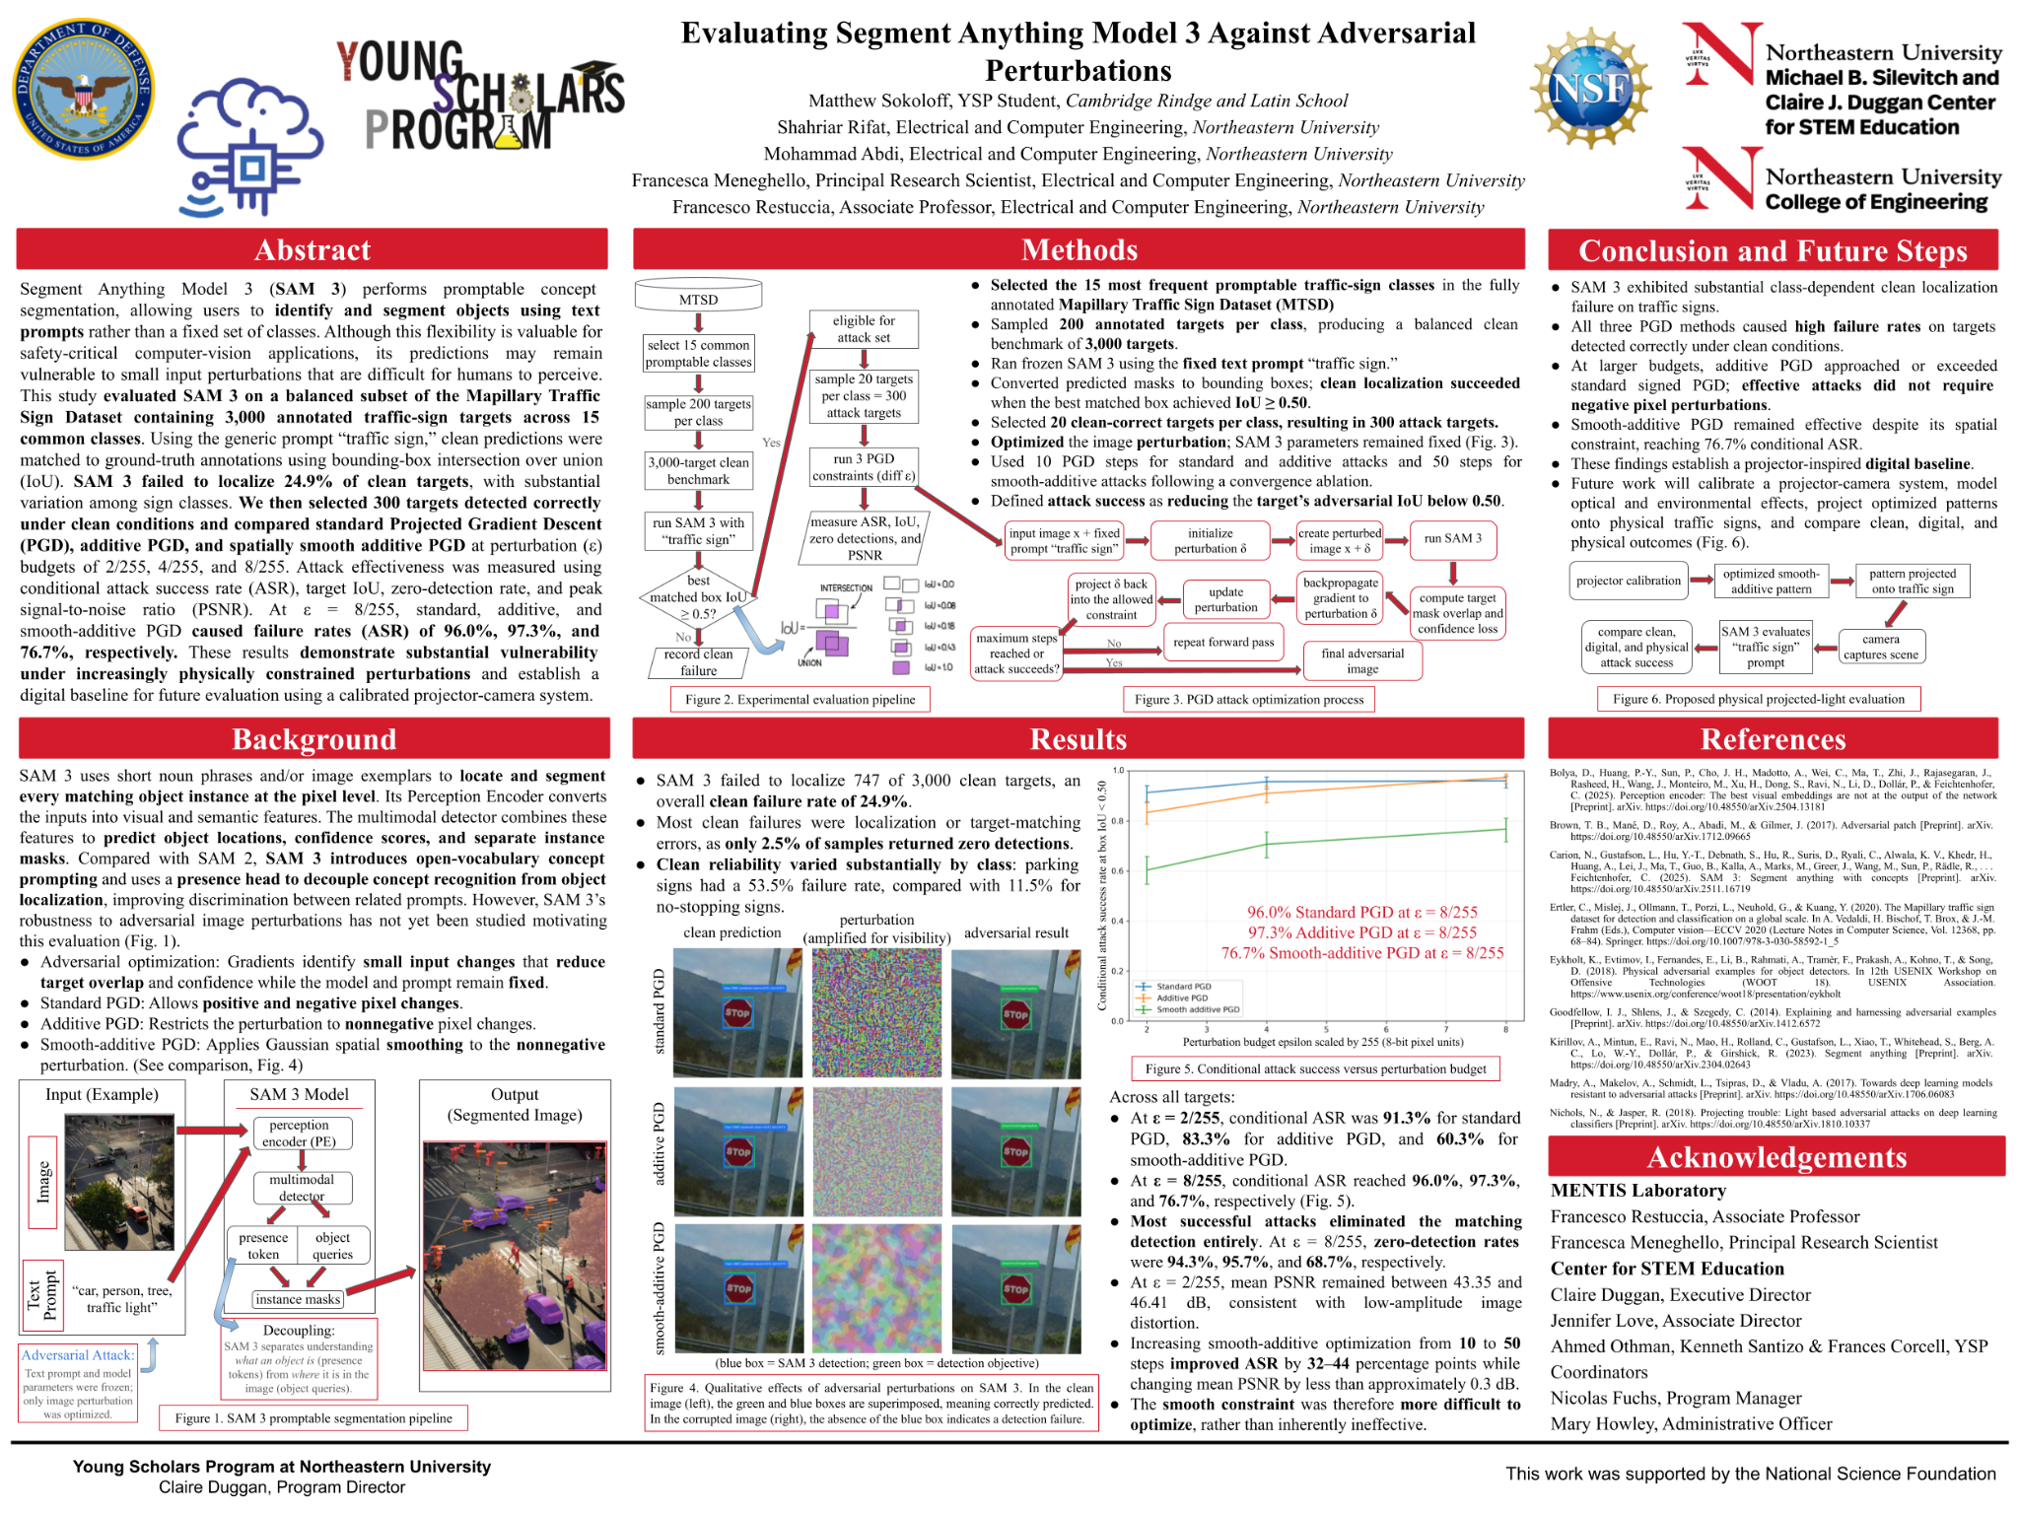
Notes:
now my lab partner will present his research
while mine was more focused on attacking ai’s doing object segmentation and localization, his was focused on ai object classification

Slide 8
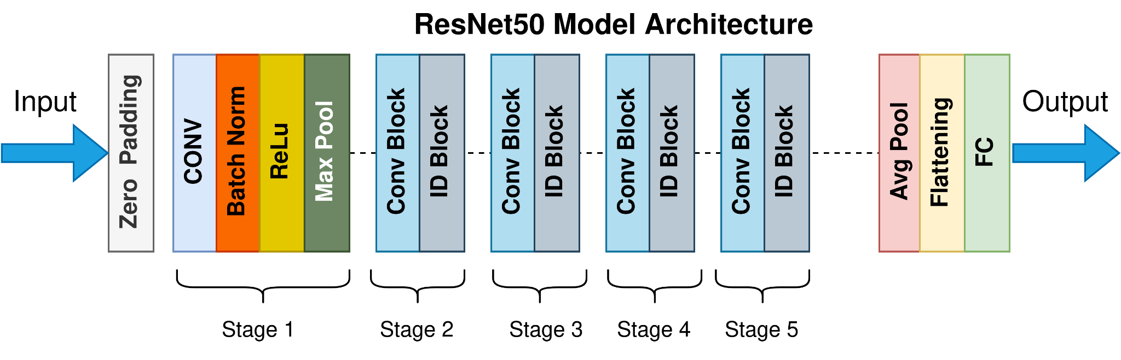
ResNet-50: A Deep Convolutional Neural Network
50 layers deep, using residual (“skip”) connections that let gradients flow through very deep networks
Pretrained on ImageNet from 1.28 million images classified into 1,000 object categories
Convolutional layers extract edges, textures, and shapes and more layers build up to object-level features
Low-Latency AI Execution Systems for Resource-Constrained Devices
Slide 08 - NEU Young Scholars Program - July 30, 2026

Slide 9
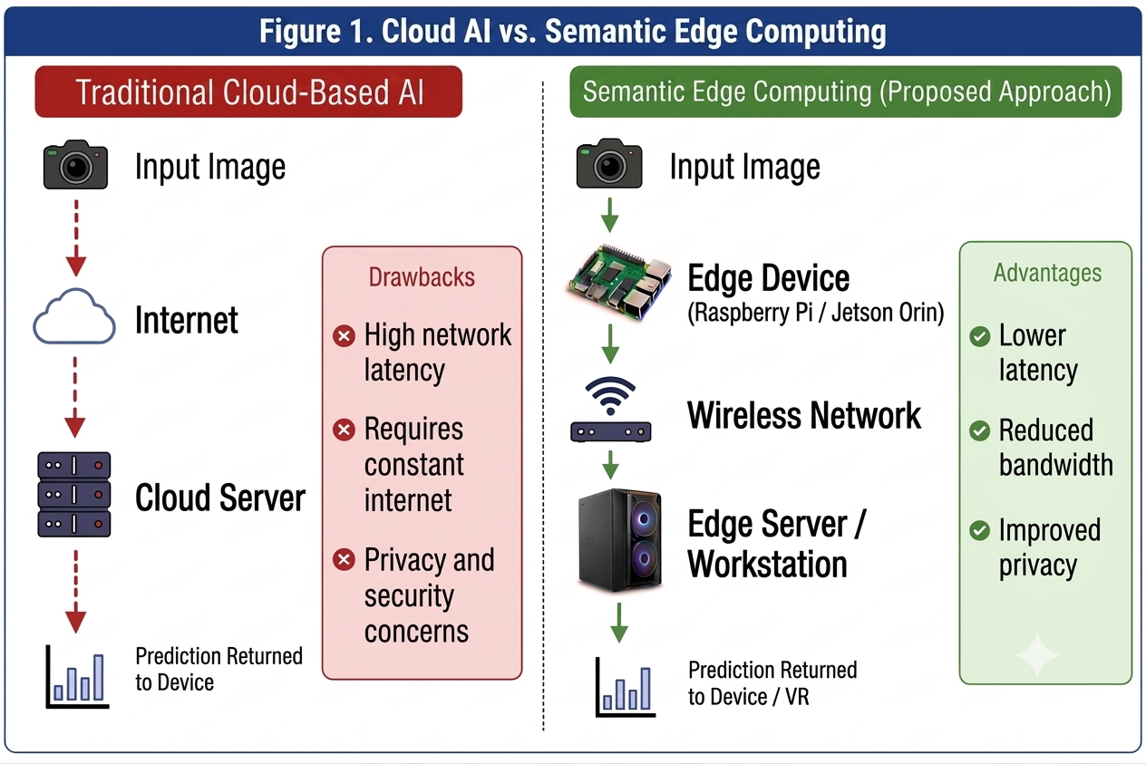
Problem
Full ResNet-50 inference is too demanding for resource-constrained devices
Cloud-based inference increases latency and bandwidth usage by transmitting raw camera frames.
Raw image transmission reduces privacy and limits real-time performance for robotics, emergency response, and VR.
Low-Latency AI Execution Systems for Resource-Constrained Devices
Slide 10 - NEU Young Scholars Program - July 30, 2026

Slide 10
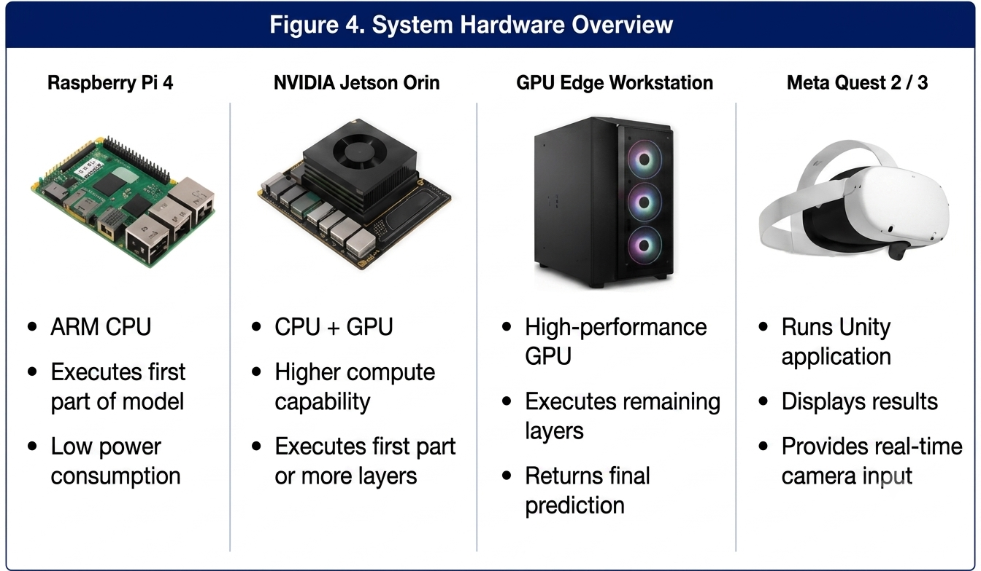
Materials
Low-Latency AI Execution Systems for Resource-Constrained Devices
Slide 09 - NEU Young Scholars Program - July 30, 2026

Slide 11
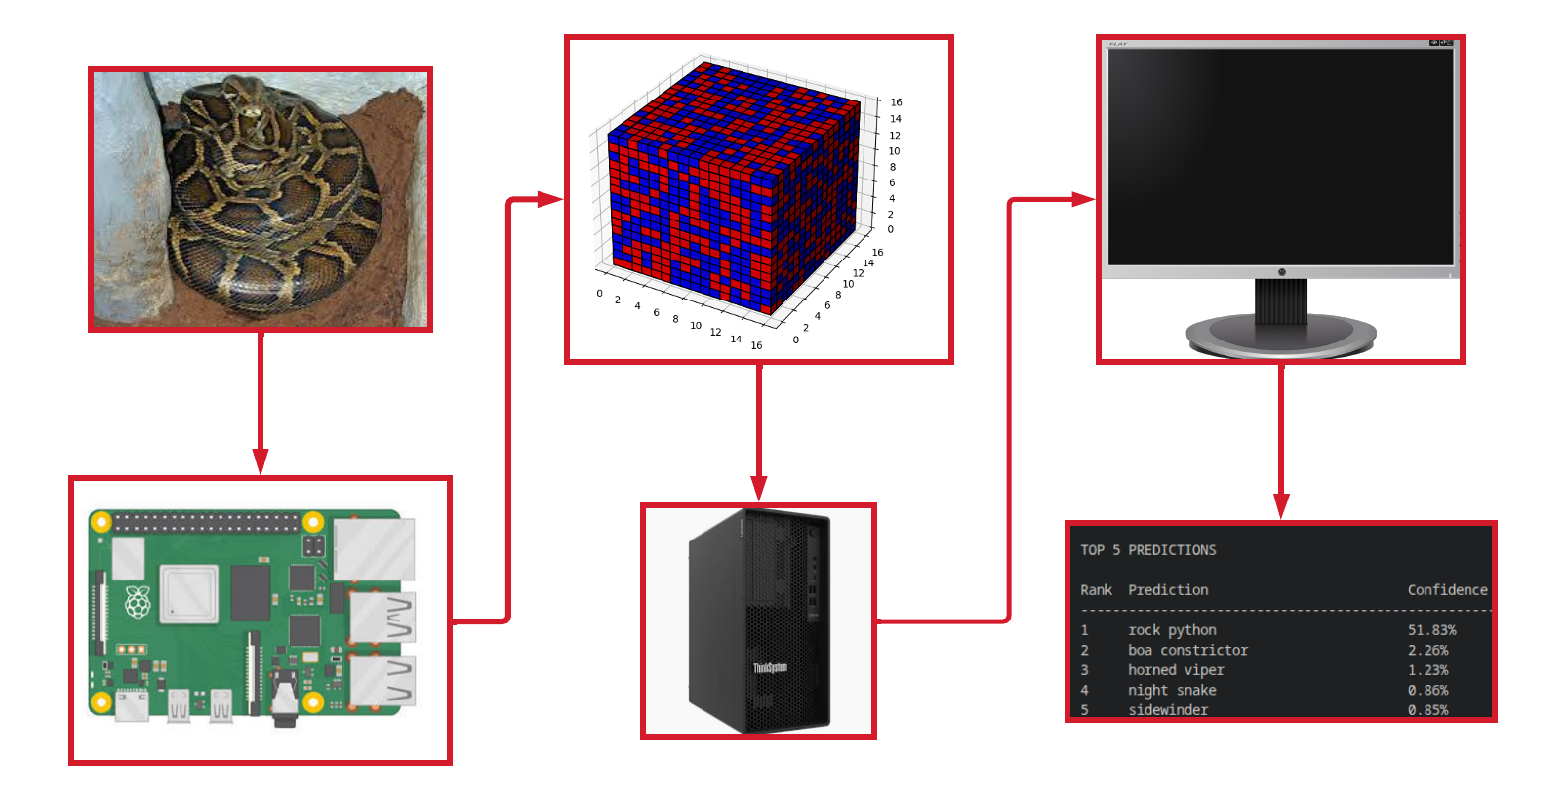
Solution
Feature Transmission (Tensors)
Monitor
Input Image
GPU Workstation
Output Text
Edge Device - Raspberry Pi
Low-Latency AI Execution Systems for Resource-Constrained Devices
Slide 11 - NEU Young Scholars Program - July 30, 2026

Slide 12
Why it works
Compressed feature tensors reduce bandwidth by transmitting features instead of raw images.
On-device execution of early layers lowers communication latency and improves responsiveness.
GPU-accelerated inference with pipelining within the GPU workstation minimizes total processing time for real-time applications.
Low-Latency AI Execution Systems for Resource-Constrained Devices
Slide 12 - NEU Young Scholars Program - July 30, 2026

Slide 13
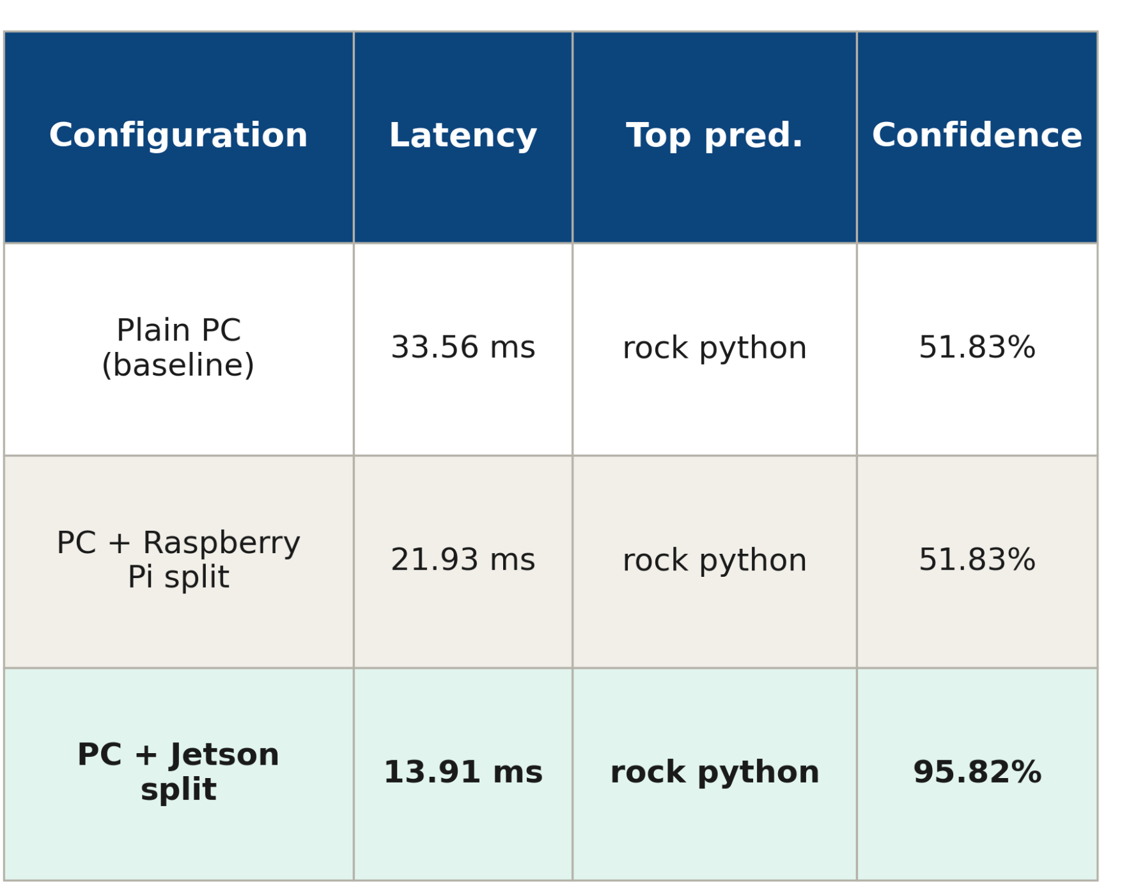
Results
Distributing inference across multiple devices reduces overall latency by balancing the computational workload.
The Jetson Orin achieved the fastest performance because its onboard GPU accelerates the assigned layers of the neural network.
Lower latency enables more responsive AI systems
Low-Latency AI Execution Systems for Resource-Constrained Devices
Slide 13 - NEU Young Scholars Program - July 30, 2026

Slide 14
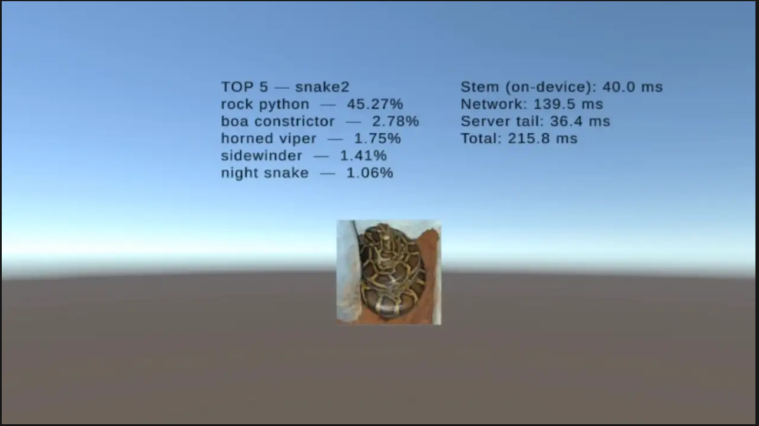
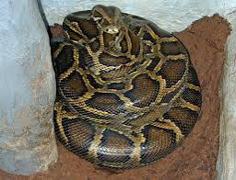
Results Cont.
The Unity VR environment demonstrates edge computing during an interactive immersive experience.
The Quest headset performs only the early layers locally and offloads the remaining computation to a remote server.
This architecture introduces network latency but:
  Enables resource-constrained VR hardware to run complex AI models.
TOP 5 Predictions
--------------------------------
rock python — 45.27%
boa constrictor — 2.78%
horned viper — 1.75%
sidewinder — 1.41%
night snake — 1.06%
Stem (on-device): 40.0 ms
Network: 139.5 ms
Server tail: 36.4 ms
Total: 215.8 ms
Low-Latency AI Execution Systems for Resource-Constrained Devices
Slide 14 - NEU Young Scholars Program - July 30, 2026

Slide 15
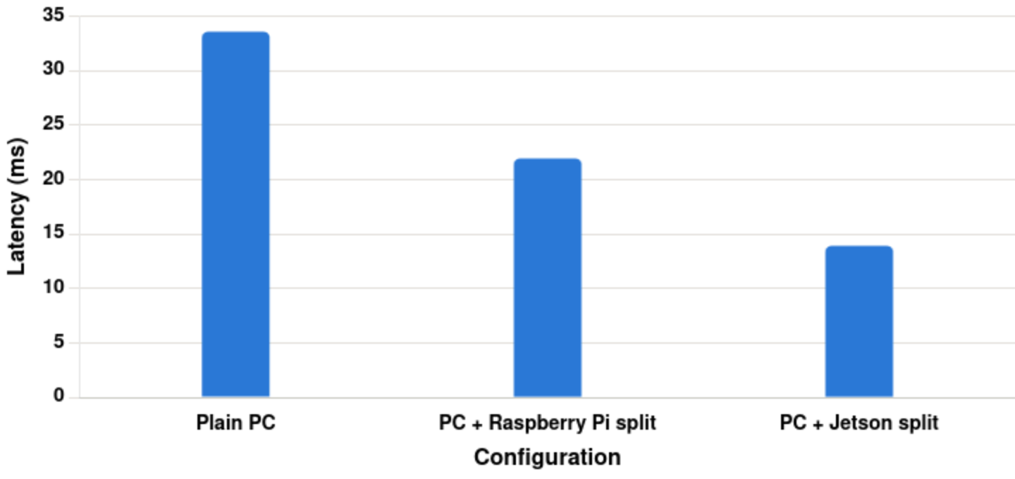
Conclusion
Demonstrated successful distributed ResNet-50 inference using semantic edge computing
Achieved low-latency AI inference while maintaining model performance.
Established a foundation for real-time computer vision on edge devices
Low-Latency AI Execution Systems for Resource-Constrained Devices
Slide 15 - NEU Young Scholars Program - July 30, 2026

Slide 16
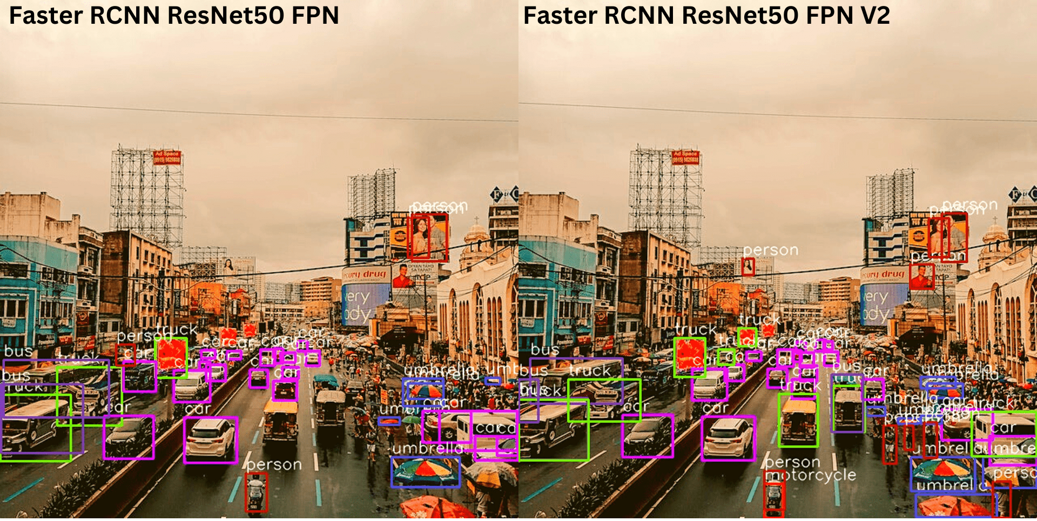
Next Steps
Integrate Meta Quest passthrough cameras for live image capture.
Perform real-time object recognition using the distributed ResNet-50 pipeline.
Enable immersive AI-powered VR applications.
Utilize different AI models within a virtual reality system
Low-Latency AI Execution Systems for Resource-Constrained Devices
Slide 16 - NEU Young Scholars Program - July 30, 2026

Slide 17
References
[1] A. Dosovitskiy et al., "An image is worth 16×16 words: Transformers for image recognition at scale," in International Conference on Learning Representations (ICLR), 2021.
[2] K. He, X. Zhang, S. Ren, and J. Sun, "Deep residual learning for image recognition," in Proceedings of the IEEE Conference on Computer Vision and Pattern Recognition (CVPR), 2016, pp. 770–778, doi: 10.1109/CVPR.2016.90.
[3] A. Kirillov et al., "Segment Anything," in Proceedings of the IEEE/CVF International Conference on Computer Vision (ICCV), 2023, pp. 4015–4026, doi: 10.1109/ICCV51070.2023.00371.
[4] A. Paszke et al., "PyTorch: An imperative style, high-performance deep learning library," in Advances in Neural Information Processing Systems, vol. 32, 2019.
[5] W. Shi, J. Cao, Q. Zhang, Y. Li, and L. Xu, "Edge computing: Vision and challenges," IEEE Internet of Things Journal, vol. 3, no. 5, pp. 637–646, Oct. 2016, doi: 10.1109/JIOT.2016.2579198.
References:
Low-Latency AI Execution Systems for Resource-Constrained Devices
Slide 17 - NEU Young Scholars Program - July 30, 2026

Slide 18
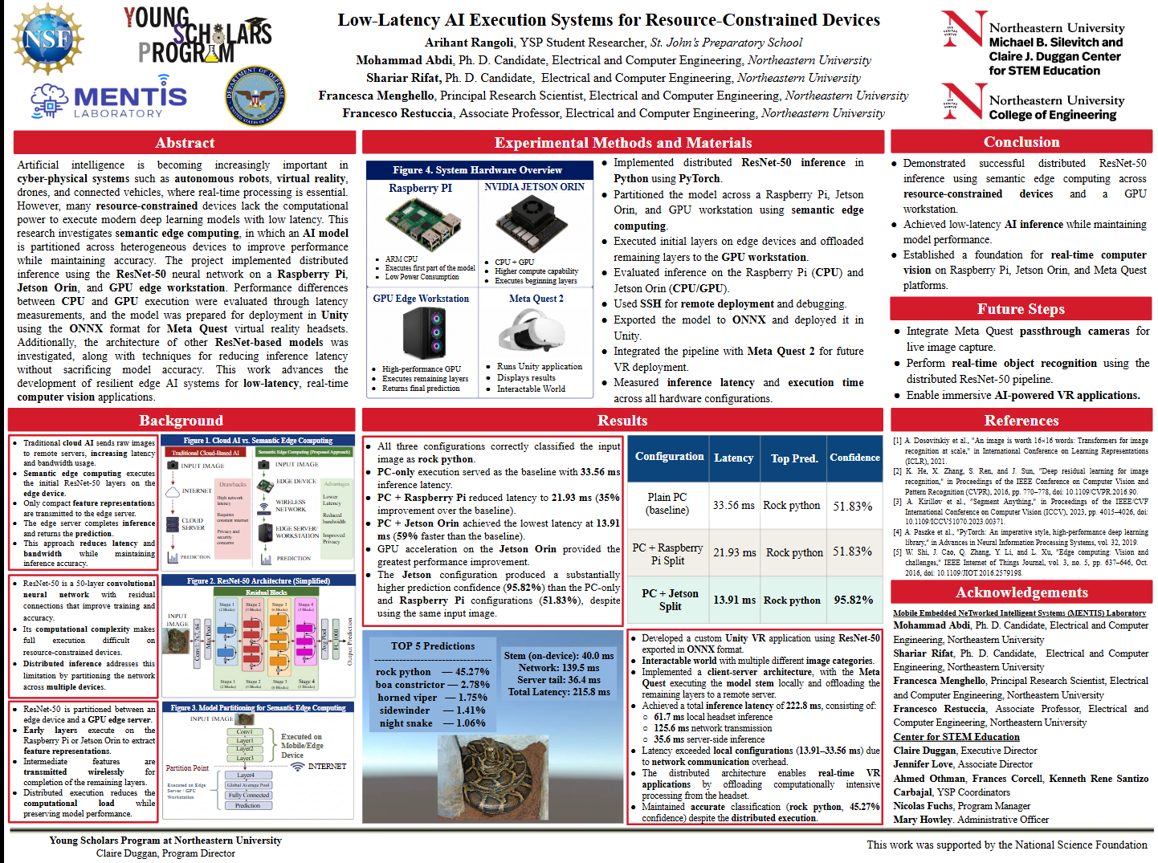

Slide 19



Acknowledgements:
Department of Electrical and Computer Engineering
Francesco Restuccia, Associate Professor
Francesca Meneghello, Principal Research Scientist
Mohammad Abdi, Ph.D. Candidate
Shariar Rifat, Ph.D. Candidate
Center for STEM Education
Claire Duggan, Executive Director
Jennifer Love, Associate Director
Ahmed Othman, Kenneth Rene Santizo Carbajal & Frances Corcell, YSP Coordinators
Nicolas Fuchs, Program Manager
Mary Howley, Administrative Officer
Mobile Embedded NeTworked Intelligent Systems (MENTIS) Laboratory
This work has been funded by the National Science Foundation (NSF) under award #2530896 and by the Department of Defense (DoD)
MENTIS Laboratory - Acknowledgements
Slide 19 - NEU Young Scholars Program - July 30, 2026

Slide 20
Questions?
MENTIS Laboratory - Acknowledgements
Slide 20 - NEU Young Scholars Program - July 30, 2026

