Slide 1






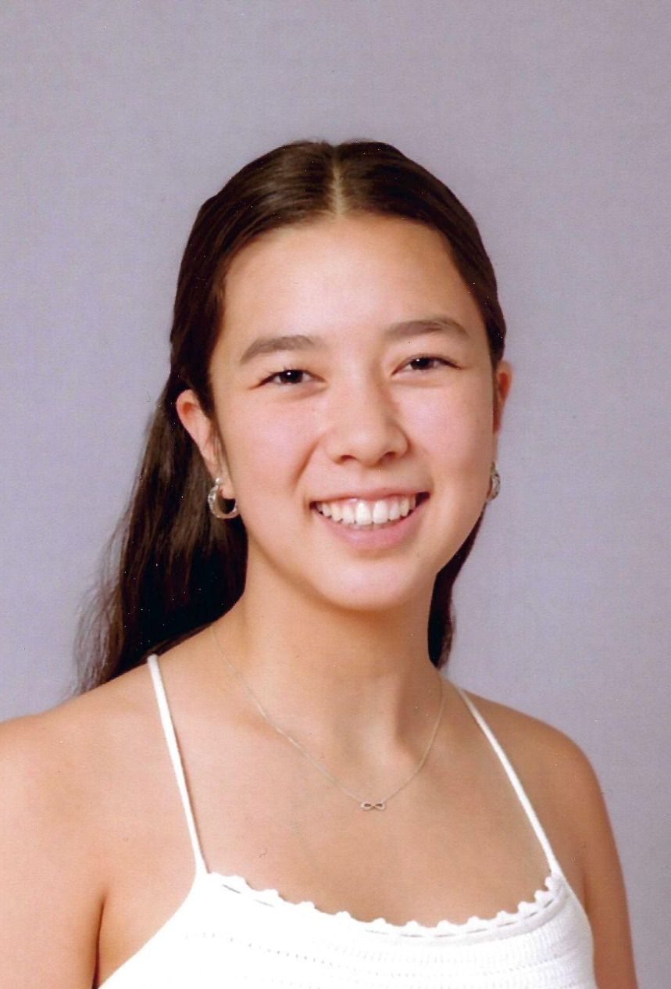




Determining How Shot Proteins Affect Neuron Morphology
Laboratory for the Physics of Living Matter
Emme Turner, YSP Student, Dana Hall
Fennell Wisseh, YSP Student, Concord-Carlisle High School
Maijia Liao, Physics and Bioengineering, Northeastern University
Louison Thorens, Bioengineering, Northeastern University​
Dongdong You, Bioengineering, Northeastern University
Notes:
Emme
Hi, my name is Emme….
Hi, I’m Fennell
And this summer we did research in the Liao lab trying to determine how shot proteins affect neuron morphology.

Slide 2

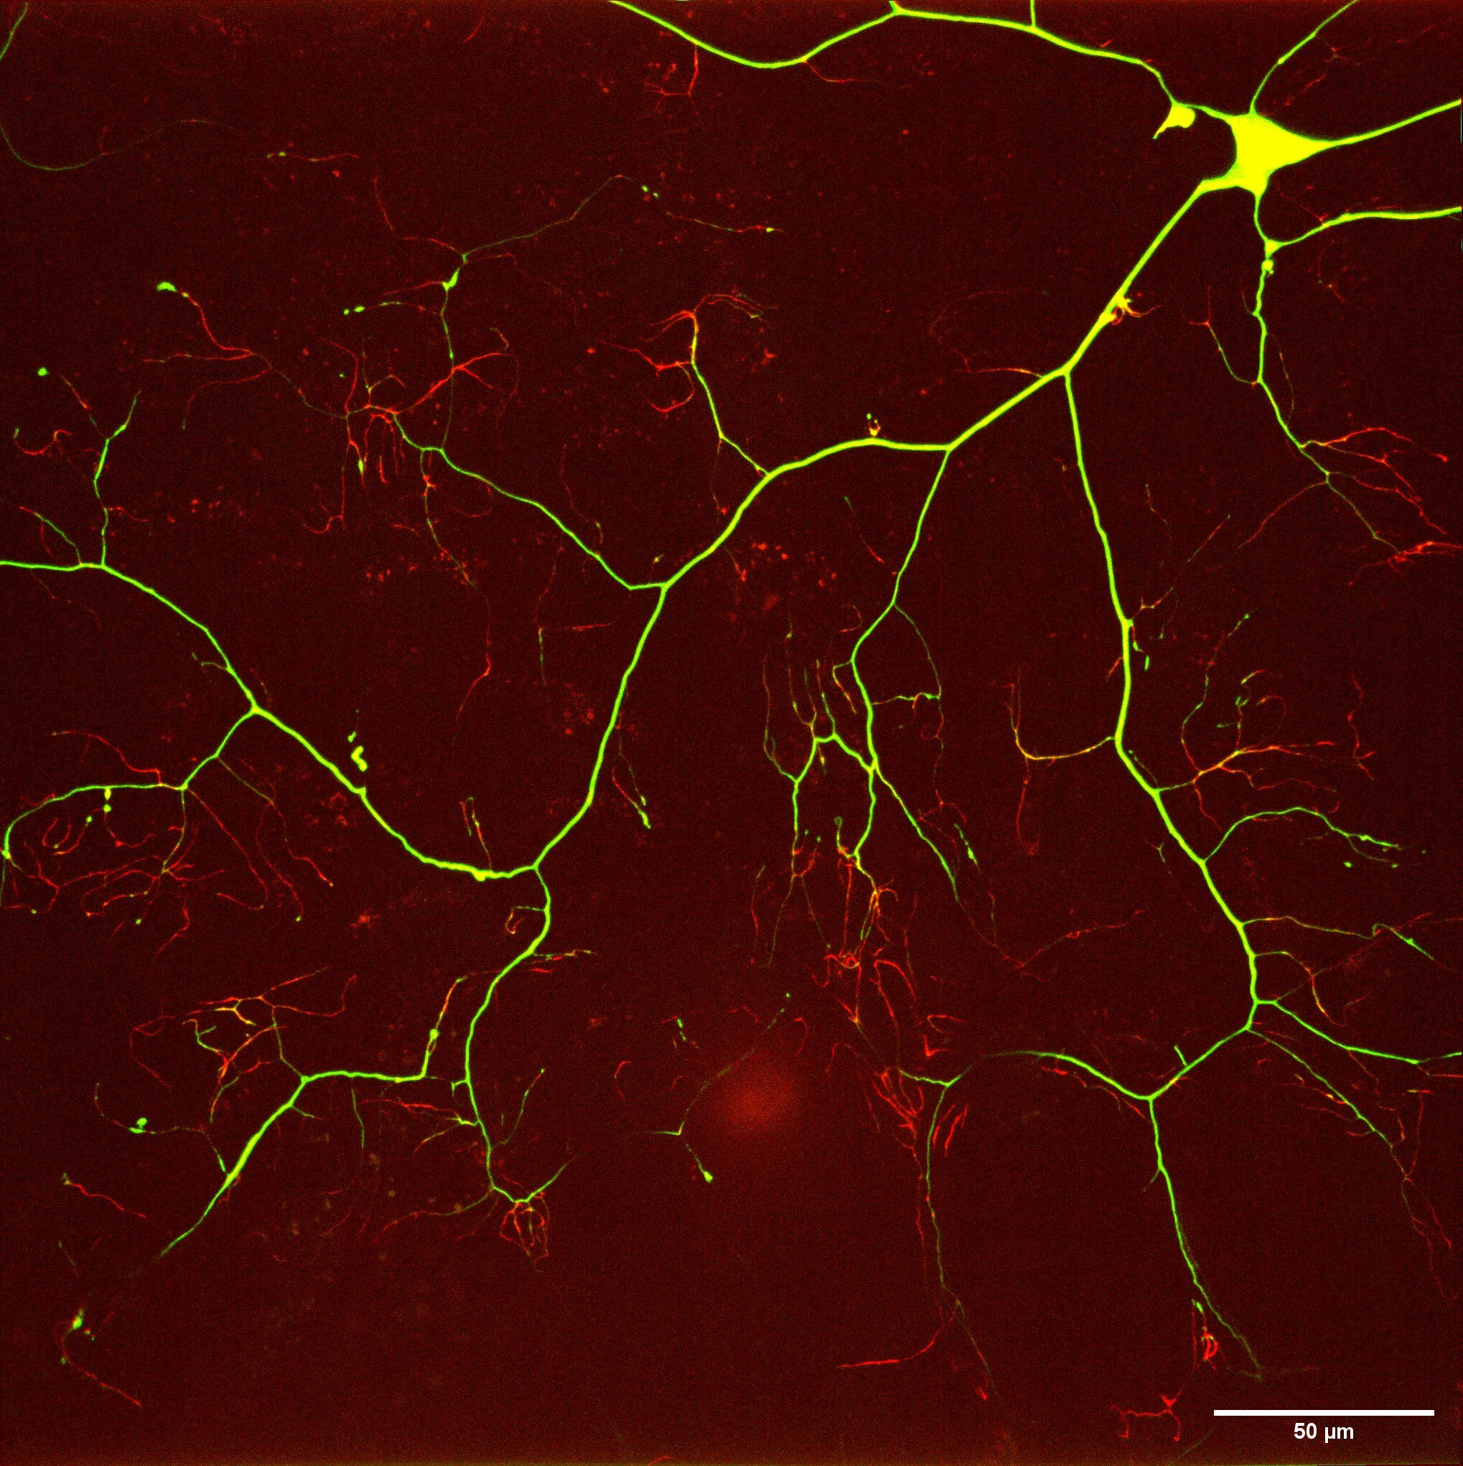
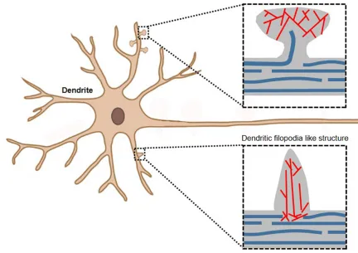
Liao Research Lab
The Sensory Neuron
Dendrites
The Neuronal Cytoskeleton is composed of microtubules and actin filaments
Proper neuronal function relies on coordination between the microtubules and actin.
— Actin
— Microtubule
Jung M, Kim D and Mun JY (2020) Direct Visualization of Actin Filaments and Actin-Binding Proteins in Neuronal Cells.
Neuronal Shape
Slide 01 / 15 - NEU Young Scholars Program - July 30, 2026
Notes:
Emme
Neurons are highly polarized cells with complex geometries. Their function relies on a tightly organized internal architecture, and this is supported by the cytoskeleton.
The neuronal cytoskeleton is composed of microtubules and actin filaments. In the image to the left, microtubules are the rigid, tube like structures inside the neuron imaged in blue that offer the intracellular cargo transport and structural support. The actin is the dense mesh in red that generates local forces that are needed to shape dendritic branches. The branches you see are called dendrites, and they cover the mesh of the larvae surface, acting as actuators sensing mechanical pressure. The image on the right shows a neuron imaged in our lab that has red fluorescent marking on the actin mesh and green marking on the microtubules.
For a neuron to function properly and extend and maintain axons and dendrites over long distances, there must be tight coordination between the microtubules and actin filament.
The sensory neuron is a specialized nerve cell that detects external and internal stimuli.

Slide 3
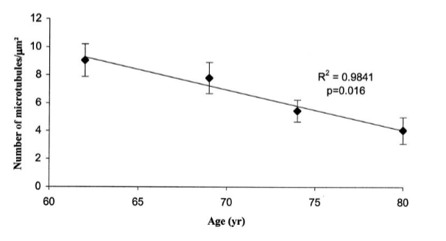
Liao Research Lab
Problem
Decrease in microtubule quantity as age increases [1]
  Loss of microtubules implicated in Alzheimer’s Disease & several NDDs
We want to understand the mechanism behind this structural breakdown.
Cash et al (2003) Microtubule reduction in Alzheimer's disease and aging is independent of tau filament formation
Neuronal Shape
Slide 02 / 15 - NEU Young Scholars Program - July 30, 2026
Notes:
FENNELL
For more context, geriatric populations are heavily impacted by the loss of these microtubules over time. This is important because this structural deficit corresponds with Alzheimer’s Disease and other NDDs. What we want to do is understand how this breakdown occurs and map the altered neuron morphology with their functional impairment.

Slide 4
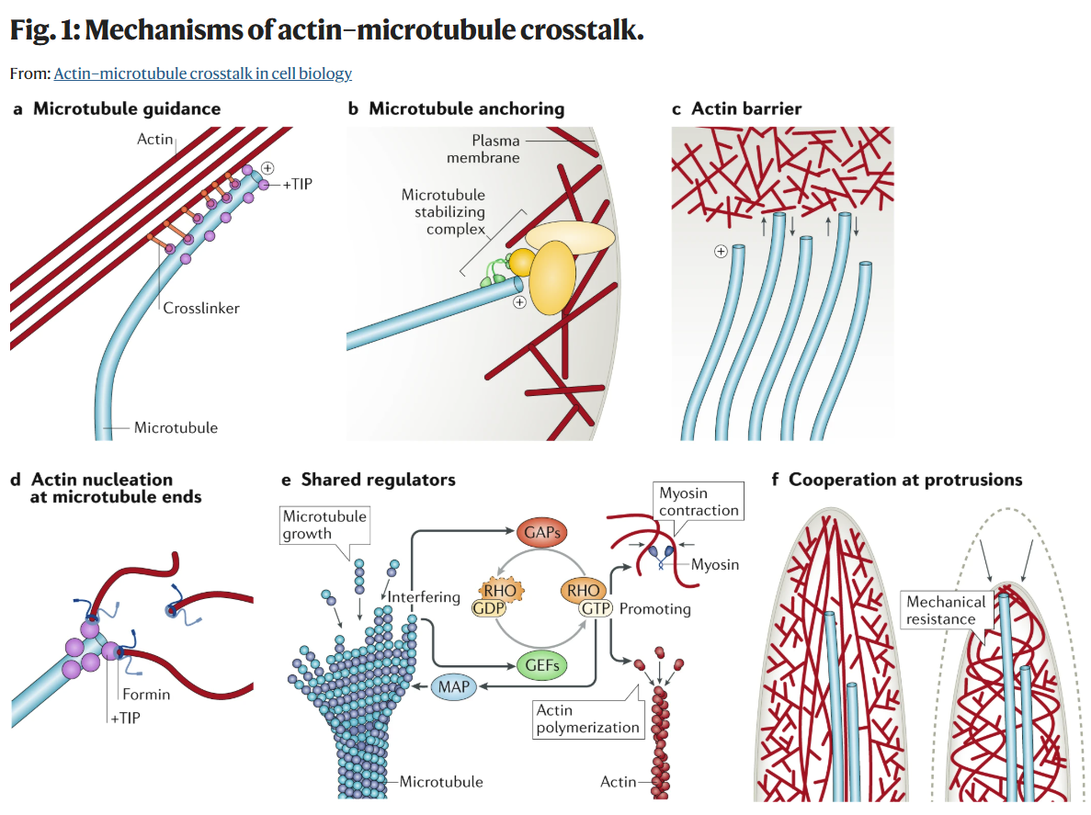
Liao Research Lab
Cytoskeletal Coordination
The broad coordination is determined by several mechanisms
Our focus: cross-linker proteins
  Physical binding
  Stability
  Neuron growth/remodeling
What we don’t know…
  The exact proteins
  How the loss of mechanical connection affects neuron structure
Dogterom, M., Koenderink, G.H. (2019).Actin–microtubule crosstalk in cell biology.
Neuronal Shape
Slide 03 / 15 - NEU Young Scholars Program - July 30, 2026
Notes:
FENNELL
Ok, so let’s talk about this coordination going on. The coordination of microtubules and actin filament is based on several different mechanisms, and the one we focused on was cross-linker proteins. These are biological molecules that mediate physical binding between polymer chains using these strong covalent bonds. This offers structural stability and contributes to neuron growth and remodeling.
Disruption of this integral coordination is implicated in neurodegenerative disease, where a destabilized cytoskeleton —> axonal and dendritic degeneration and a loss of intracellular transport
Importantly, there are gaps of knowledge regarding these cross-linker proteins that we strive to fill, such as the exact proteins performing the roles and how the loss of mechanical connection effects neuron structure.

Slide 5
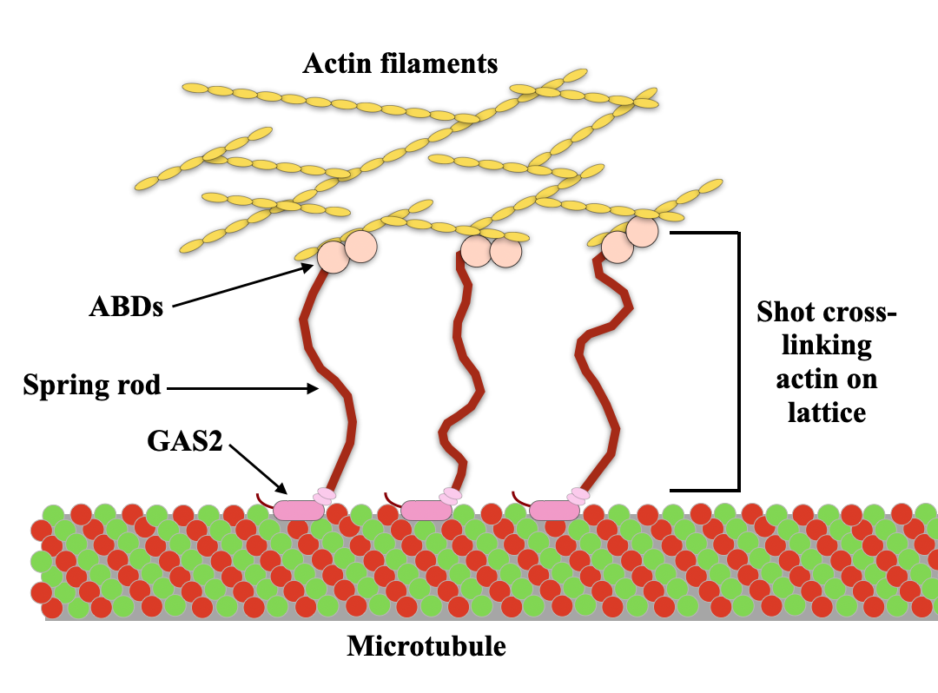
Liao Research Lab
Research Objective
Goal: Apply biophysical lens to quantify the relationship of protein crosslinkers and neuron morphology
Method: Investigate Short-stop (Shot) protein for insights into crosstalk dynamics
Adapted from Derek Applewhite, et al (2013) The actin-microtubule cross-linking activity of Drosophila Short stop is regulated by intramolecular inhibition
Neuronal Shape
Slide 04 / 15 - NEU Young Scholars Program - July 30, 2026
Notes:
Emme adapted from
Our research in particular is focused on the cross linker protein Short Stop, which we refer to as Shot.
We are interested in how Shot mediates the physical binding of microtubules and actin. The image on the right is a simple depiction of what that cross linking looks like.
Our experiments entailed reducing the amount of shot proteins in neurons and comparing the images and analysis of these neurons to control neurons to see how neuronal shape has been impacted.
The hypothesis that we are testing is that Shot helps anchor the actin mesh in place, enabling new dendrites to branch.
We are trying to clarify how loss of cytoskeletal cross-linkers drives neuronal structural breakdown.
Our theory is that a loss of cytoskeletal crosslinking drives structural breakdown, which could look like a neuron having fewer dendrites covering its surface, for example. This is important because it is the kind of breakdown often seen in neurodegenerative diseases.

Slide 6
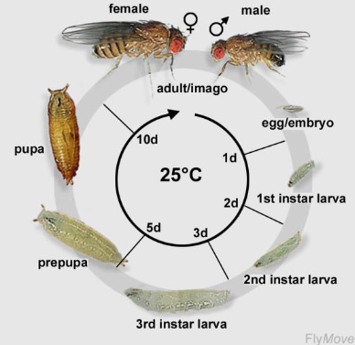
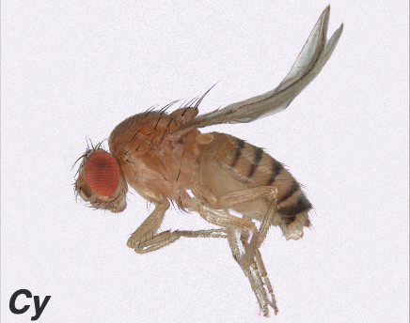
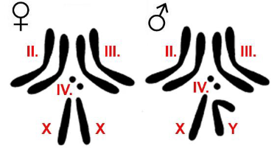
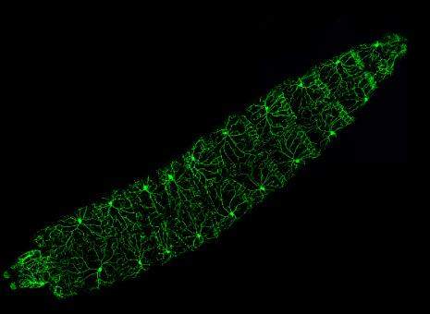
Liao Research Lab
Our Study Model
The Drosophila melanogaster
Why Drosophila?
Low redundancy: Only 4 chromosomes
75% of human diseases conserved [4]
Fast reproduction/life cycle
Visible markers
Feasibility: cost and maintenance
In particular, we study…
The c4da sensory neurons
  Flat, peripheral dendritic arbors
[4]
1 mm
Xiang, Y., Yuan, Q., Vogt, N. et al. (2010) Light-avoidance-mediating photoreceptors tile the Drosophila larval body wall.
Neuronal Shape
Slide 05 / 15 - NEU Young Scholars Program - July 30, 2026
Notes:
FENNELL
Class IV dendritic arborization
“Based on our research objective, we were drawn to select the Drosophila melanogaster as our study model.
We selected this organism model for multiple reasons. First off, their low redundancy of only 4 chromosomes gives us an easy template to manage using balancers. Also, 75% of human diseases are conserved, allowing us to draw larger connections to human neurons. Other than that, they have a fast reproduction/life cycle, visible phenotypic markers, and they are feasible to maintain.
In particular, we are going to study their class 4 sensory neurons, which usefully are flat and peripheral.

Slide 7
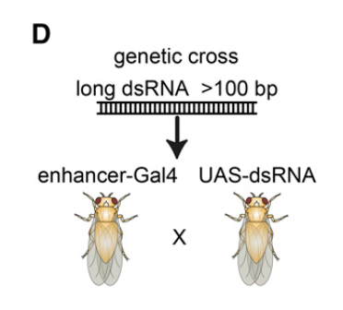
Liao Research Lab
RNA Interference
We use RNAi to knock down the amount of Shot expression
This amount is not yet quantified
Shot expression is reduced only in sensory neurons
Florian Heigwer, Filip Port, and Michael Boutros (2018) RNA Interference (RNAi) Screening in Drosophila
Neuronal Shape
Slide 06 / 15 - NEU Young Scholars Program - July 30, 2026
Notes:
EMME
Amount not quantified yet
Specially engineered flues that lack shot, use public stock
In order to investigate this coordination and reduce the amount of shot in a neuron, we used a process called RNA Interference, which lets us reduce the amount of Shot expression in the sensory neuron. This lets us compare neurons with normal Shot levels to neurons with reduced Shot, and see how that affects dendrite structure.

Slide 8
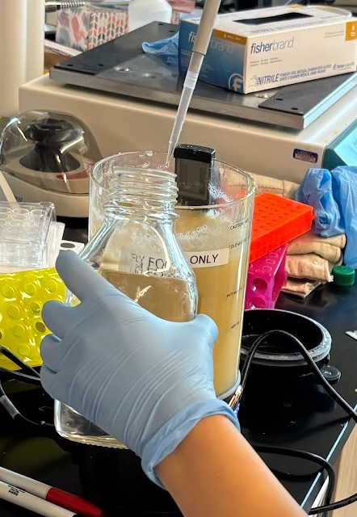
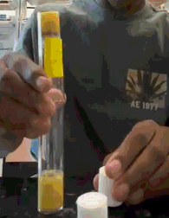
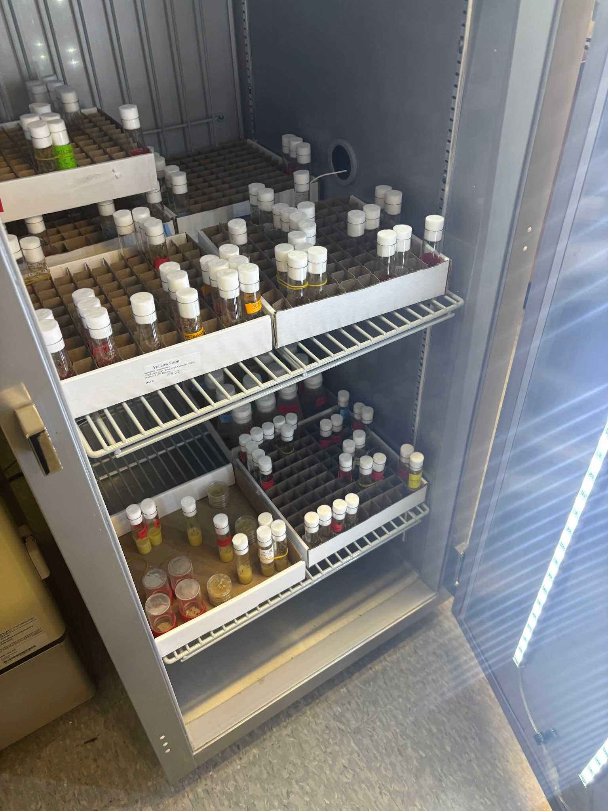
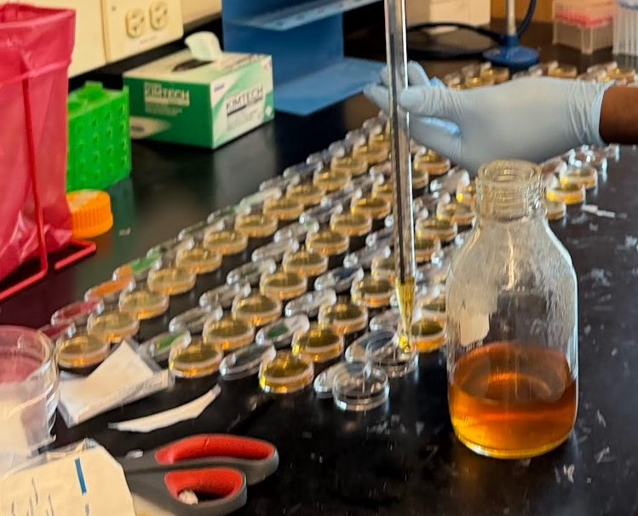
Liao Research Lab
[1] Stock Maintenance
Made fly food
Agar nutrients + apple juice mix
Fly flipping:
Transfer live flies to new tubes with food
Fly fridge kept at 25° C, 60% humidity, and simulated day/night cycle
Neuronal Shape
Slide 07 / 15 - NEU Young Scholars Program - July 30, 2026
Notes:
FENNELL
25 deg C, 60% humidity + day/night cycle stimulated
Promotes ideal growth conditions

Slide 9
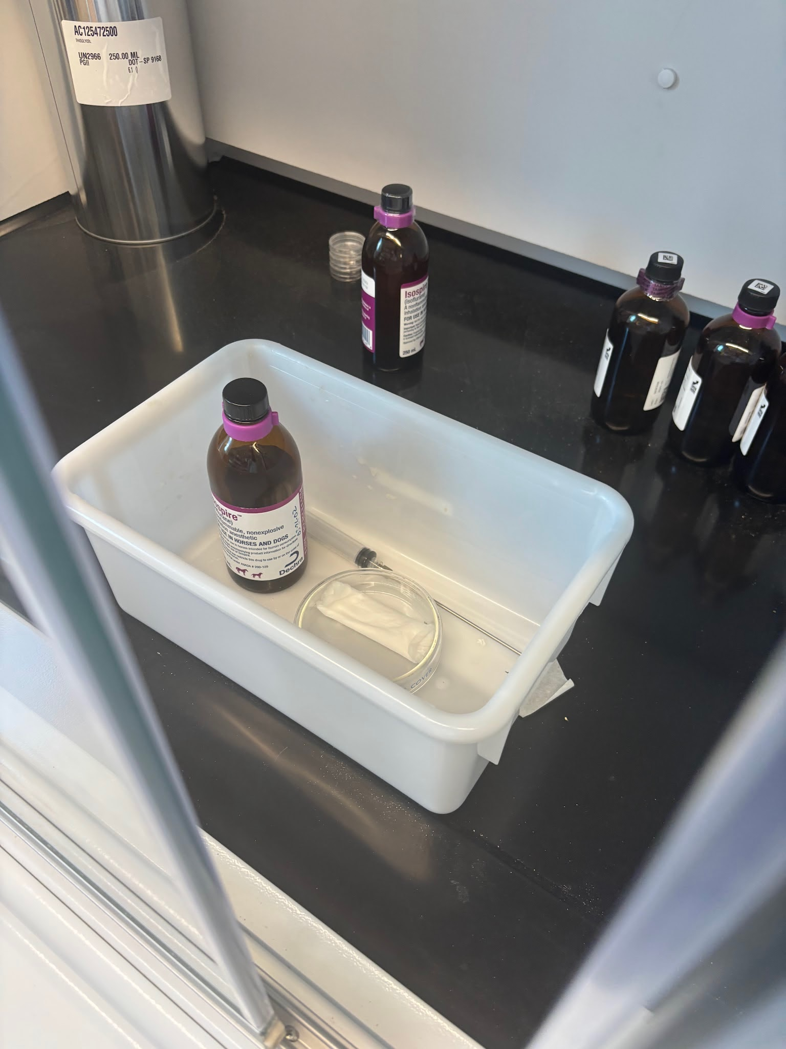
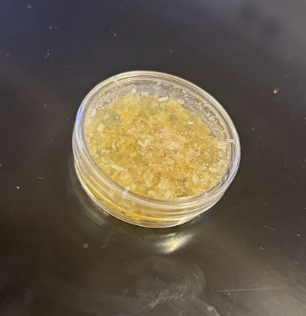
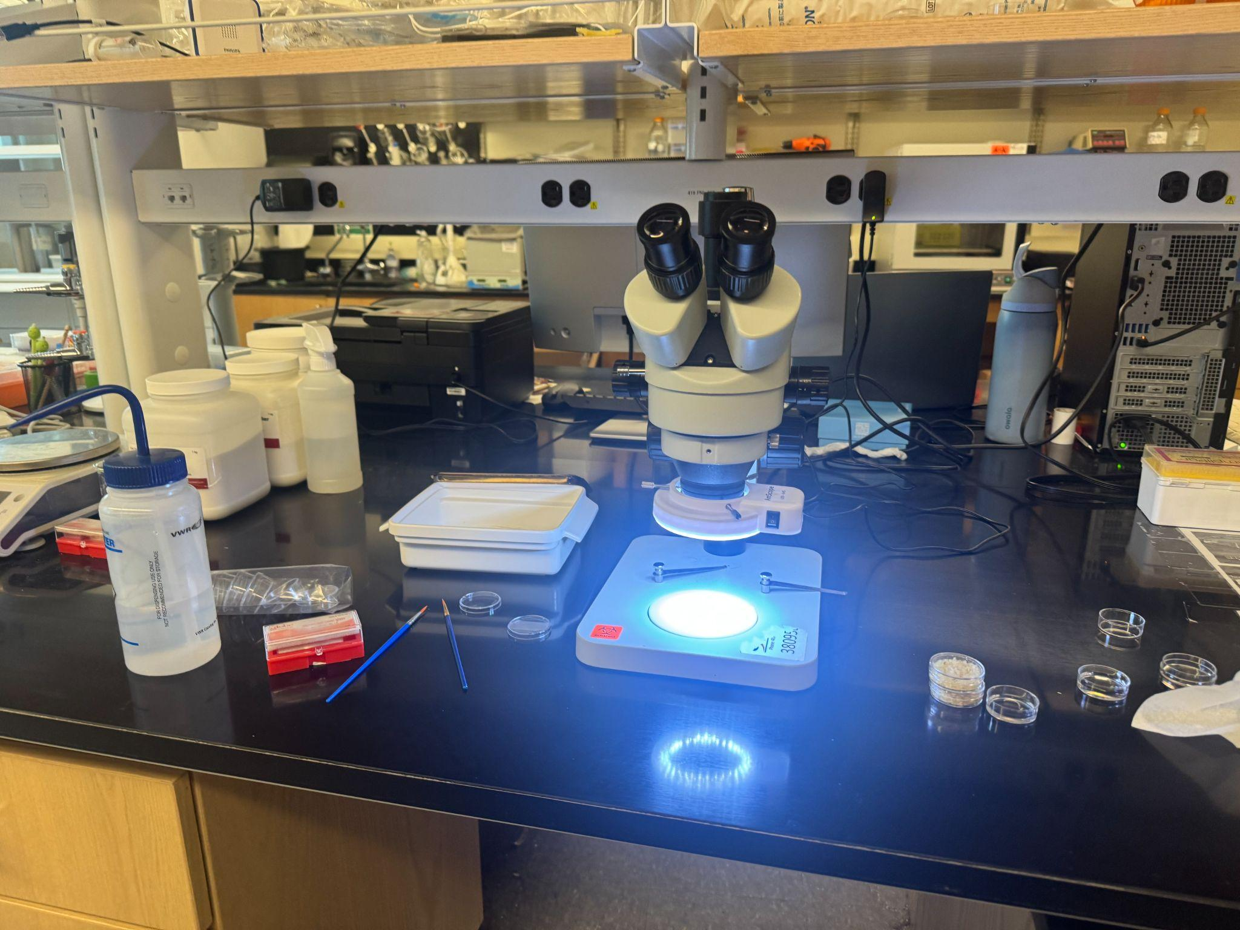
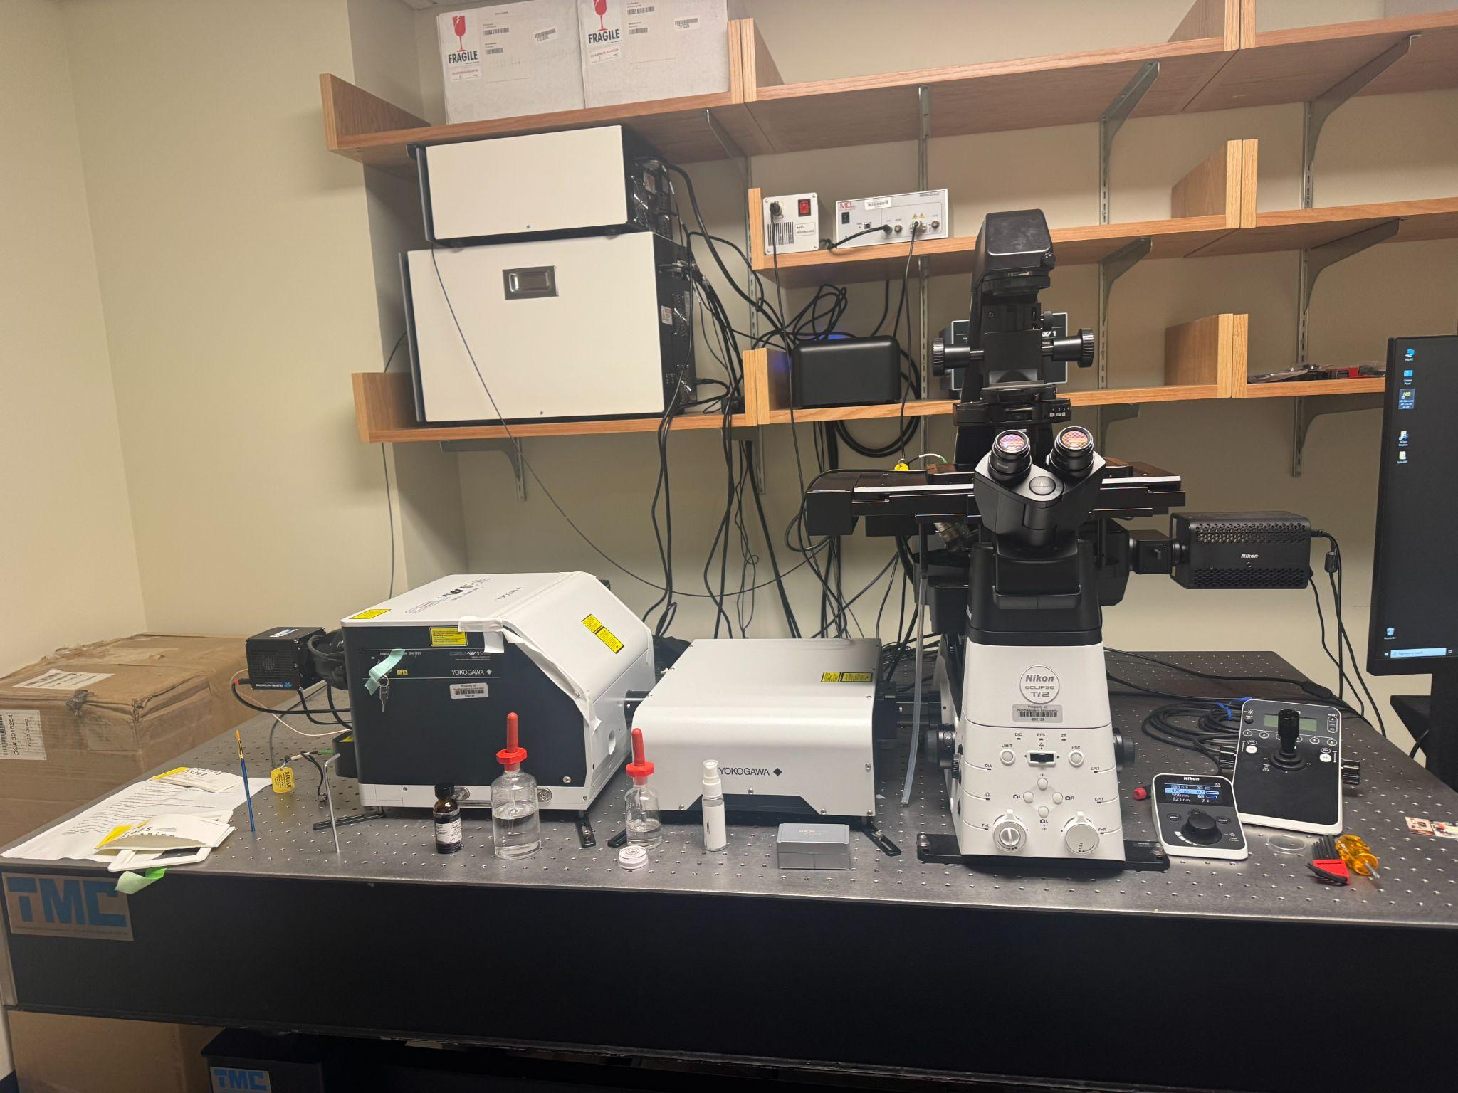
Liao Research Lab
Our Setup for Imaging
Larvae ready for imaging, 120 hours after egg-laying
Sedation with isoflurane
Confocal fluorescent microscopy of larvae in vivo
Larvae selection
Neuronal Shape
Slide 08 / 15 - NEU Young Scholars Program - July 30, 2026
Notes:
EMME
This is our process for the actual imaging of the flies. So we image them during their larval state because that is when they are transparent. It takes five days for the embryos to become larva. To image the larva, you have to rinse them with ionized water and flip them onto their dorsal side using the microscope. Then, you place them into the fume and hood and put them to sleep using isoflurane, which lasts about 15 minutes. Then you take them to the confocal laser microscope to take very thin z-slice images of the larvae.
Fridge: Develop flies and systematically breed them to get the correct genotype for the offspring – whichever you may need

Slide 10
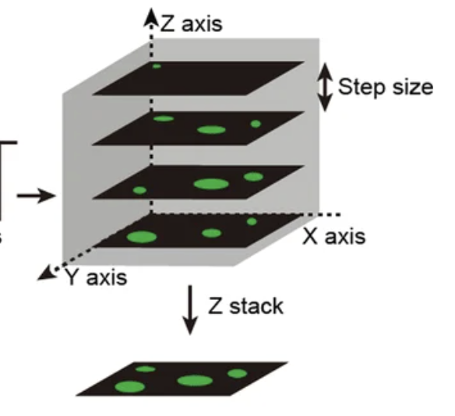
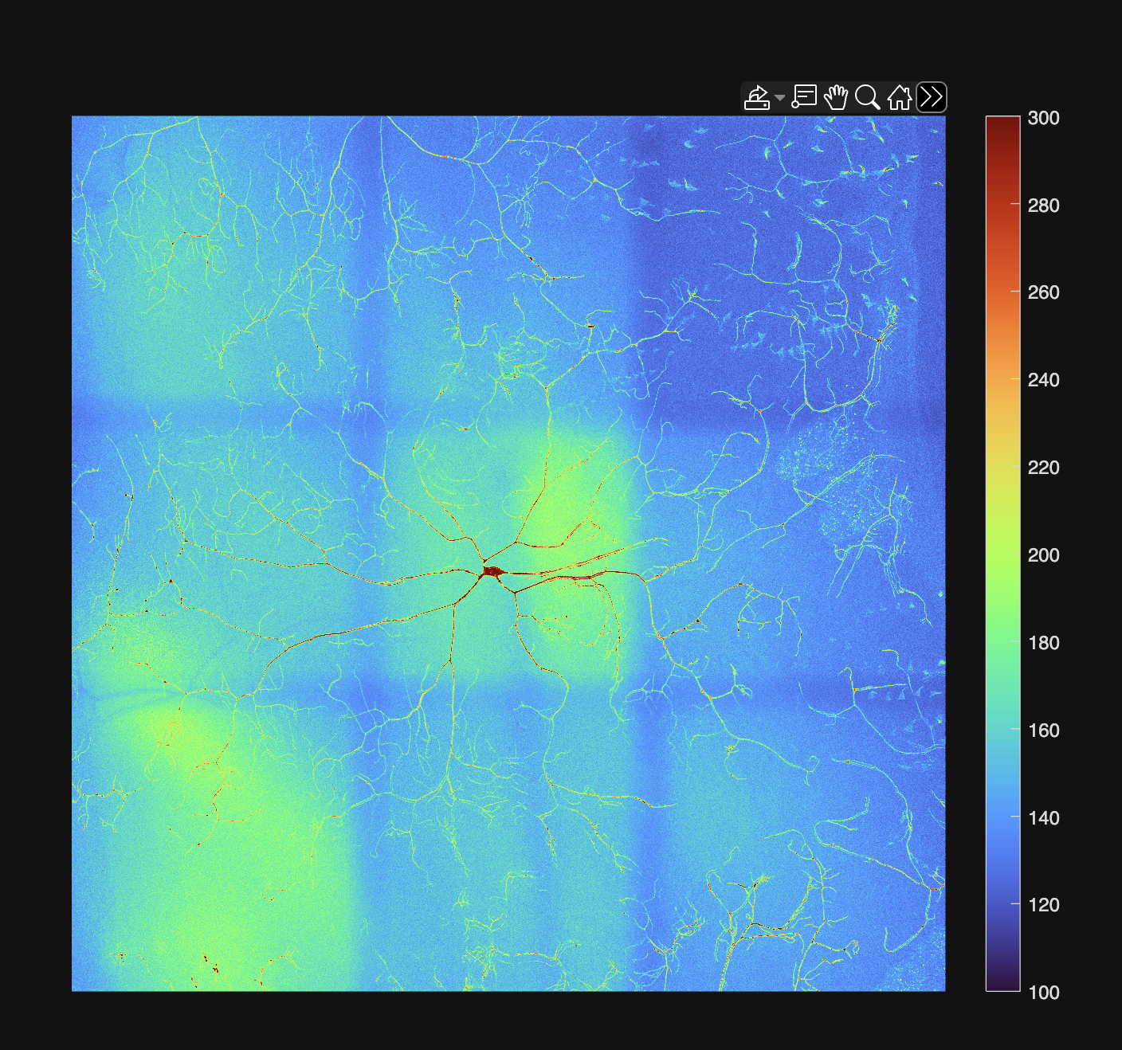
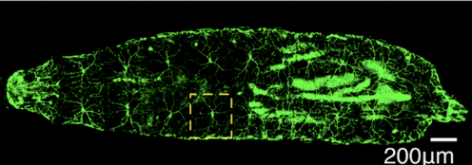
Liao Research Lab
[2] Live Imaging Process
800 nm
25 μm
100 μm
Proteins of interest tagged with GFP
Confocal microscope of larvae in vivo
Recording through each z-slice
Maximum projection: condense 3D z-stacks onto 2D plane (MatLab)
Image stitching using cross-correlation function (MatLab)
Neuronal Shape
Slide 09 / 15 - NEU Young Scholars Program - July 30, 2026
Xiaomeng Li, et al. (2022) Assay establishment and validation of a high throughput organoid-based drug screening platform
Notes:
FENNELL
So when the larvae is under the microscope, the green fluorescence proteins tag the microtubules, offering us direct view of their sensory neurons. Our microscope works by recording at different z-depths, which creates this array of ultra-thin “z-stacks”.
Then on MatLab we used maximum projection to condense this 3D array of z-stacks onto a 2D plane. Next, we stitch the images together using cross-correlation to stabilize against the natural movement of larvae while under sedation.

Slide 11
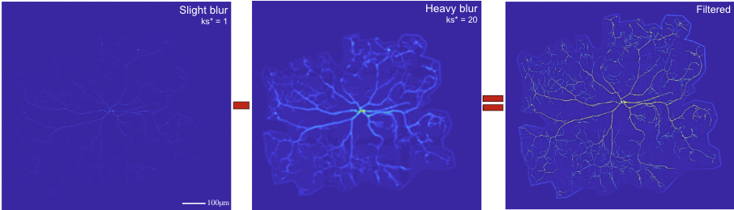
Liao Research Lab
[3] Image Processing
Gaussian kernels for blurring - (MatLab)
2) Neuron tracing on in-house software
Neuronal Shape
Slide 10 / 15 - NEU Young Scholars Program - July 30, 2026
Notes:
Emme:
To process the images and prepare them for analysis, we have to go through a few steps.
The first is to apply gaussian filtering to each neuron image using code in matlab. Gaussian filtering is actually commonly used in image processing and for things like noise reduction. What it does it blurs an image by replacing each pixel with a weighted average of its neighbors, where nearby pixels count more and farther pixels count less. A small kernel size means a subtle blur, and a large kernel size means a heave blur. The image on the top left is a slight blur and represents the background trend and fine detail of the neuron. The middle image is a heavy blur and represents the slow changing background trend. We subtract the heavily blurred image from the lightly blurred one pixel by pixel so that the background trend is cancelled out and all that is left is the fine detail of the branch structure.
We need this filtering to calculate things like mesh size, total branch length, and the neuron density map.
The second piece of processing we have to do is to precisely trace each neuron we image on a software called Napari, which allows us to calculate things like the leaf number, branch order, branch length, and intensity of the actin and microtubule so that we can compare the differences between our control and modified groups further.

Slide 12
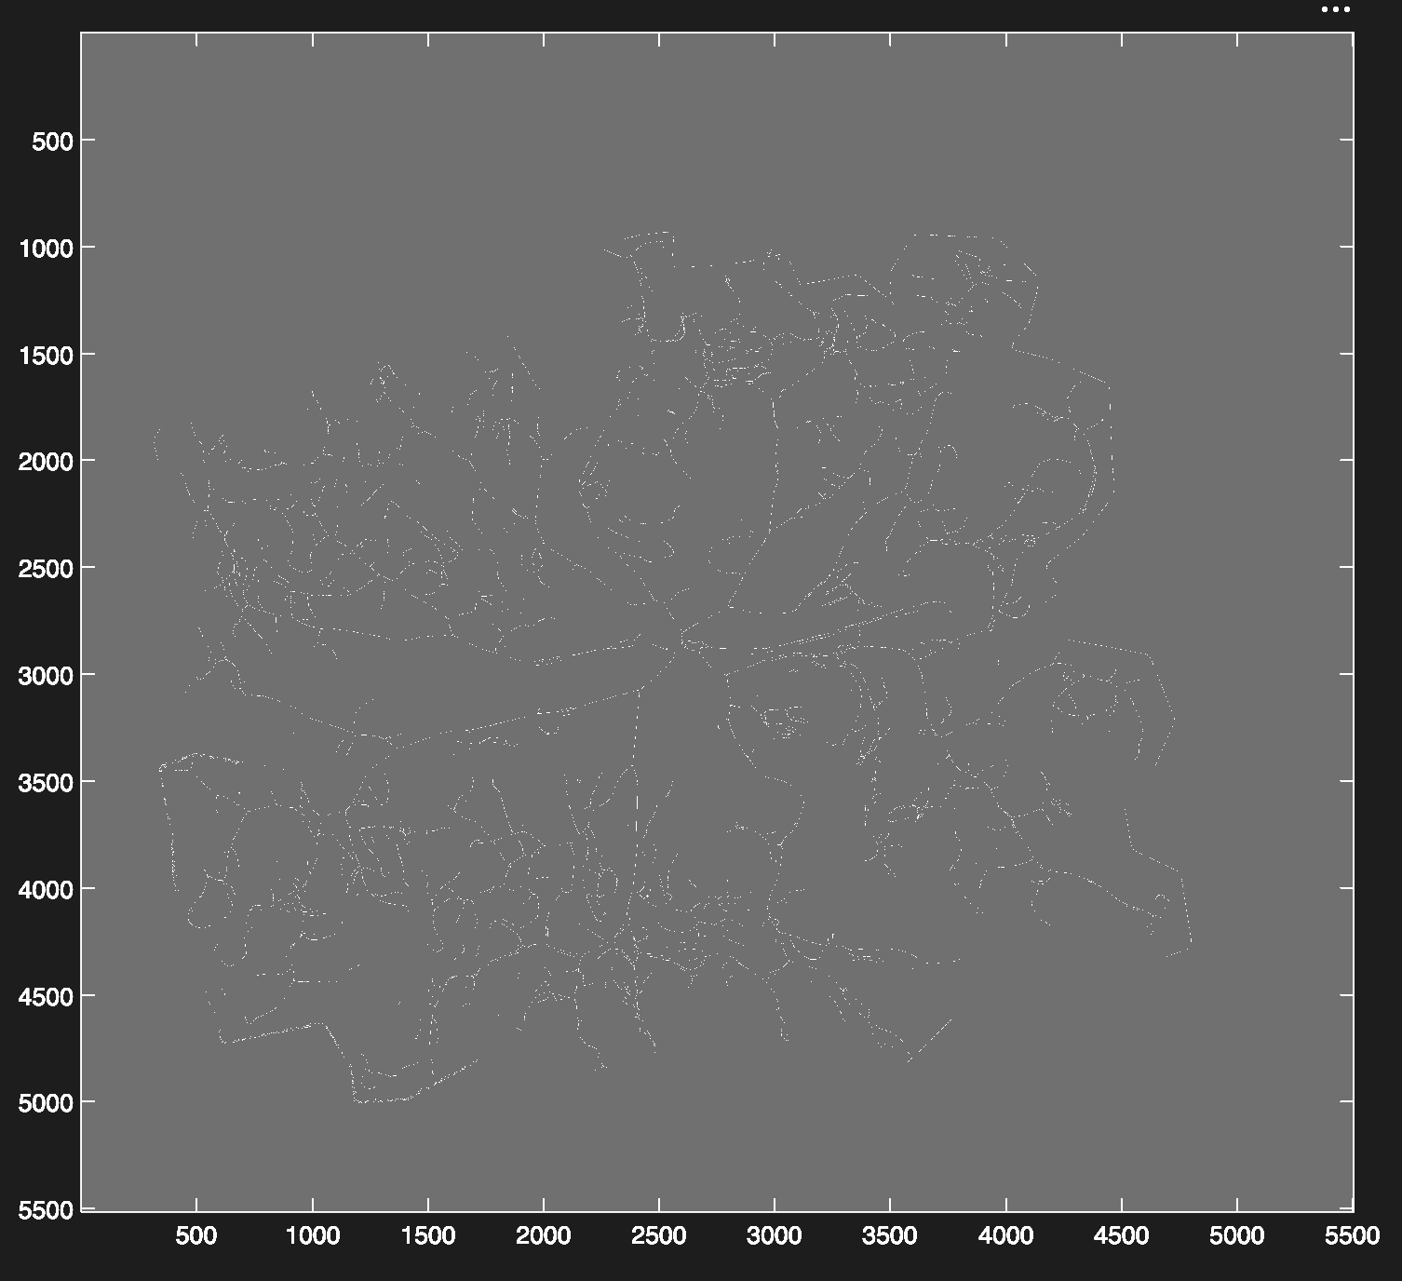
Liao Research Lab
Analysis
After processing, there are several forms of statistical comparison:
  Leaf count
  Total branch length
  Calculating mesh size
  Sholl analysis
  Intensity analysis of actin and microtubules
Mesh Size
Describe the distribution and occupancy of neuron
Mesh size is the box length b at which the probability that a b×b box contains neuron branch equals 0.5 [6].
100 μm
Binarize → Skeletonize
Neuronal Shape
Slide 11 / 15 - NEU Young Scholars Program - July 30, 2026
Notes:
FENNELL
After processing the image, there are several ways we can analyze the image. We specifically chose to analyze the total branch length and calculate the mesh size.
Mesh size basically describes the distribution and occupancy of a neuron.
A lower mesh size would mean that the dendrites are tightly compact, and thus perceive stimuli better
A higher mesh size would mean the dendrites are more spread out, and thus are worse at perceiving stimuli
So with a processed image, we binarize it into 0’s (which represents the background) and 1’s (which represents a branch), and then skeletonize it into one-pixel width branches – an example of a skeletonized neuron is over here on the right

Slide 13
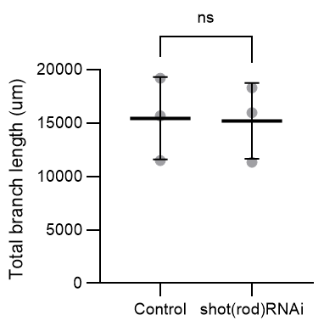
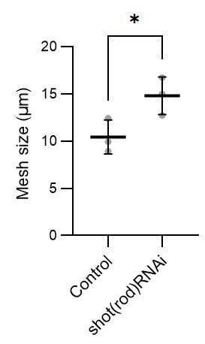
Liao Research Lab
 | Mesh Size (µm) |  | Total Branch Length (µm)
Samples | Control Group | Shot Rod RNAi Group | Control Group | Shot Rod RNAi Group
1 | 8.9 | 12.1 | 15,660 | 18,305
2 | 12.4 | 15.0 | 19,183 | 15,957
3 | 9.9 | 16.7 | 11,478 | 11,320
Independent Two-Sample t-Tests
Neuronal Shape
Slide 12 / 15 - NEU Young Scholars Program - July 30, 2026
Notes:
Emme:
So we took 6 neuron images - 3 for a control group and 3 for a reduced shot group, and calculated both their mesh sizes and total branch lengths. We compiled our data and did two t-Tests to ensure that there is statistical difference between the two variables of comparison. We found that the neurons of Shot-knockdown flies have a higher mesh size than the wild type controls but a very similar total branch length .

Slide 14
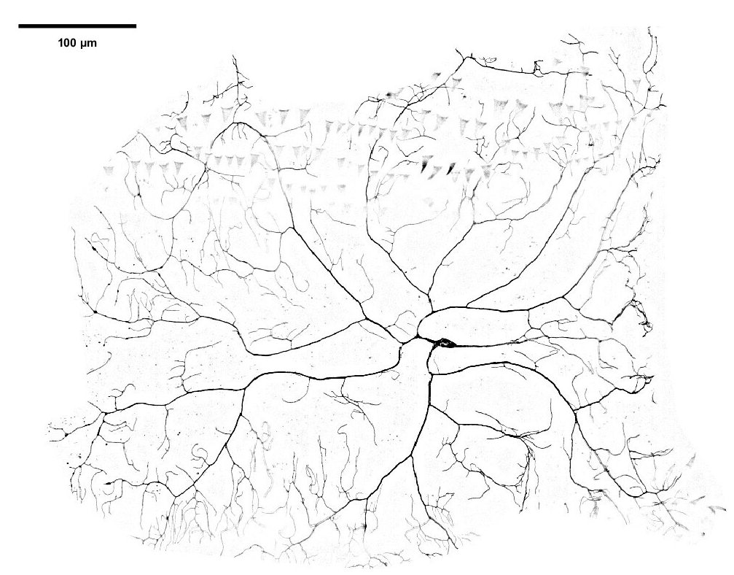
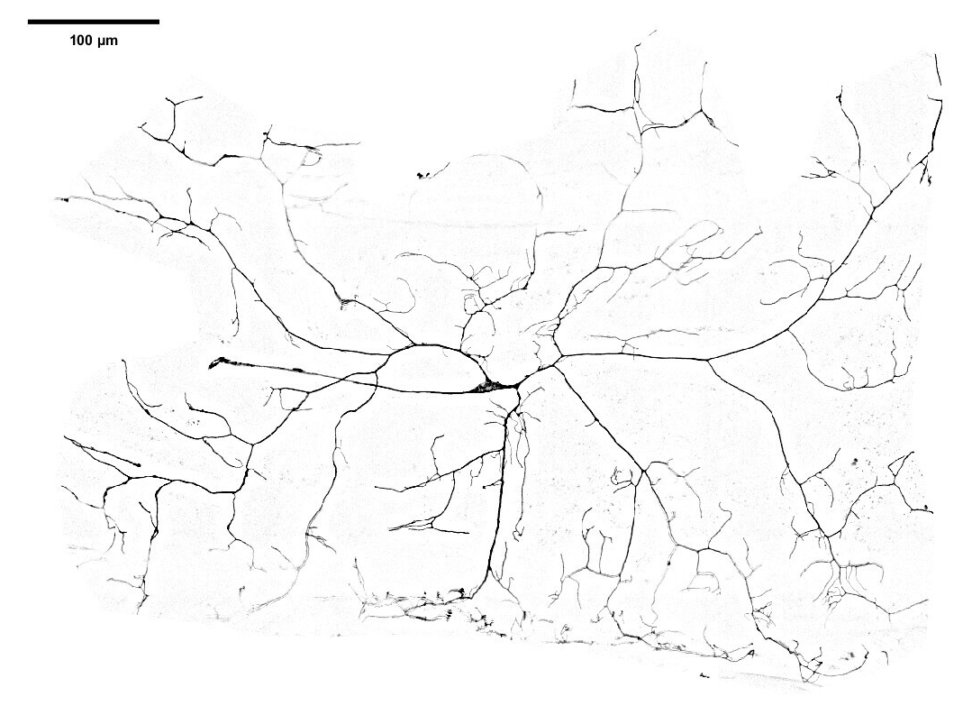
Liao Research Lab
Control (wt)
Shot Rod RNAi
Neuronal Shape
Slide 13 / 15 - NEU Young Scholars Program - July 30, 2026
Notes:
Emme:
Here are two images of the neurons that we worked with, and you can see the difference in how the dendrites cover the space. The neuron on the right seems to be more densely packed with dendrites, and the neuron on the left is a little more sparse.

Slide 15
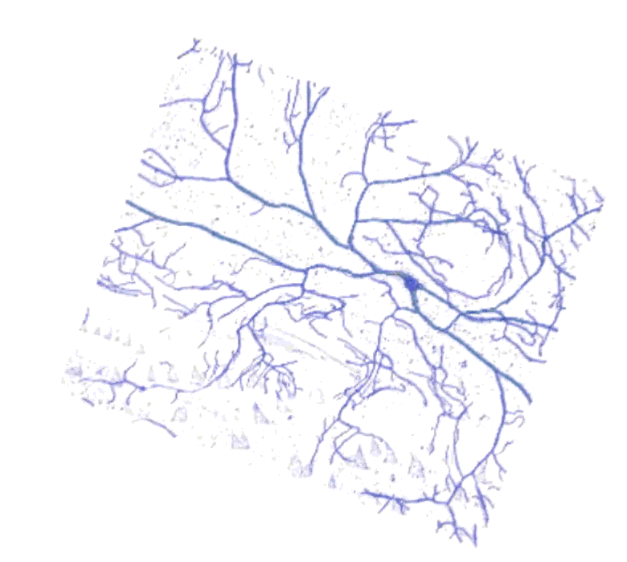
Liao Research Lab
Conclusion
  Shot RNAi neurons cover larvae surface more sparsely than control neurons. This may lead to reduced capability to detect mechanical threat.
Theory: Absence of Shot hinders nucleation of dendritic branches. Shot enables dendritic growth by holding the actin mesh in place.
100 μm
Neuronal Shape
Slide 14 / 15 - NEU Young Scholars Program - July 30, 2026
Notes:
Fennell
Based on the results, we concluded that the Shot RNAi neurons cover larvae surface more sparsely than control neurons while maintaining the same total branch length. This can lead to reduced capability to detect mechanical threat.
Over our 6 weeks, we take away that the absence of shot hinders the nucleation of dendritic branches, verifying our hypothesis that Shot does enable neurocellular growth by crosslinking the actin mesh into place.

Slide 16
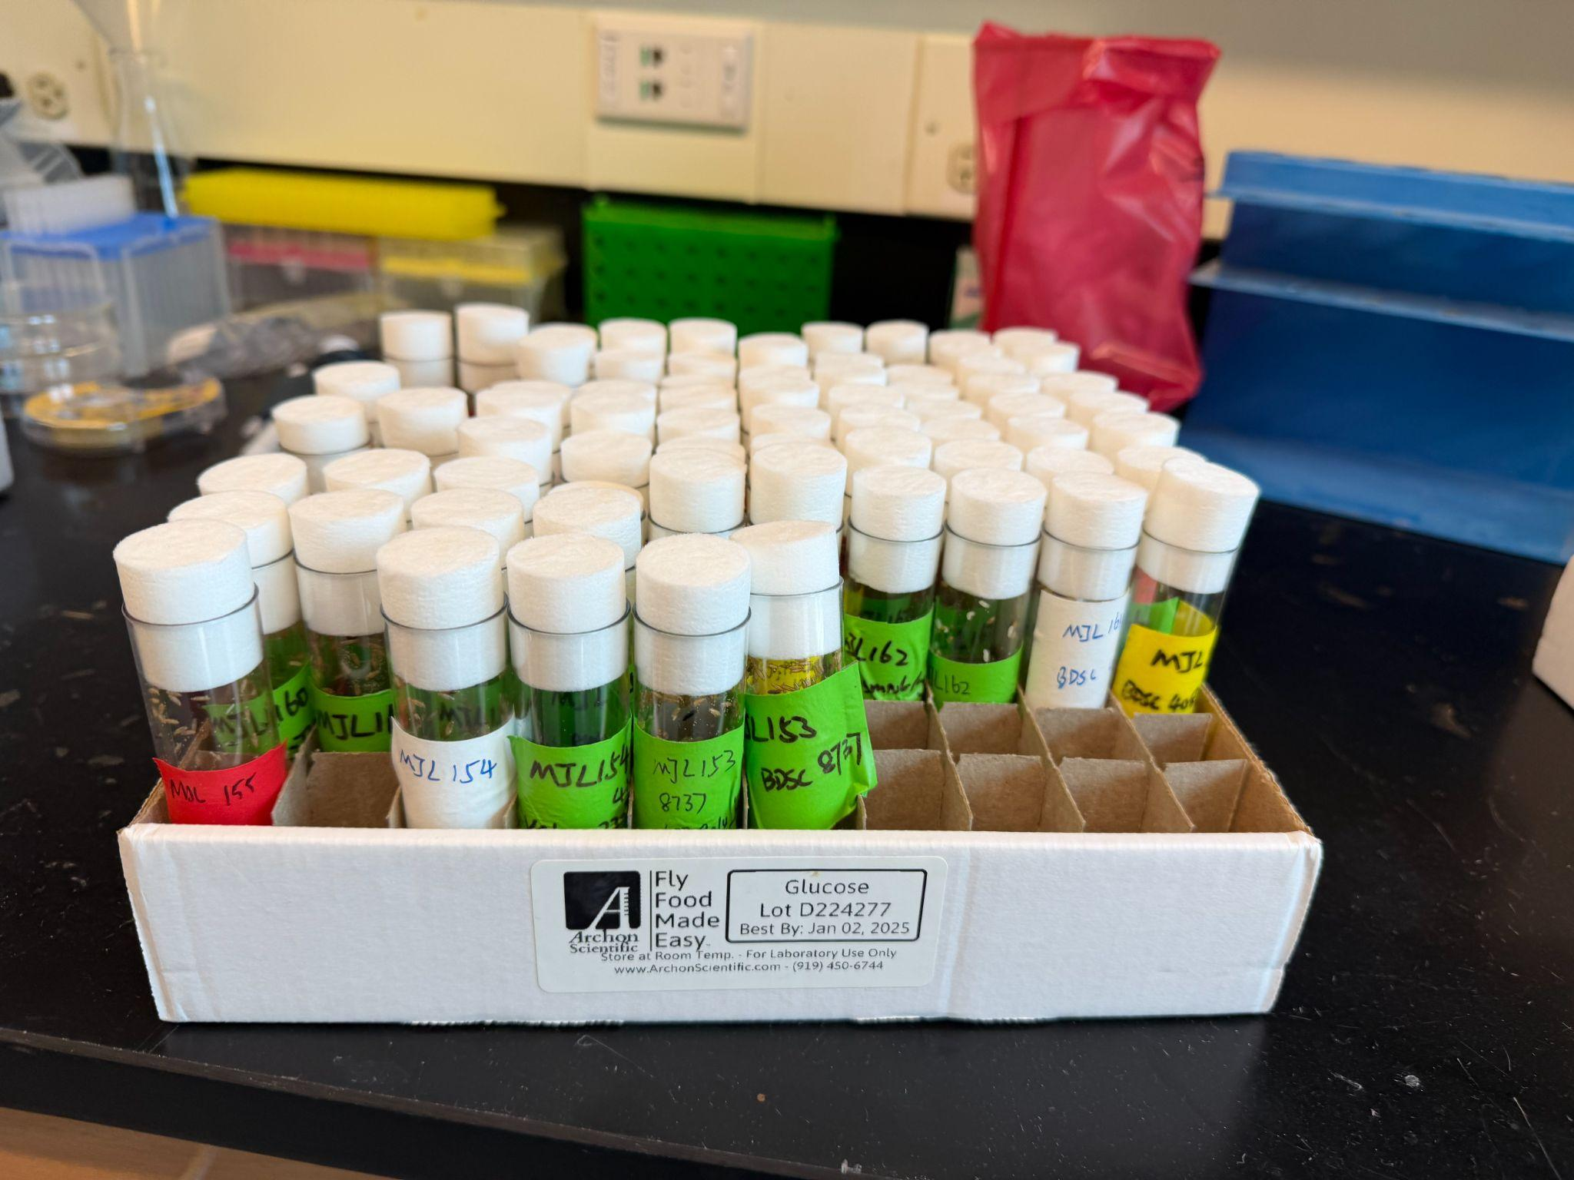
Liao Research Lab
Next Steps
Continue computational analysis:
  Microtubule and actin intensity
  Neuron density map
Continue studying cross linker proteins:
  Different extents of Shot expression (using MARCM, namely)
  Different protein crosslinkers to analyze (e.g. clip, rho, etc.)
Neuronal Shape
Slide 15 / 15 - NEU Young Scholars Program - July 30, 2026
Notes:
Emme
MARCM = Mosaic Analysis with a Repressible Cell Marker

Slide 17
Liao Research Lab
References
[1] Cash, Adam D et al. “Microtubule reduction in Alzheimer's disease and aging is independent of tau filament formation.” The American journal of pathology vol. 162,5 (2003): 1623-7. doi:10.1016/s0002-9440(10)64296-4
[2] Milatovic, D., Montine, T. J., Zaja‐Milatovic, S., Madison, J. L., Bowman, A. B., & Aschner, M. (2010). Morphometric Analysis in Neurodegenerative Disorders. Current Protocols in Toxicology, 46(1). https://doi.org/10.1002/0471140856.tx1216s46.
[3] Heigwer, F., Port, F., & Boutros, M. (2018). RNA interference (RNAI) screening in Drosophila. Genetics, 208(3), 853–874. https://doi.org/10.1534/genetics.117.300077.
[4] Jan, Yuh-Nung, and Lily Yeh Jan. "Branching Out: Mechanisms of Dendritic Arborization." Nature Reviews Neuroscience, vol. 11, no. 5, 2010, pp. 316–328, doi.org/10.1038/nrn2836.
[5] Prokop, A. (n.d.). A rough guide to Drosophila mating schemes. http://halfonlab.ccr.buffalo.edu/courses/BCH512/Roote+Prokop-SupplMat-1v2 .2.pdf Wikipedia contributors.
[6] Ganguly, Sujoy, et al. "Morphology of Fly Larval Class IV Dendrites Accords with a Random Branching and Contact Based Branch Deletion Model." arXiv, 16 Apr. 2018, arxiv.org/abs/1611.05918.
Neuronal Shape
NEU Young Scholars Program - July 30, 2026
Notes:
Grant #?

Slide 18



Liao Research Lab
Acknowledgements:
Department of Bioengineering
Maijia Liao, Assistant Professor (Bioengineering, Physics, Institute for Mechanobiology)
Louison Thorens, Postdoctoral Fellow (Bioengineering, Physics, Institute for Mechanobiology)
Dongdong You, Ph.D Candidate (Bioengineering, Physics)
Center for STEM Education
Claire Duggan, Executive Director
Jennifer Love, Associate Director
Frances Corcell, Kenneth Santizo, and Ahmed Othman,
YSP Coordinators
Nicolas Fuchs, Program Manager
Mary Howley, Administrative Officer
Liao Research Laboratory
This work has been funded by the National Science Foundation (NSF).
Neuronal Shape
NEU Young Scholars Program - July 30, 2026
Notes:
Grant #?

Slide 19
