Slide 1

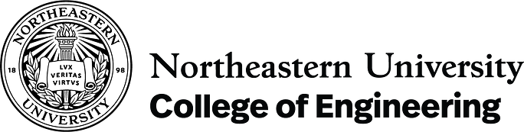


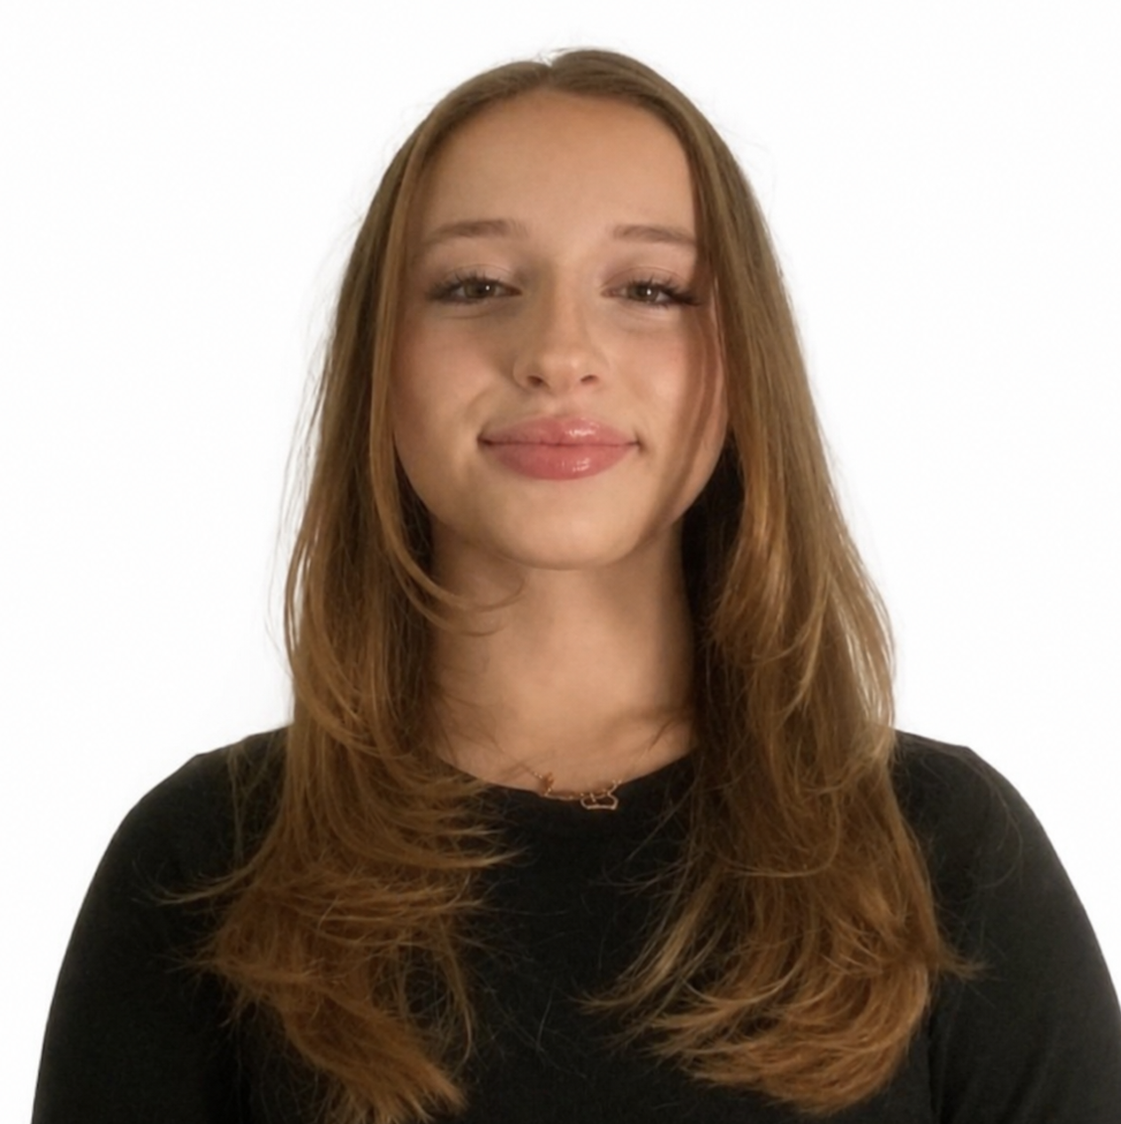
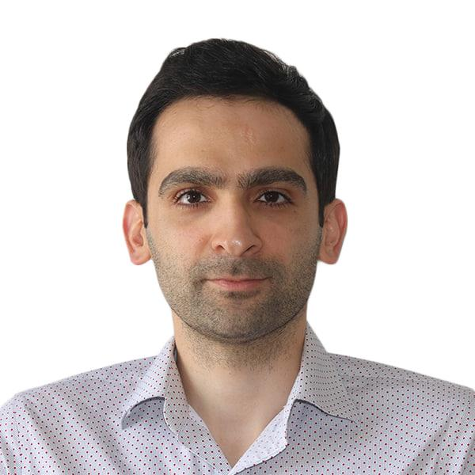
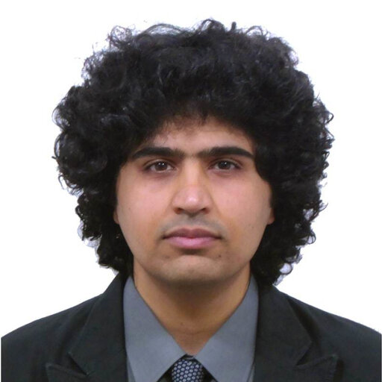
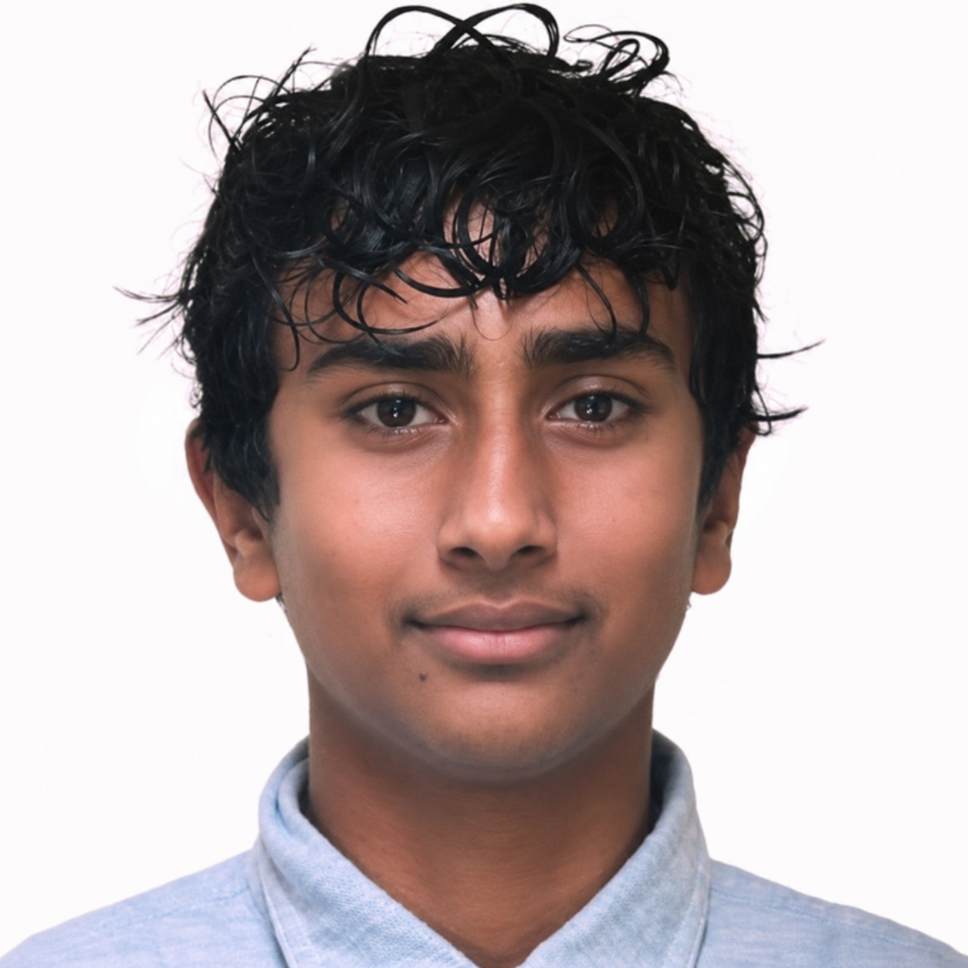
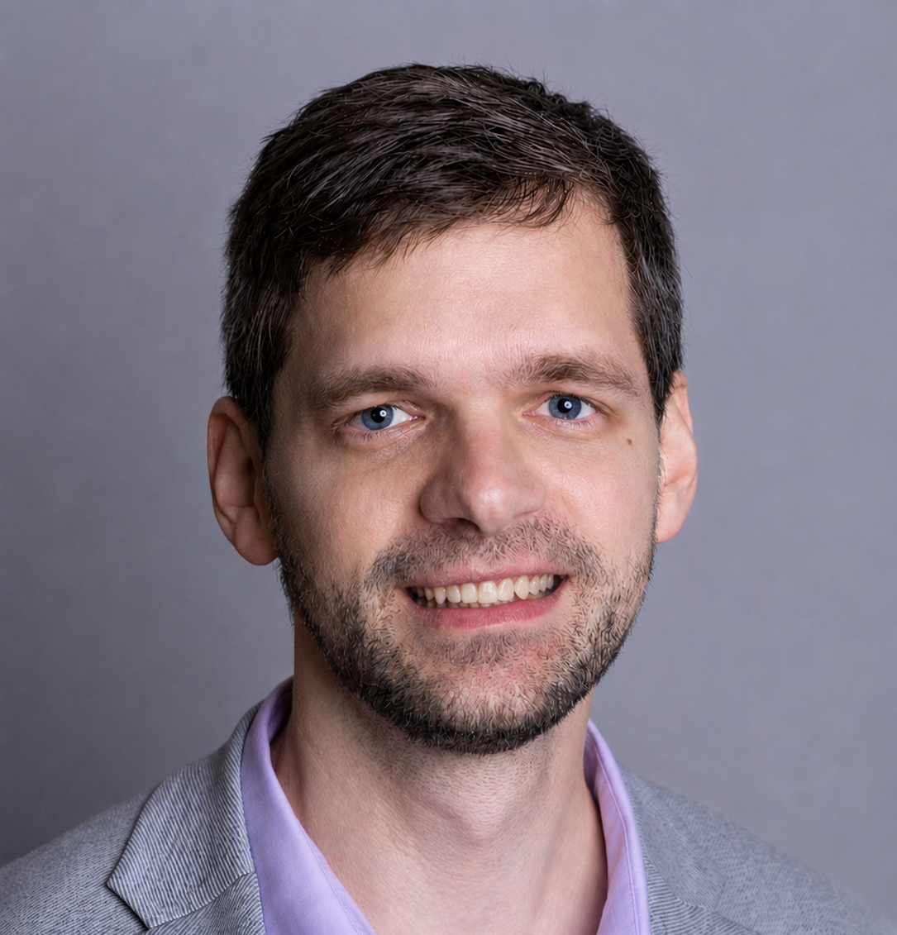
AI Driven Design of Semiconductor Alloys with Tuned Effective Masses
Farah Can, Westford Academy
Dhruvaite Upmanyu, Pingree School
Prof. Peter Schindler, Northeastern University
Dr. Emad Rezaei, Northeastern University
Ardavan Mehdizadeh, Northeastern University​
Department of Mechanical and Industrial Engineering

Slide 2
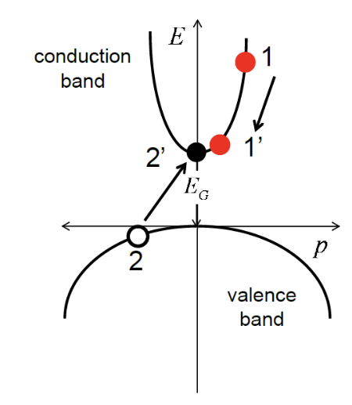
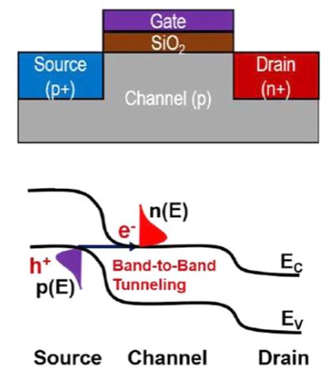
Motivation
Band structure defines electronic properties of materials
The curvature of the bands relates to effective mass
Effective mass: the mass of an electron while in motion → determines charge carrier mobility
Impact ionization - how semiconductors transfer kinetic energy to a valence electron → electrons jump to a higher energy level
  This creates an electron-hole pair,
  leaving a free electron and a hole behind
  Determines the characteristics of semiconductor devices
Strategy to minimize impact ionization:
large band gap + heavy effective mass
However, for fast transistors:
need light effective mass → high carrier mobility
2D materials-based nanoscale tunneling field effect transistors: current developments and future prospects. Kanungo et.al.
Notes:
Make sure to mention:

Slide 3
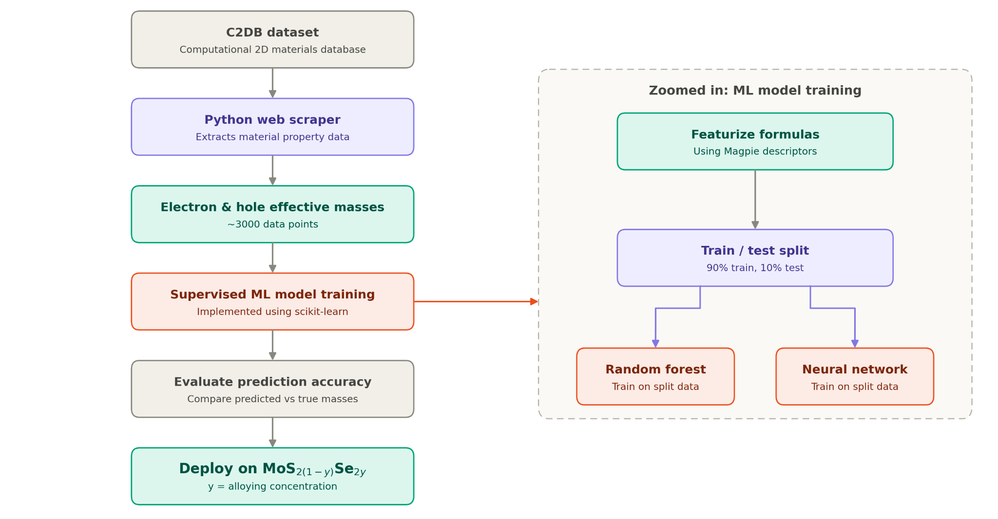
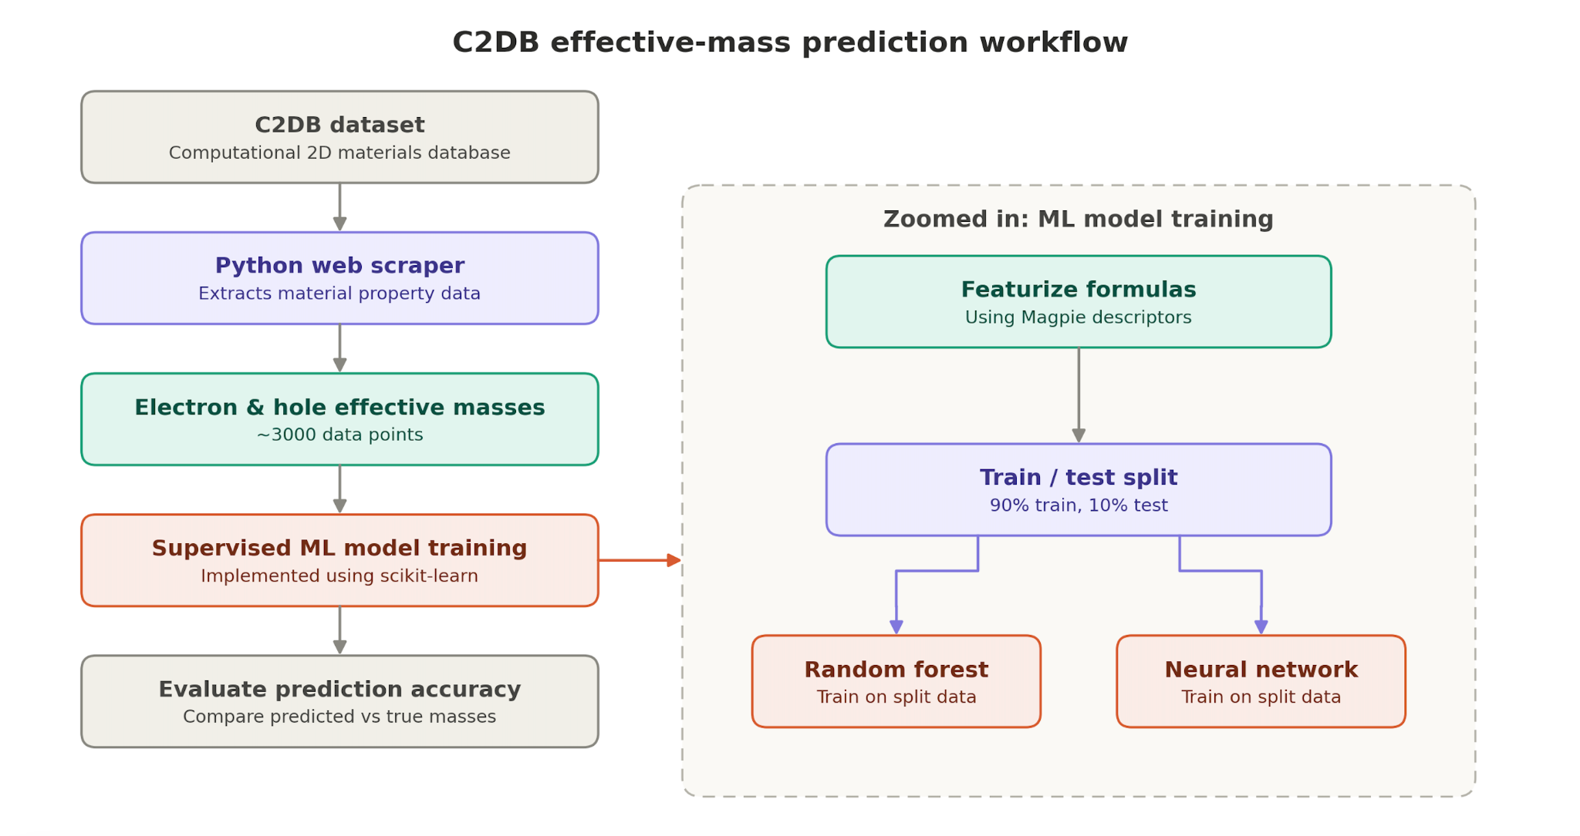
Overall Workflow
Notes:
Make sure to mention: Significance of results

Slide 4
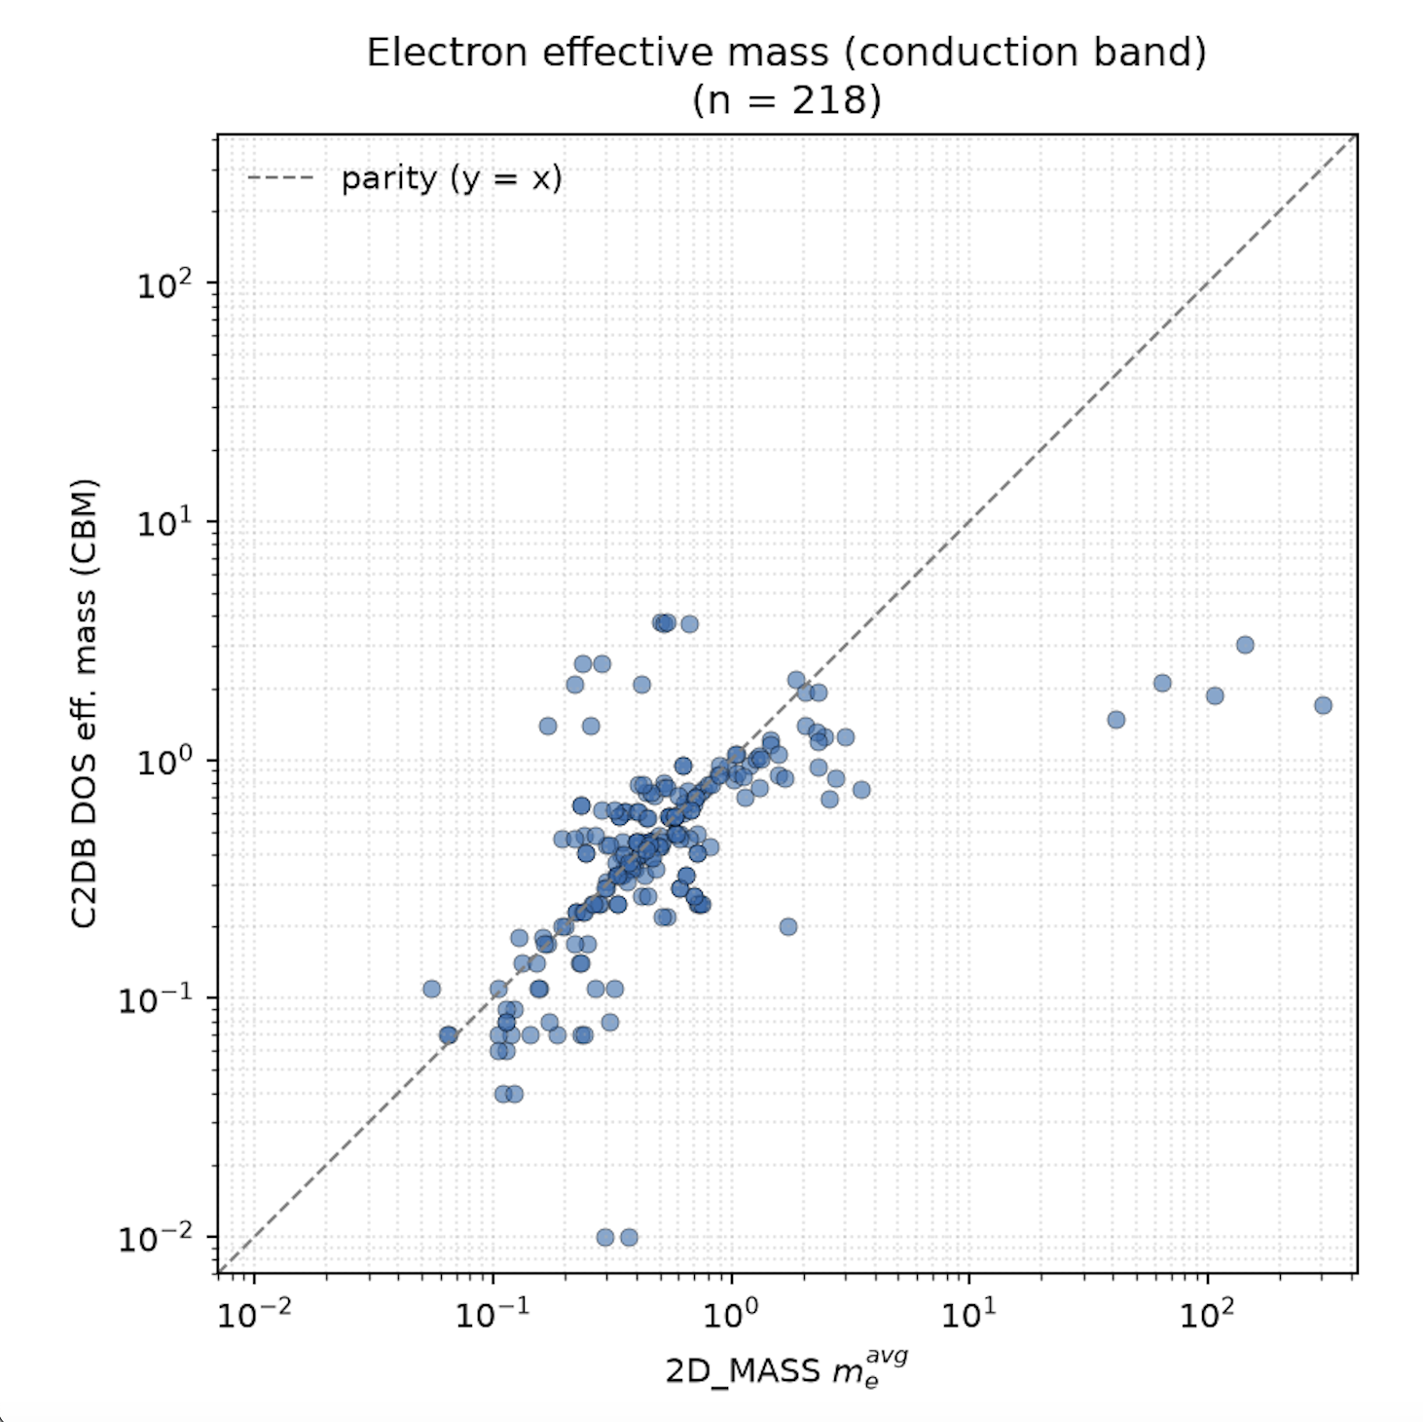
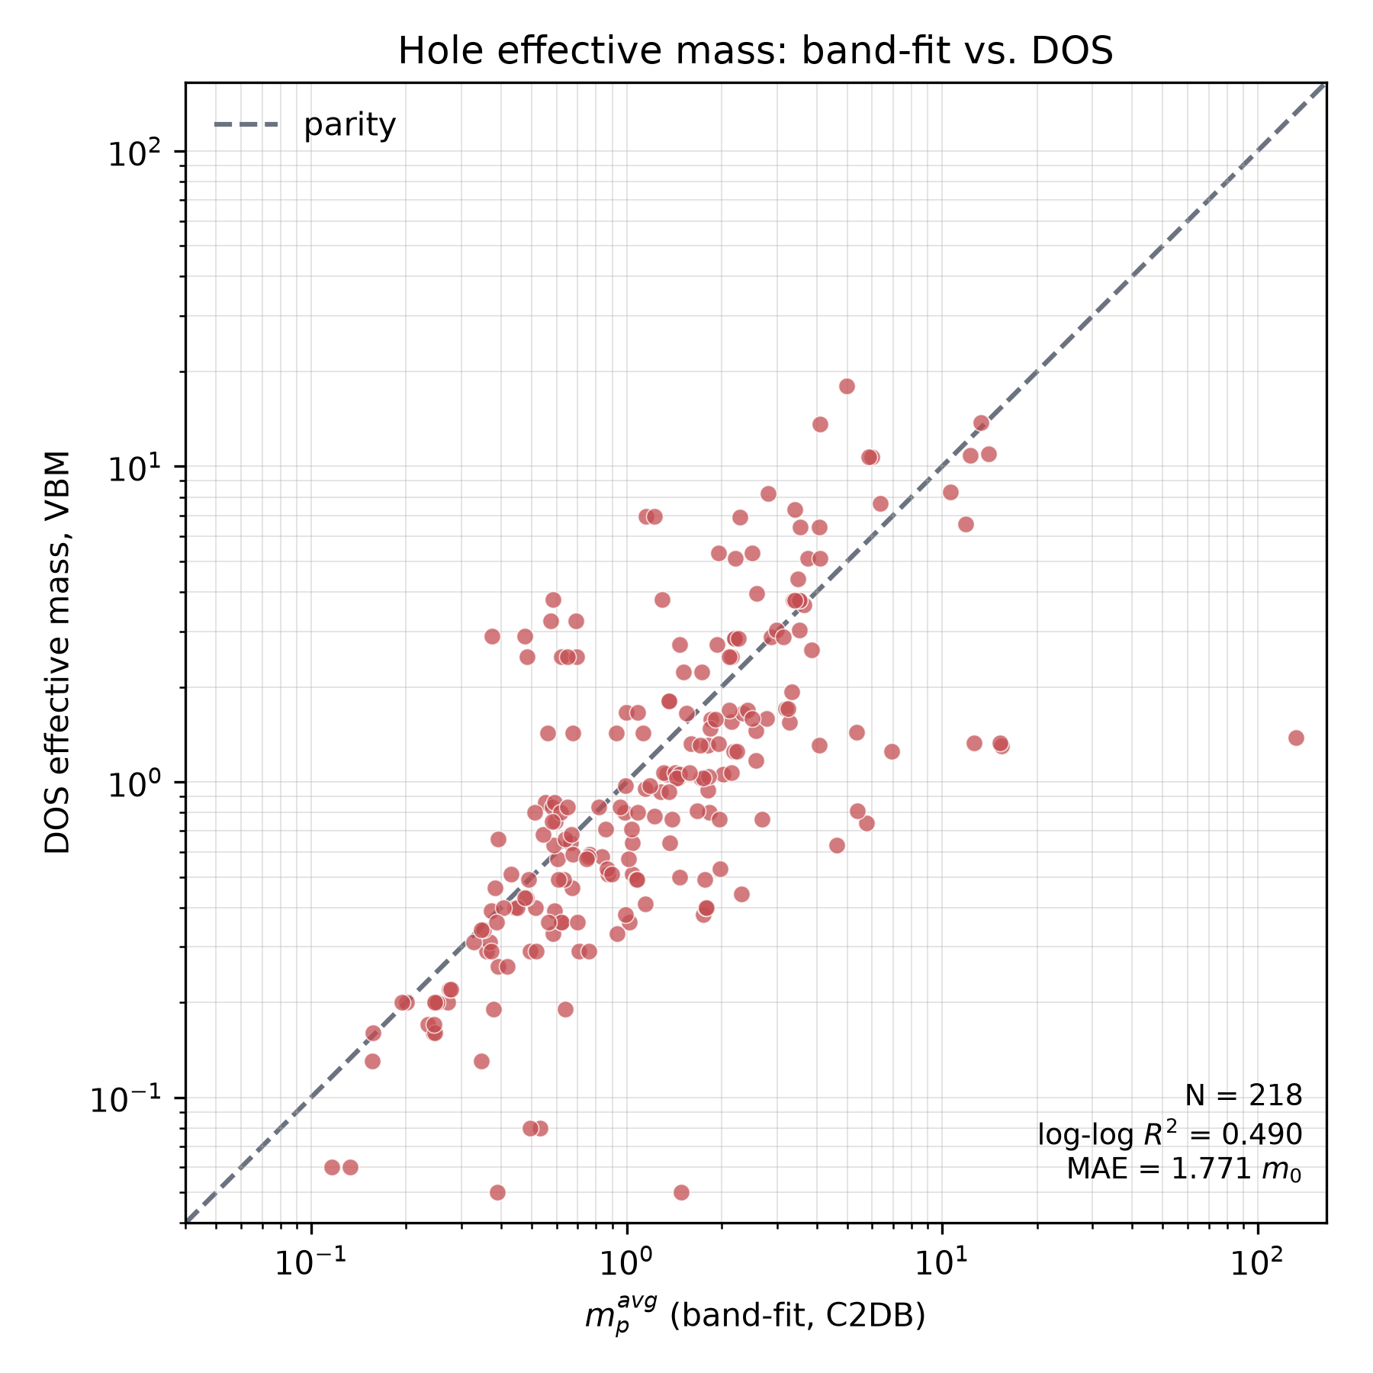
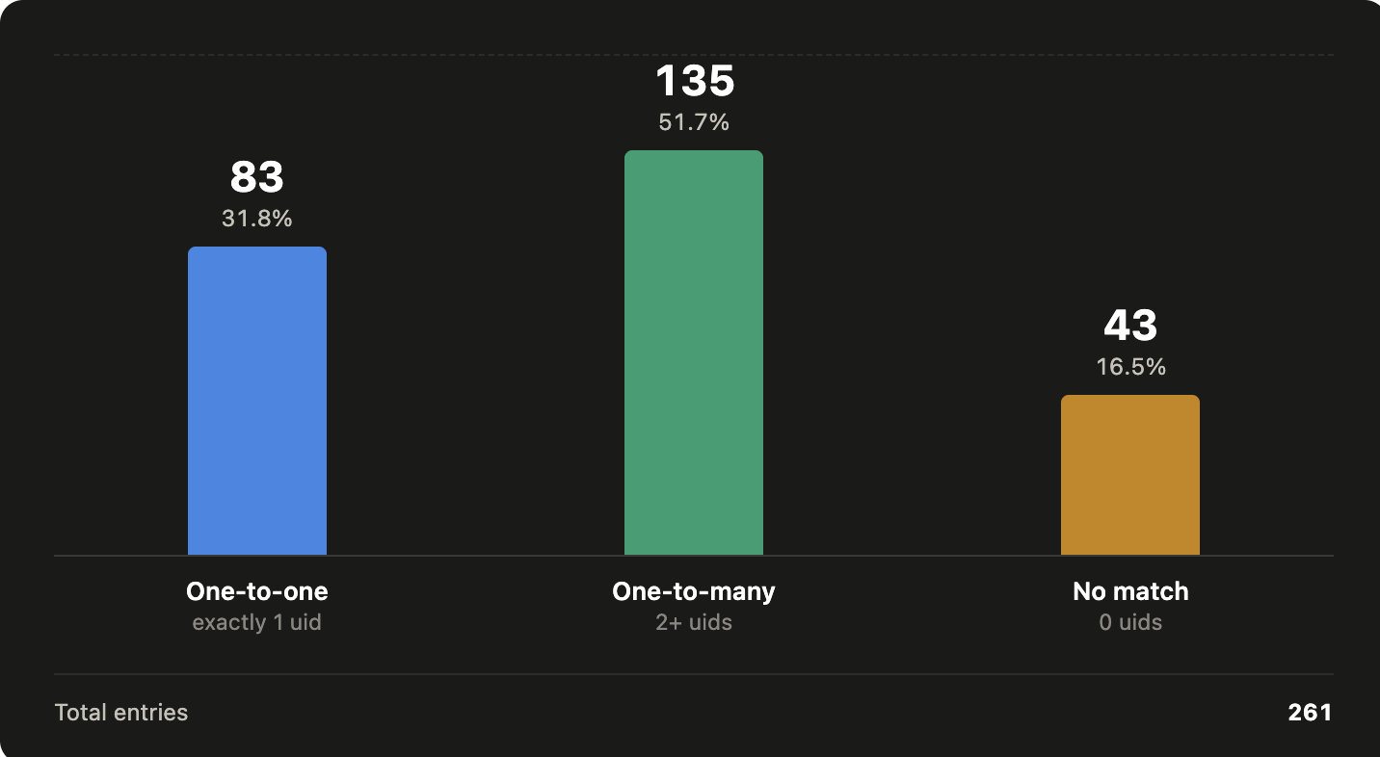
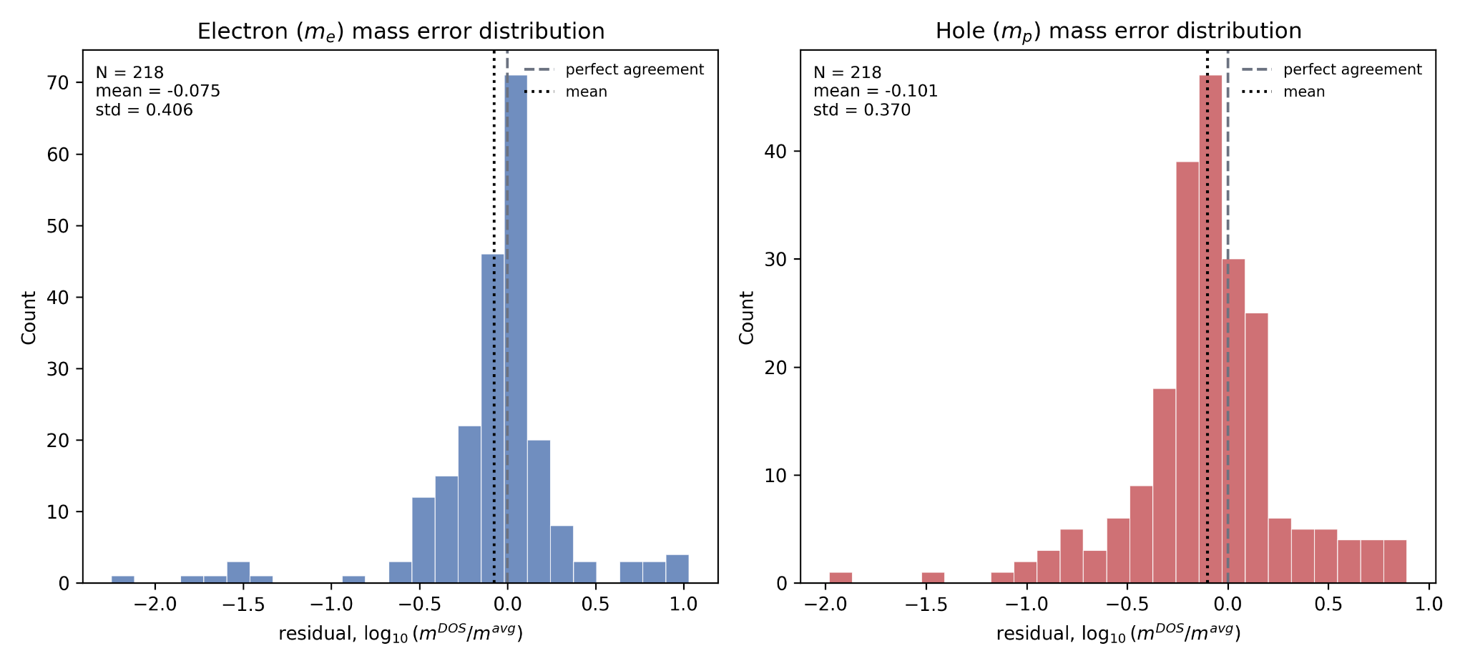
Scraping Effective Masses from C2DB Website
Created script to scrape effective masses from C2DB (dataset of 2D materials)
→ ~3,000 data points
Matched materials with another source to compare consistency
→ 261 data points
To resolve one-to-many matches:
Pick the lower energy structure
(energy above hull)
→ most stable phase
Analyze agreement between the two datasets:
Log-log transform
Parity plots for electron effective and hole effective masses
Two histograms for error distributions
Result:
Agreement relatively weak suggesting that effective mass computation strongly affected by implementation
Notes:
Make sure to mention: Significance of results

Slide 5
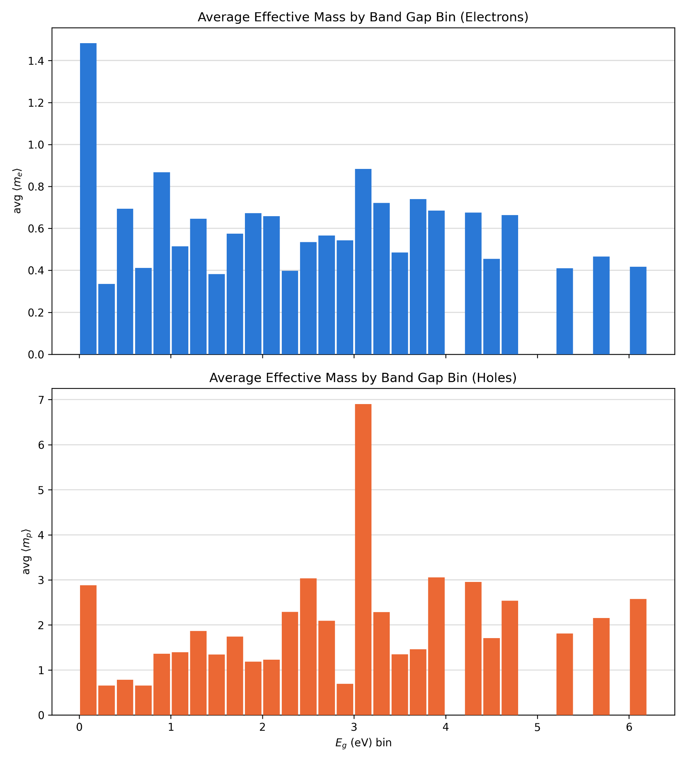
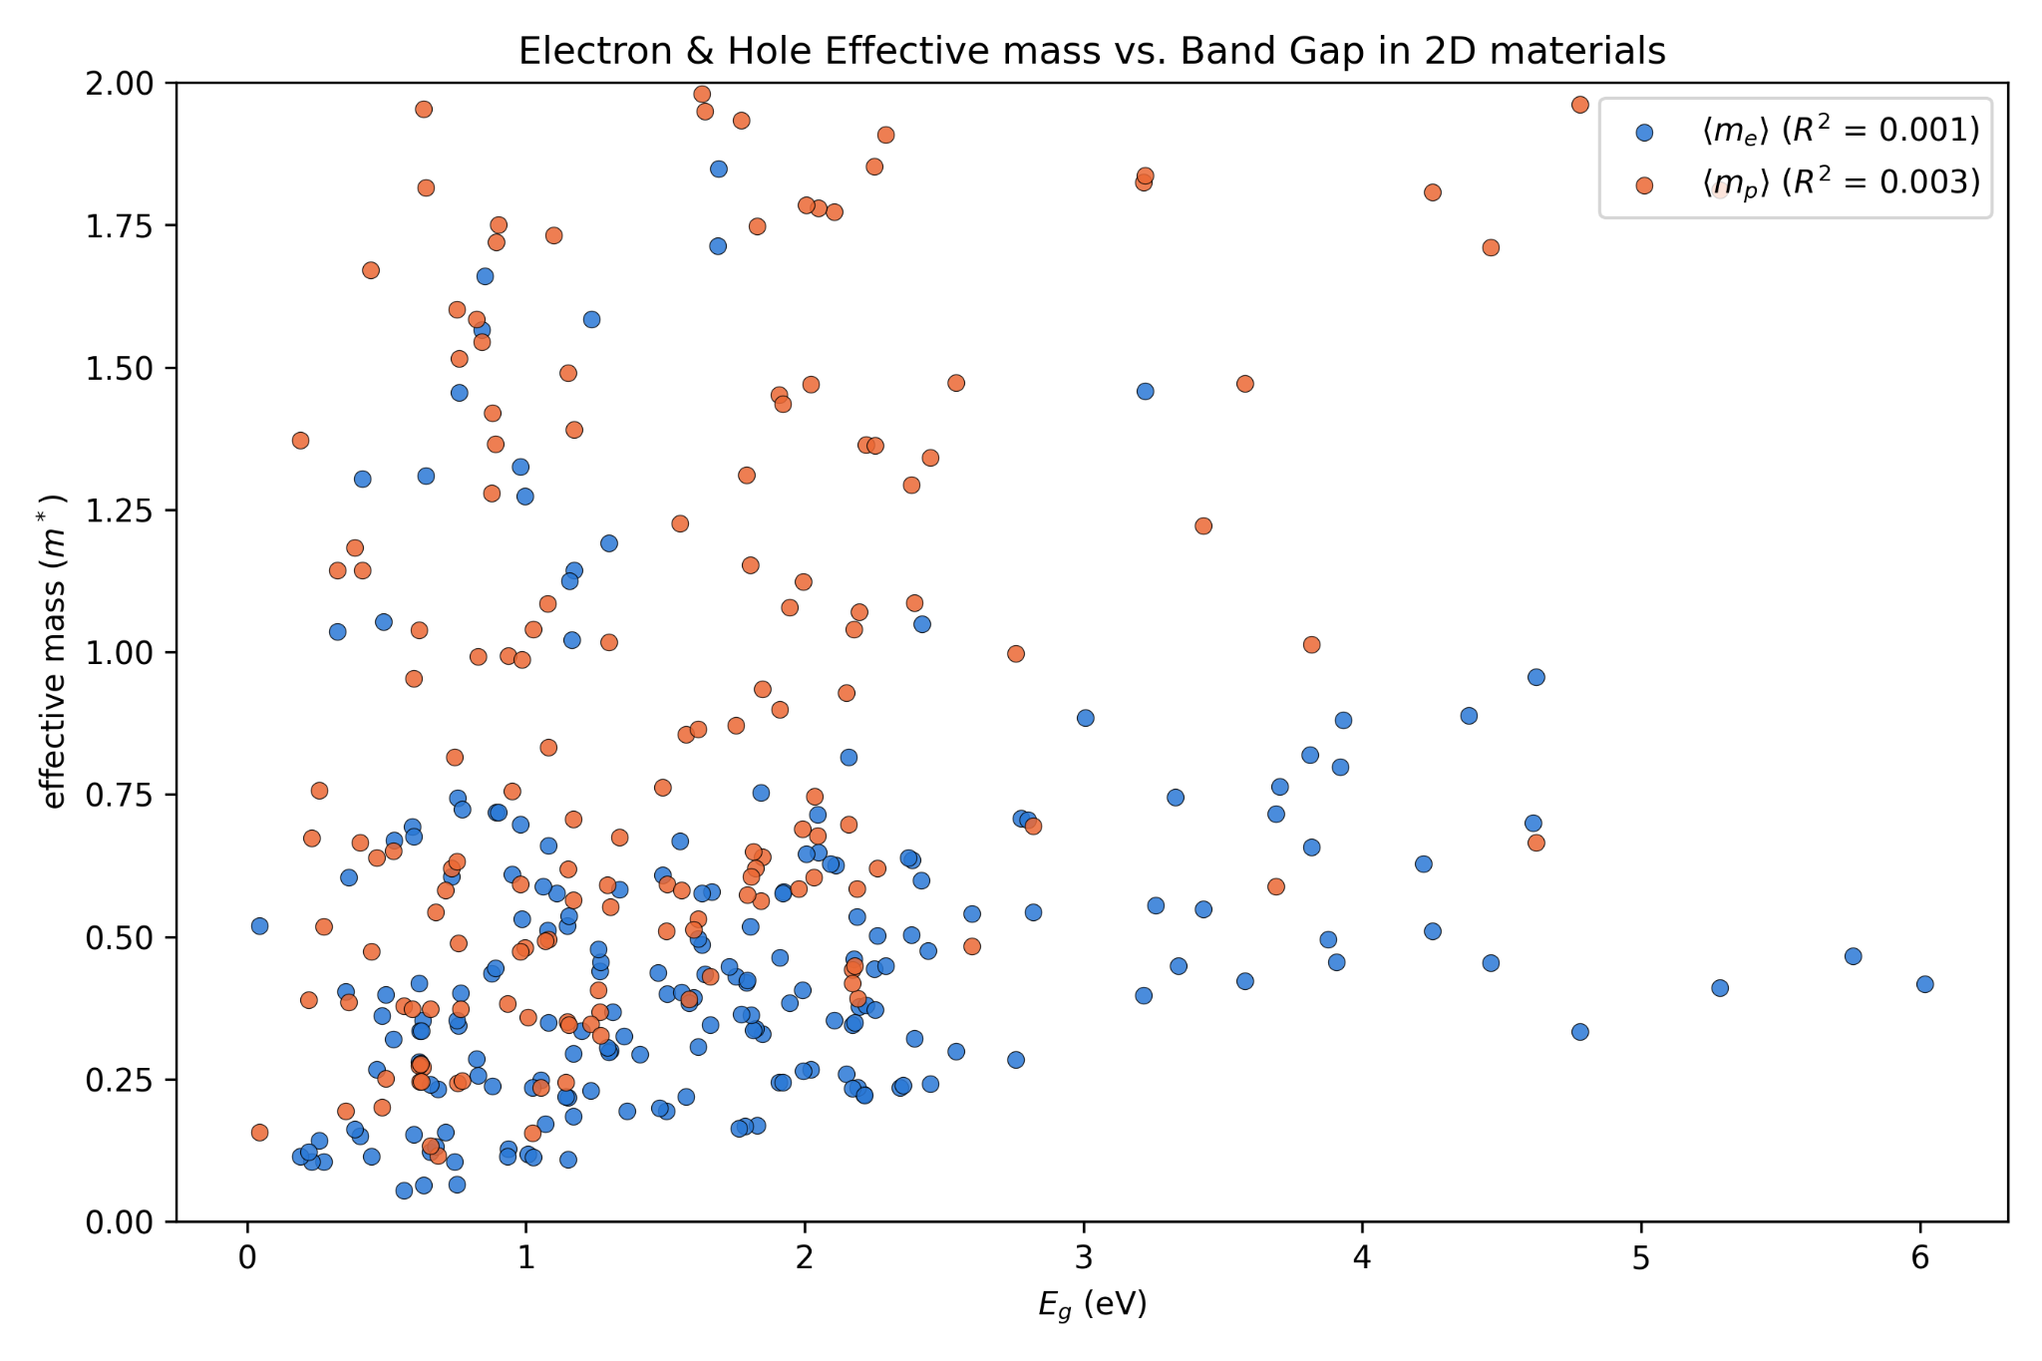
Correlation Between Band Gap and Effective Mass
Data distribution of effective mass vs. band gap
Scatter plot + Histogram visualization
Result: R²=0.1% for m_{e} (=0.3% for m_{p}) → Correlation weak → Largely independent
Notes:
Make sure to mention: Significance of results

Slide 6
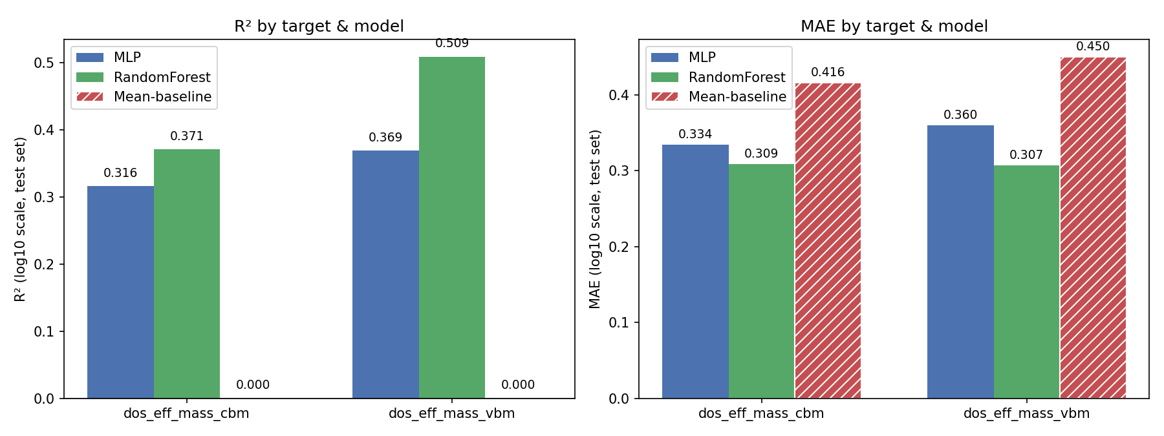
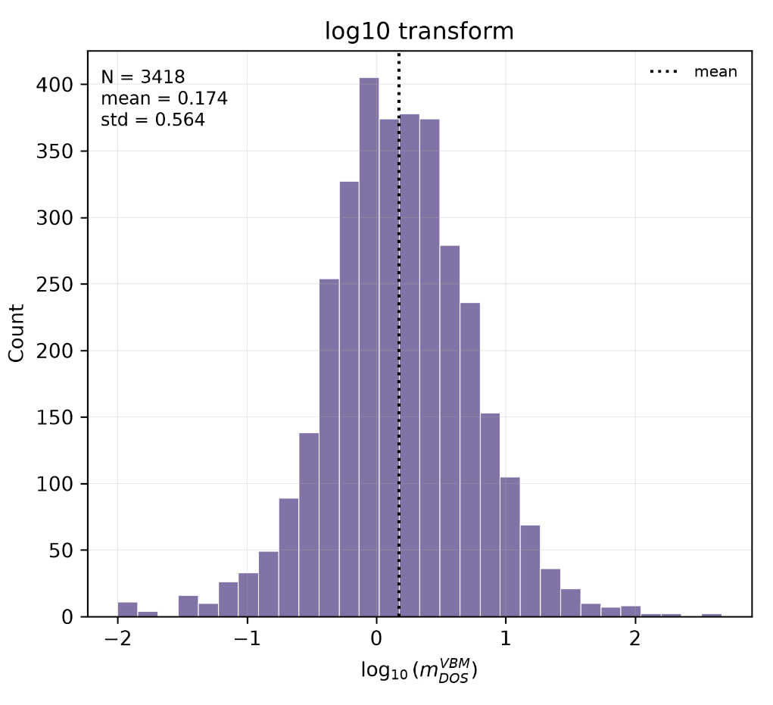
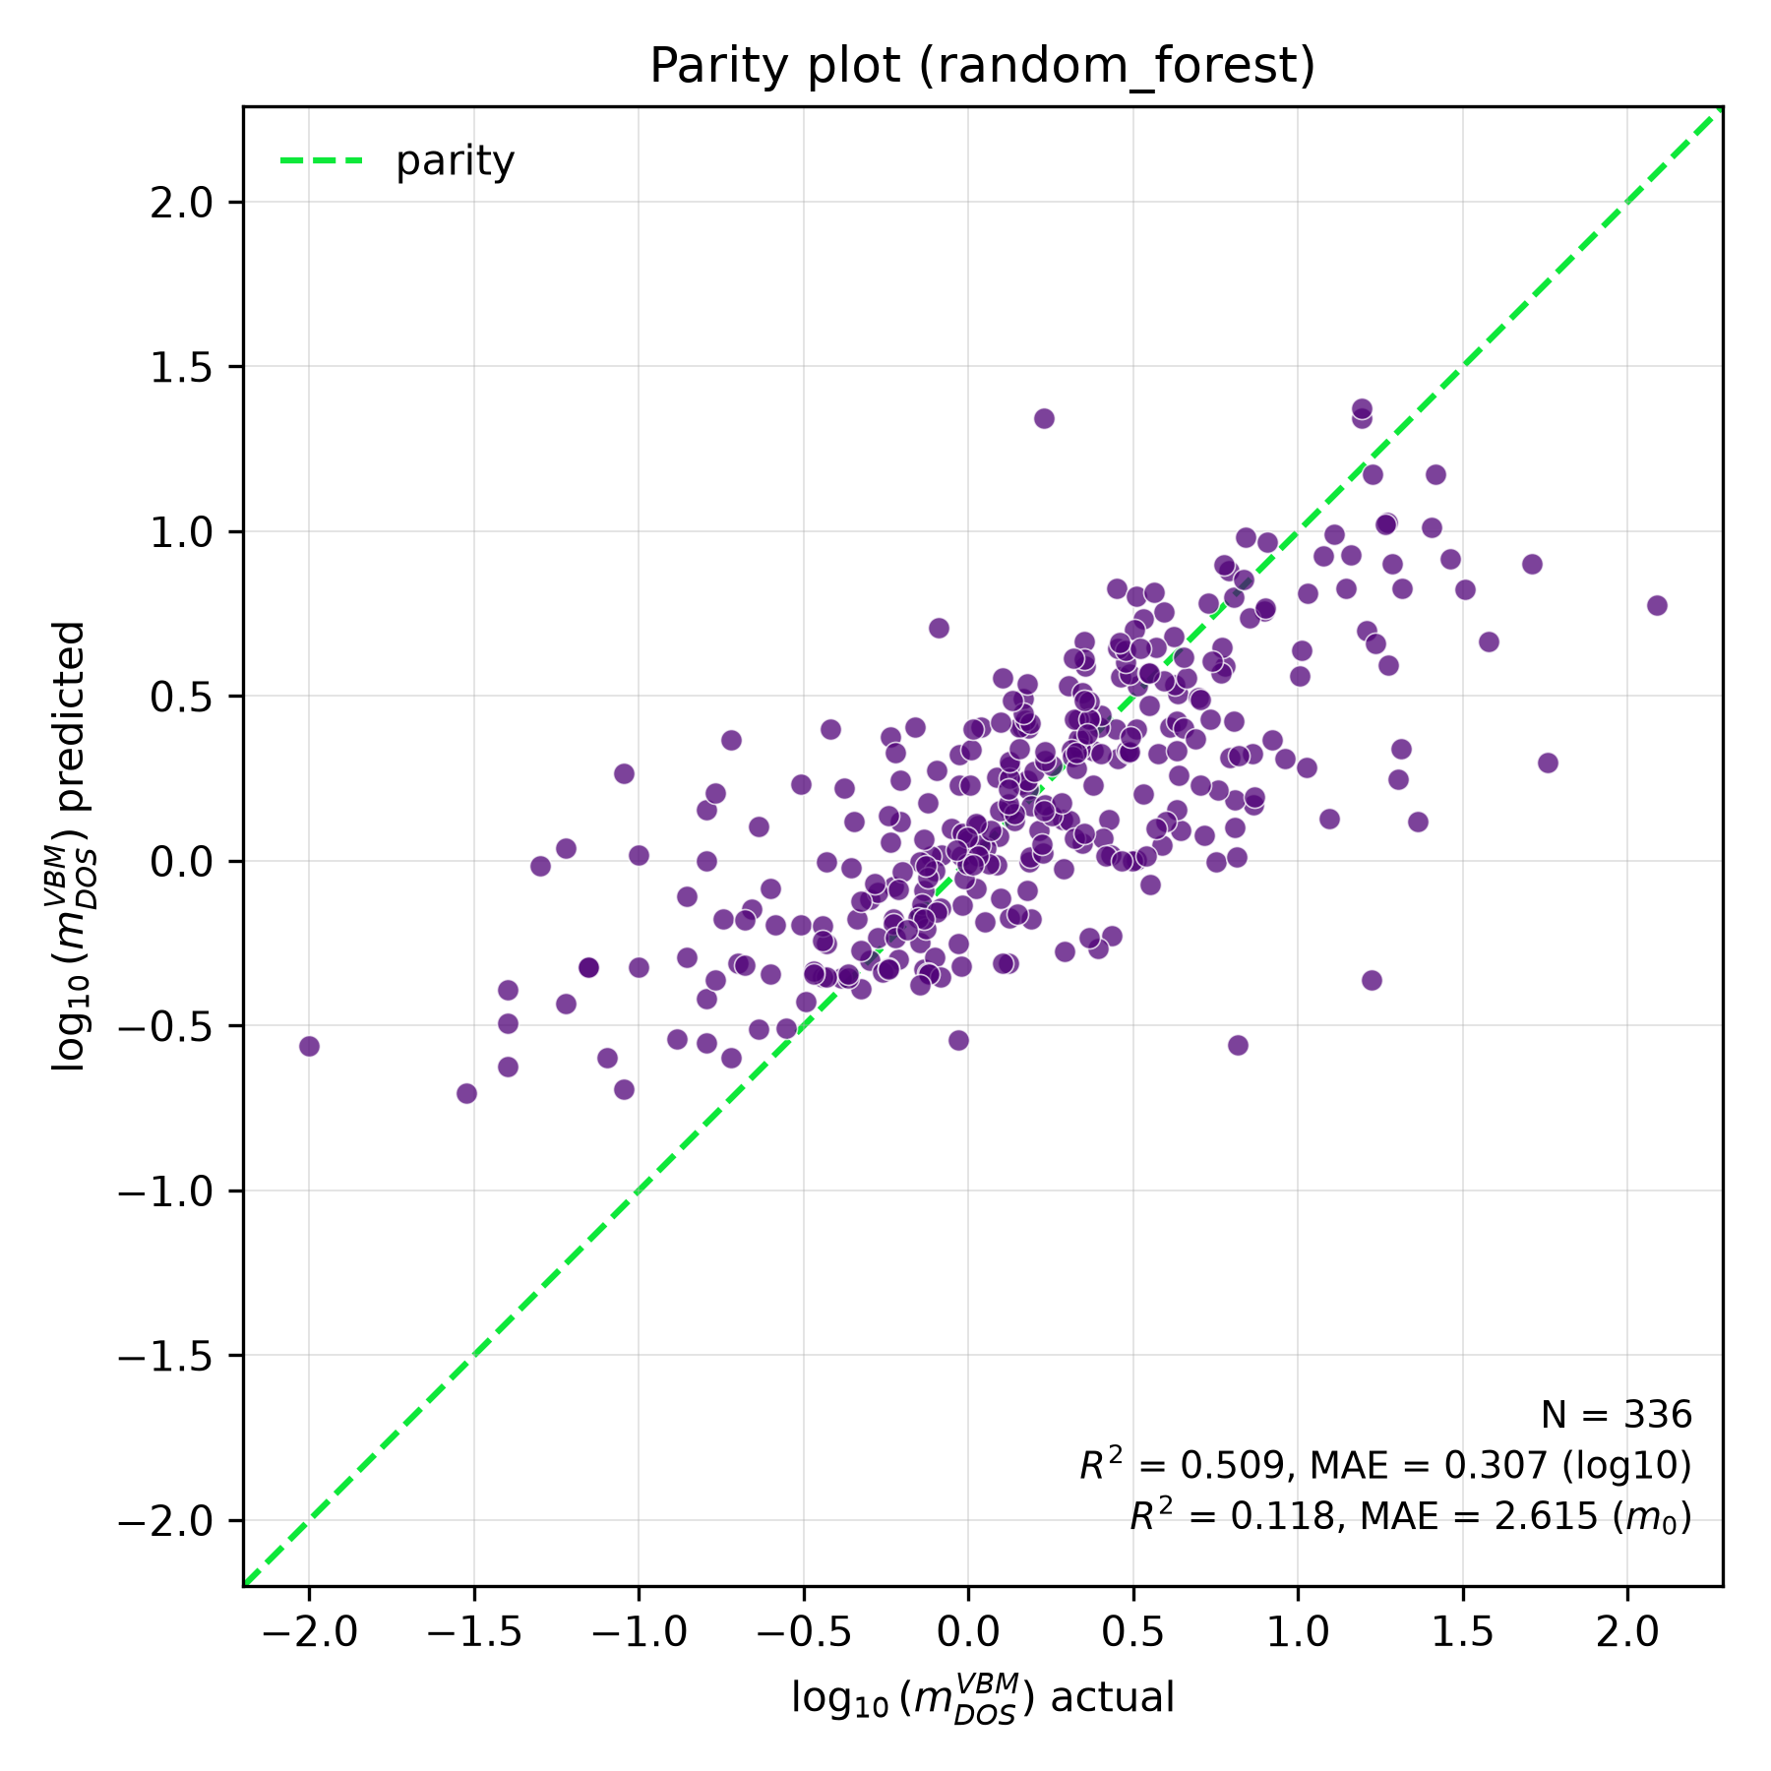
Machine Learning Model of Electron and Hole Effective Masses
Dataset is split:
  90% was used to train the model to compare the true value of the test set
  10% of the data was left as a test data set for checking model performance
Models trained: Random forest and Neural Network (MLP)
with an elemental featurizer (MagPie) is utilized
Comparison of R2 and Mean Absolute Error (MAE) performance metrics for the test set.
+ Parity plots and error histograms shown for hole effective masses (random forest)
Results:
Random forest better; hole effective mass better predicted; overall model performance is average
Notes:
Make sure to mention: Significance of results

Slide 7
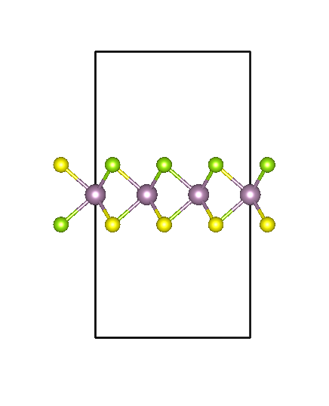
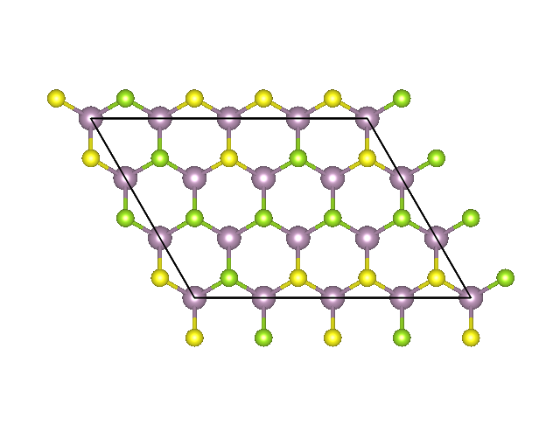
Apply ML Models to Design Semiconductor Alloy
Using the trained ML models, our goal was to design an optimal semiconductor alloy for transistor devices
We picked an ideal 2D crystal as a test:
MoS_{2(1-y)}Se_{2y} where y is the Se alloying concentration
Notes:
Make sure to mention:
We picked MoSSe because MoS2 and MoSe2 are extensively studied semiconductor compounds, and we could replace some Sulfur with Selenium to create the optimal alloy

Slide 8
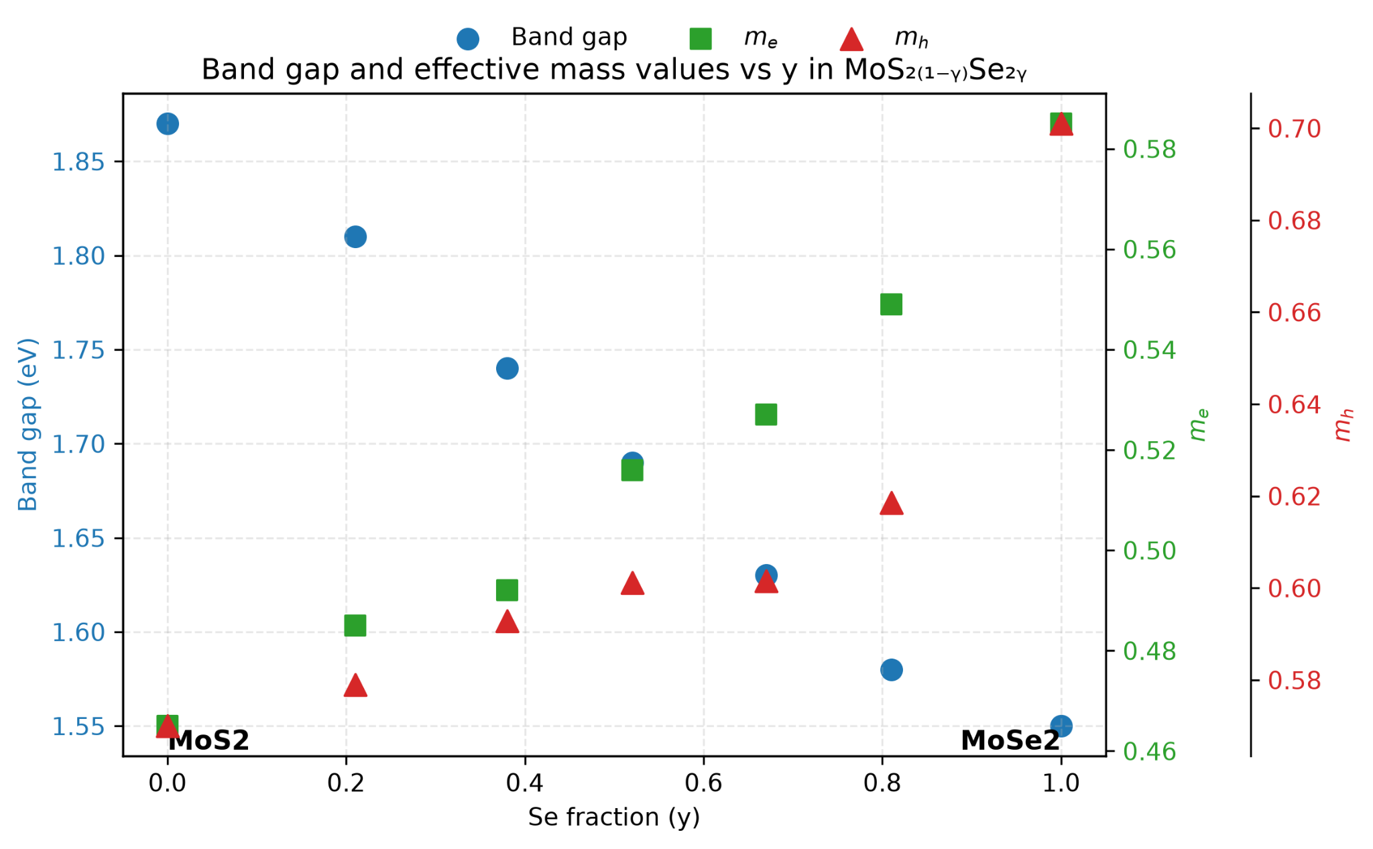
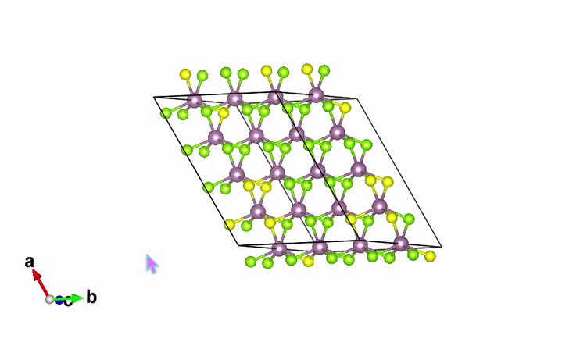
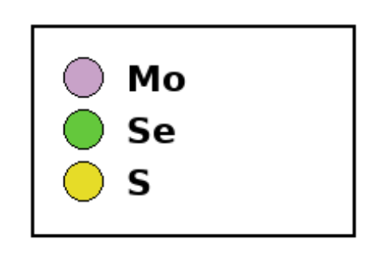

Final Result of Designed Alloy
Machine learning predicted effective masses and band gap for varying compositions y
Pick optimal composition as a trade-off between low band gap and low effective mass
Final candidate: MoSSe (y=0.5)
Notes:
Make sure to mention:

Slide 9
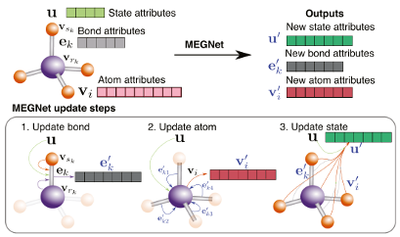
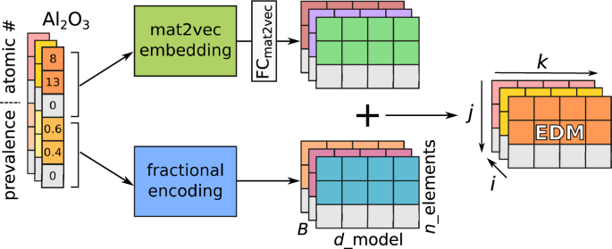
Future Work
Transfer this machine learning approach (e.g., in CrabNet) by training on other large materials databases
Input whole crystal structures into the ML model instead of only relying on material composition (e.g., Graph Neural Network like MEGNet)
Expand our framework into different types of properties (e.g., underrepresented material properties)
CrabNet
MEGNet
npj Comput Mater 7, 77 (2021)
Chem. Mater. (2019) 31 (9): 3564–3572.
Notes:
Make sure to mention:

Slide 10
Acknowledgements
D2R2 Group
Prof. Peter Schindler, Principal Investigator
Dr. Emad Rezaei, Postdoctoral Researcher
Ardavan Mehdizadeh, PhD Student
Center for STEM Education​
Claire Duggan, Executive Director
Jennifer Love, Associate Director
Ahmed Othman, Kenneth Santizo, Frances Corcell, YSP Coordinators​
Nicolas Fuchs, Program Manager
Mary Howley, Administrative Officer
Notes:
Make sure to mention:

Slide 11
