Slide 1







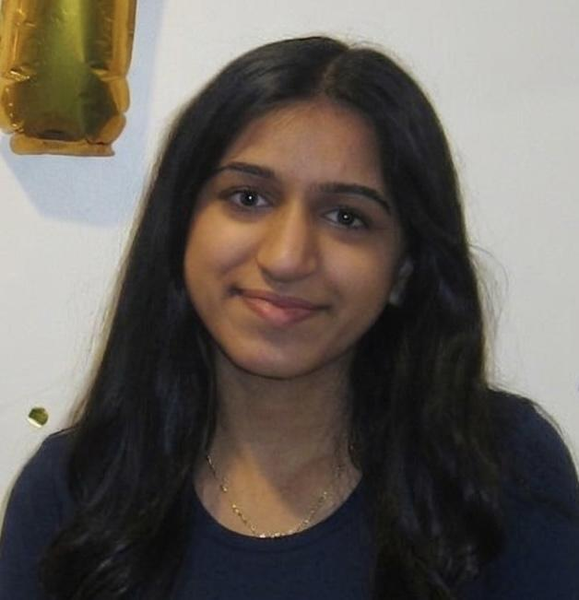



Comparison of Motion in Chiari Type I Malformation Patients​ Versus
Healthy Controls
Henry Mai, YSP Student, Revere High School
Nymisha Goli, YSP Student, Acton-Boxborough Regional High School
Hannah Higgins, PhD Student, Northeastern University​​
Dr. Francis Loth, Department of Bioengineering, Department of Mechanical and Industrial Engineering, Northeastern University​​
Notes:
Henry introduction
Nymisha introduction + title
Nymisha odd

Slide 2

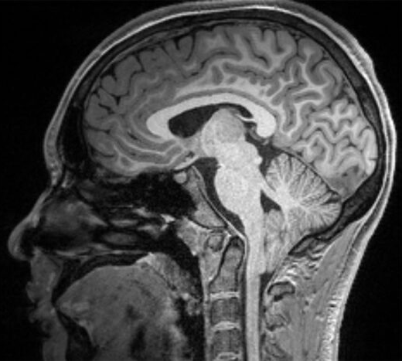
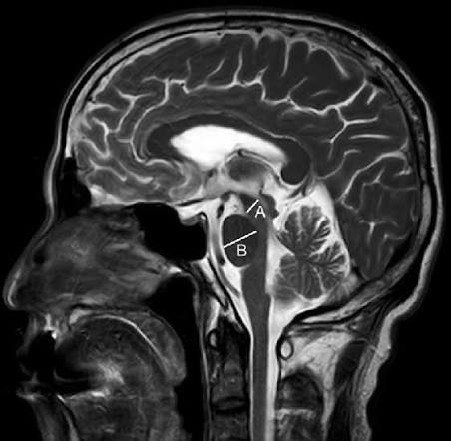

Chiari Neurobiomechanics Research Laboratory
Chiari Neurobiomechanics Research Laboratory
AMSIC Research Lab
The Problem
Chiari Type 1 Malformation: cerebrospinal fluid (CSF) disorder
  Affects 1 in 1200
  Cerebellar tonsils descend ≥ 5 mm
  Restricts CSF flow
Symptoms
  Valsalva-induced occipital headaches
  Balance issues
  Brainstem/cranial nerve issues
WashU Pediatric Neurosurgery
Xu et al. (2017)
Comparison of Motion in Chiari Type I Malformation Patients​
Slide 2/16 - NEU Young Scholars Program 2026 - July 30, 2026
Notes:
Henry even
Valsalva -> breathing technique where you exhale forcefully against a closed airway
if asked -> the headaches are caused by coughing/sneezing/straining
if asked -> midbrain is line A and pons is line B

Slide 3
Chiari Neurobiomechanics Research Laboratory
Chiari Neurobiomechanics Research Laboratory
AMSIC Research Lab
Research Goals
Current research hasn’t deeply explored differences in CSF velocity and acceleration timing changes in Chiari patients
  A lack of metrics for surgical outcomes and non-invasive treatment methods
Our Goal:
  Identifying differences in tissue and CSF motion between Chiari patients and healthy controls
  Use MATLAB to graph and analyze MRI data of patients to display differences in velocity and acceleration of the two groups
Comparison of Motion in Chiari Type I Malformation Patients​
Slide 3/16 - NEU Young Scholars Program 2026 - July 30, 2026

Slide 4
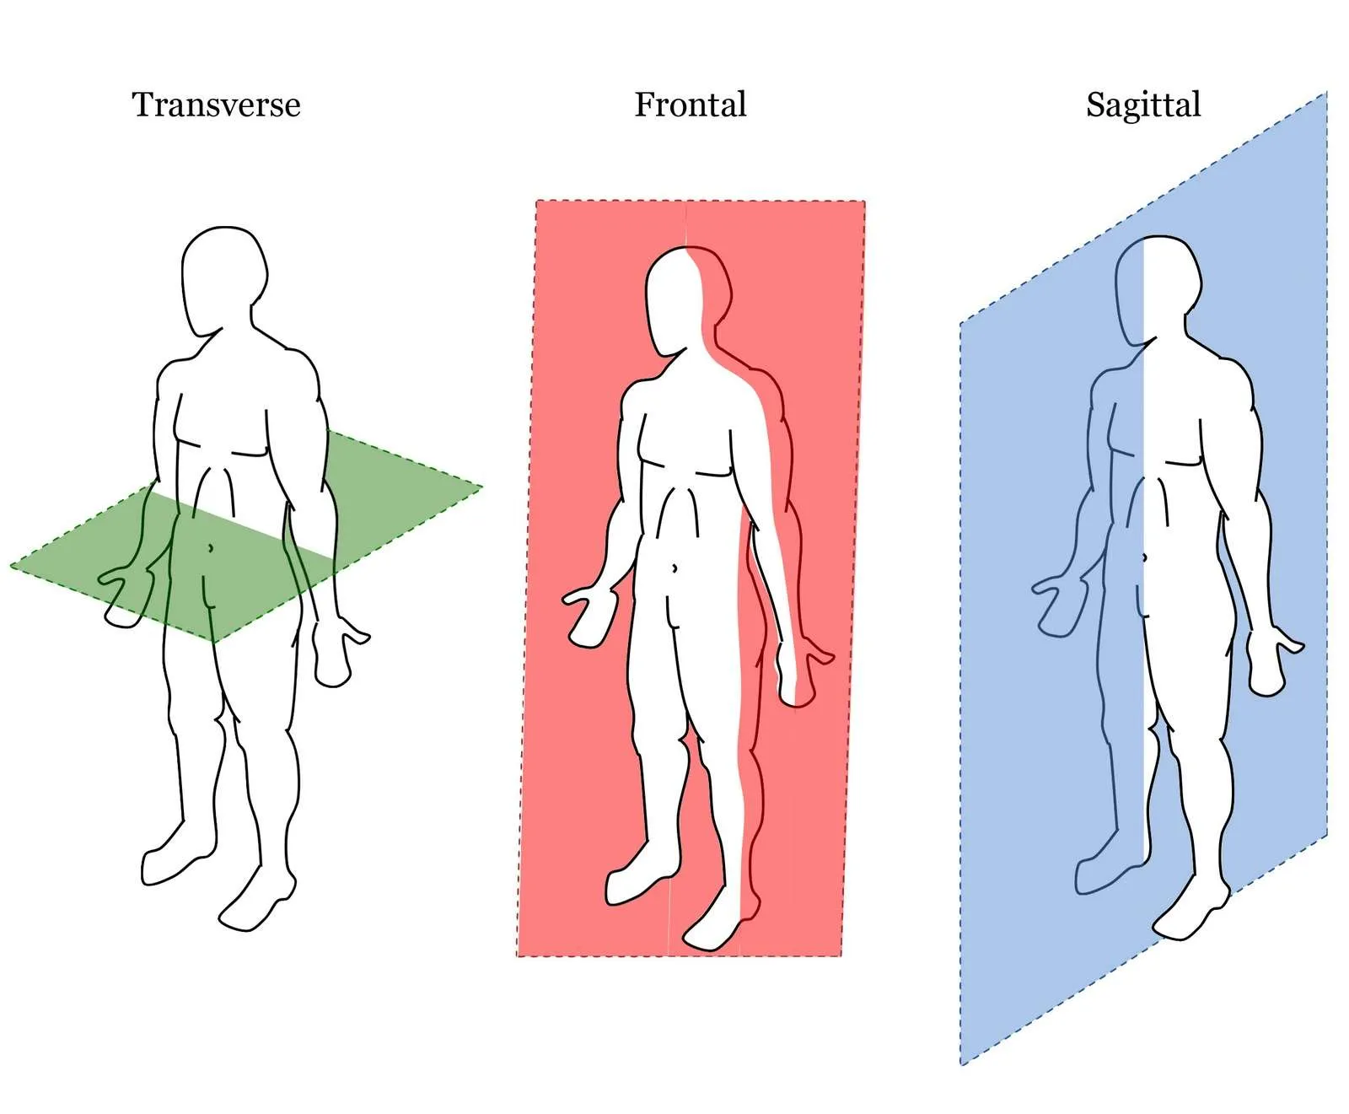
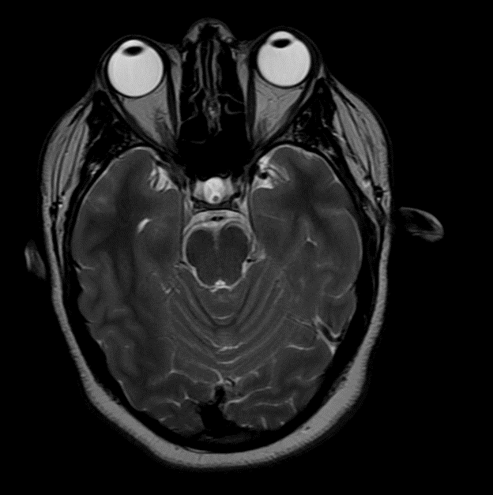
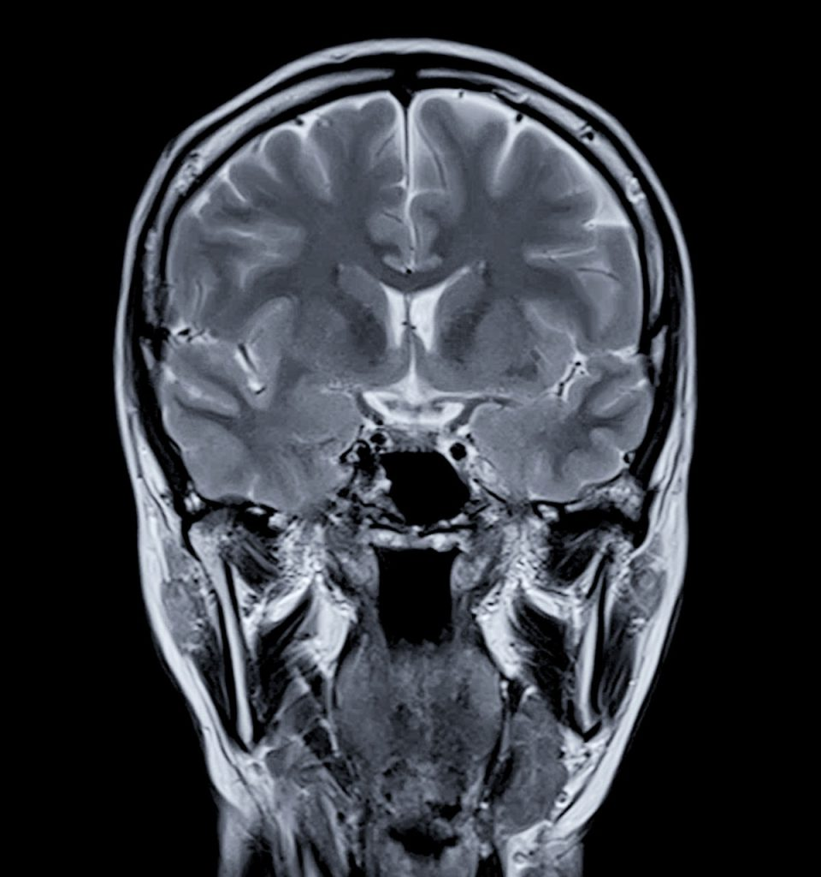
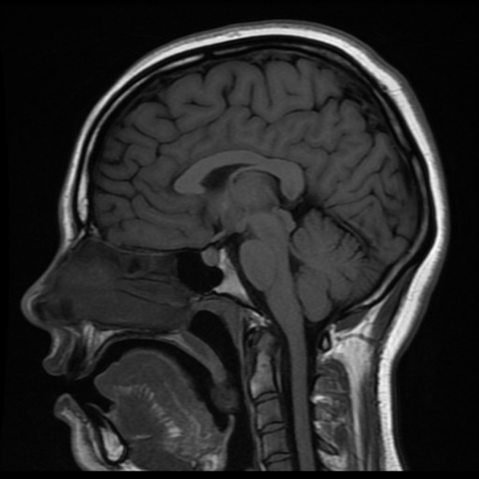
Chiari Neurobiomechanics Research Laboratory
Chiari Neurobiomechanics Research Laboratory
AMSIC Research Lab
Types of Body Planes
Axial Coronal Sagittal
Physique Development, n.d.
(Greater Waterbury Imaging Center, n.d.)
(Boulder MRI, n.d.)
Hattingh (2026)
Comparison of Motion in Chiari Type I Malformation Patients​
Slide 4/16 - NEU Young Scholars Program 2026 - July 30, 2026
Notes:
https://physiquedevelopment.com/planes-of-motion-sagittal-frontal-transverse/
https://greaterwaterburyimagingcenter.org/portfolio/mr-head-and-orbits-with-and-without-iv-contrast/
https://bouldermri.com/brain-mri/
https://radiopaedia.org/articles/sagittal-midline-of-the-brain-an-approach-1

Slide 5
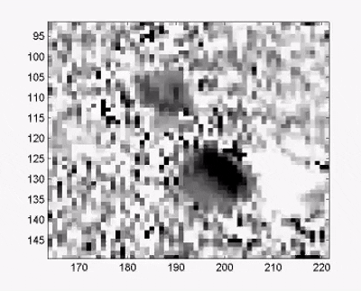
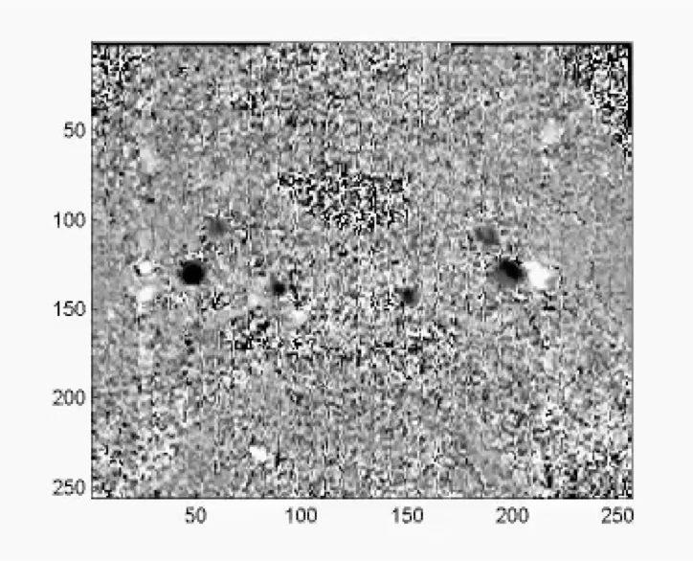
Chiari Neurobiomechanics Research Laboratory
Chiari Neurobiomechanics Research Laboratory
AMSIC Research Lab
Phase Contrast - MRIs
Previous Loth Lecture
Previous Loth Lecture
Comparison of Motion in Chiari Type I Malformation Patients​
Slide 5/16 - NEU Young Scholars Program 2026 - July 30, 2026
Notes:
black -> up -> artery
Standard MRI → captures still images
PC-MRI → moving scan to measure fluid
Uses magnetic pulses to track the motion of hydrogen protons in fluid and tissue
Flowing fluid appears white in one direction and black in the other
the velocity of voxels (3d pixel) is captured
Take 25 frames over one cardiac cycle to create a video-like scan
Velocity encoding
Fluid appears white flowing one way, black the other
Direction + brightness = velocity data

Slide 6
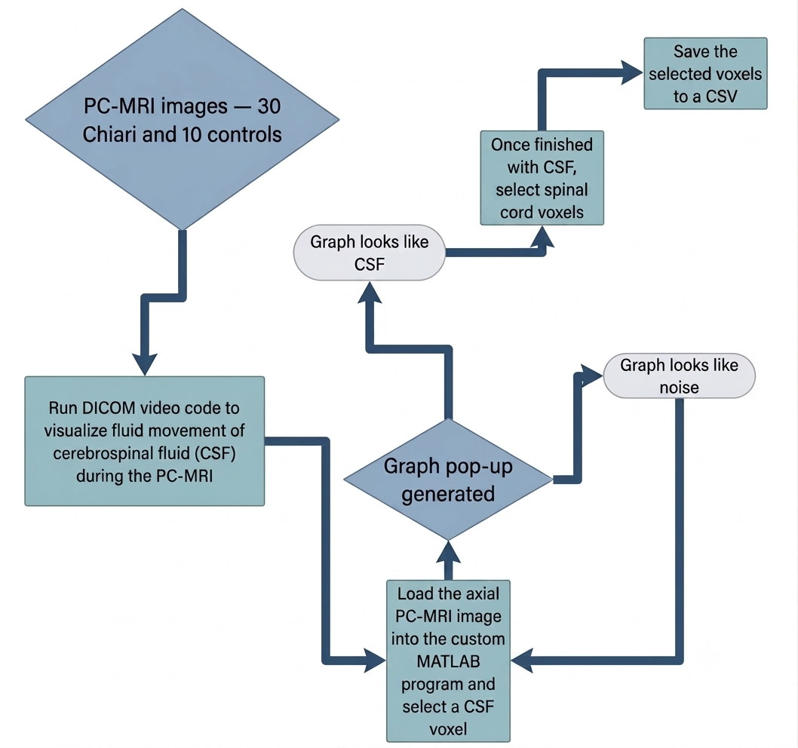
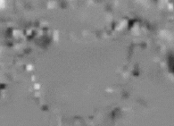
Chiari Neurobiomechanics Research Laboratory
Chiari Neurobiomechanics Research Laboratory
AMSIC Research Lab
Data Collection Process
Selected Voxel
Comparison of Motion in Chiari Type I Malformation Patients​
Slide 6/16 - NEU Young Scholars Program 2026 - July 30, 2026
Notes:
Collect, find highest resolution image, select regions of interest to save more on that in the next slide
https://lucid.app/lucidchart/9b534097-c6c3-47e0-8299-ed22ec54d804/edit?invitationId=inv_d4fdc298-6875-48c1-882c-9cf490e98929&page=0_0#

Slide 7
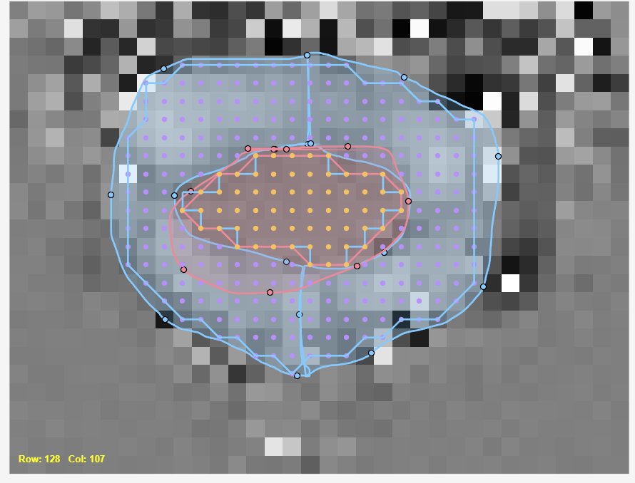
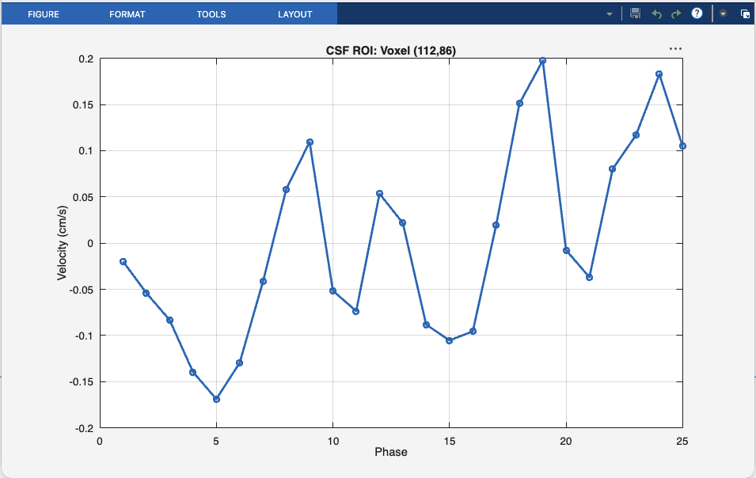
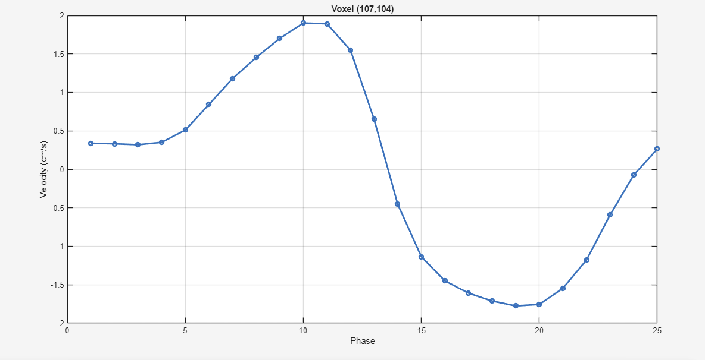
Chiari Neurobiomechanics Research Laboratory
Chiari Neurobiomechanics Research Laboratory
AMSIC Research Lab
Data Collection
Used MATLAB to code programs allowing for bulk and individual voxel selection
Exported data of CSF and spinal cord voxels to Excel and CSV files
Noise
CSF
Comparison of Motion in Chiari Type I Malformation Patients​
Slide 7/16 - NEU Young Scholars Program 2026 - July 30, 2026
Notes:
MATLAB processes and obtains data from patient PC-MRI scan in the axial plane​
Custom program allows for bulk and voxel-by-voxel selection with pop-up velocity vs phase graph to confirm whether it is cerebral spinal fluid, spinal cord, or unwanted noise​
Excel and CSV stores exported region of interest data with patient ID attached​
Voxel coordinates and within each selected voxel, there are 25 velocities over 25 phases (pictures of patient) over a cardiac cycle​

Slide 8
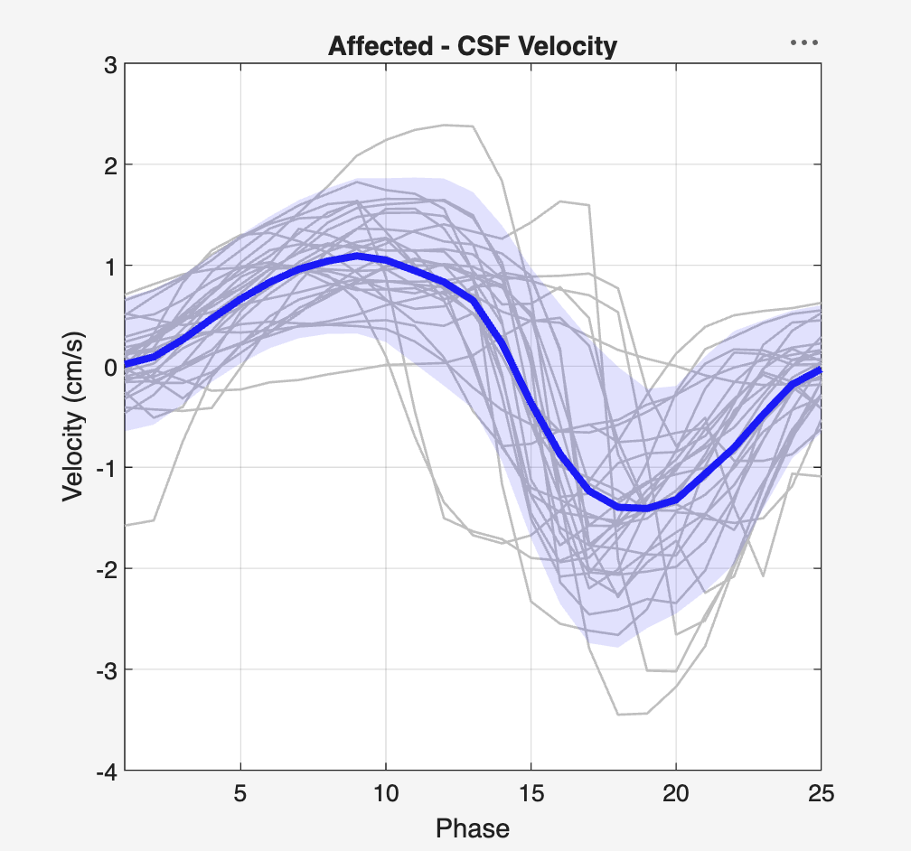
Chiari Neurobiomechanics Research Laboratory
AMSIC Research Lab
Graphing Data
Gray lines: Each Chiari patient’s mean CSF velocity curve (averaged across voxels)
Thick line: Population mean velocity (all voxels pooled across all patients)
Shaded region: standard deviations across all pooled voxels
Comparison of Motion in Chiari Type I Malformation Patients​
Slide 8/16 - NEU Young Scholars Program 2026 - July 30, 2026

Slide 9
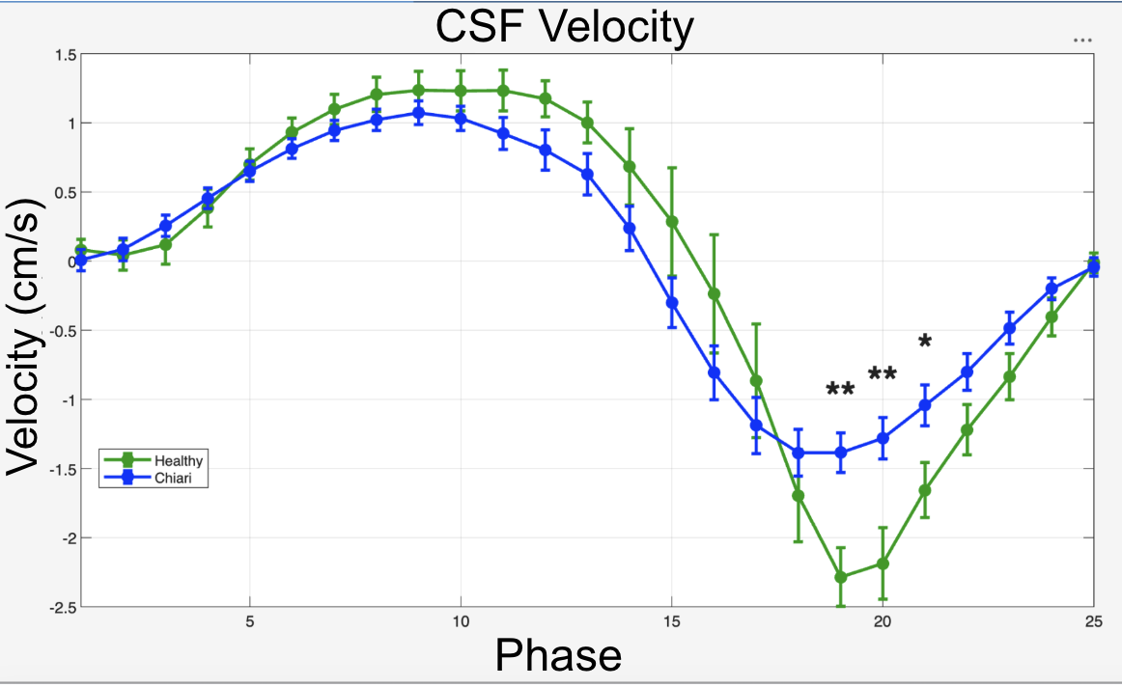
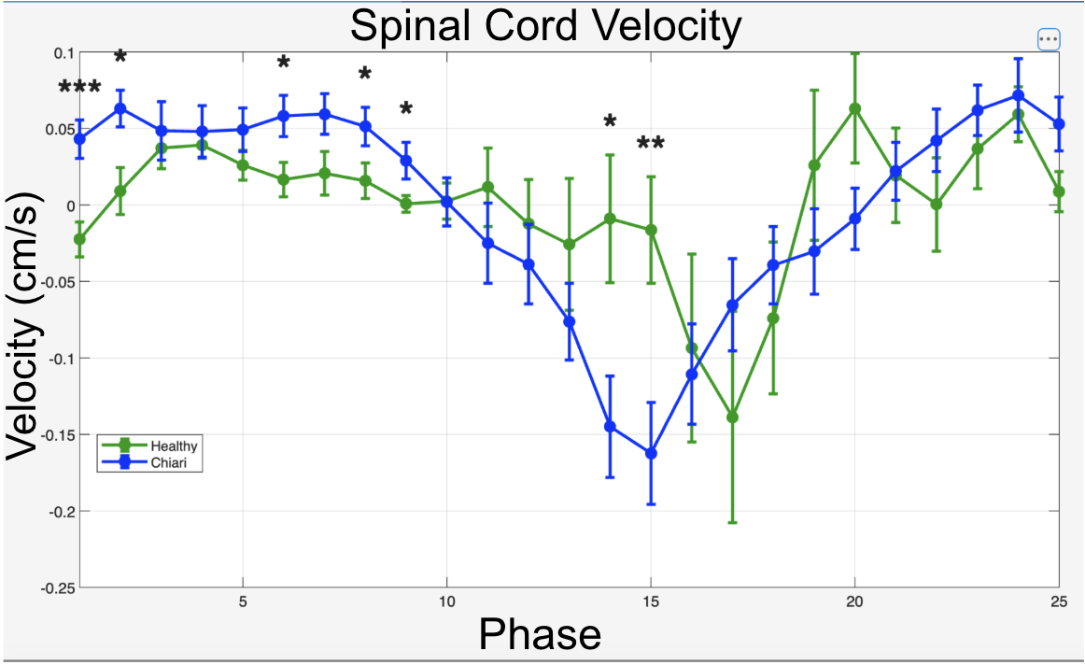
Chiari Neurobiomechanics Research Laboratory
Chiari Neurobiomechanics Research Laboratory
AMSIC Research Lab
AMSIC Research Lab
Two-Sample T-Test
Statistical analysis of two populations
Determines if the means of two independent groups are significantly different
  Due to randomness or study group
Comparison of Motion in Chiari Type I Malformation Patients​
Slide 9/16 - NEU Young Scholars Program 2026 - July 30, 2026
Notes:
1 star p<0.05
2 stars p<0.01
3 stars p<0.001

Slide 10
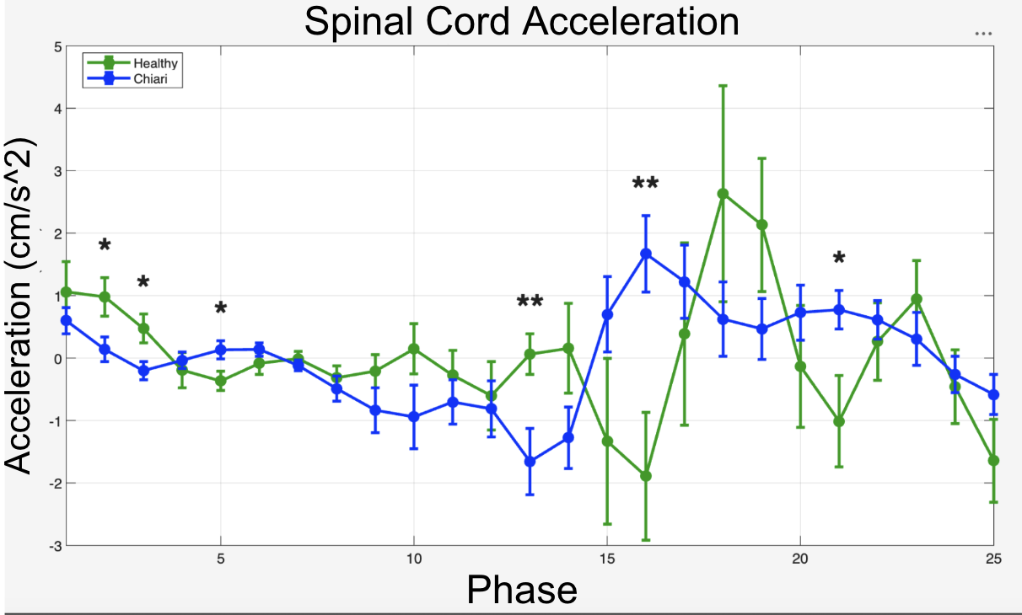
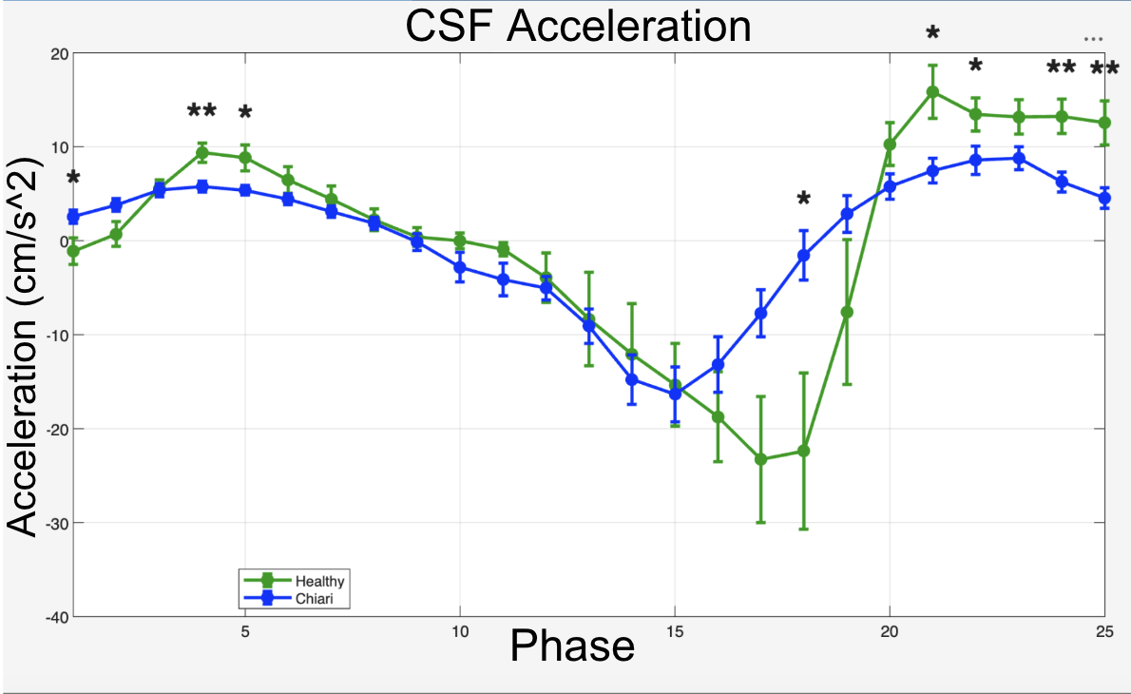
Chiari Neurobiomechanics Research Laboratory
Chiari Neurobiomechanics Research Laboratory
AMSIC Research Lab
AMSIC Research Lab
Two-Sample T-Test for Acceleration
Comparison of Motion in Chiari Type I Malformation Patients​
Slide 10/16 - NEU Young Scholars Program 2026 - July 30, 2026
Notes:
1 star p<0.05
2 stars p<0.01
3 stars p<0.001

Slide 11
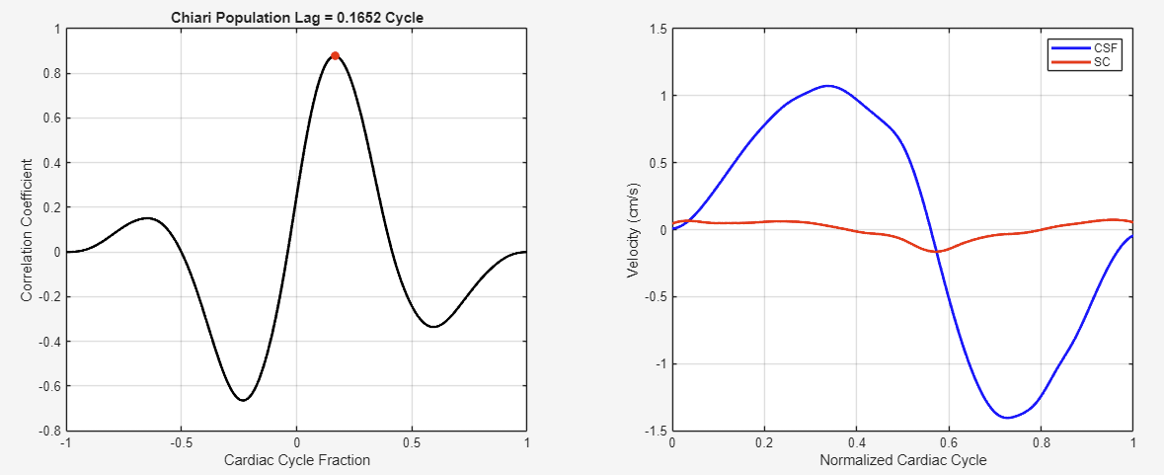
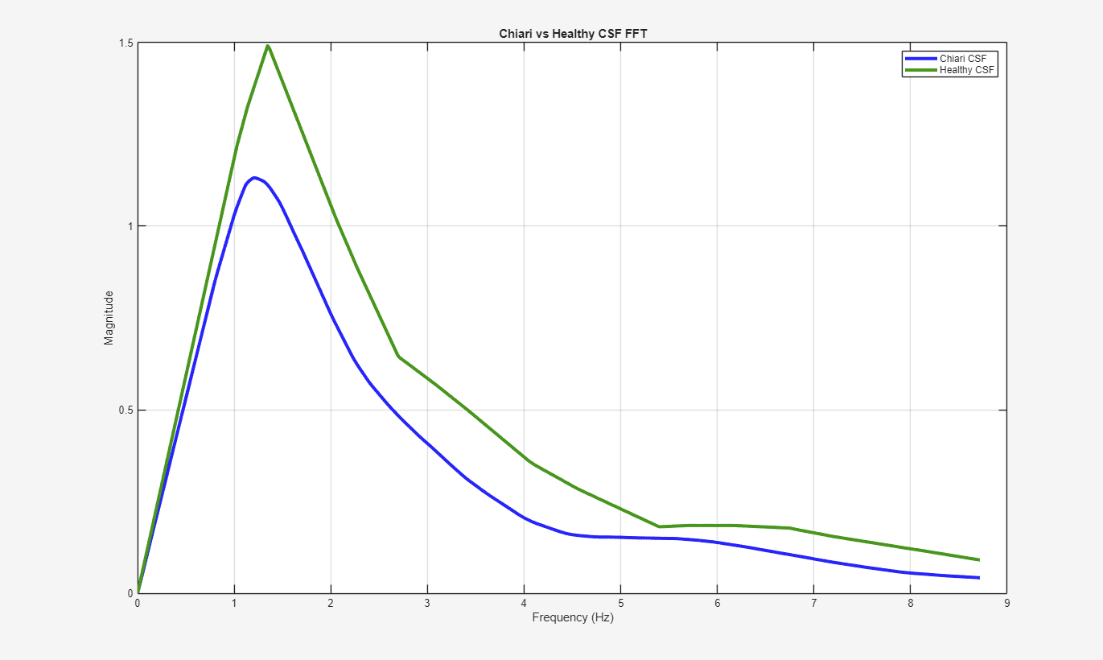
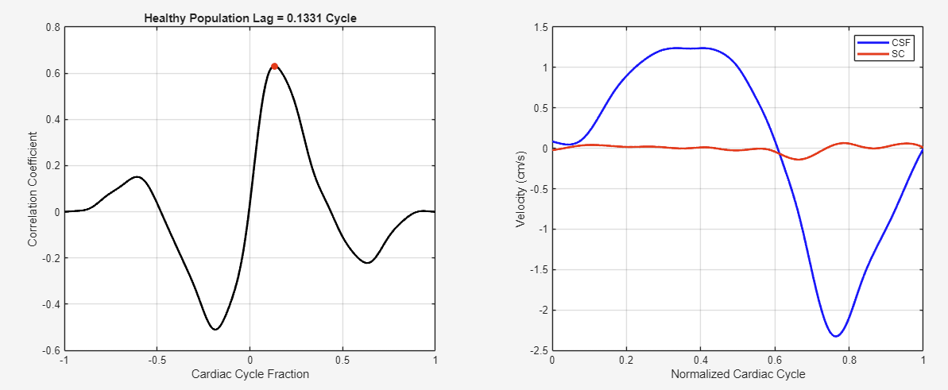
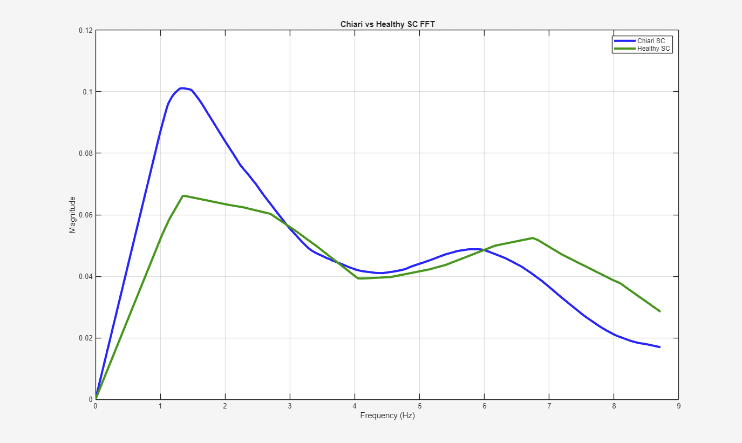
Chiari Neurobiomechanics Research Laboratory
Chiari Neurobiomechanics Research Laboratory
AMSIC Research Lab
AMSIC Research Lab
Cross Correlation
Fast Fourier Transform
Comparison of Motion in Chiari Type I Malformation Patients​
Slide 11/16 - NEU Young Scholars Program 2026 - July 30, 2026
Notes:
These are secondary algorithms used to find differences between Chiari and unaffected subjects.
In short, Cross correlation is a method of finding how well two graphs compare changing their timings
FFT breaks down graphs into its frequency components and tells you which frequencies are present and how strong they present themselves like breaking sound into its different notes

Slide 12
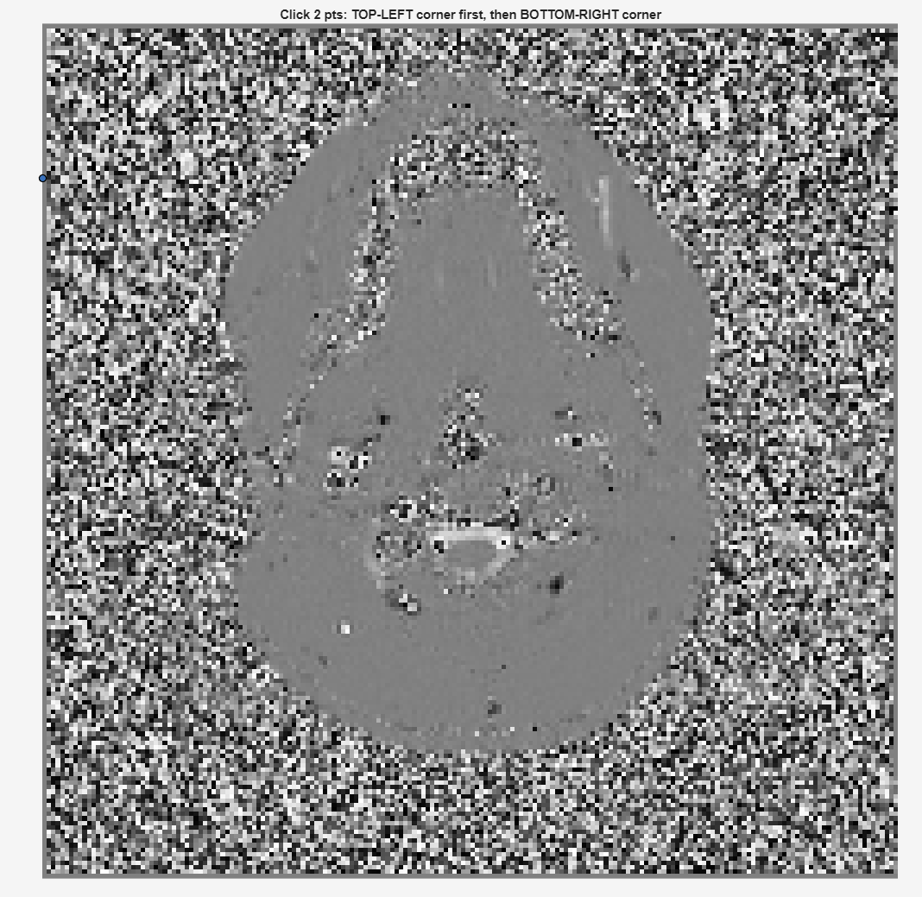
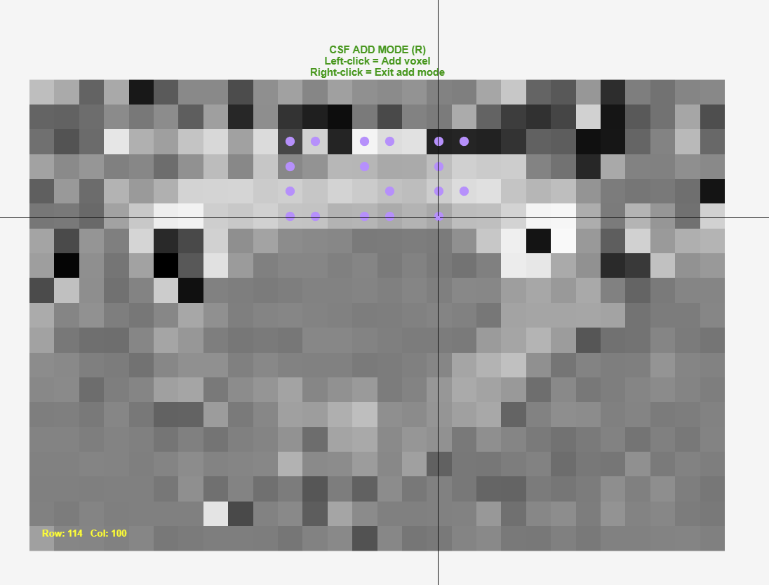
Chiari Neurobiomechanics Research Laboratory
Chiari Neurobiomechanics Research Laboratory
AMSIC Research Lab
AMSIC Research Lab
Conclusion
Conclusion
We found significant differences around the downward peaks of velocity for the CSF
We were able to collect and analyze data, adding to small number of existing velocity waveform analyses of Chiari Type I Malformation
Created a streamlined software for the lab to use in further research
Our research helps identify a potential biomarker for identifying symptomatology in Chiari patients
Comparison of Motion in Chiari Type I Malformation Patients​
Slide 12/16 - NEU Young Scholars Program 2026 - July 30, 2026
Notes:
Nymisha

Slide 13
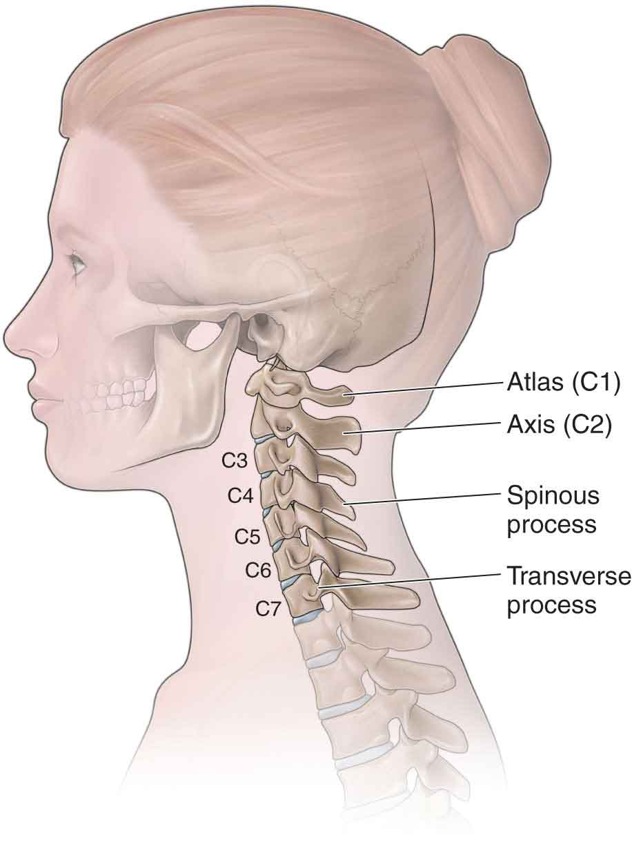
Chiari Neurobiomechanics Research Laboratory
Chiari Neurobiomechanics Research Laboratory
AMSIC Research Lab
AMSIC Research Lab
Next Steps
Redo at different spinal landmarks
Create new tools and algorithms to eliminate distorted data or noise distorted data
Compare subpopulations such as males vs females or pre-surgery vs post-surgery
The Cervical Spine | Musculoskeletal Key
Comparison of Motion in Chiari Type I Malformation Patients​
Slide 13/16 - NEU Young Scholars Program 2026 - July 30, 2026
Notes:
Henry

Slide 14
Chiari Neurobiomechanics Research Laboratory
Chiari Neurobiomechanics Research Laboratory
AMSIC Research Lab
AMSIC Research Lab
References
The Cervical Spine | Musculoskeletal Key. (n.d.). https://musculoskeletalkey.com/the-cervical-spine-7/
Clarke, E. C., Stoodley, M. A., & Bilston, L. E. (2013). Changes in temporal flow characteristics of CSF in Chiari malformation Type I with and without syringomyelia: implications for theory of syrinx development. Journal of neurosurgery, 118(5), 1135–1140. https://doi.org/10.3171/2013.2.JNS12759​
​
Eppelheimer, M. S., Nwotchouang, B. S. T., Heidari Pahlavian, S., Barrow, J. W., Barrow, D. L., Amini, R., Allen, P. A., Loth, F., & Oshinski, J. N. (2021). Cerebellar and Brainstem Displacement Measured with DENSE MRI in Chiari Malformation Following Posterior Fossa Decompression Surgery. Radiology, 301(1), 187–194. https://doi.org/10.1148/radiol.2021203036
Labuda, R., Nwotchouang, B. S. T., Ibrahimy, A., Allen, P. A., Oshinski, J. N., Klinge, P., & Loth, F. (2022). A new hypothesis for the pathophysiology of symptomatic adult Chiari malformation Type I. Medical hypotheses, 158, 110740. https://doi.org/10.1016/j.mehy.2021.110740 ​
​
Reynolds, M. (2024). Researchers define new subtypes of common brain disorder | WashU Medicine. In WashU Medicine. https://medicine.washu.edu/news/researchers-define-new-subtypes-of-common-brain-disorder/
Nwotchouang, B. S. T., Eppelheimer, M. S., Bishop, P., Biswas, D., Andronowski, J. M., Bapuraj, J. R., Frim, D., Labuda, R., Amini, R., & Loth, F. (2019). Three-Dimensional CT Morphometric Image Analysis of the Clivus and Sphenoid Sinus in Chiari Malformation Type I. Annals of biomedical engineering, 47(11), 2284–2295. https://doi.org/10.1007/s10439-019-02301-5​
Xu, Z., Lim, T. C. C., Au, W. L., & Tan, L. C. S. (2017). Progressive Supranuclear Gaze Palsy with Predominant Cerebellar Ataxia: A Case Series with Videos. Journal of movement disorders, 10(2), 87–91. https://doi.org/10.14802/jmd.16059
Yildiz, S., Thyagaraj, S., Jin, N., Zhong, X., Heidari Pahlavian, S., Martin, B. A., Loth, F., Oshinski, J., & Sabra, K. G. (2017). Quantifying the influence of respiration and cardiac pulsations on cerebrospinal fluid dynamics using real-time phase-contrast MRI. Journal of magnetic resonance imaging : JMRI, 46(2), 431–439. https://doi.org/10.1002/jmri.25591​
References:
Comparison of Motion in Chiari Type I Malformation Patients​
Slide 14/16 - NEU Young Scholars Program 2026 - July 30, 2026

Slide 15
Chiari Neurobiomechanics Research Laboratory
Chiari Neurobiomechanics Research Laboratory
AMSIC Research Lab
AMSIC Research Lab
Acknowledgements
Chiari Neurobiomechanics Research Laboratory ​
Hannah Higgins, PhD Student, Bioengineering​
Francis Loth, PhD, Prof. of Bioengineering, Prof. of Mechanical and Industrial Engineering​
Center for STEM Education​​
Claire Duggan, Executive Director​
Jennifer Love, Associate Director​
Ahmed Othman & Kenneth Santizo Carbajal & Frances Corcell, YSP Coordinators​​
Nicolas Fuchs, Program Manager​
Mary Howley, Administrative Officer​
Comparison of Motion in Chiari Type I Malformation Patients​
Slide 15/16 - NEU Young Scholars Program 2026 - July 30, 2026

Slide 16
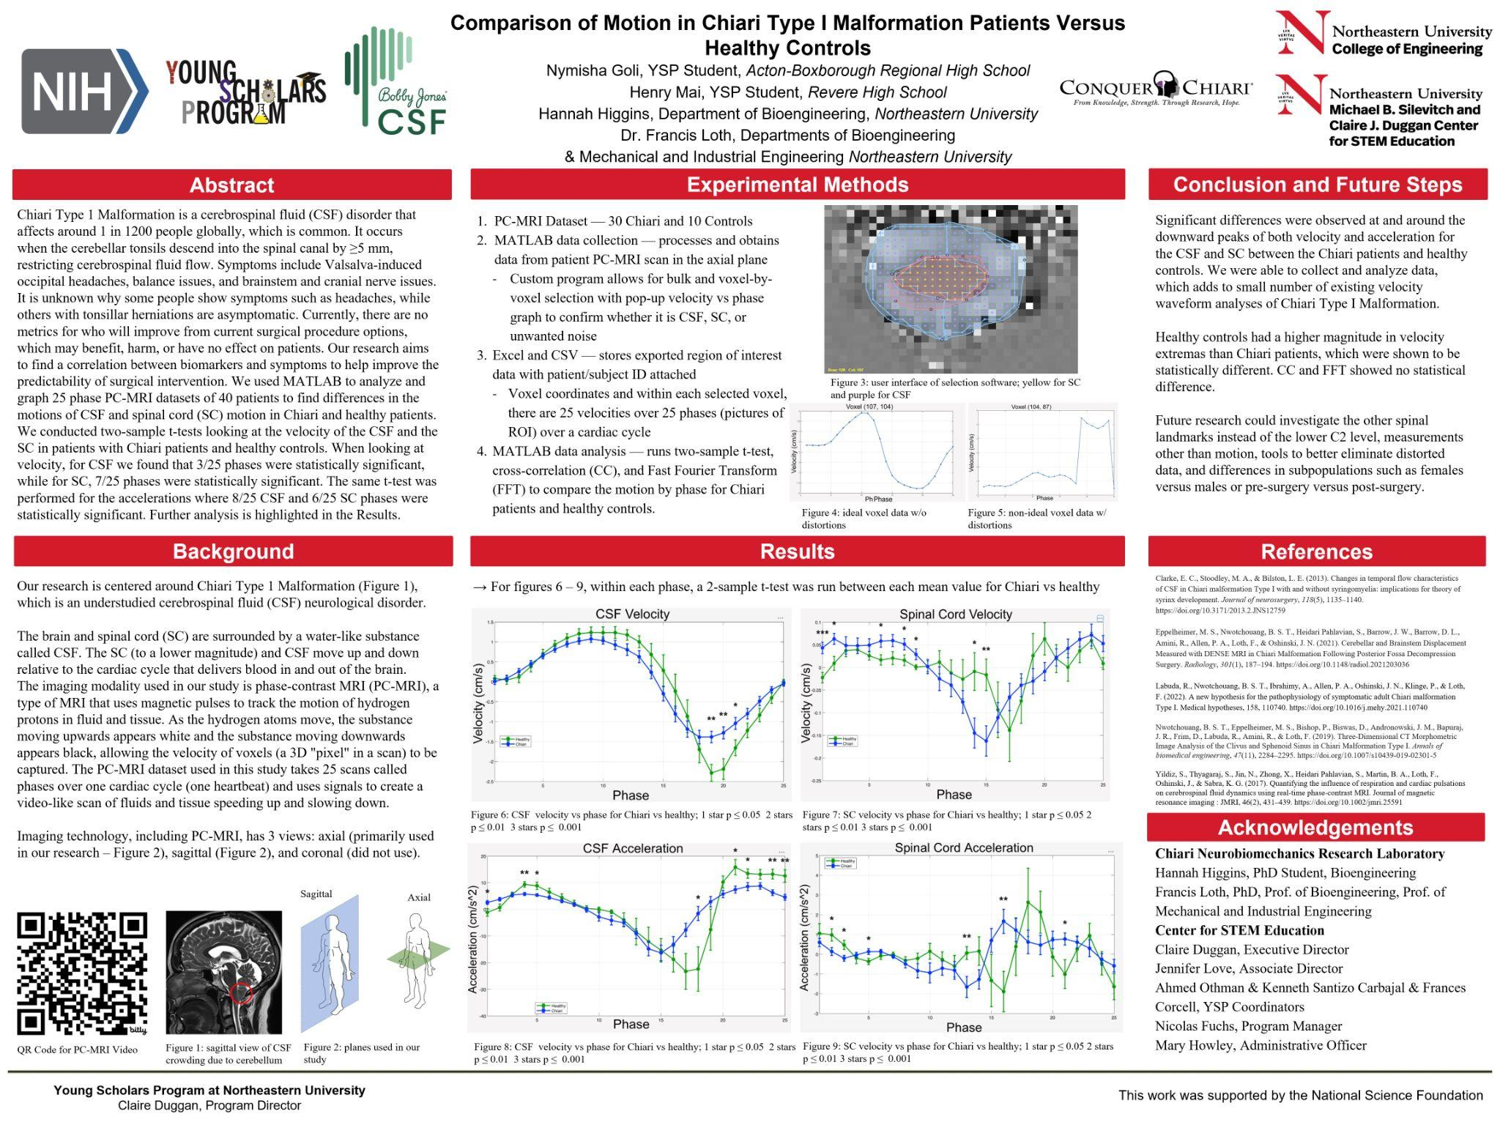
Poster
References:
Comparison of Motion in Chiari Type I Malformation Patients​
Slide 16/16 - NEU Young Scholars Program 2026 - July 30, 2026

