Slide 1



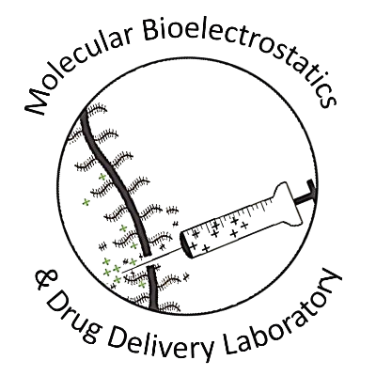








Charge-Based Biomaterials for Targeted Drug Delivery
Tejasvi Kalluri, YSP Student, Fontbonne Academy
Katherine Sola YSP Student, Madison Park Tech. Voc/ High School
Bill Hakim, Molecular Bio-Electrostatics & Drug Delivery, Northeastern University
Helna Mary, Molecular Bio-Electrostatics & Drug Delivery, Northeastern University​
Andrew Selvadoss, Molecular Bio-Electrostatics & Drug Delivery, Northeastern University​
Professor Ambika Bajpayee, Bioengineering, Northeastern University​

Slide 2


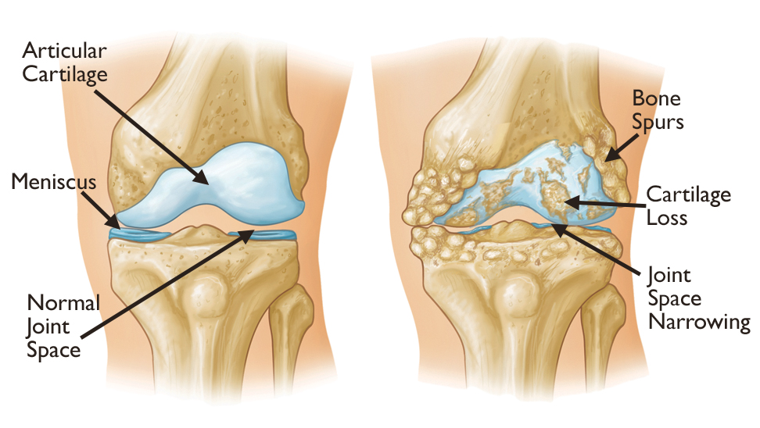
Overall Focus
Normal Knee
Osteoarthiritis
Osteoarthritis affects…
Athletes
Elderly individuals
Individuals with obesity
Common degenerative disease affecting cartilage, bone, and surroinding tissue.
Inflammatory signals trigger enzymes that destroy cartilage cushioning (collagen and aggrecan).
Cartilage lacks blood vessels, making it extremely difficult for drugs to penetrate and stay in the joint.
Osteoarthritis. OrthoInfo / American Academy of Orthopaedic Surgeons (AAOS)
Charge-Based Biomaterials for Targeted Drug Delivery - Center of STEM Education, NEU Young Scholars Program - July 30th 2026
Young Scholars Program, Northeastern University
Claire Duggan, Program Director

Slide 3
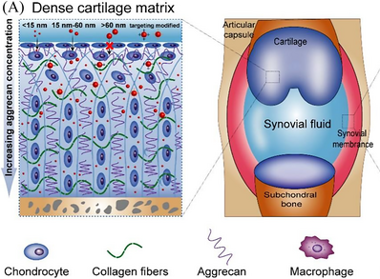
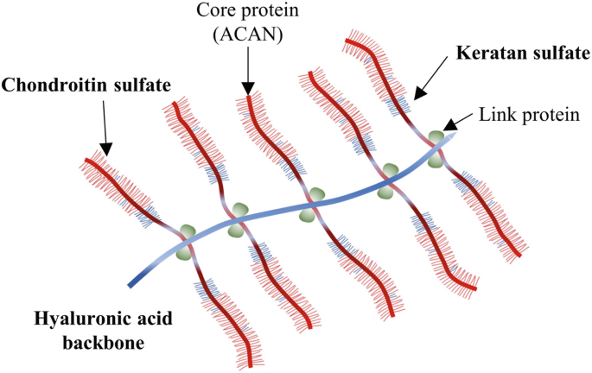
The Problem
Why Drugs Cannot Penetrate
Cartilage is a mesh of collagen and negatively charged GAGs (glycoaminoglycans)
The body constantly drains synovial fluid washing away drugs within 4-6 hours.
What Gets Destroyed
In OA, inflammatory signals cause GAGs to strip away, degrading the cartilage
Barriers to Joint Drug Delivery. Source: ResearchGate
Radhouani et al., 2022 (Springer Nature)
Charge-Based Biomaterials for Targeted Drug Delivery
Center of STEM Education, NEU Young Scholars Program
Claire Duggan, Program Director

Slide 4
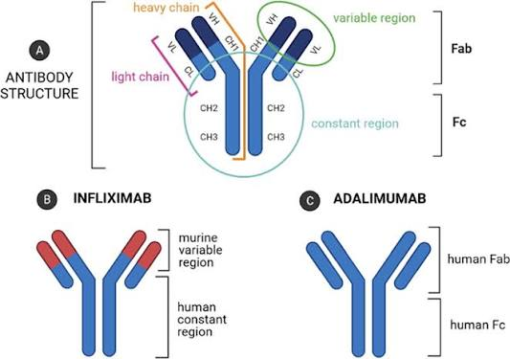
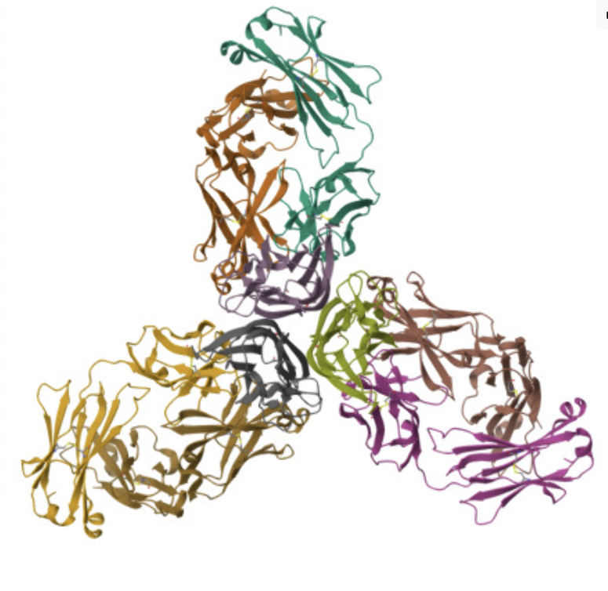
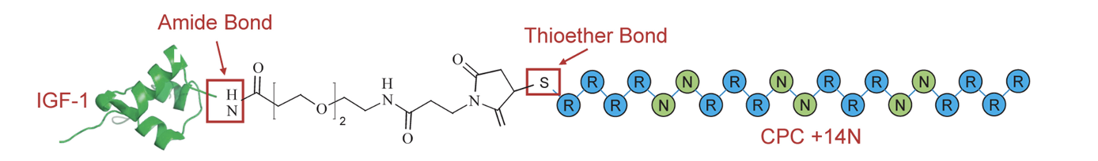
Inhibitor Modeling
AlphaFold
Entered amino acid sequences (2 Light Chains & 2 Heavy Chains from Infliximab
Modeled CPC tags
Complete 3D protein construct
ChimeraX
Built the Complete Model: Combined the Heavy (H) and Light (L) antibody chains with the CPC carrier
Added CPC Tags: Attached designed inhibitors tags to the N (beginning) and C (end) terminus of the CPC
N & C terminus are physically different structures: behaves differently depending on where it's placed.
4 Design Variations Tested
Heavy Chain + N-terminus CPC
Heavy Chain + C-terminus CPC
Light Chain + N-terminus CPC
Light Chain + C-terminus CPC
TNF-Alpha
PDB ID: 4G3Y (Liang et al., 2013) / RCSB Protein Data Bank
Figure adapted from Eder et al. (2021)
Vedadghavami et al. (2022). Arthritis Research & Therapy
Charge-Based Biomaterials for Targeted Drug Delivery
Center of STEM Education, NEU Young Scholars Program
Claire Duggan, Program Director

Slide 5
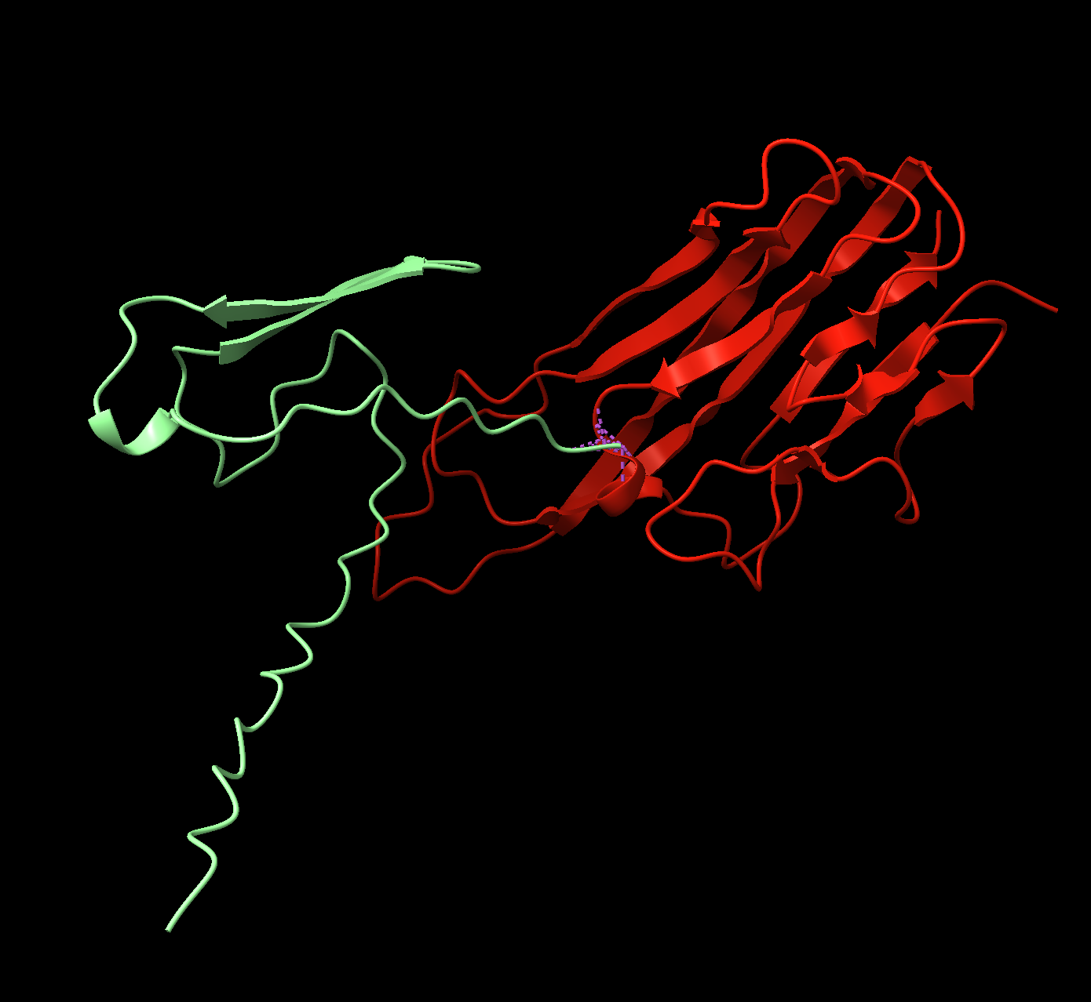
Computational Results
Inspired By | CPC Position | Clashes | RMSD
Light Chain | C - Terminus | 511 | 43 pruned atom pairs is 0.692 angstroms
Light Chain | N -Terminus | 101 | 43 pruned atom pairs is 0.692 angstroms
Heavy Chain | C - Terminus | 107 | 67 pruned atom pairs is 0.562 angstroms
Heavy Chain | N - Terminus | 123 | 69 pruned atom pairs is 0.445 angstroms
CPC N-Terminus
Light Chain
Light chain + CPC located from N-terminus
Charge-Based Biomaterials for Targeted Drug Delivery
Center of STEM Education, NEU Young Scholars Program
Claire Duggan, Program Director

Slide 6
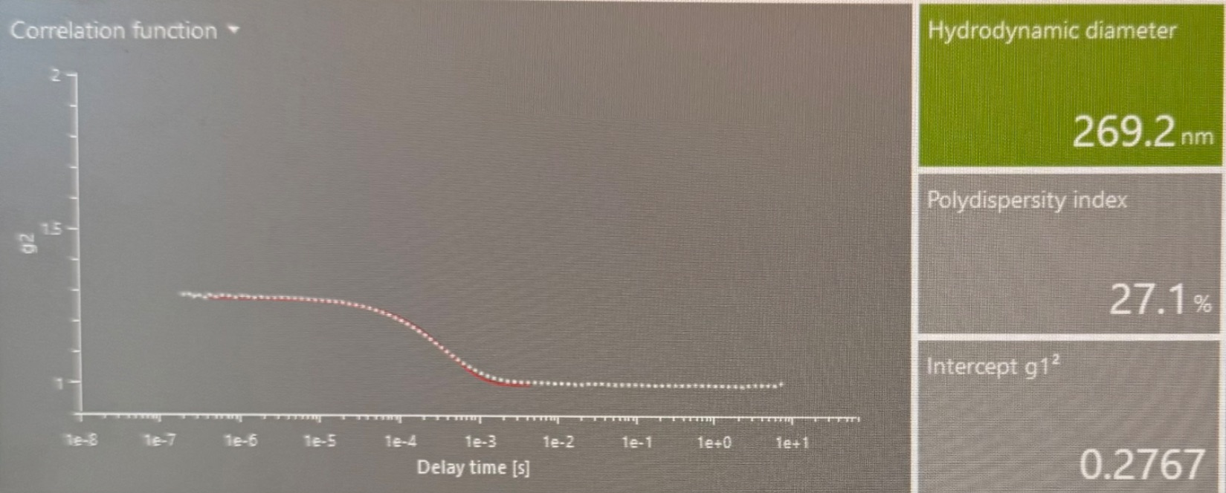
Liposomes
Liposome container
CPC
CPC
CPC
Exosomes
Carry materials out of cell
Liposomes
Synthetic exosomes
Synthesis
Drying/boiling
Hydration
Sizing Particles
Want similar sizes
DLS machine
  Brownian motion
TNF-Alpha
TNF-Alpha
TNF-Alpha
CPC
TNF-Alpha
TNF-Alpha
CPC
TNF-Alpha
TNF-Alpha
TNF-Alpha
Liposome Size Characterization by Dynamic Light Scattering
Charge-Based Biomaterials for Targeted Drug Delivery
Center of STEM Education, NEU Young Scholars Program
Claire Duggan, Program Director
Notes:
DLS machine flashes ight at particles and sees how much the intensity fluctuates due to brownian motion, which allows it to calculate the particle size
More intensity smaller particle

Slide 7
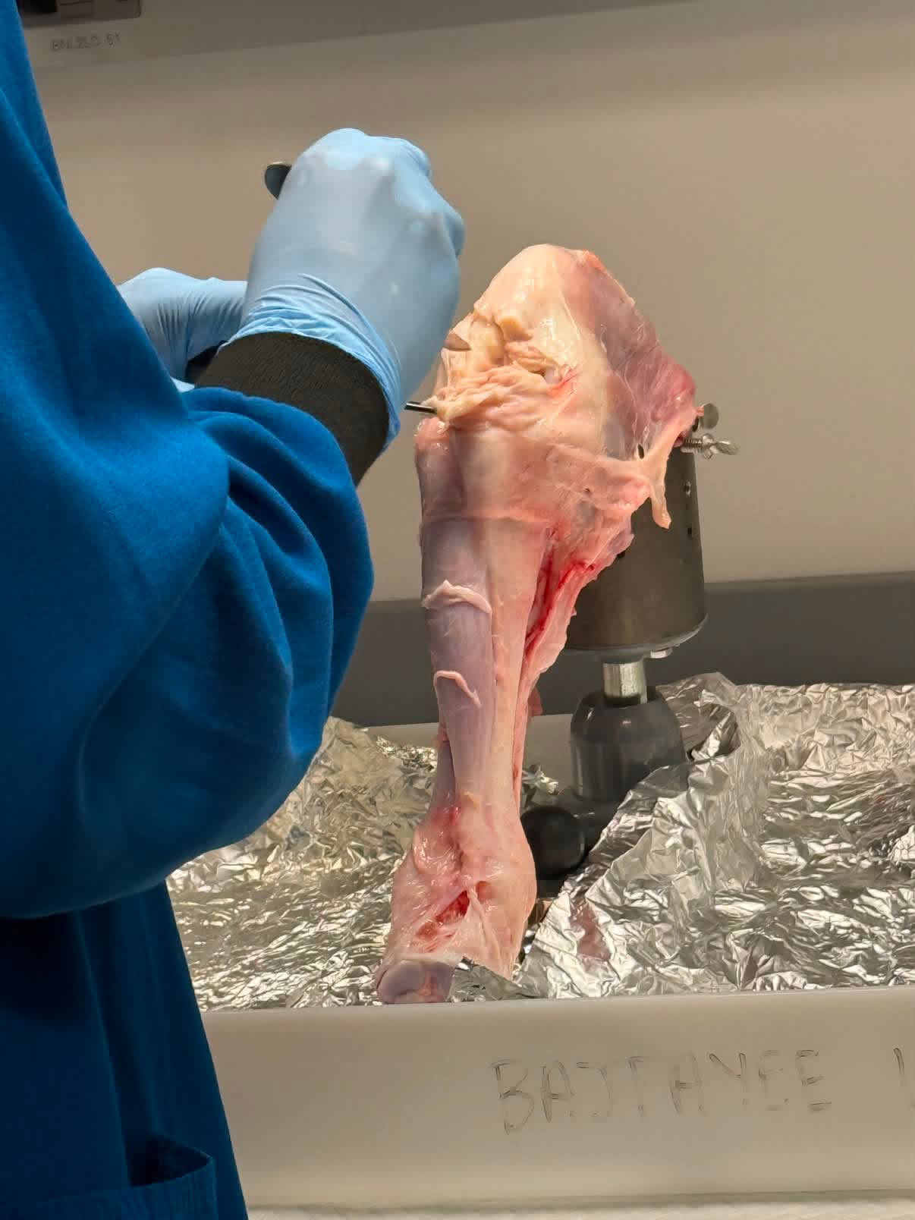
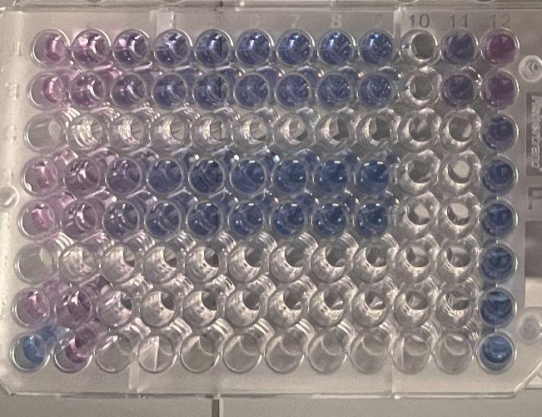
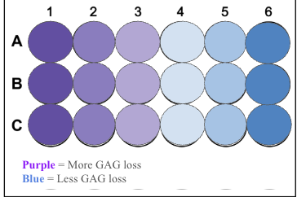
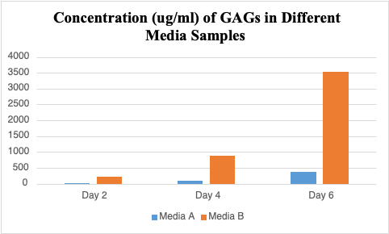
Bovine Harvesting to DMMB Assay
Punch cartilage into uniform 6 mm discs.
Wash with sterile PBS(Phosphate-Buffered Saline)) to clean the samples.
Rest in DMEM nutrient media overnight to keep cells alive.
Collect the DMEM media (catches GAGs that leaked out).
Digest the solid tissue using Tris buffer (releases remaining GAGs).
Mix samples with DMMB dye (1,9-Dimethylmethylene Blue) turns from blue to purple when bound to GAGs.
Read absorbance on a plate reader to calculate exact GAG levels.
Charge-Based Biomaterials for Targeted Drug Delivery
Center of STEM Education, NEU Young Scholars Program
Claire Duggan, Program Director
Notes:
Establishing a model for OA
We added IL-1 to the orange, which is a pro-inflammatory cytokine

Slide 8
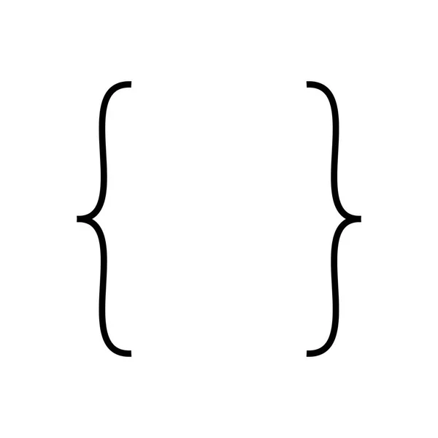
Conclusions + Further Steps
OA in Cartilage Samples
Media samples had less GAGs = cartilage was relatively healthy with less inflammation.
TNF-a model
The light chain + CPC on the N-terminus is our model with the least clashes.
To make the computationally designed drug
Figure out how to add the desired amount of drug into the liposome
Charge-Based Biomaterials for Targeted Drug Delivery
Center of STEM Education, NEU Young Scholars Program
Claire Duggan, Program Director

Slide 9
References
TNF inhibitor. (n.d.). Wikipedia. Retrieved July 28, 2026, from
https://en.wikipedia.org/wiki/TNF_inhibitor
Arthritis and Osteoarthritis treatment NYC (Brooklyn, Manhattan, Harlem). (2019, September 23). Century Medical & Dental Center.
https://www.centurymedicaldental.com/arthritis-osteoarthritis/
Wikipedia contributors. (2026, July 16). Liposome. Wikipedia, The Free Encyclopedia.
https://en.wikipedia.org/w/index.php?title=Liposome&oldid=1364503653
Chang, Y., Kong, K., Qiao, H., Jin, M., Wu, X., Fan, W., Zhang, J., Qi, Y., Xu, Y., Qin, A., Zhai, Z., & Li, H. (2025). TrkC protects against osteoarthritis progression by maintaining articular cartilage homeostasis. International Journal of Biological Sciences, 21(8), 3597–3613.
https://doi.org/10.7150/ijbs.108832
Osteoarthritis - OrthoInfo - AAOS. (n.d.). Orthoinfo.org. Retrieved July 28, 2026, from
https://www.orthoinfo.org/diseases--conditions/osteoarthritis/
(N.d.). Researchgate.net. Retrieved July 28, 2026, from https://www.researchgate.net/figure/Barriers-to-drug-delivery-in-jointsA-Penetration-of-different-sizes-of-nanoparticles_fig2_375657560
Charge-Based Biomaterials for Targeted Drug Delivery
Center of STEM Education, NEU Young Scholars Program
Claire Duggan, Program Director

Slide 10
