Slide 1




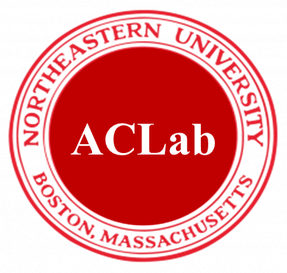
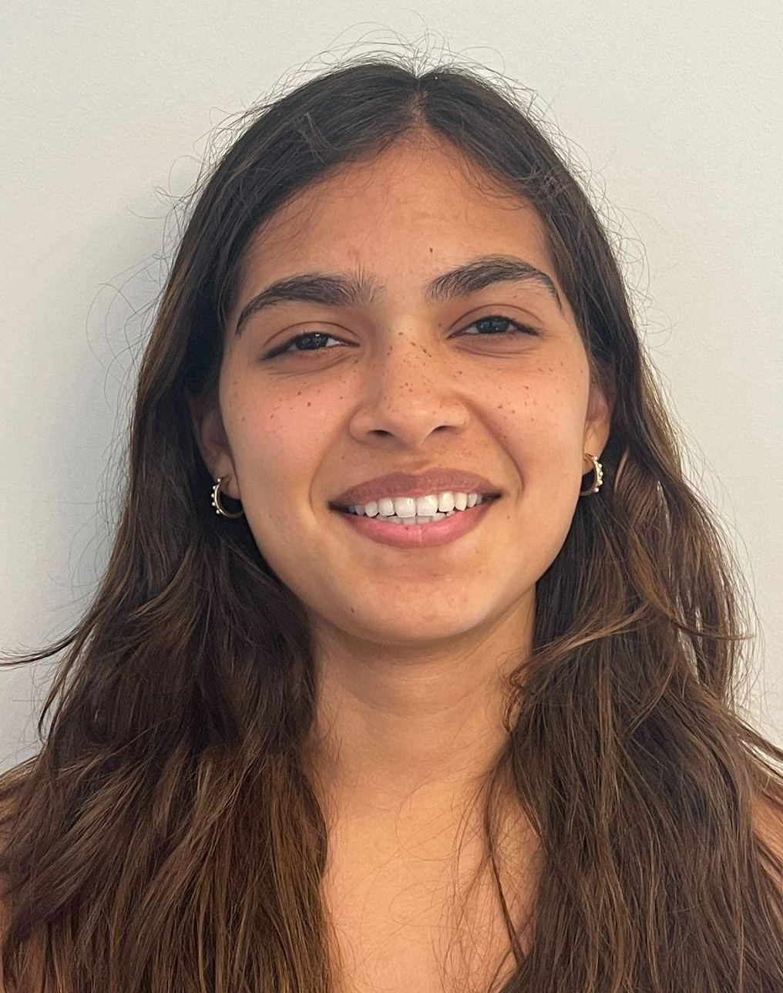
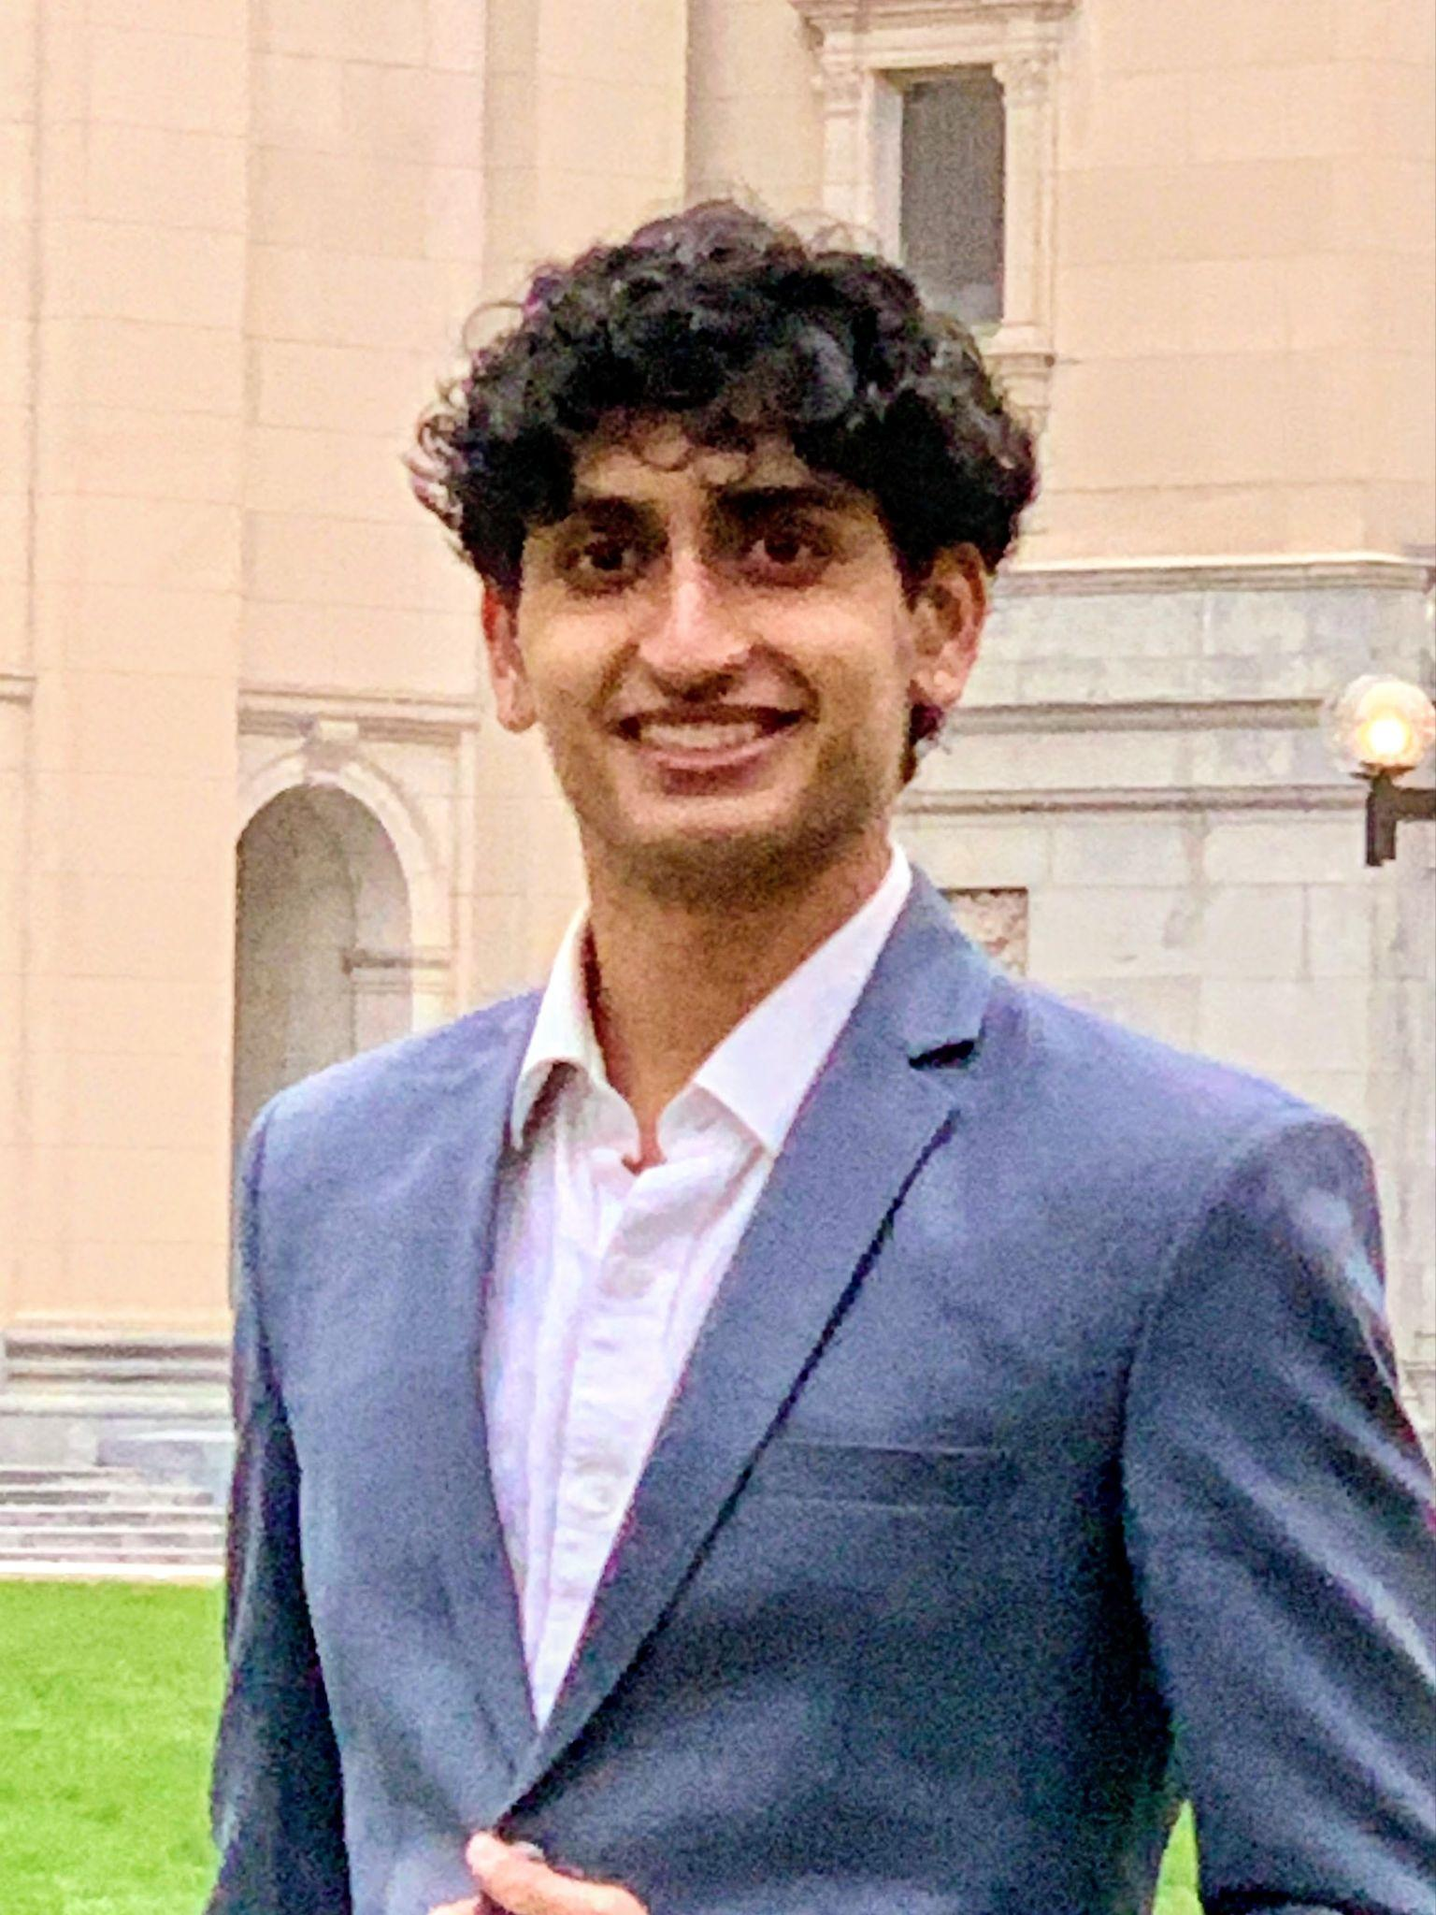


Video Language Models for Generic Task Assistance
Nyasa Luharuka, YSP Student, Lexington High School
Arin Shinde, YSP Student, Shrewsbury High School
Bishoy Galouaa, Electrical and Computer Engineering, Northeastern University
Sarah Ostadabbas, Electrical and Computer Engineering, Northeastern University​

Slide 2


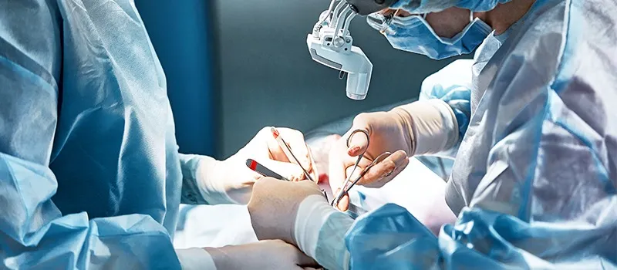
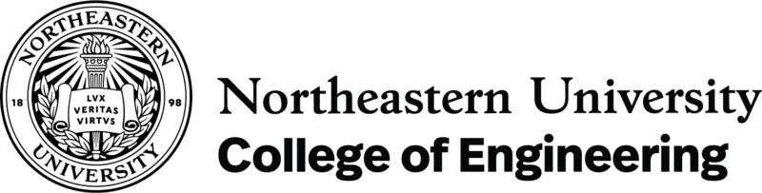
ACLab
Problem
Based on the current situation and developments in technology, AI still lacks in the ability to understand and reason with information from videos
$200,000+
Average Cost Per Retained Foreign Body Incident
80%
Of Incidents Require Secondary Surgery
4,000+
Retained Surgical Items in the U.S. Every Year
Video Language Models for Generic Task Assistance
Slide 02 / 21 - NEU Young Scholars Program 2026 - July 30, 2026

Slide 3

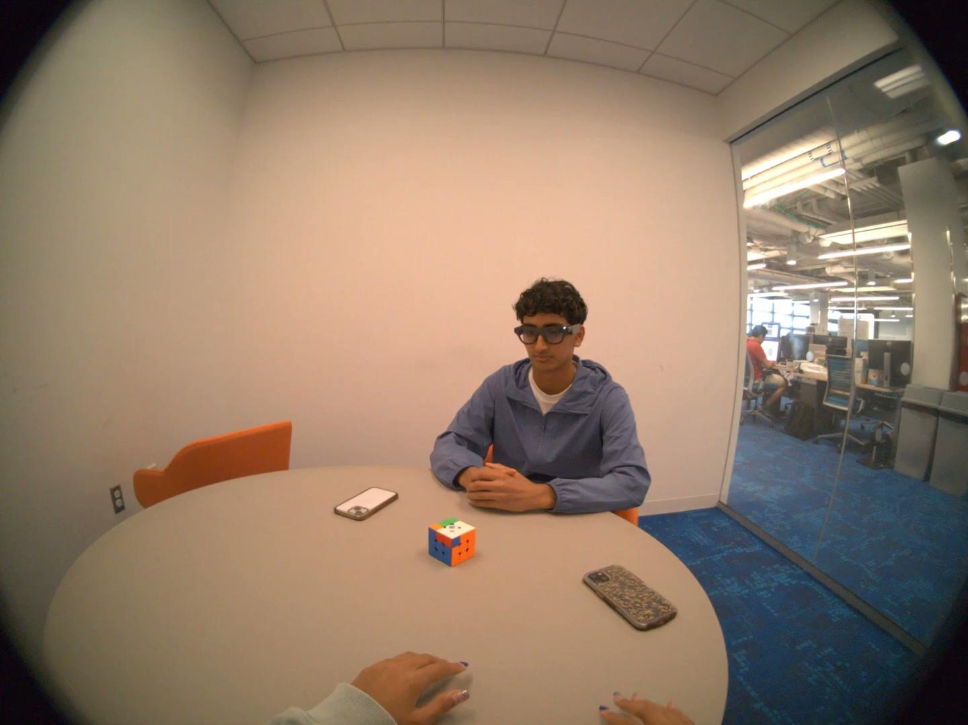
ACLab
Shortcomings & Weaknesses
Seen through Rubik’s Cube Experiment
  Unable to identify actions taken
  AI understands very broad situation
Video Language Models for Generic Task Assistance
Slide 03 / 21 - NEU Young Scholars Program 2026 - July 30, 2026

Slide 4
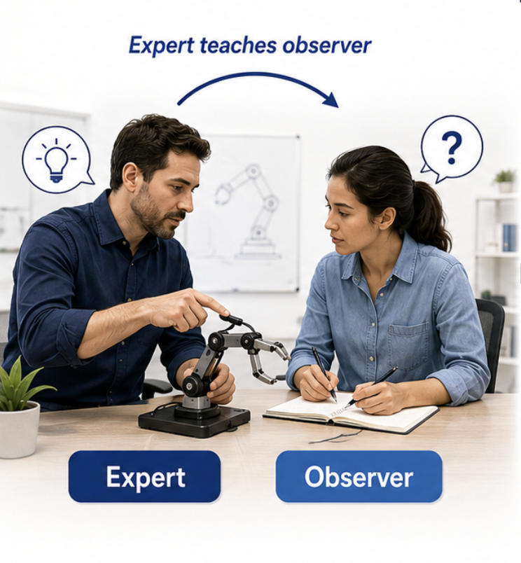
ACLab
Proposed Solutions
Proposed Solution: Creating datasets and Visual Language Model (VLM)
  Expert teaches observer
  Eventual goal is to create Expert AI
Video Language Models for Generic Task Assistance
Slide 03 / 21 - NEU Young Scholars Program 2026 - July 30, 2026

Slide 5
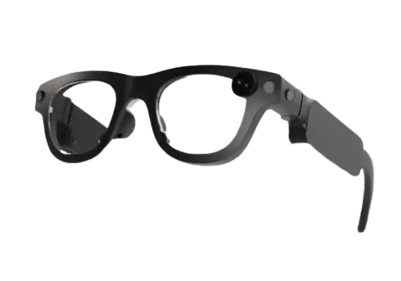
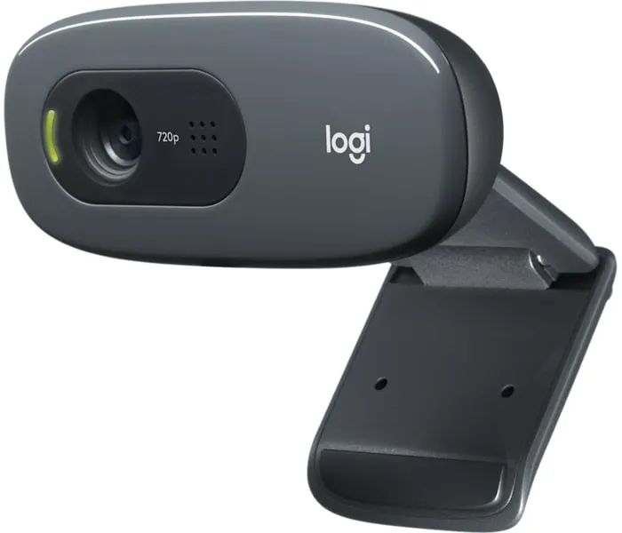
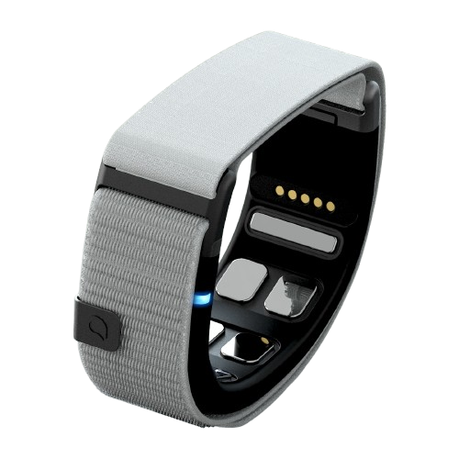
ACLab
Devices
Egocentric
Exocentric
Neural
Aria Gen2 Glasses
Logitech Camera
Mudra Band
Video Language Models for Generic Task Assistance
Slide 04 / 21 - NEU Young Scholars Program 2026 - July 30, 2026

Slide 6
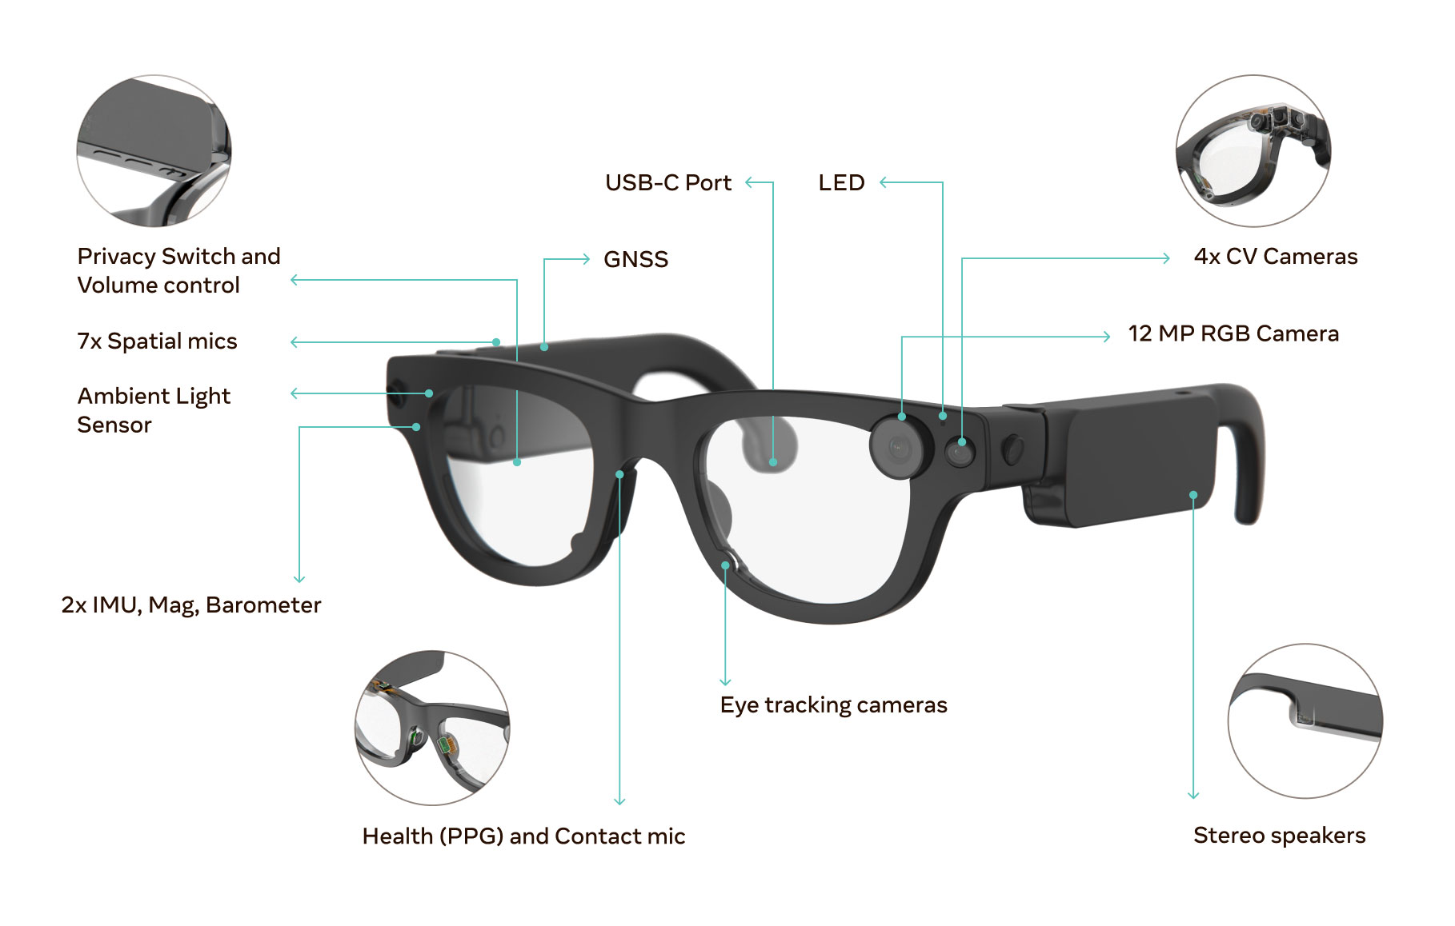
ACLab
Aria Glasses
Research Wearable
  Allow for different user perspectives
  Capture egocentric data
  Includes motion sensors, GPS sensor, hand tracking, and more
  Two units let you record both participants in a task simultaneously
Video Language Models for Generic Task Assistance
Slide 04 / 21 - NEU Young Scholars Program 2026 - July 30, 2026
Notes:
Mention howOnly 6 Schools in the entire world have these glasses!

Slide 7
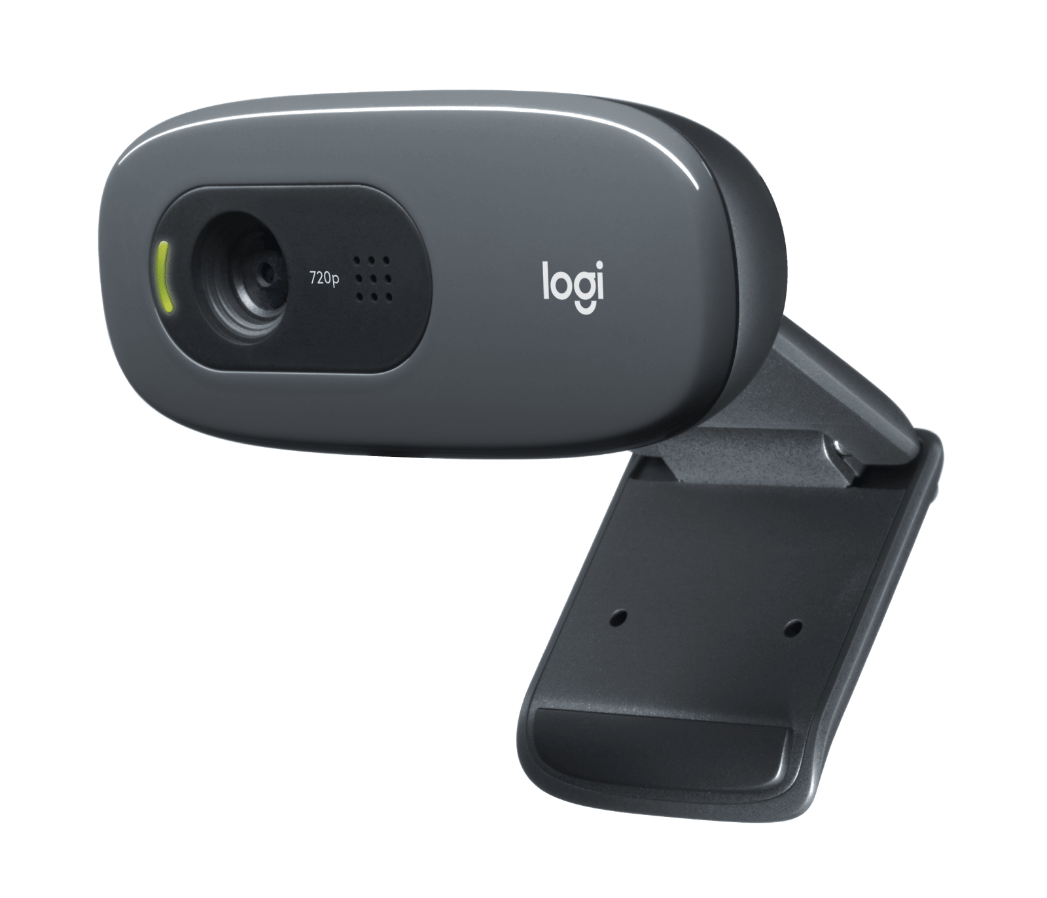
ACLab
Devices
Logitech Cameras - 720p
  Give different angles of a situation
  Reducing blind spots
Video Language Models for Generic Task Assistance
Slide 05 / 21 - NEU Young Scholars Program 2026 - July 30, 2026

Slide 8
ACLab
Devices
Mudra Bands
  Captures forearm muscle (EMG) signals via surface electrodes
  Enables fine motor movement detection
Video Language Models for Generic Task Assistance
Slide 05 / 21 - NEU Young Scholars Program 2026 - July 30, 2026

Slide 9
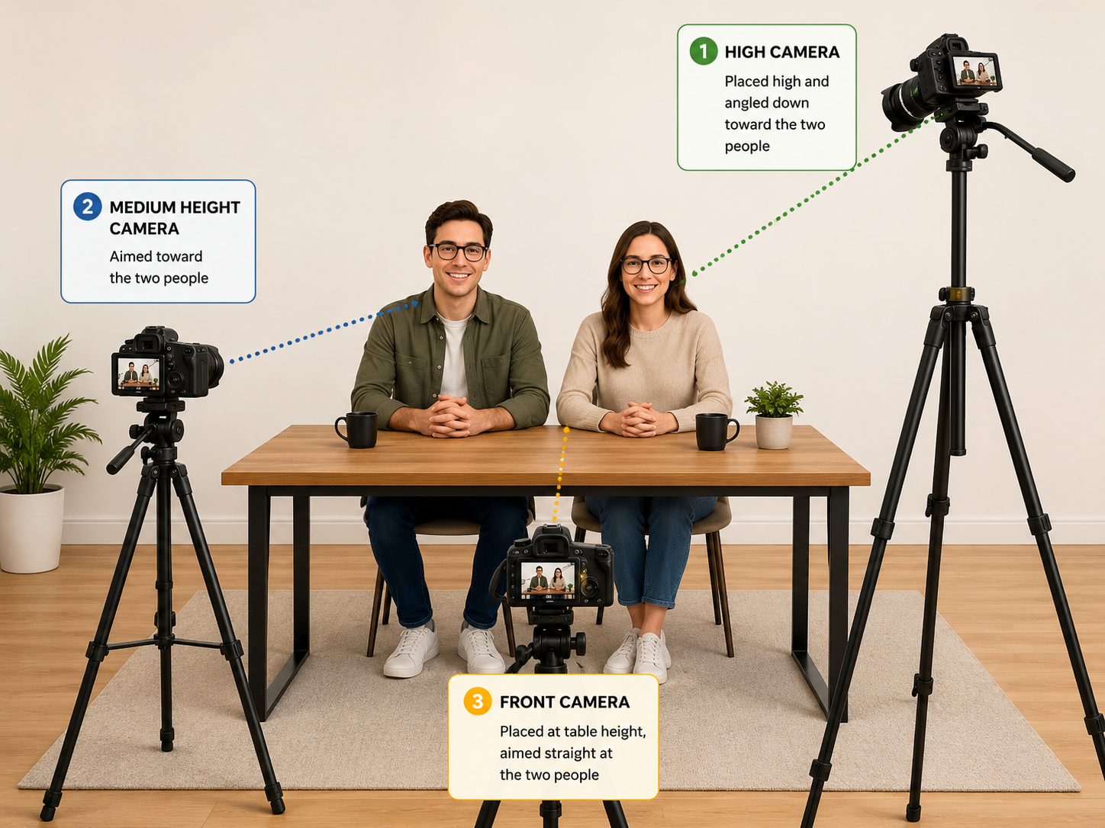
ACLab
Scene
Simulated 3D Model of Perspectives used for Datasets
Video Language Models for Generic Task Assistance
Slide 06 / 21 - NEU Young Scholars Program 2026 - July 30, 2026

Slide 10
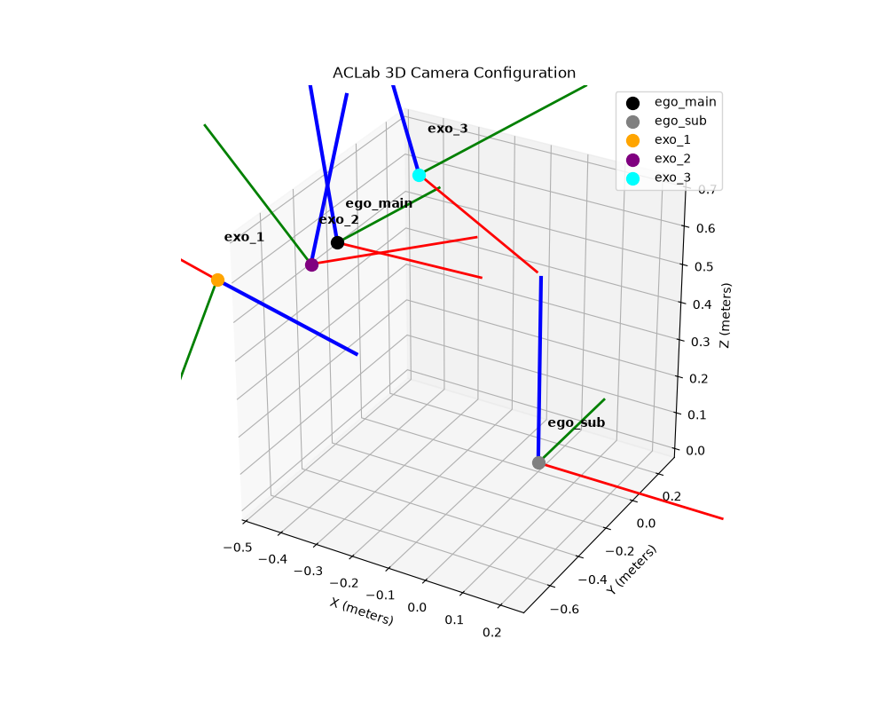
ACLab
How to Record Dataset
Using different devices for different perspectives
Organic Mistakes
Temporal Segmentation
Simulated 3D Model of Perspectives used for Datasets
Video Language Models for Generic Task Assistance
Slide 07 / 21 - NEU Young Scholars Program 2026 - July 30, 2026

Slide 11
ACLab
Dataset Creation Categories
Engineering
Culinary
Manufacturing
Medicine
Goal: put tools back where they belong
Goal: get ingredients
Goal: build a peanut butter and jelly sandwich
Goal: build a hotdog
Goal: assemble an IKEA chair
Goal: disassemble an IKEA chair
Goal: create an AI to guide user through surgery
Video Language Models for Generic Task Assistance
Slide 08 / 21 - NEU Young Scholars Program 2026 - July 30, 2026

Slide 12
ACLab
Tools Dataset
Video Language Models for Generic Task Assistance
Slide 08 / 21 - NEU Young Scholars Program 2026 - July 30, 2026

Slide 13
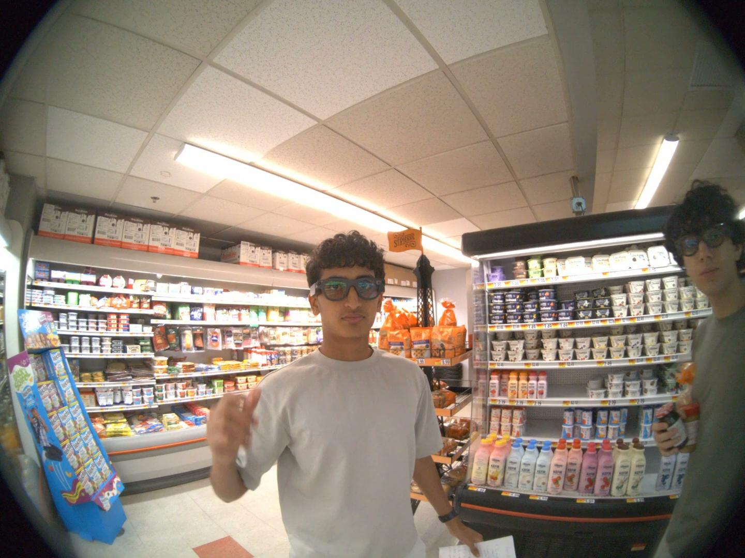
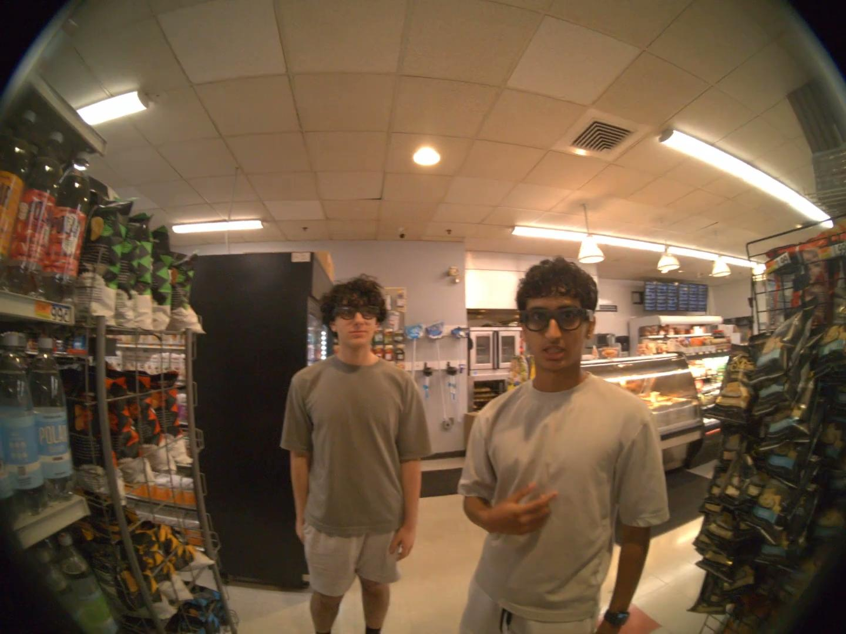
ACLab
Grocery Store Dataset
Video Language Models for Generic Task Assistance
Slide 09 / 21 - NEU Young Scholars Program 2026 - July 30, 2026

Slide 14
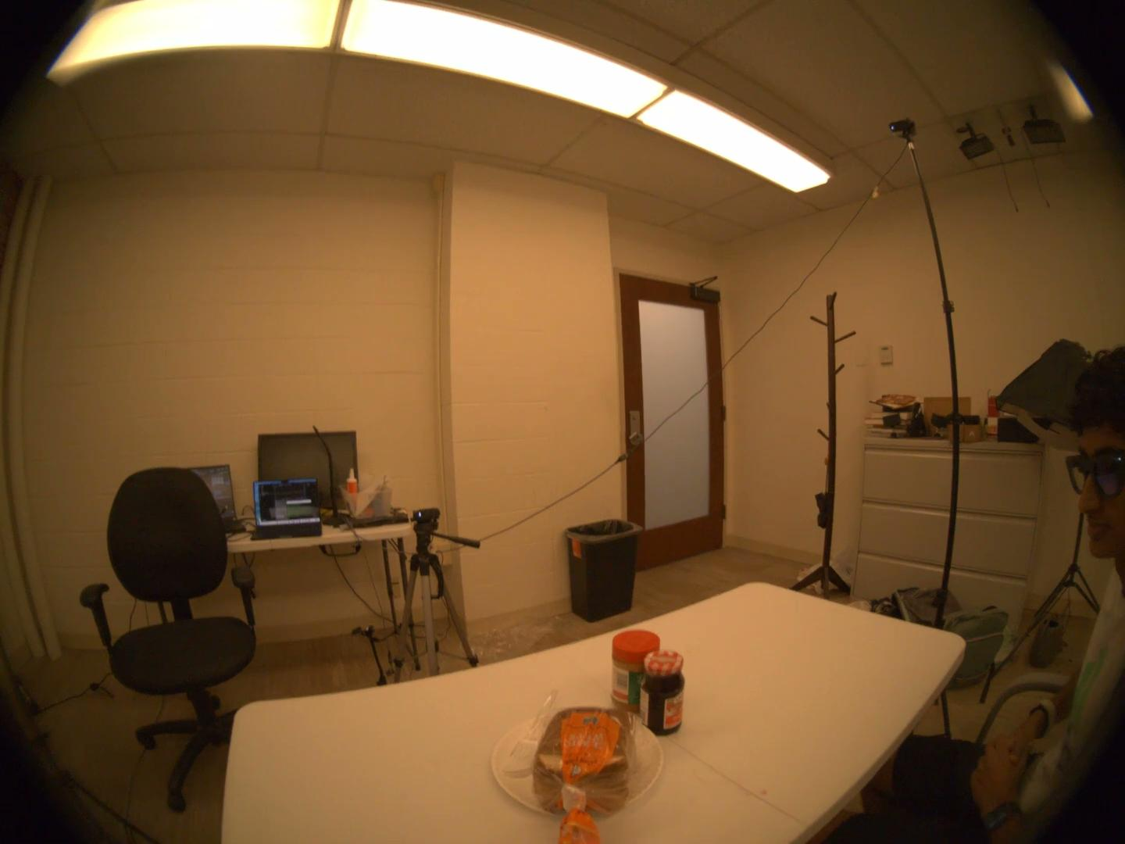
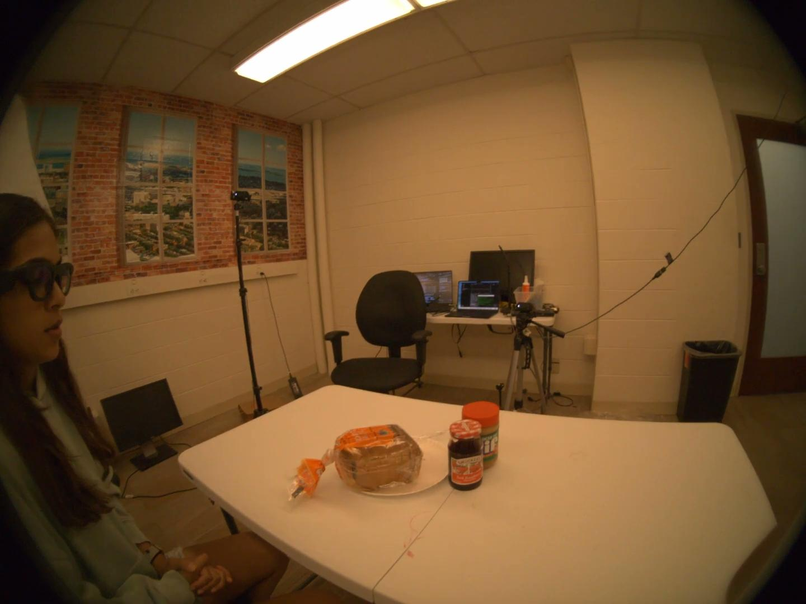
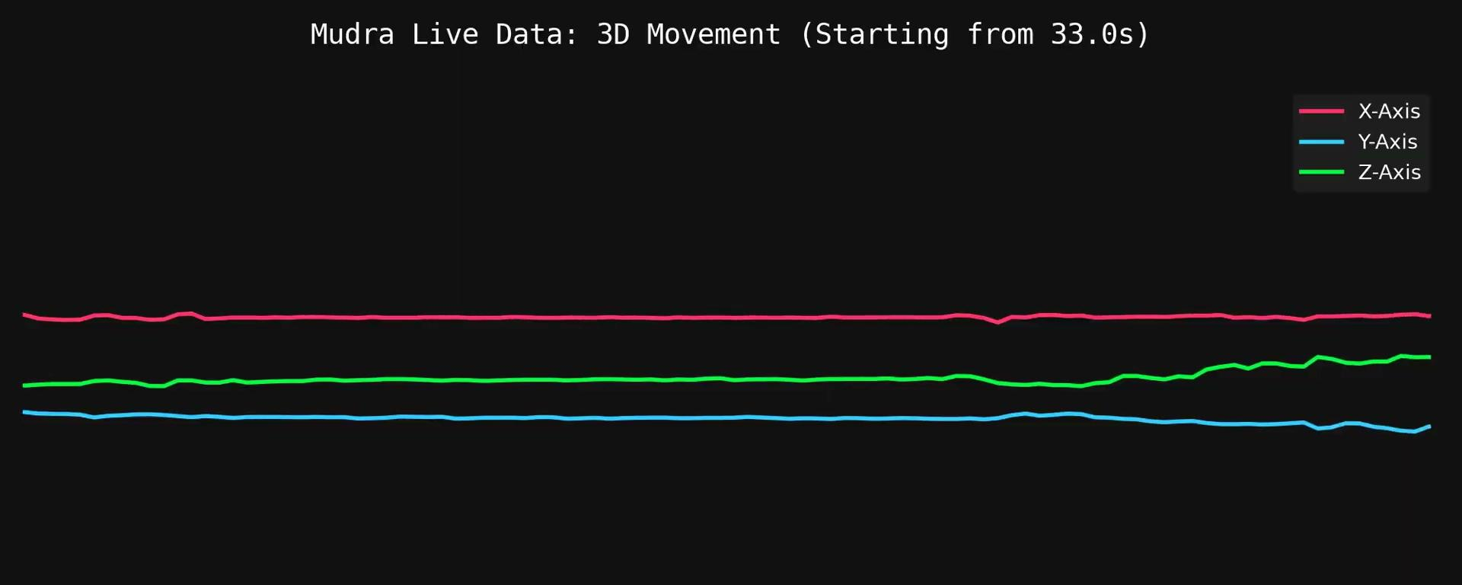

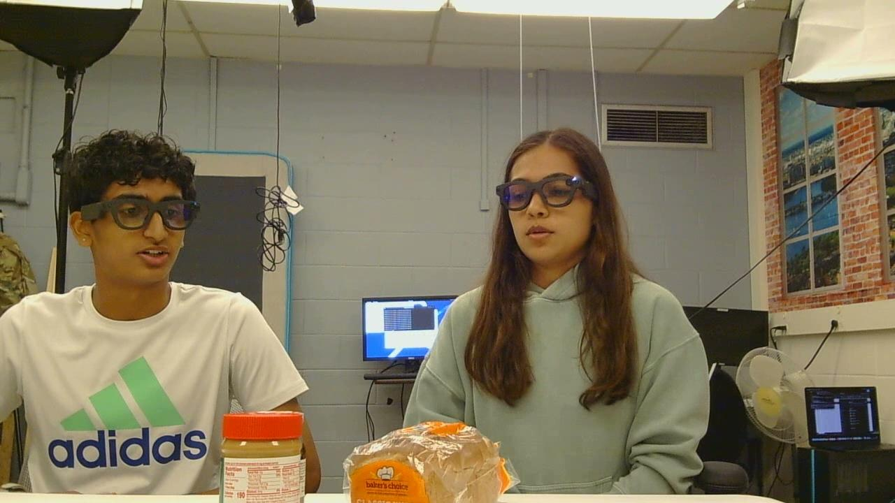
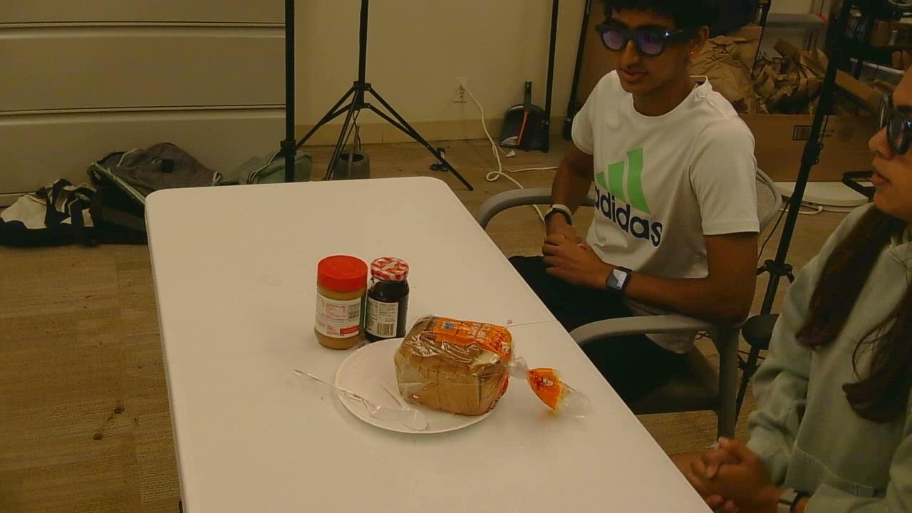
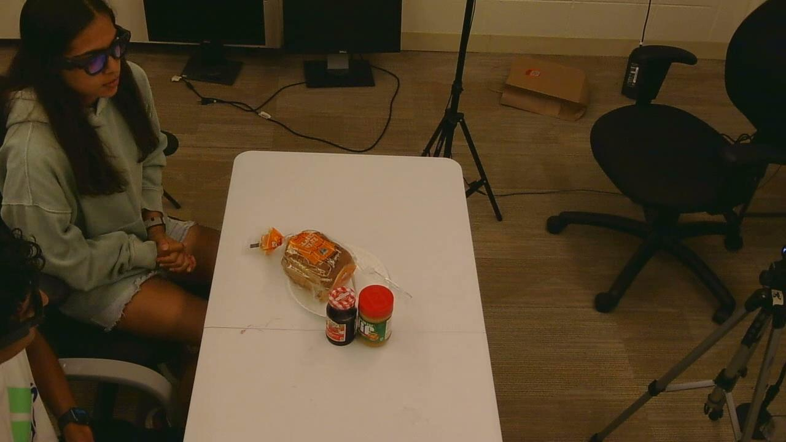
ACLab
Peanut Butter and Jelly Sandwich Dataset
Mudra Link Data:
Egocentric Data:
Audio Transcript:
Exocentric Data:
Notes:
arin

Slide 15
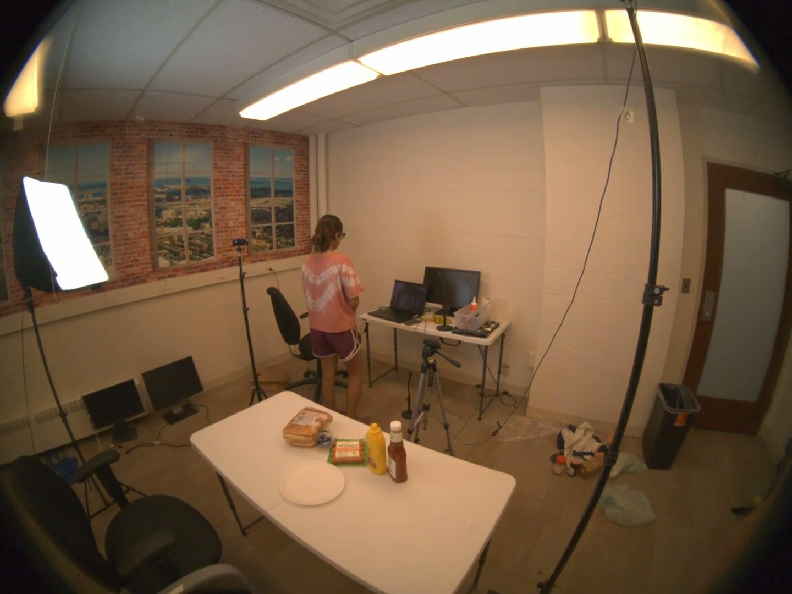
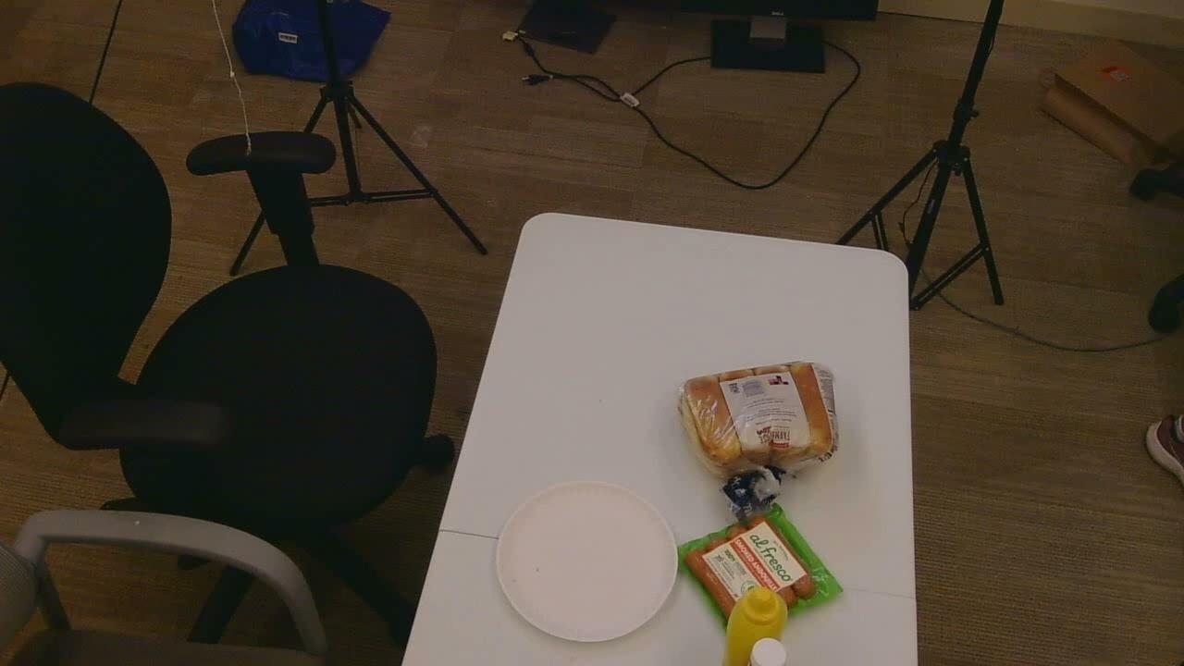
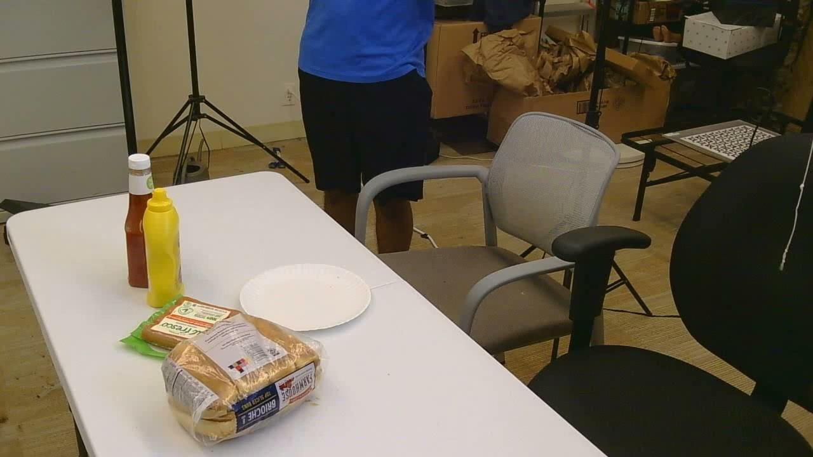
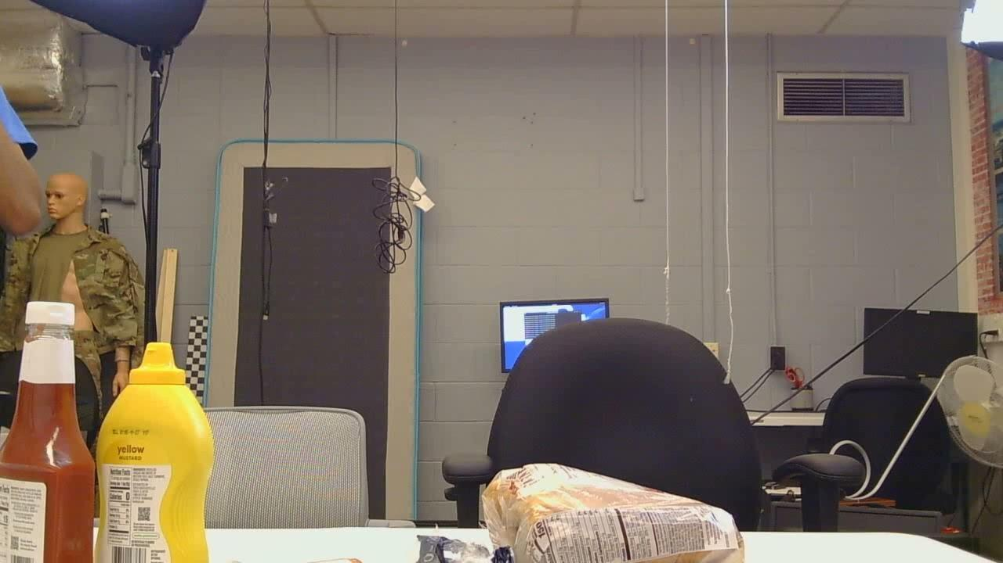
ACLab
Hotdog Dataset
Video Language Models for Generic Task Assistance
Slide 13 / 21 - NEU Young Scholars Program 2026 - July 30, 2026

Slide 16
ACLab
Ikea Chair Dataset
Video Language Models for Generic Task Assistance
Slide 15 / 21 - NEU Young Scholars Program 2026 - July 30, 2026

Slide 17
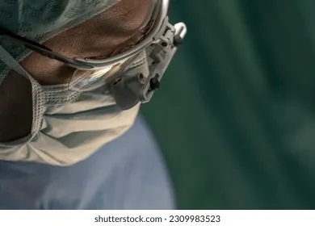
ACLab
Preface for Demo
Don’t forget to take out the gauze!
Goal: create an assistant to help with surgical procedure
Can identify missing steps
Can guide user into next steps
Use existing LLM and fine-tune it for our purpose
Video Language Models for Generic Task Assistance
Slide 17 / 21 - NEU Young Scholars Program 2026 - July 30, 2026

Slide 18
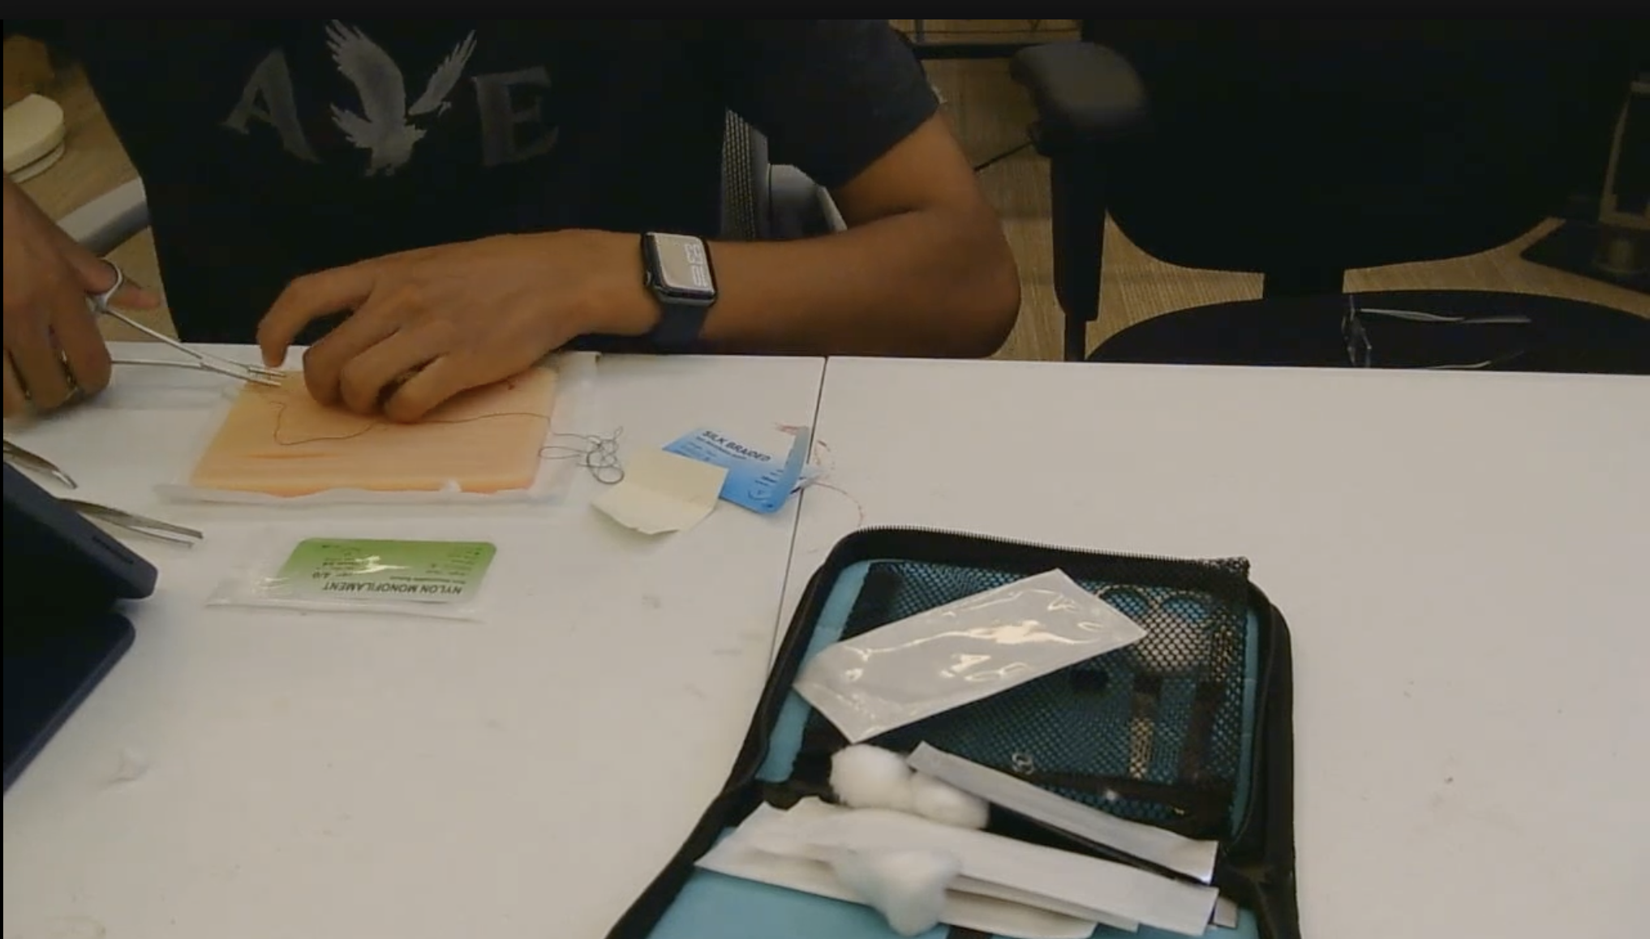
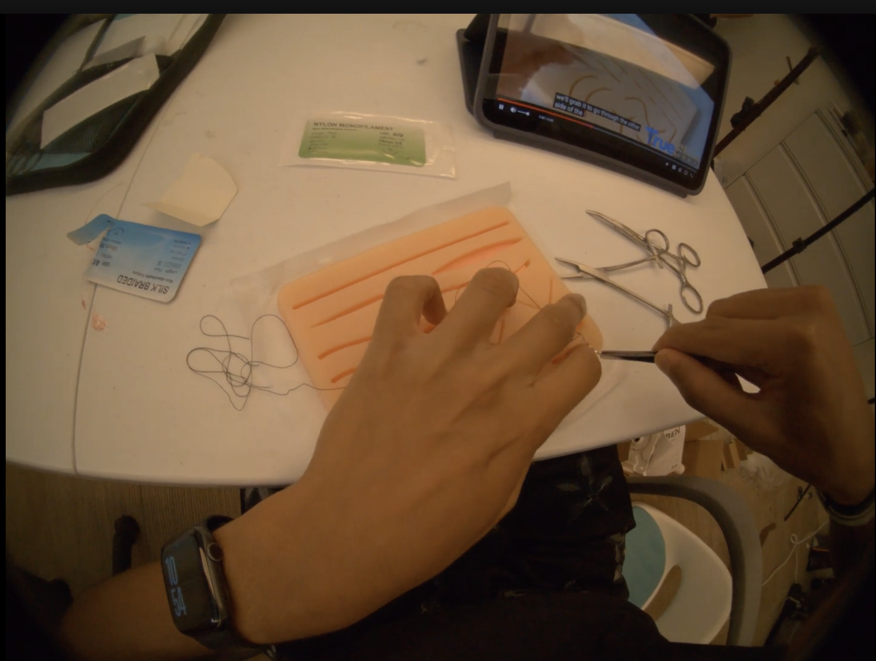
ACLab
Creating the AI
Application in Medical Field
  Create the data of a surgery procedure
  Analyze data to temporally segment
  Creating the prompt for the LLM: Using Qwen3-VL-4B-Instruct
Figure 1: Exocentric Camera 4
Figure 2: Egocentric Camera 1
Video Language Models for Generic Task Assistance
Slide 18 / 21 - NEU Young Scholars Program 2026 - July 30, 2026

Slide 19
ACLab
AI Visual
Video Language Models for Generic Task Assistance
Slide 18 / 21 - NEU Young Scholars Program 2026 - July 30, 2026

Slide 20
ACLab
Demo
Video Language Models for Generic Task Assistance
Slide 19 / 21 - NEU Young Scholars Program 2026 - July 30, 2026

Slide 21
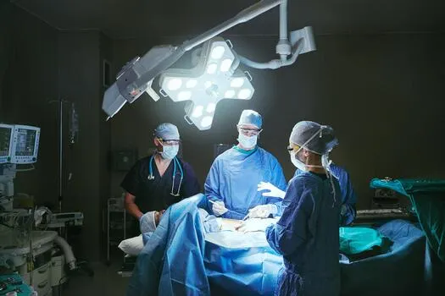
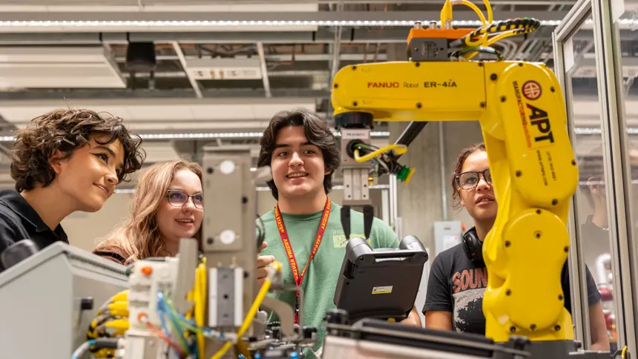
ACLab
Conclusions
Can be implemented in many different fields
Human error can be accounted for
Gathering more data
AI can work side by side with humans
Video Language Models for Generic Task Assistance
Slide 20 / 21 - NEU Young Scholars Program 2026 - July 30, 2026

Slide 22



ACLab
Acknowledgements:
Department of Electrical and Computer Engineering
Professor Sarah Ostadabbas
Bishoy Galoaa, Ph. D. Student
Center for STEM Education
Claire Duggan, Executive Director
Jennifer Love, Associate Director
Frances Corcell, Kenneth Santizo, and Ahmed Othman,
YSP Coordinators
Nicolas Fuchs, Program Manager
Mary Howley, Administrative Officer
Augmented Cognition Laboratory (ACLab)
This work has been funded by the National Science Foundation (NSF).
Video Language Models for Generic Task Assistance
Slide 21 / 21 - NEU Young Scholars Program 2026 - July 30, 2026

Slide 23


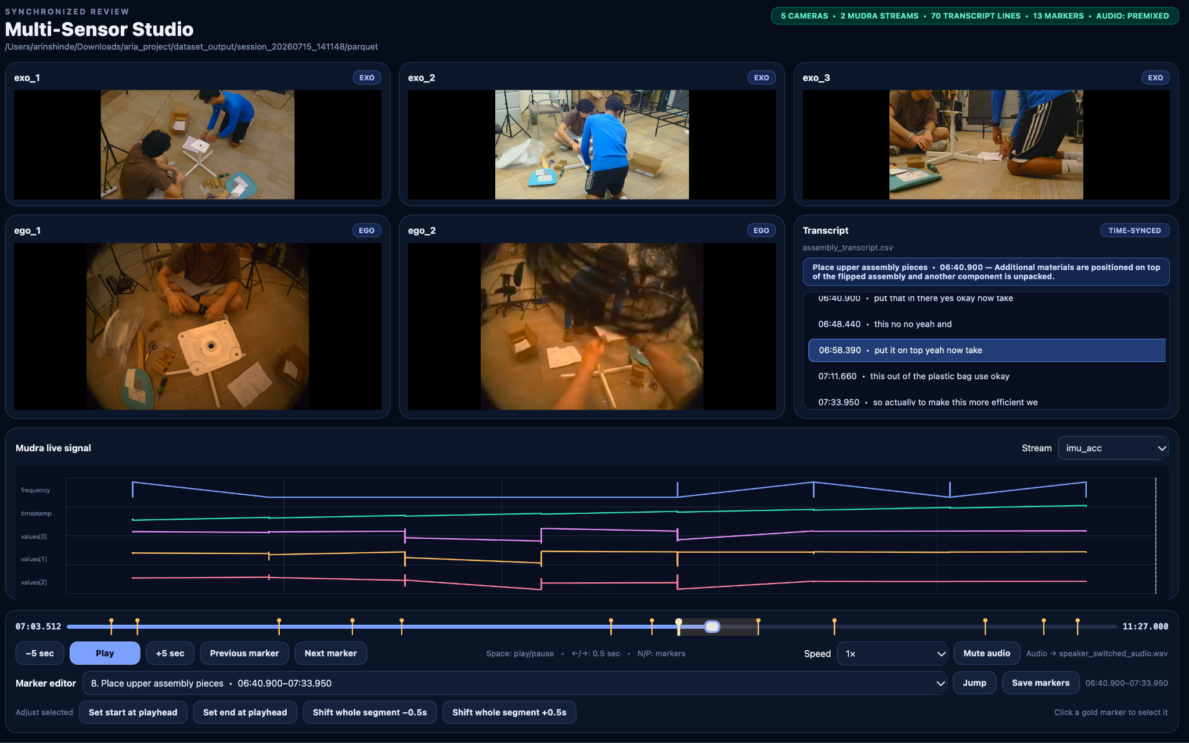
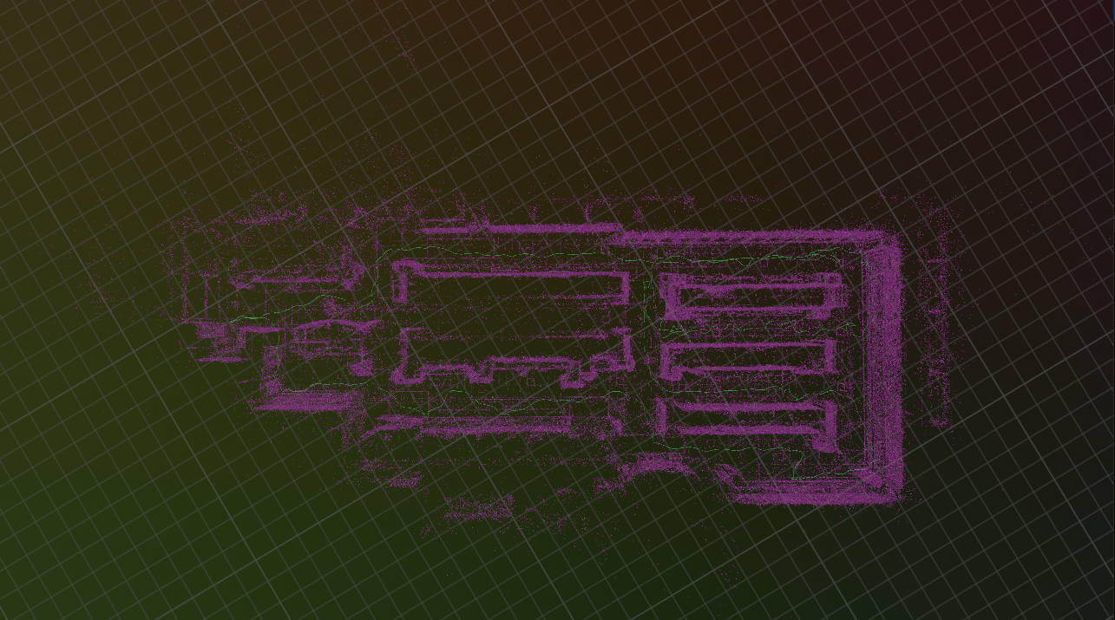
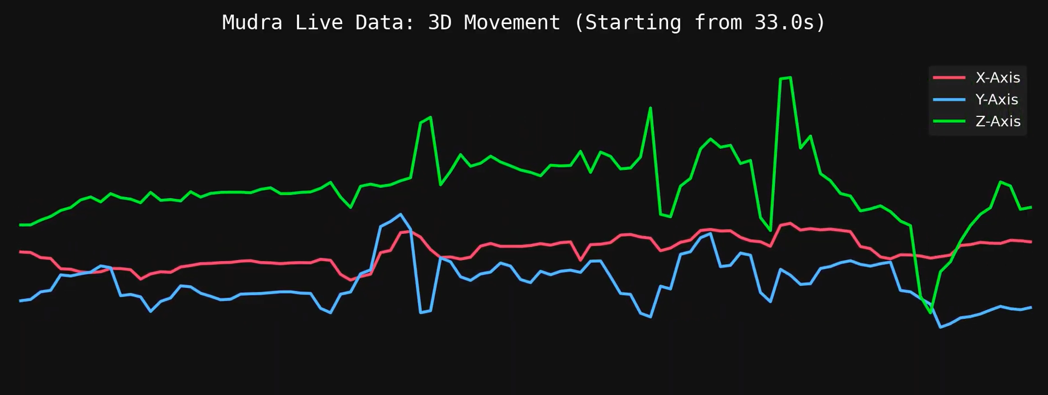
Video Language Models for Generic Task Assistance
Arin Shinde, YSP Student, Shrewsbury High School​
Nyasa Luharuka, YSP Student, Lexington High School​
Kurosh Kavoosi, Student, Nashua High School South
Bishoy Galoaa, College of Electrical and Computer Engineering, Northeastern University​
Sarah Ostadabbas, Department, Northeastern University​
Abstract
Experimental Methods
Conclusion and Future Steps
Artificial intelligence struggles to reason through long, multi-step human activities. Important information may be distributed across first-person video, third-person video, body-motion signals, and spoken instructions. We developed a synchronized multimodal data-collection and visualization method for studying task completion with mistakes and corrections. Participants completed tool organization, grocery-shopping, and food preparation tasks, and IKEA chair assembly and disassembly while being recorded with Aria Gen2 smart glasses, exocentric cameras, and Mudra Link wristbands. These inputs were synchronized , divided into temporal action segments, connected to transcripts, and organized in a Parquet format. Interactive interfaces were created to display the video, biosignal, transcript, and task-segment data on a shared timeline. This work creates the infrastructure needed to train future video-language models to provide step-by-step task assistance in a variety of fields from robotics to medicine.
This project demonstrates a proof of concept multimodal AI assistant that combines procedural guidance with mistake detection.
The main contribution however is not a clinically validated surgical system, but a synchronized data and visualization pipeline for developing systems that reason across multiple viewpoints, movement signals, transcripts, and task history. With further development and testing, similar technology could provide an additional safety layer in a variety of fields.
Multimodal task assistance can have applications in manufacturing, equipment maintenance, laboratory work, emergency response, and education.
Stage 1: Multimodal Data Collection
Human activities recorded using many different types of devices
  Aria Gen2 glasses: egocentric, first-person video of participant’s hands and the working area
  Logitech Cameras: exocentric, wider scene and multiple angles to reduce occlusion
  Mudra Link wristbands: biosignal data on intentionality and wrist movement
Stage 2: Expert-Observer Recording Framework
Expert explained how to complete a task and observer performed actions
Paired examples of spoken guidance, visible actions, and mistakes along with their corrections
  Putting tools back in drawers
  Making a peanut butter and jelly sandwich
  Making a hotdog
  Assembly and disassembly of an ikea chair
Stage 3: Synchronization and Temporal Segmentation
Streams were not fully aligned
  Used a clap performed at beginning of recording to create a synchronization event
Temporal segmentation needed to split up a clip into separate steps
Used Python and FFmpeg scripts to align streams and divide recordings into meaningful procedural segments
Stage 4: Data Processing and Organization
Data structured into Parquet format
  Different modalities could be accessed using a shared timeline
Created an interactive visualization interface to display multiple camera views, transcript, and Mudra signals
Stage 5: Final Suturing Demonstration
Used a synthetic suturing kit and simulated wound
  Three gauze pads were included in procedure
AI assistant provided procedural guidance while monitoring activity captured by cameras
  When closure began with one pad remaining, assistant gave a warning
Background
References
Retained surgical items are objects unintentionally left inside a patient following an operation. They are classified as serious, preventable safety events and may result in pain, infection, or death. The Agency for Healthcare Research and Quality reports an estimated incidence of approximately 1.3 retained surgical items per 10,000 procedures.
Current prevention strategies rely heavily on manual counts, communication between surgical team members, and technologies such as radiographic detection. However, it was reported that out of 190,000 operations, most retained-object events occurred. This demonstrates the need for multiple complementary safety systems.
An AI assistant capable of observing the procedure could potentially function as an additional safety layer. To do this effectively, the system must understand more than a single video frame. It must track objects, recognize the current procedural step, and identify whether an item has been removed or not.
With the use of multiple different perspectives from the Aria Gen2 glasses, exocentric cameras, and Mudra Link bands, this can provide additional aid to a model to visually understand. Our objective was therefore to build a reusable pipeline that synchronizes multiple perspectives and sensor types during tasks.
Chavan, V., Imgrund, Y., Dao, T., Bai, S., Wang, B., Lu, Z., Heimann, O., & Krüger, J. (2025). IndEgo: A dataset of industrial scenarios and collaborative work for egocentric assistants. Advances in Neural Information Processing Systems (NeurIPS). https://doi.org/10.48550/arXiv.2511.19684
Jia, B., Chen, Y., Huang, S., Zhu, Y., & Zhu, S.-C. (2020). LEMMA: A multi-view dataset for learning multi-agent multi-task activities. Proceedings of the European Conference on Computer Vision (ECCV), 598–614. https://doi.org/10.1007/978-3-030-58580-8_36
Ohkawa, T., He, K., Sener, F., Hodan, T., Tran, L., & Keskin, C. (2023). AssemblyHands: Towards egocentric activity understanding via 3D hand pose estimation. Proceedings of the IEEE/CVF Conference on Computer Vision and Pattern Recognition (CVPR), 12999–13008. https://doi.org/10.1109/cvpr52729.2023.01249
Özsoy, E., Mamur, A., Tristram, F., Pellegrini, C., Wysocki, M., Busam, B., & Navab, N. (2025). EgoExOR: An ego-exo-centric operating room dataset for surgical activity understanding. Advances in Neural Information Processing Systems (NeurIPS), 38. https://doi.org/10.48550/arXiv.2505.15814
Ragusa, F., Leonardi, R., Mazzamuto, M., Di Mauro, D., Quattrocchi, C., Passanisi, A., D'Ambra, I., Furnari, A., & Farinella, G. M. (2026). ENIGMA-360: An ego-exo dataset for human behavior understanding in industrial scenarios. arXiv. https://doi.org/10.48550/arXiv.2603.09741
Sener, F., Chatterjee, D., Shelepov, D., He, K., Singhania, D., Wang, R., & Yao, A. (2022). Assembly101: A large-scale multi-view video dataset for understanding procedural activities. Proceedings of the IEEE/CVF Conference on Computer Vision and Pattern Recognition (CVPR), 21096–21106. https://doi.org/10.48550/arxiv.2203.14712
Wang, X., Kwon, T., Rad, M., Pan, B., Chakraborty, I., Andrist, S., Bohus, D., Feniello, A., Tekin, B., Frujeri, F. V., Joshi, N., & Pollefeys, M. (2023). HoloAssist: An egocentric human interaction dataset for interactive AI assistants in the real world. Proceedings of the IEEE/CVF International Conference on Computer Vision (ICCV), 20213–20224. https://doi.org/10.1109/iccv51070.2023.01854
Results
Acknowledgements
LAB
Sarah Ostadabbas, Associate Professor in the Electrical and Computer Engineering Department
Bishoy Galoaa, PhD Student/Graduate Research Assistant
Center for STEM Education​
Claire Duggan, Executive Director
Jennifer Love, Associate Director
Frances Corcell, Kenneth Santizo, and Ahmed Othman, YSP Coordinators​
Nicolas Fuchs, Program Manager
Mary Howley. Administrative Officer
Figure 2: 3D SLAM Map of Wollaston's Grocery Store
Figure 1: Visual interface of data collection during disassembly of a chair.
Figure 3: Hand Movement of Observer during PB&J Assembly
Young Scholars Program at Northeastern University
Claire Duggan, Program Director
This work was supported by the National Science Foundation
Notes:
23
Add lab specific sponsor logos and grant #s if there is one.

