Slide 1

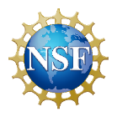



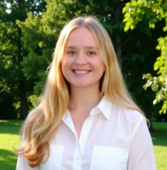
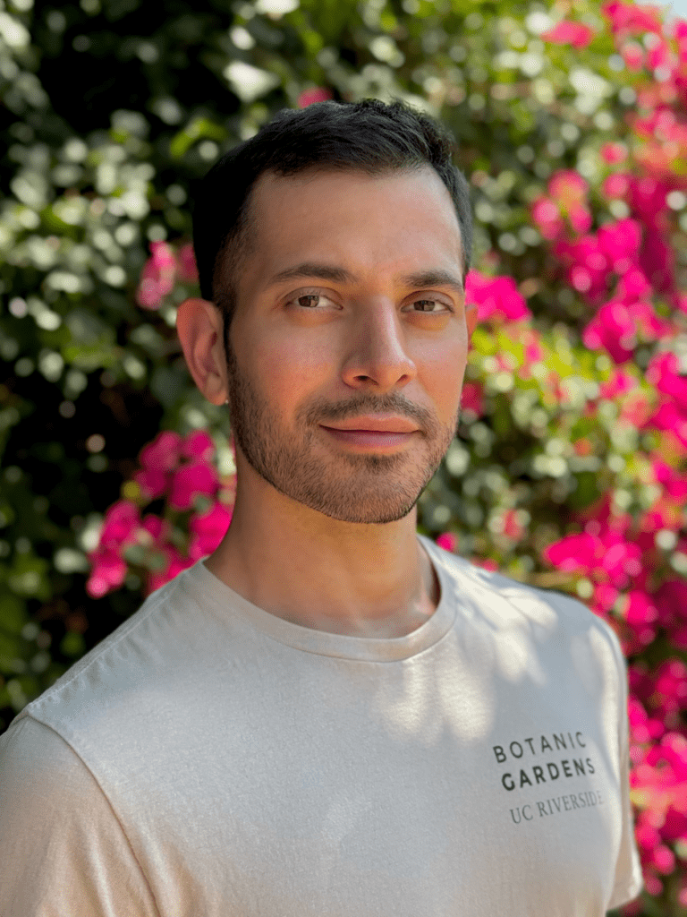
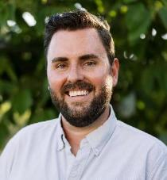
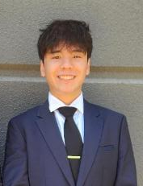
Bioremediation of Nanoplastics Using Mycelium Paddy Biopods and Plants
Phoebe Corcell, YSP Student - Wakefield Memorial High School
Marcus Klingler, YSP Student - Danvers High School
Christopher Castillo, Postdoc Scholar – Department of Chemical Engineering, Chemistry and Chemical Biology Northeastern University
Dr. Adam A. Caparco, Prof. Of Chemical Engineering, Chemistry and Chemical Biology – Northeastern University
Center for STEM Education Staff

Slide 2
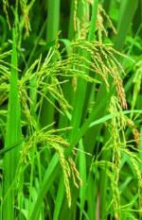

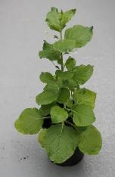
Abstract
Plastic production and pollution have increased dramatically; nanoplastics have accumulated in the environment
Nanoplastics pose a danger to agricultural processes and human life
This investigation explores the potential role of mycelium paddies in bioremediation within a hydroponic system
Involves two plants (monocot: O. sativa (Oryza sativa)); eudicot: N. benthamiana (Nicotiana benthamiana))
  The main structural differences between monocots and eudicots involve seed leaves, stem layout, and root systems, specifically: one vs. two cotyledons (embryonic leaf), scattered vs. ringed vascular bundles, and fibrous vs. taproot systems
Involves two polystyrene nanoplastics (abbrev. PS NP): 20 nm dyed Nile red (NR), 30 nm dyed Yellow-green fluorophore (YG)
Results:
A hydroponic system that could successfully facilitate the growth of O. sativa and N. benthamiana inside mycelium paddies
Mycelium successfully remediated systems for both plants
Bioremediation of Nanoplastics Using Mycelium Paddy Biopods and Plants
NEU Young Scholars Program June 22, 2026 – July 30, 2026

Slide 3
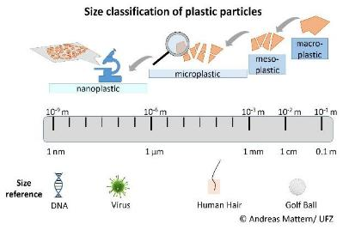
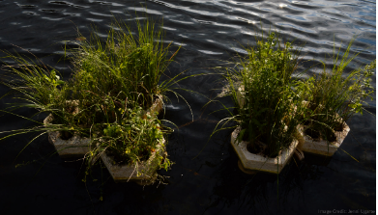
Background
Environmental stressors like ultraviolet (UV) radiation, mechanical abrasion, and temperature fluctuations cause plastics to become brittle and crack, gradually breaking them into smaller pieces until they reach the nanoscale
Increased concentration of nanoplastics in the environment threatens organic life and the most critical agriculturally relevant plants
Fungi are excellent bioremediators, capable of absorbing and breaking down pollutants from water
Biopods, developed by Biopod Co use floating mycelium nodes equipped with plants in bioremediation
This investigation uses Biopods, using mycelium columns and plants
Size classification of plastic particles; Credit: https://www.transcend.org/tms/2022/02/how-nanoplastics enter-the-human-body/
Hypotheses:
Both O. sativa and N. benthamiana will uptake both nanoplastics.
The mycelium paddies will absorb both the nanoplastics in the hydroponic systems.
Biopod anchored in Triplets;
Credit: Banerjee, M., Velho, A., Metha, V., & Zolotovsky, K. (2023). Bipods: Integrating Regenerative Technologies into Urban Ecologies.
Bioremediation of Nanoplastics Using Mycelium Paddy Biopods and Plants
NEU Young Scholars Program June 22, 2026 – July 30, 2026

Slide 4
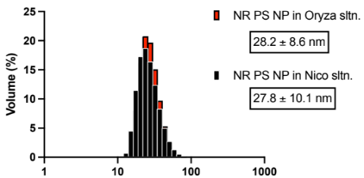
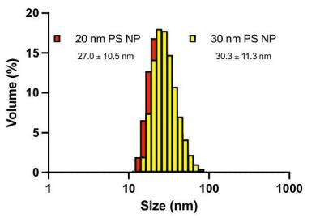
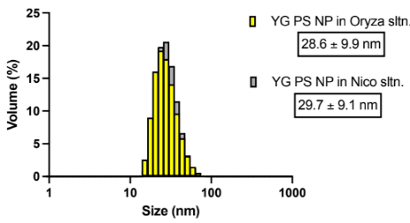
Dynamic Light Scattering (DLS) Data
Nutrient Solutions
Using the Malvern Zetasizer, the hydrodynamic sizes of the 20 and 30 nm PS NPs were determined.
Measures particle size by shining a laser through a liquid suspension and analyzing the fluctuations in the scattered light
DI Water
Hydrodynamic size refers to the size of a particle in an aqueous medium​
These tests could confirm the size of the nanoparticles, as well as show how the size of the particle may differ indifferent solutions​
Sample size (n=6)
Bioremediation of Nanoplastics Using Mycelium Paddy Biopods and Plants
NEU Young Scholars Program June 22, 2026 – July 30, 2026

Slide 5
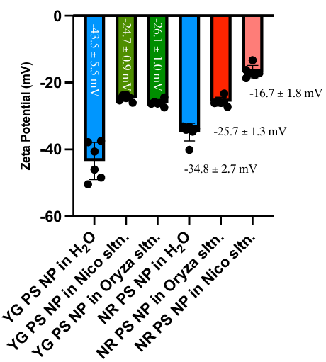
Dynamic Light Scattering (DLS) Data
Using the Malvern Zetasizer, the zeta potential of the 20 and 30 nm PS NPs were also determined.
Zeta potential is a measure of the electric charge surrounding particles in a liquid
In the nutrient solutions, the zeta potential decreased. However, it still retains a high negative zeta potential, suggesting it will still be able to bypass the plant membrane.
A high zeta potential (+30 mV / -30 mV) indicates that particles will stay separated/repel each other
A low zeta potential (near 0 mV) suggests the particles will collide/clump
A high zeta potential, negative or positive, is required for the nanoparticles to bypass the plant cell membrane
Sample size (n=6)
Bioremediation of Nanoplastics Using Mycelium Paddy Biopods and Plants
NEU Young Scholars Program June 22, 2026 – July 30, 2026

Slide 6
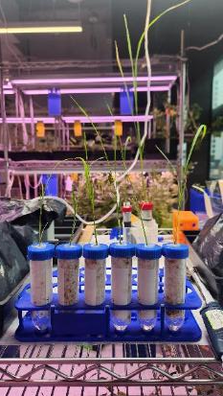
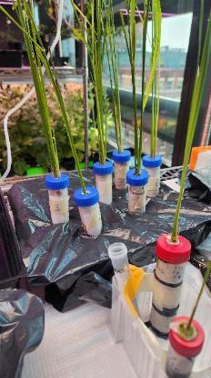
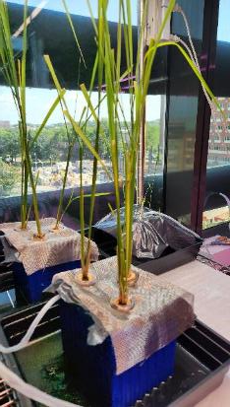
Setup 1
Setup 2
Setup 3
6 O. sativa samples (still in microcentrifuge tubes) placed into falcon tubes containing mycelium column
Falcon tubes filled with nutrient solution
6 O. sativa samples placed into falcon tubes containing mycelium column
Roots of O. sativa samples were threaded through mycelium column to directly expose the roots to nutrient solution
6 O. sativa samples in falcon tubes with the bottoms cut off
Submerged completely in nutrient solution
Mesh wire used to suspend the plants upright within solution
Bioremediation of Nanoplastics Using Mycelium Paddy Biopods and Plants
NEU Young Scholars Program June 22, 2026 – July 30, 2026

Slide 7
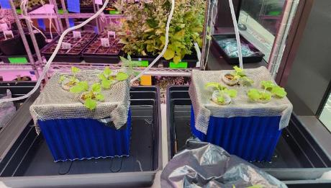
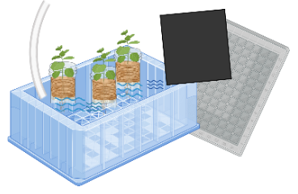
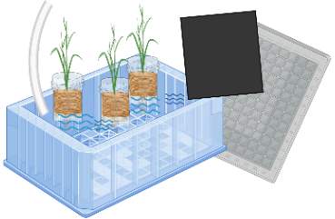
Our Final Setup
Setup 4
N. benthamiana
O. sativa
6 Nicotiana benthamiana samples (3-4 week old plants) placed into mycelium columns (column height reduced by ~75%)
Plant and mycelium columns suspended using wire mesh to allow total submersion of N. benthamiana roots within the hydroponic system
Bioremediation of Nanoplastics Using Mycelium Paddy Biopods and Plants
NEU Young Scholars Program June 22, 2026 – July 30, 2026

Slide 8
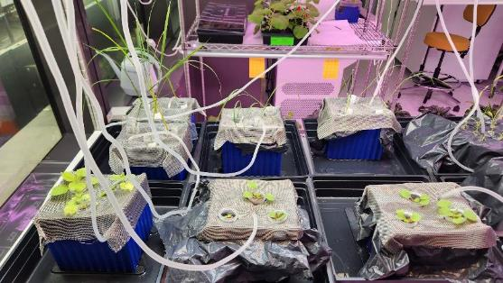
Our Final Setup
YG-treated O. sativa plants (n=3)
Control O. sativa plants (n=6)
NR-treated O. sativa plants (n=3)
Control N. benthamiana plants (n=6)
YG-treated N. bethamiana plants (n=3)
Final concentration (experimental):
0.00294% NR PS NP
0.00235% YG PS NP
NR-treated N. bethamiana plants (n=3)
Bioremediation of Nanoplastics Using Mycelium Paddy Biopods and Plants
NEU Young Scholars Program June 22, 2026 – July 30, 2026

Slide 9
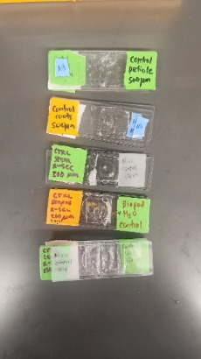
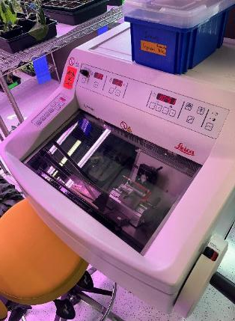
Cryostat Microtome
Samples of plant tissue taken from control and experimental plants
Plant tissue sliced thinly using cryostat microtome
Slices prepared on microscope slide and used for observation and imaging
Bioremediation of Nanoplastics Using Mycelium Paddy Biopods and Plants
NEU Young Scholars Program June 22, 2026 – July 30, 2026

Slide 10
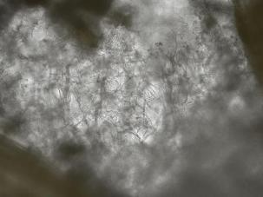
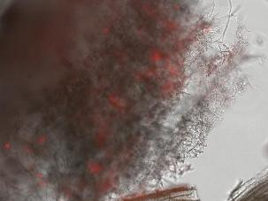
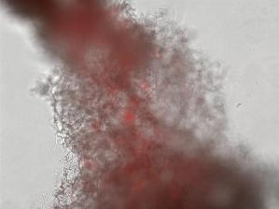
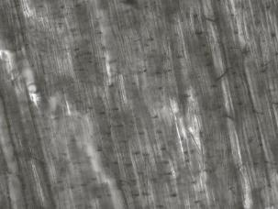
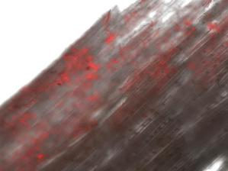
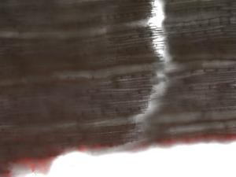
N. benthamiana Biopod Overlay
Control
Experimental
Experimental
Mycelium Fungus
Wood
Bioremediation of Nanoplastics Using Mycelium Paddy Biopods and Plants
NEU Young Scholars Program June 22, 2026 – July 30, 2026

Slide 11
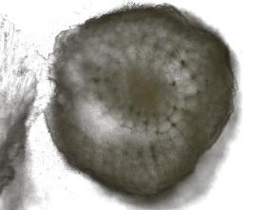
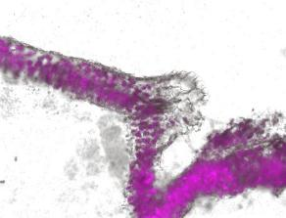


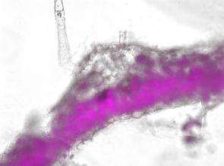
N. benthamiana Plant Tissue Overlay
Root
Petiole
Leaf
Control
Experimental (NR)
Bioremediation of Nanoplastics Using Mycelium Paddy Biopods and Plants
NEU Young Scholars Program June 22, 2026 – July 30, 2026

Slide 12
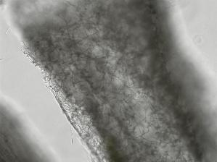
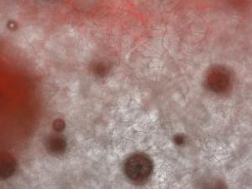
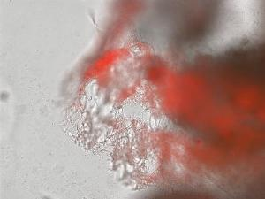
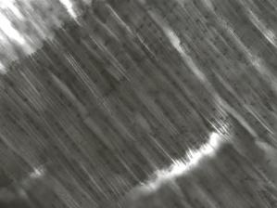
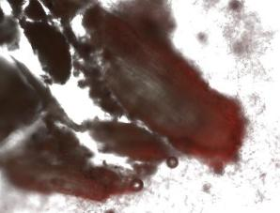
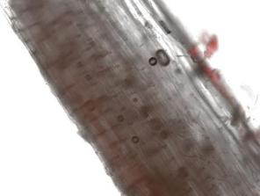
O. sativa Biopod Overlay
Control
Experimental
Experimental
Mycelium Fungus
Wood
Bioremediation of Nanoplastics Using Mycelium Paddy Biopods and Plants
NEU Young Scholars Program June 22, 2026 – July 30, 2026

Slide 13
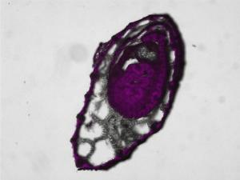

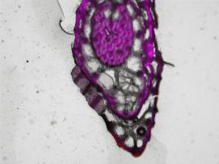
O. sativa Plant Tissue Overlay
Root
Stem
Leaf
Control
Experimental (NR)
Bioremediation of Nanoplastics Using Mycelium Paddy Biopods and Plants
NEU Young Scholars Program June 22, 2026 – July 30, 2026

Slide 14
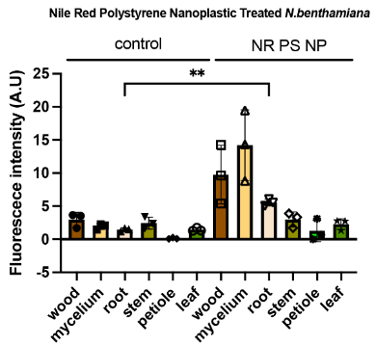
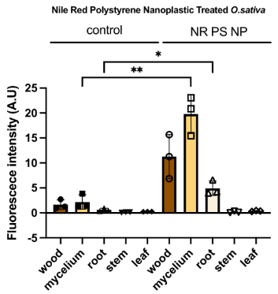
Fluorescence Intensity Results
N. benthamiana
O. sativa
Fluorescence intensity increased significantly from control to experimental imaging within Biopod materials (mycelium + wood) and plant roots
Nile Red PS NP
Bioremediation of Nanoplastics Using Mycelium Paddy Biopods and Plants
NEU Young Scholars Program June 22, 2026 – July 30, 2026

Slide 15
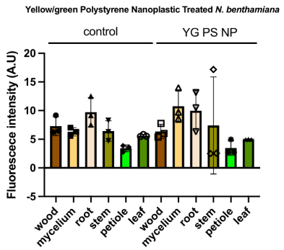
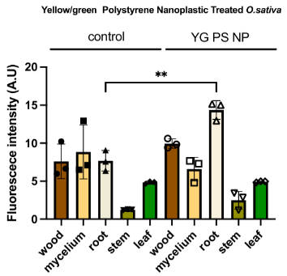
Fluorescence Intensity Results
N. benthamiana
O. sativa
Changes in fluorescence intensity detected, but higher autofluorescence may cause false positives (requires further experimentation)
Yellow-Green PS NP
Bioremediation of Nanoplastics Using Mycelium Paddy Biopods and Plants
NEU Young Scholars Program June 22, 2026 – July 30, 2026

Slide 16
Conclusion and Future Steps
Results:
(Eudicot) - For N. benthamiana, a significant amount of the NR PS NPs were absorbed by the mycelium column materials and the plant roots.
(Monocot) - For O. sativa, a significant amount of the NR and YG PS NPs were absorbed by the mycelium column. Similarly, NR and YG PS NPs were identified in the roots.
Overall, mycelium Biopods were successful at bioremediating fluorescent nanoplastics.
Future Steps:
Experiment with longer plant incubation time with the nanoplastics/until plants fully develop (long-term implications of nanoplastic exposure)
Experiment with different widths/heights of mycelium paddies
Use confocal imaging to increase detection sensitivity
Bioremediation of Nanoplastics Using Mycelium Paddy Biopods and Plants
NEU Young Scholars Program June 22, 2026 – July 30, 2026

Slide 17

Acknowledgements
Caparco Research Group
Dr. Adam A. Caparco, Principal Investigator
Christopher Castillo, Postdoctoral Scholar and Mentor
Manini Banerjee and Avantika Velho, Graduate Students
Lauren Jolley, Undergraduate Student
Center for STEM Education​
Claire Duggan, Executive Director
Jennifer Love, Associate Director
Ahmed Othman, Kenneth Santizo, and Frances Corcell, YSP Coordinators
Nicolas Fuchs, Program Manager
Mary Howley, Administrative Officer
Bioremediation of Nanoplastics Using Mycelium Paddy Biopods and Plants
NEU Young Scholars Program June 22, 2026 – July 30, 2026

Slide 18
References
Banerjee, M., Velho, A., Metha, V., & Zolotovsky, K. (2023). Bipods: Integrating
Regenerative Technologies into Urban Ecologies.
2. Zhu, R., Wang, Y., Yuan, Y., Zhou, F., Yan, N., Song, Q., Zhong, H., & Dang, F. (2026). Route-
Specific Phytotoxicity: Foliar Polystyrene Nanoplastics Inhibit Rice Photosynthesis. Environmental
science & technology, 60(5), 3899–3910.
3. Kochanek, A.; et al., Micro- and Nanoplastics in the Environment: Current State of Research, Sources of Origin, Health Risks, and Regulations—A Comprehensive Review. Toxics 2025, 13, 564. https://doi.org/10.3390/toxics13070564
4. Min Hao Wong, Rahul P. Misra, Juan P. Giraldo, Seon-Yeong Kwak, Youngwoo Son, Markita P. Landry, James W. Swan, Daniel Blankschtein, Michael S. Strano; Lipid Exchange Envelope Penetration (LEEP) of Nanoparticles for Plant Engineering: A Universal Localization Mechanism. Nano Lett. 10 February 2016; 16 (2): 1161–1172.
Bioremediation of Nanoplastics Using Mycelium Paddy Biopods and Plants
NEU Young Scholars Program June 22, 2026 – July 30, 2026

Slide 19
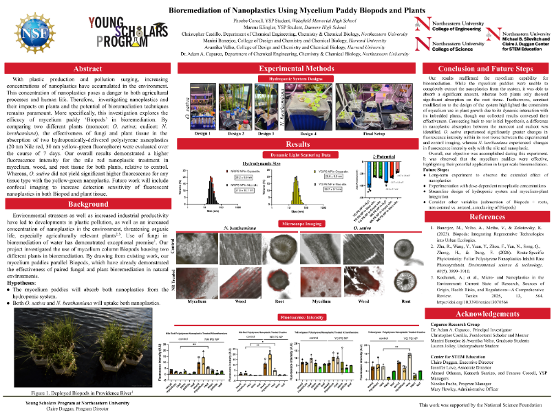
Bioremediation of Nanoplastics Using Mycelium Paddy Biopods and Plants
NEU Young Scholars Program June 22, 2026 – July 30, 2026

