Slide 1





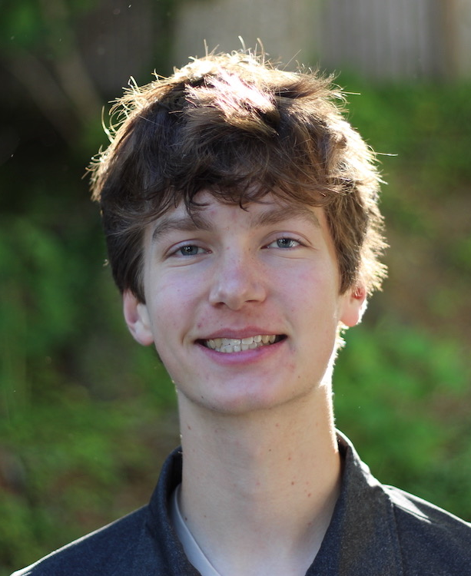
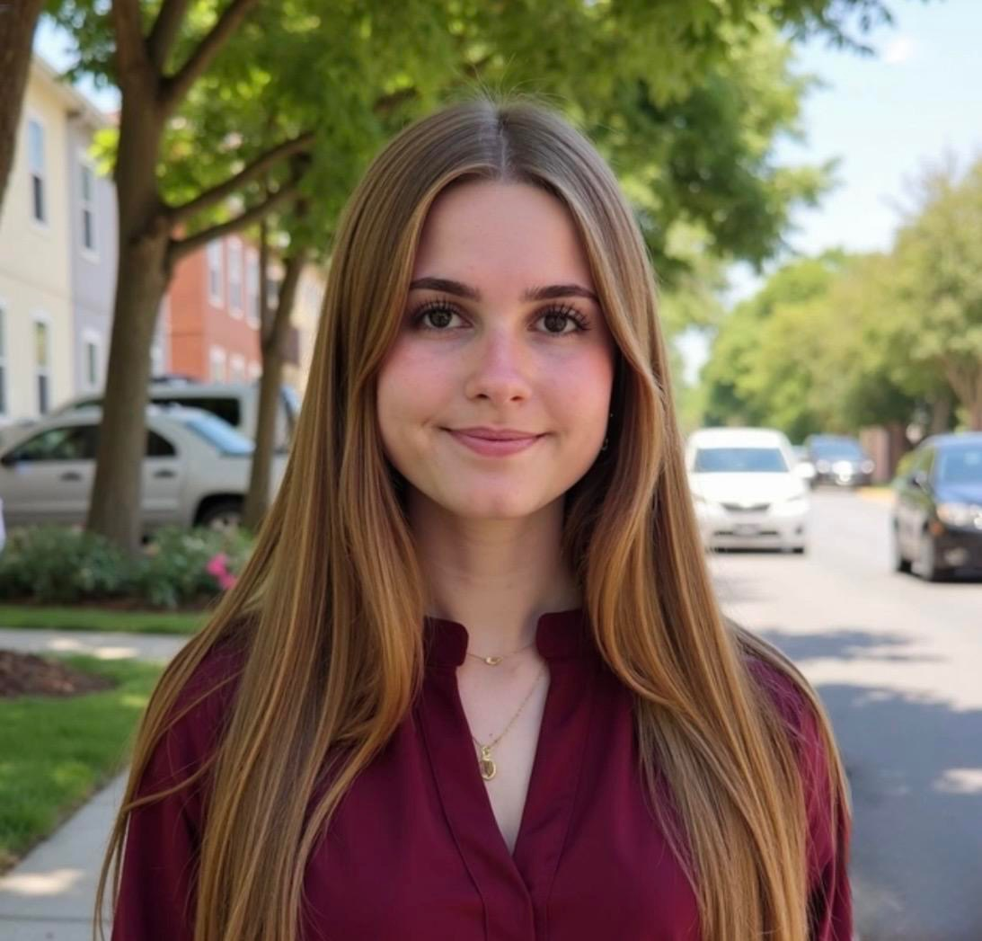
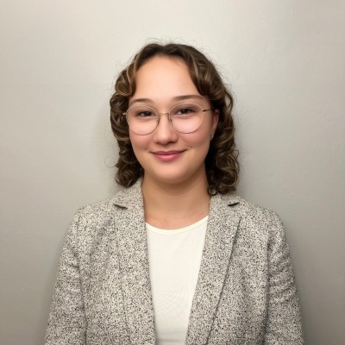
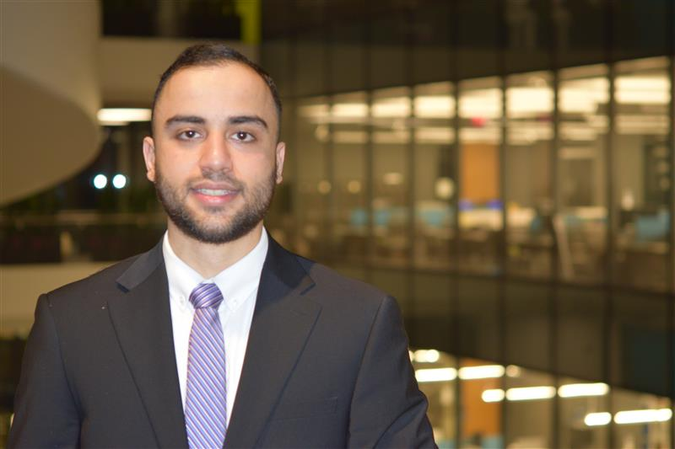
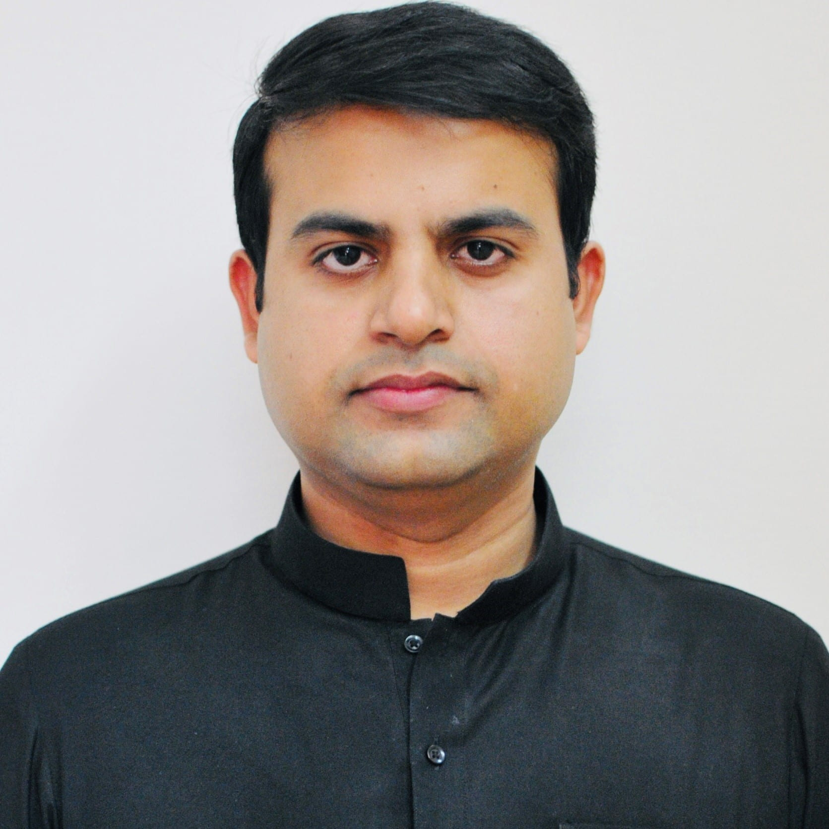
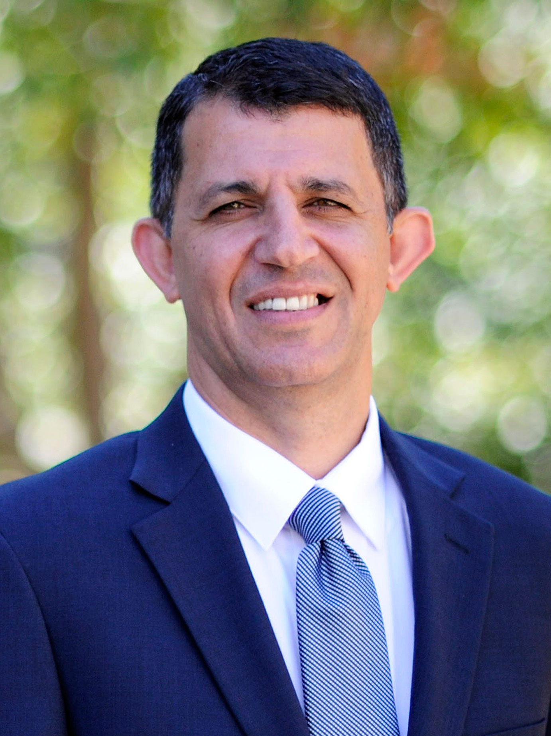
Synthesis and Characterization of Biomass-Derived Activated Carbon for Electrochemical Water Treatment
Spencer Seidel, YSP Student, Needham High School
Chelsea Bateman, YSP Student, Boston Latin School
Amanda Thomas – PhD. Candidate
Nima Sakhaee – PhD. Candidate
Fahad Ehsan – Research Scientist
Akram Alshawabkeh – Program Director
Synthesis and Characterization of Biomass-Derived Functional Carbon for Electrochemical Water Treatment
NEU Young Scholars Program June 22, 2026 - July 30, 2026
1

Slide 2

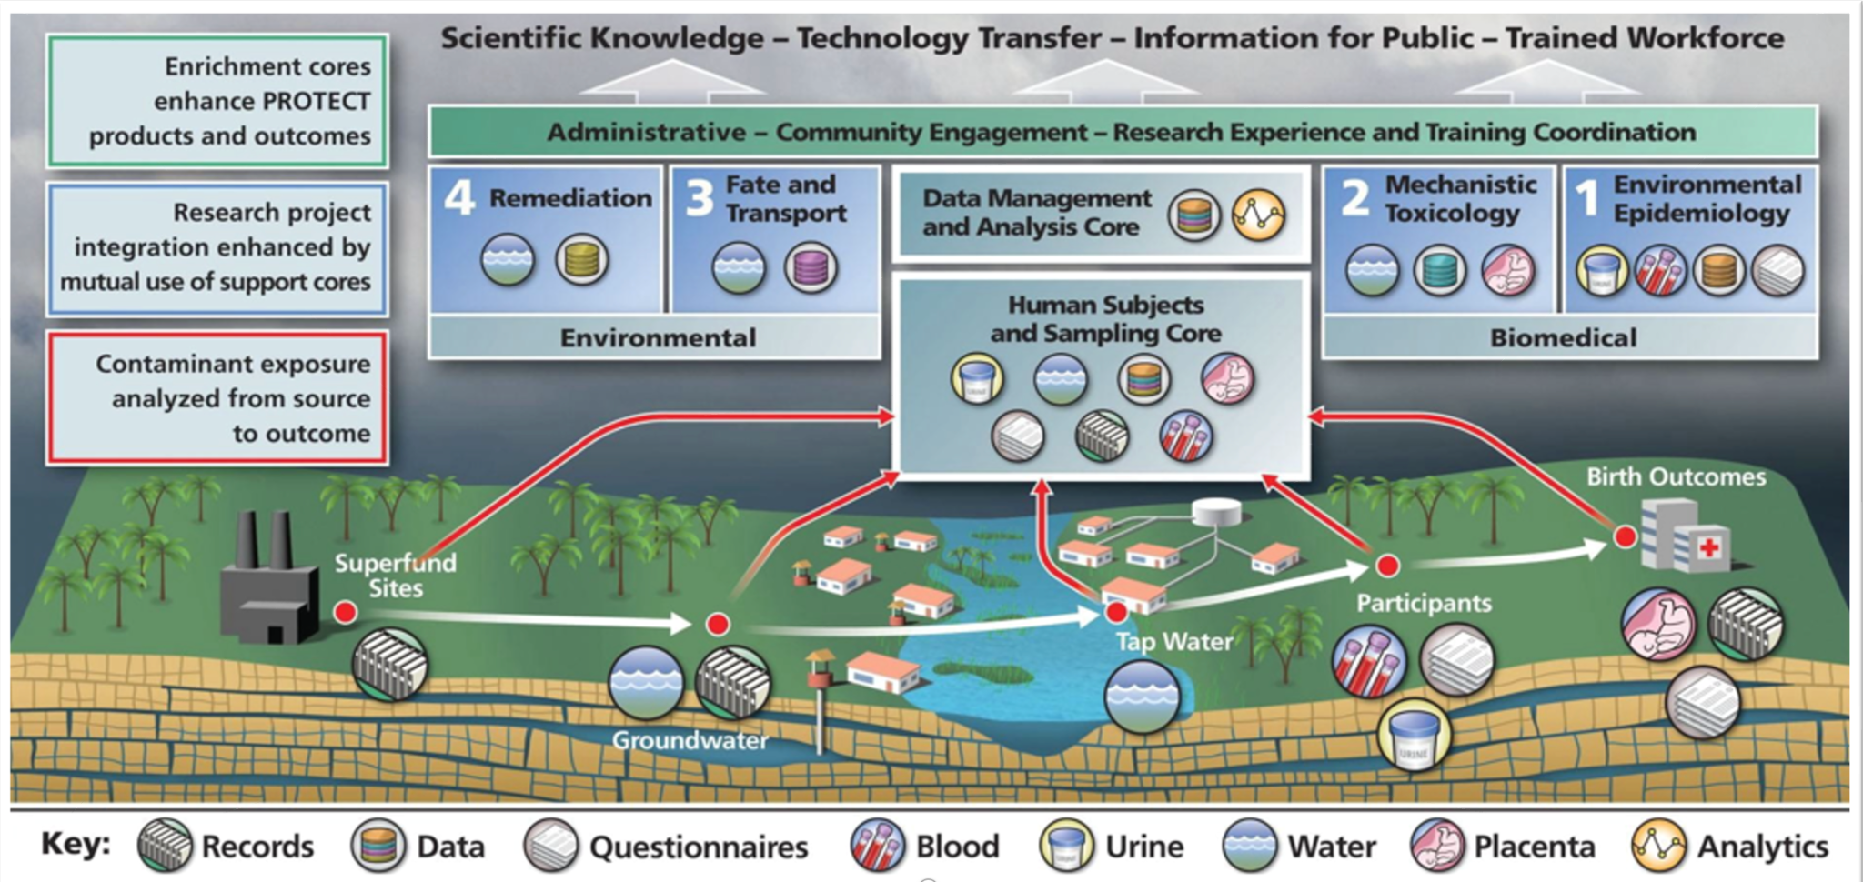
PROTECT Center
Puerto Rico Testsite for Exploring Contamination Threats
(PROTECT Research Lab, 2024)
Synthesis and Characterization of Biomass-Derived Functional Carbon for Electrochemical Water Treatment
NEU Young Scholars Program June 22, 2026 - July 30, 2026
Notes:
PROTECT aims to investigate environmental contamination and adverse birth outcomes in Puerto Rico
Emerging Contaminants (ECs) in drinking water are known to cause:
Preterm births
Pregnancy complications
Other disease & health complications
Goal: Develop a portable, low-maintenance, and sustainable water filtration technology that can be used by the people of Puerto Rico

Slide 3
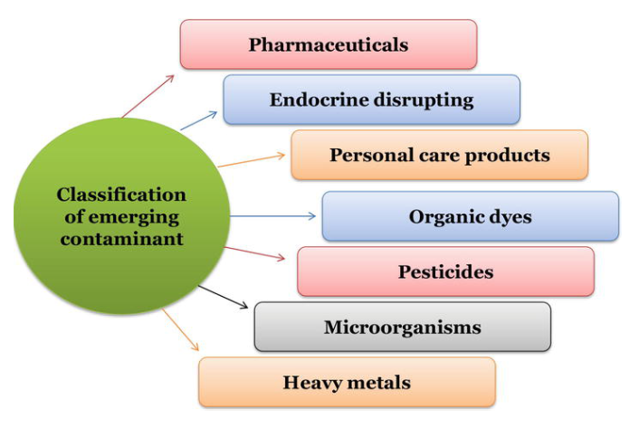
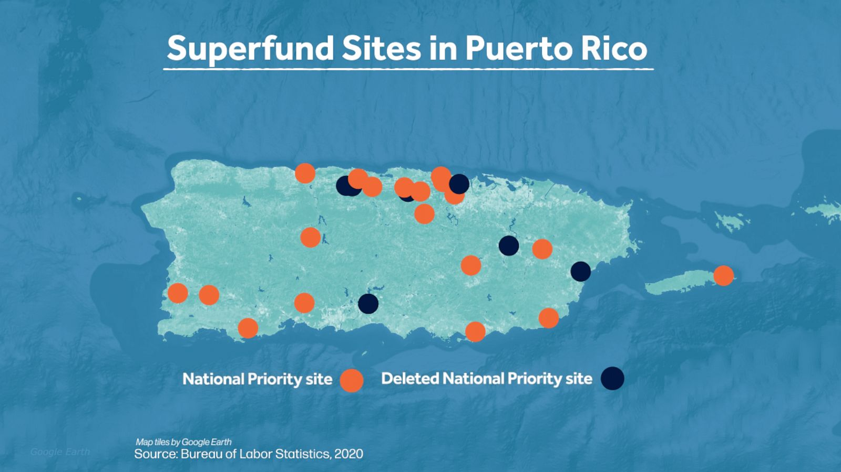
PROTECT Center
Puerto Rico Testsite for Exploring Contamination Threats
Goal: Develop a portable, low-maintenance, and sustainable water filtration technology that can be used by the people of Puerto Rico
Figure 2: Emerging contaminants (Mahmood 2022)
Figure 1: Map displaying the 19 Superfund sites throughout Puerto Rico, (ABC News, 2026)
Synthesis and Characterization of Biomass-Derived Functional Carbon for Electrochemical Water Treatment
NEU Young Scholars Program June 22, 2026 - July 30, 2026
Notes:
PROTECT aims to investigate environmental contamination and adverse birth outcomes in Puerto Rico
Emerging Contaminants (ECs) in drinking water are known to cause:
Preterm births
Pregnancy complications
Other disease & health complications
Goal: Develop a portable, low-maintenance, and sustainable water filtration technology that can be used by the people of Puerto Rico

Slide 4
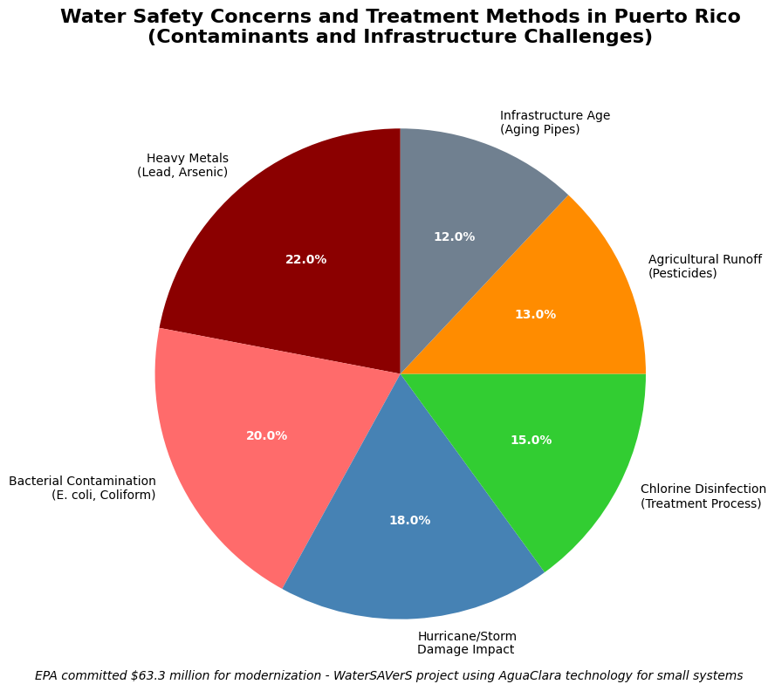
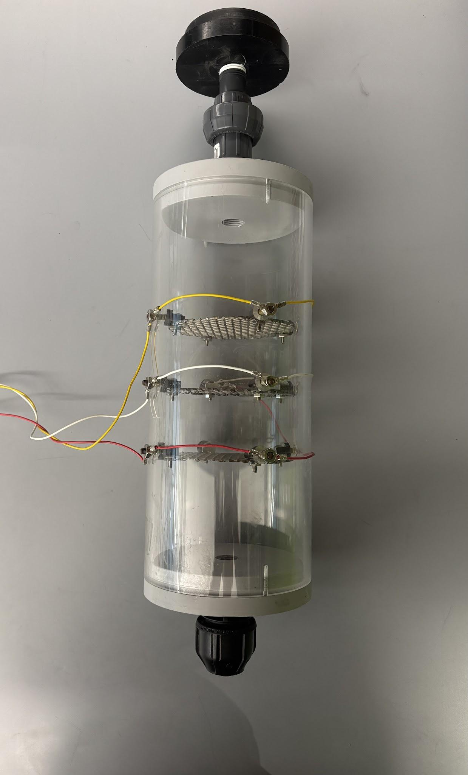
Biomass Derived Carbon
Water treatment
Invasive species mitigation
Figure 3: Contributions to pollution in Puerto Rico (Olympian Water Testing, 2025)
Figure 4: Electrochemical flow through reactor column
Synthesis and Characterization of Biomass-Derived Functional Carbon for Electrochemical Water Treatment
NEU Young Scholars Program June 22, 2026 - July 30, 2026
Notes:
Disposable water filters can become environmental waste
Heating up used filters can remove trapped waste, but this process is very energy intensive and is not generally accessible to the public.
Many filters are replaced before their expiration date due to being clogged with pollutants.
Carbon cathodes act as a solution to water pollution and sustainability.
Polarity reversal - longer lasting filtration, h2o2 breaks down contaminants

Slide 5
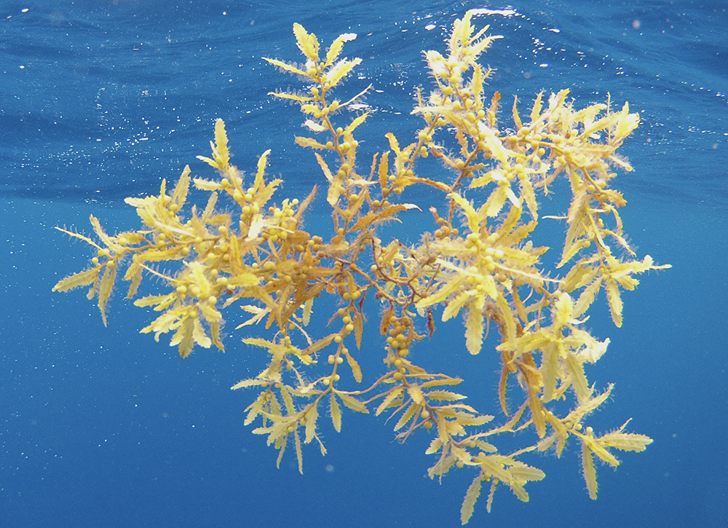
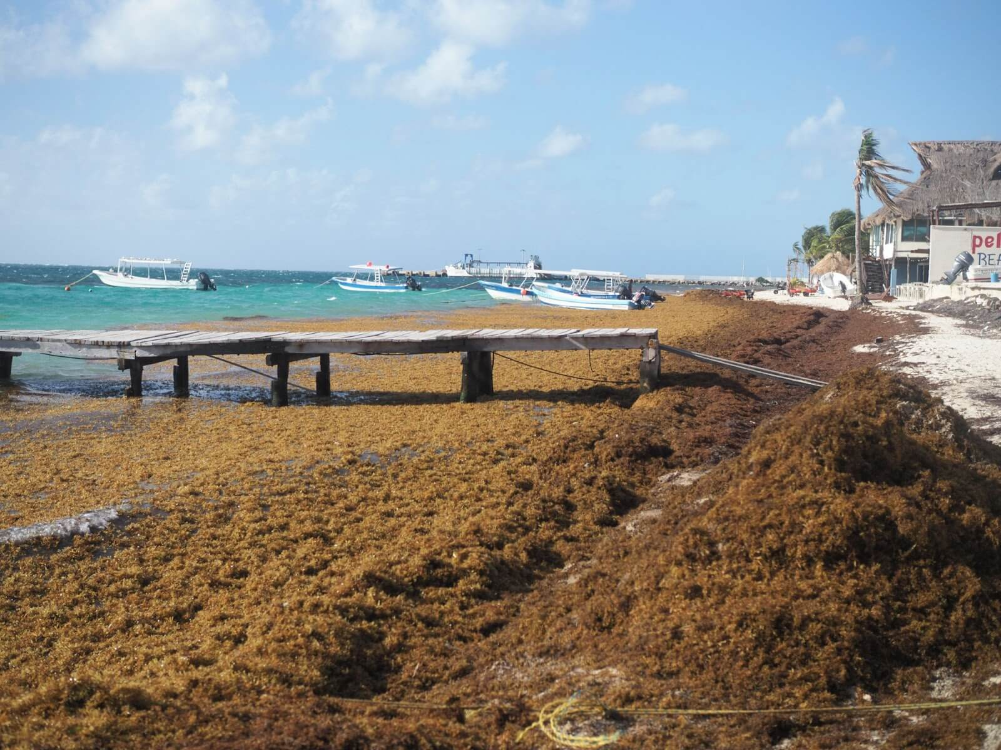
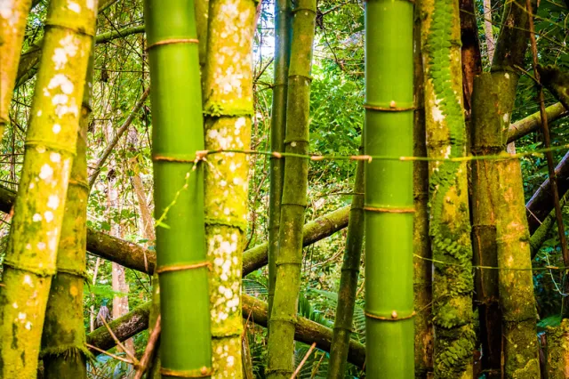
Invasive Species in Puerto Rico
Sargassum is an invasive seaweed in Puerto Rico
When washed up and left to decompose on a beach it releases hydrogen sulfide gas → respiratory irritation and headaches
Large belts in the ocean blocks sunlight → environmental harm
Makes beaches smell → harms tourism
(Furness, 2025)
(Jim, 2023)
(Carbonwave, 2023)
Synthesis and Characterization of Biomass-Derived Functional Carbon for Electrochemical Water Treatment
NEU Young Scholars Program June 22, 2026 - July 30, 2026
Notes:
Sargassum is an invasive seaweed in Puerto Rico
When washed up and left to decompose on a beach it releases hydrogen sulfide gas → respiratory irritation and headaches
Large belts in the ocean blocks sunlight → environmental harm
Makes beaches smell → harms tourism
Bamboo is an invasive species that has been spreading across Puerto rico
It crowds out native plants → loss of biodiversity

Slide 6
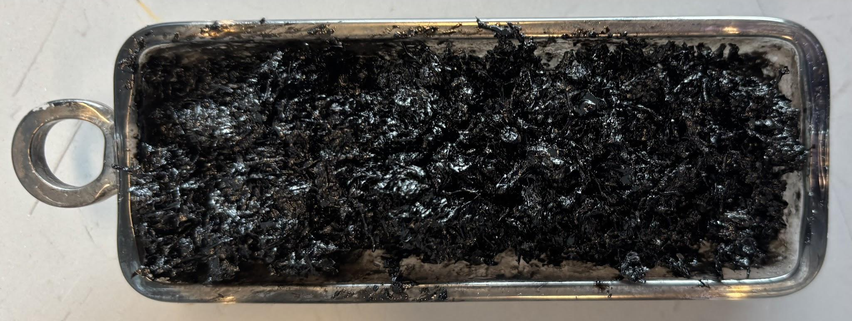
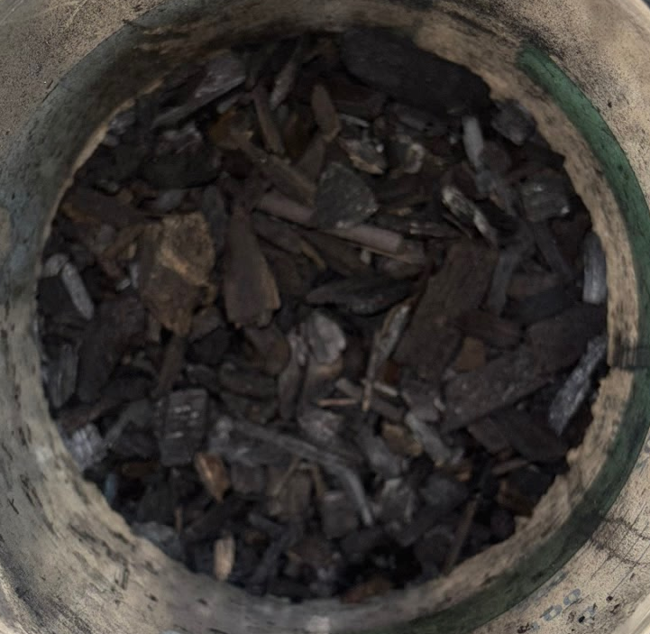
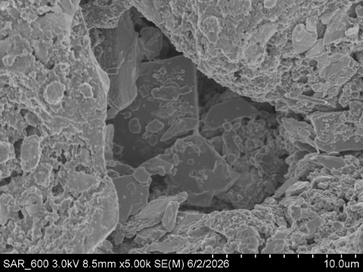
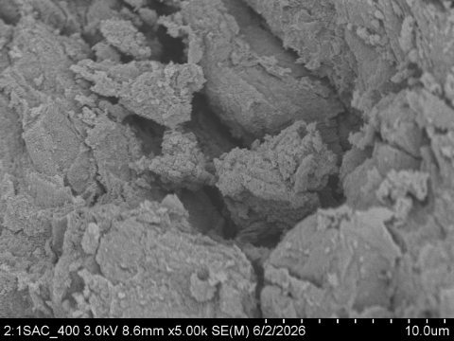
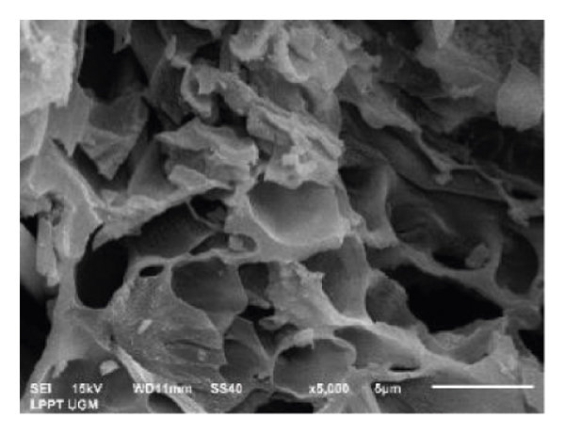
Activated Sargassum
Bamboo Biochar
Figure 5: Activated sargassum
Figure 6: Bamboo biochar
Figures 7a-1b: Activated sargassum under SEM
Figure 8: Bamboo biochar under SEM
Synthesis and Characterization of Biomass-Derived Functional Carbon for Electrochemical Water Treatment
NEU Young Scholars Program June 22, 2026 - July 30, 2026

Slide 7
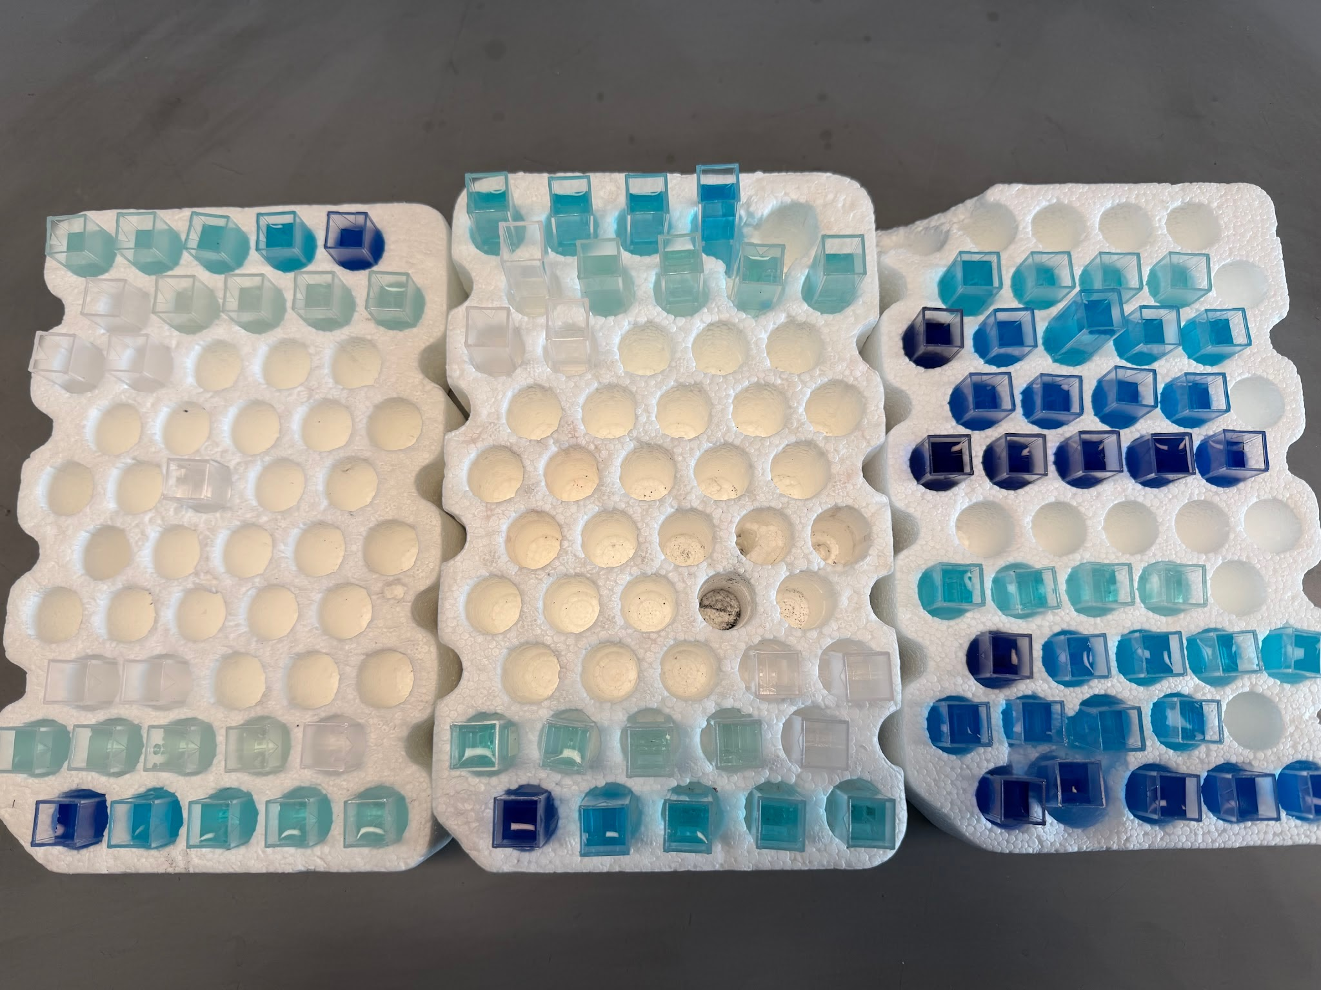
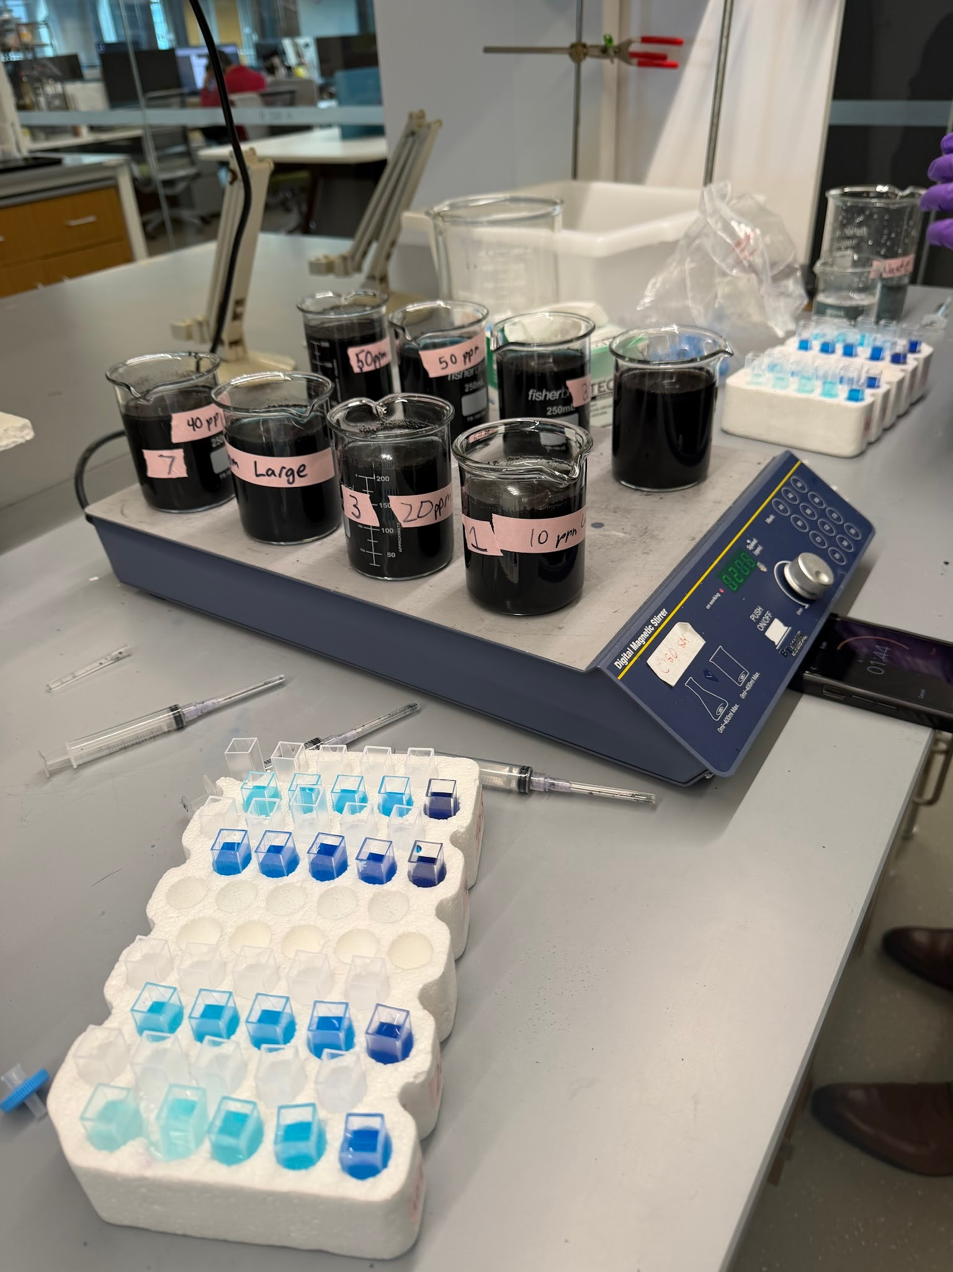
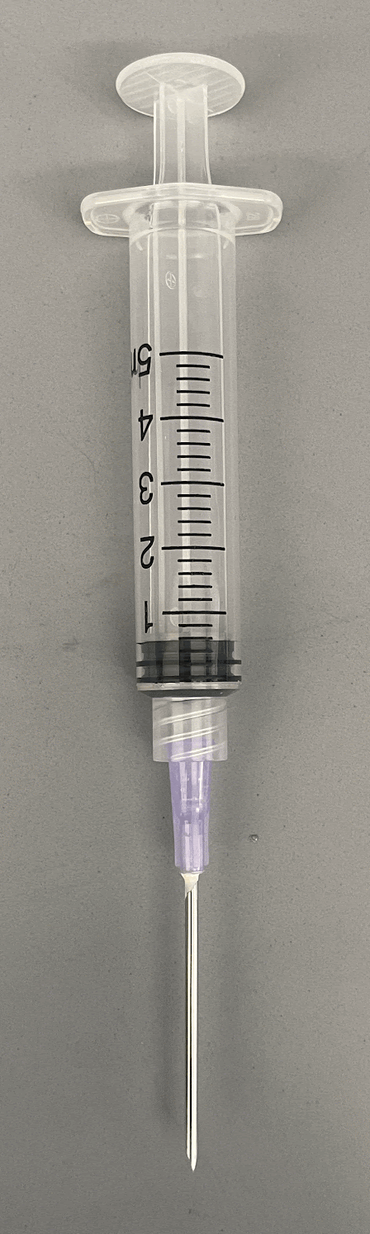
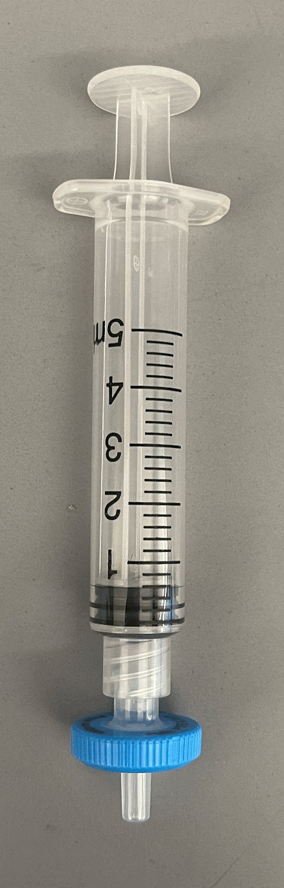
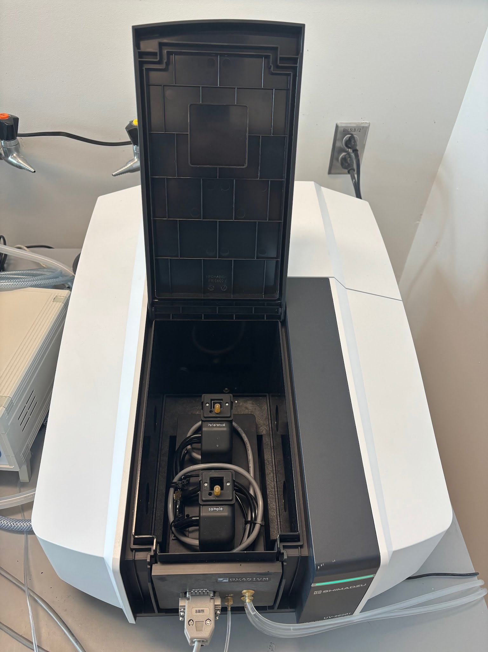
Experiment 1: Loose Bamboo Biochar
Samples were collected at varying time stamps and filtered into cuvettes.
Figure 11: Cuvettes
The cuvettes were analyzed with the UV-Vis Spectrophotometer for concentration of MB at each time stamp.
Figure 9: Loose bamboo biochar batch
experimental setup
Figure 10a and 10b: Syringes used for sample collection and filtration
Figure 12: UV-Vis Spectrophotometer
Synthesis and Characterization of Biomass-Derived Functional Carbon for Electrochemical Water Treatment
NEU Young Scholars Program June 22, 2026 - July 30, 2026
Notes:
200 mL of MB solution were prepared at concentrations of 10, 20, 30, 40, and 50 ppm
1.5 g of BB or SAC was added to each beaker and samples were taken at t = 0, 5, 10, 15, 20, 30, 45, 60, 80, 100, 120, 150, 180, and 1440 min
At each time point, an aliquot was taken using a needle and syringe and filtered into a cuvette with a 0.2um filter.
All samples were analyzed on a UV-Vis Spectrophotometer at 665 nm

Slide 8
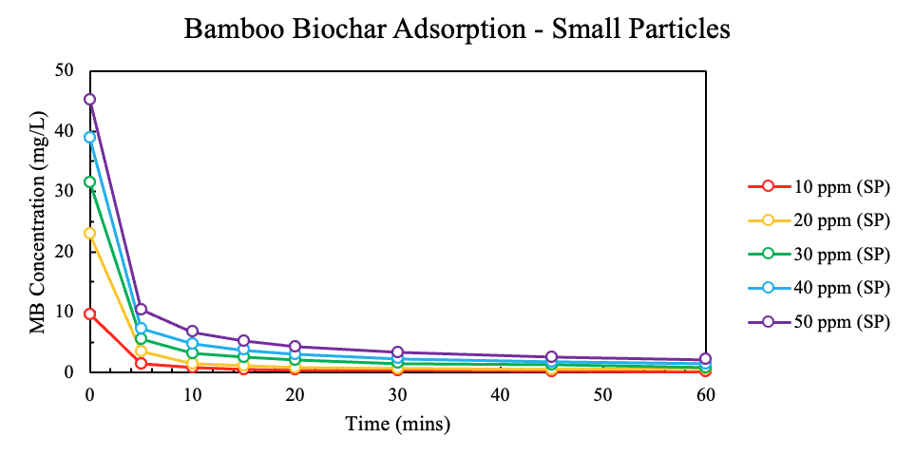
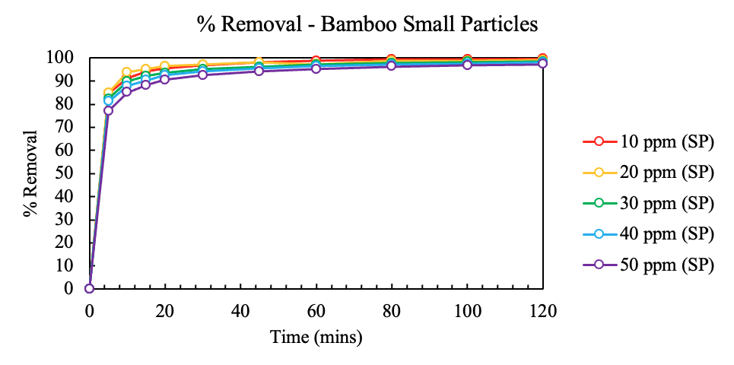
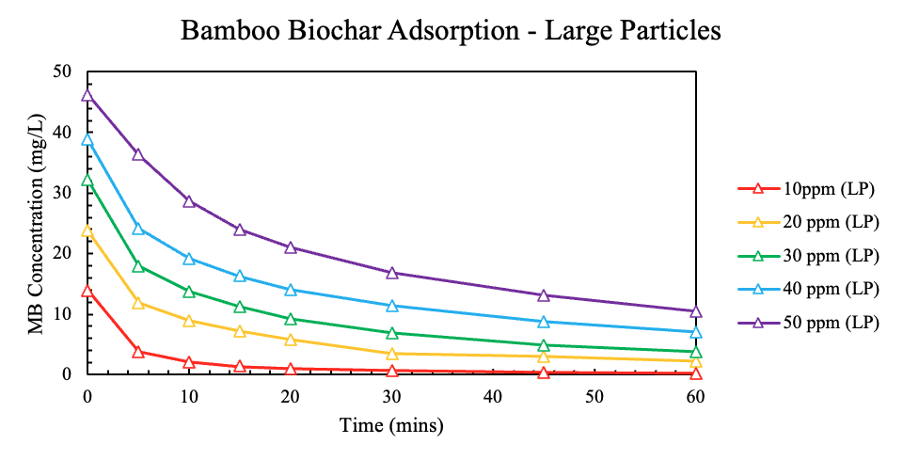
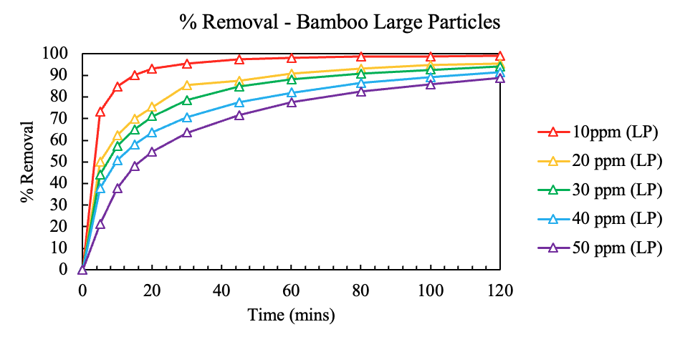
Loose Bamboo Biochar: Results and Conclusion
Figure 13a: Bamboo Biochar absorption - Small Particles
Figure 13b: % Removal - Bamboo Small Particles
Figure 14a: Bamboo Biochar absorption - Large Particles
Figure 14b: % Removal - Bamboo Large Particles
Synthesis and Characterization of Biomass-Derived Functional Carbon for Electrochemical Water Treatment
NEU Young Scholars Program June 22, 2026 - July 30, 2026

Slide 9
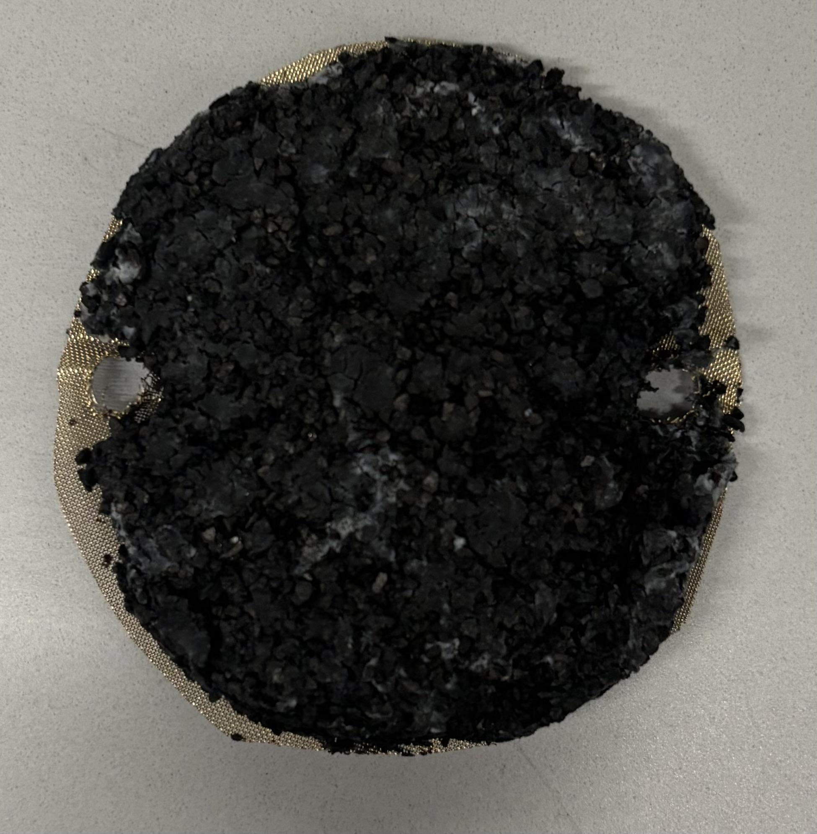
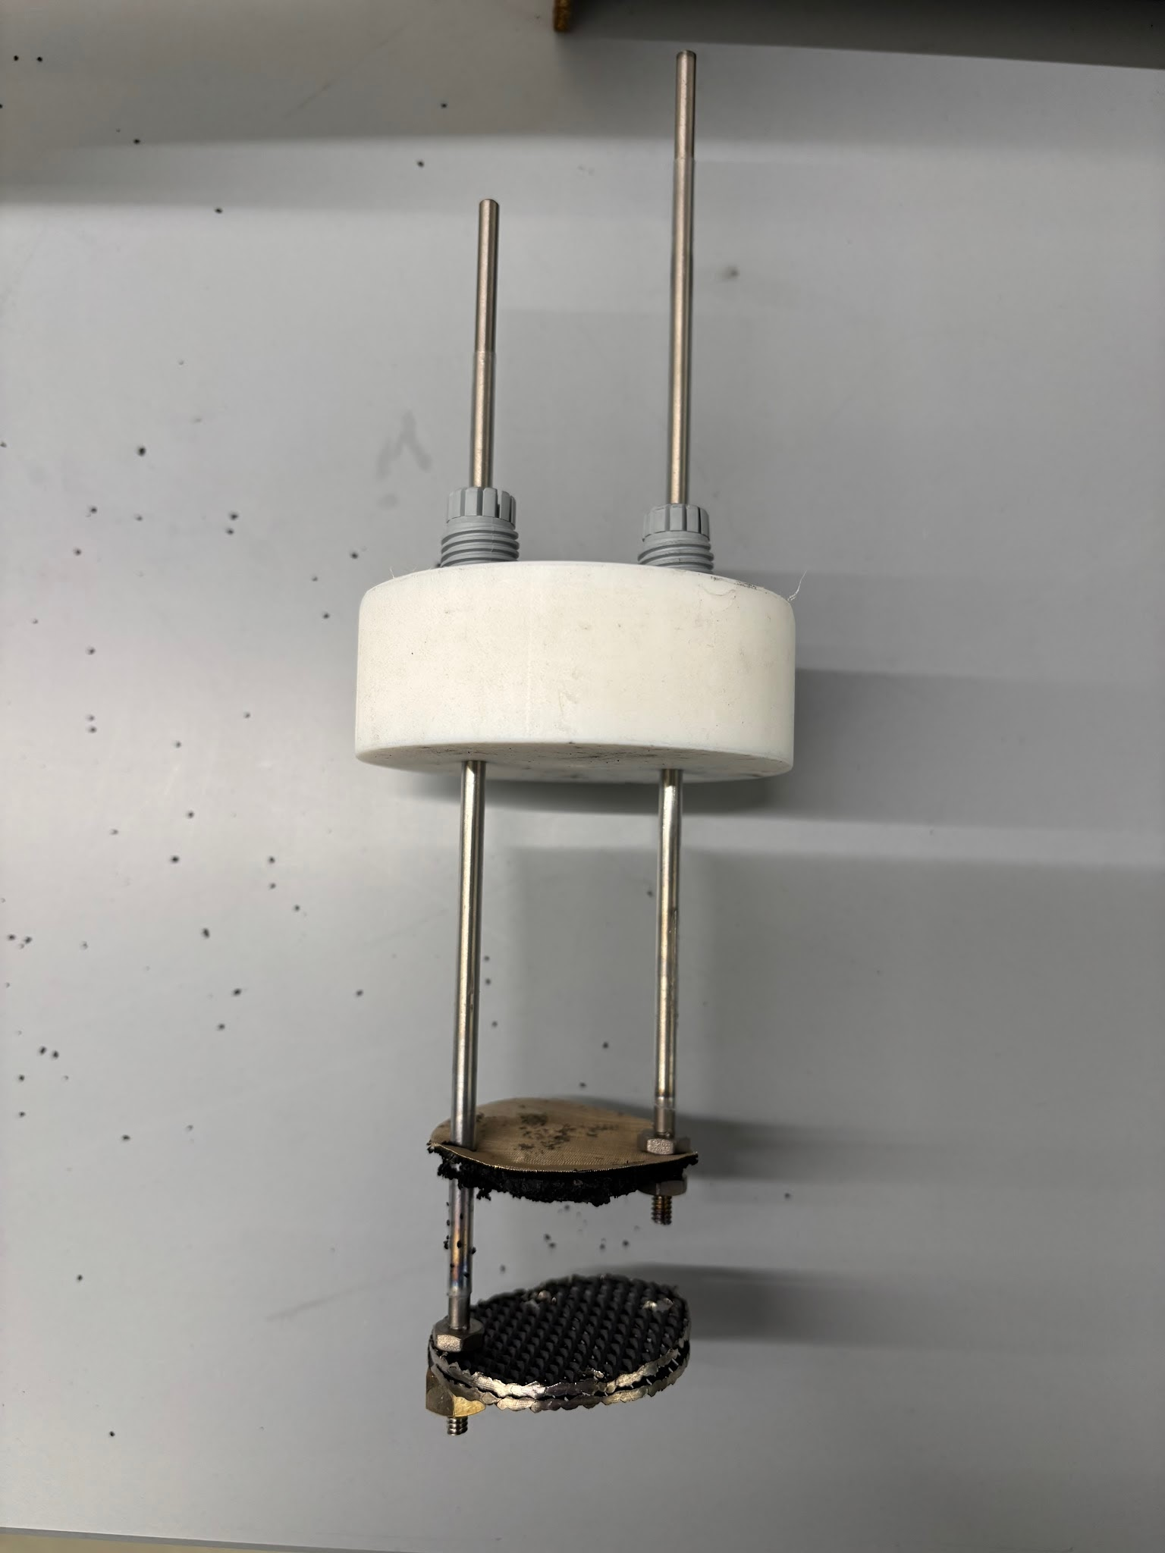
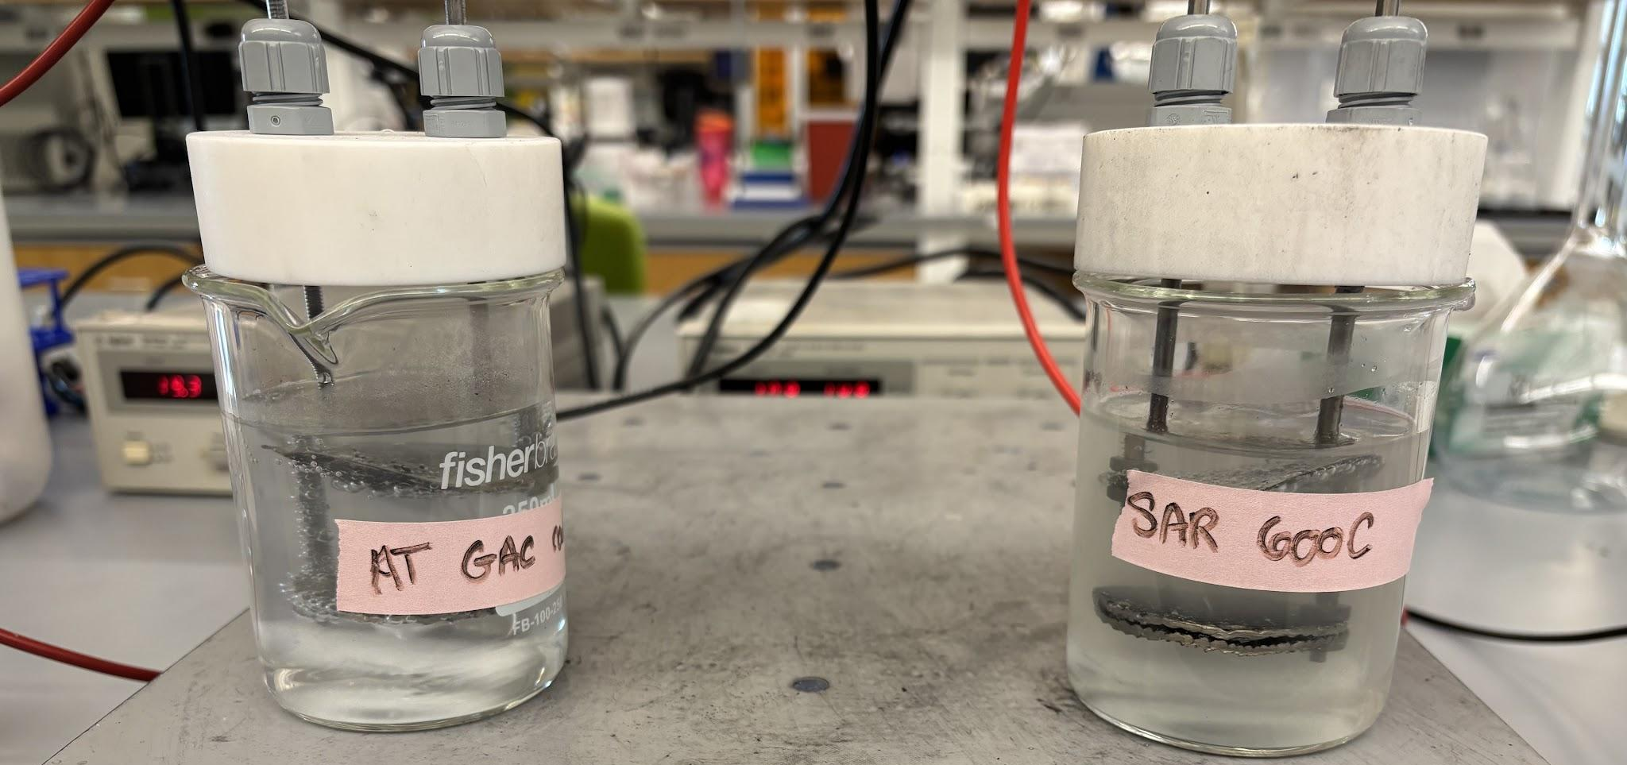
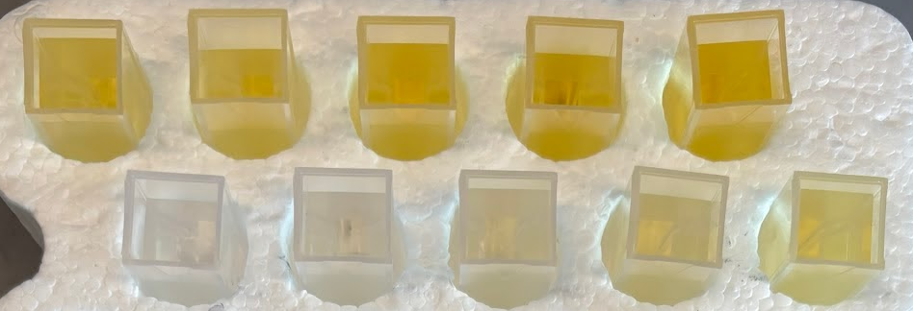
Experiment 2: Sargassum Electrochemical System
Samples were collected at varying time stamps and filtered into cuvettes.
Titanium rods securing electrodes
Cathode: Biomass-derived activated carbon on stainless steel mesh
Figure 15: Sargassum Cathode
Anode: Titanium mixed metal oxide
Figure 16: Electrochemical System Setups
The cuvettes were analyzed with the UV-Vis Spectrophotometer for concentration of H₂O₂ at each time stamp.
Figure 17: H₂O₂ Samples Figure 18: Labeled Electrochemical System
Synthesis and Characterization of Biomass-Derived Functional Carbon for Electrochemical Water Treatment
NEU Young Scholars Program June 22, 2026 - July 30, 2026

Slide 10
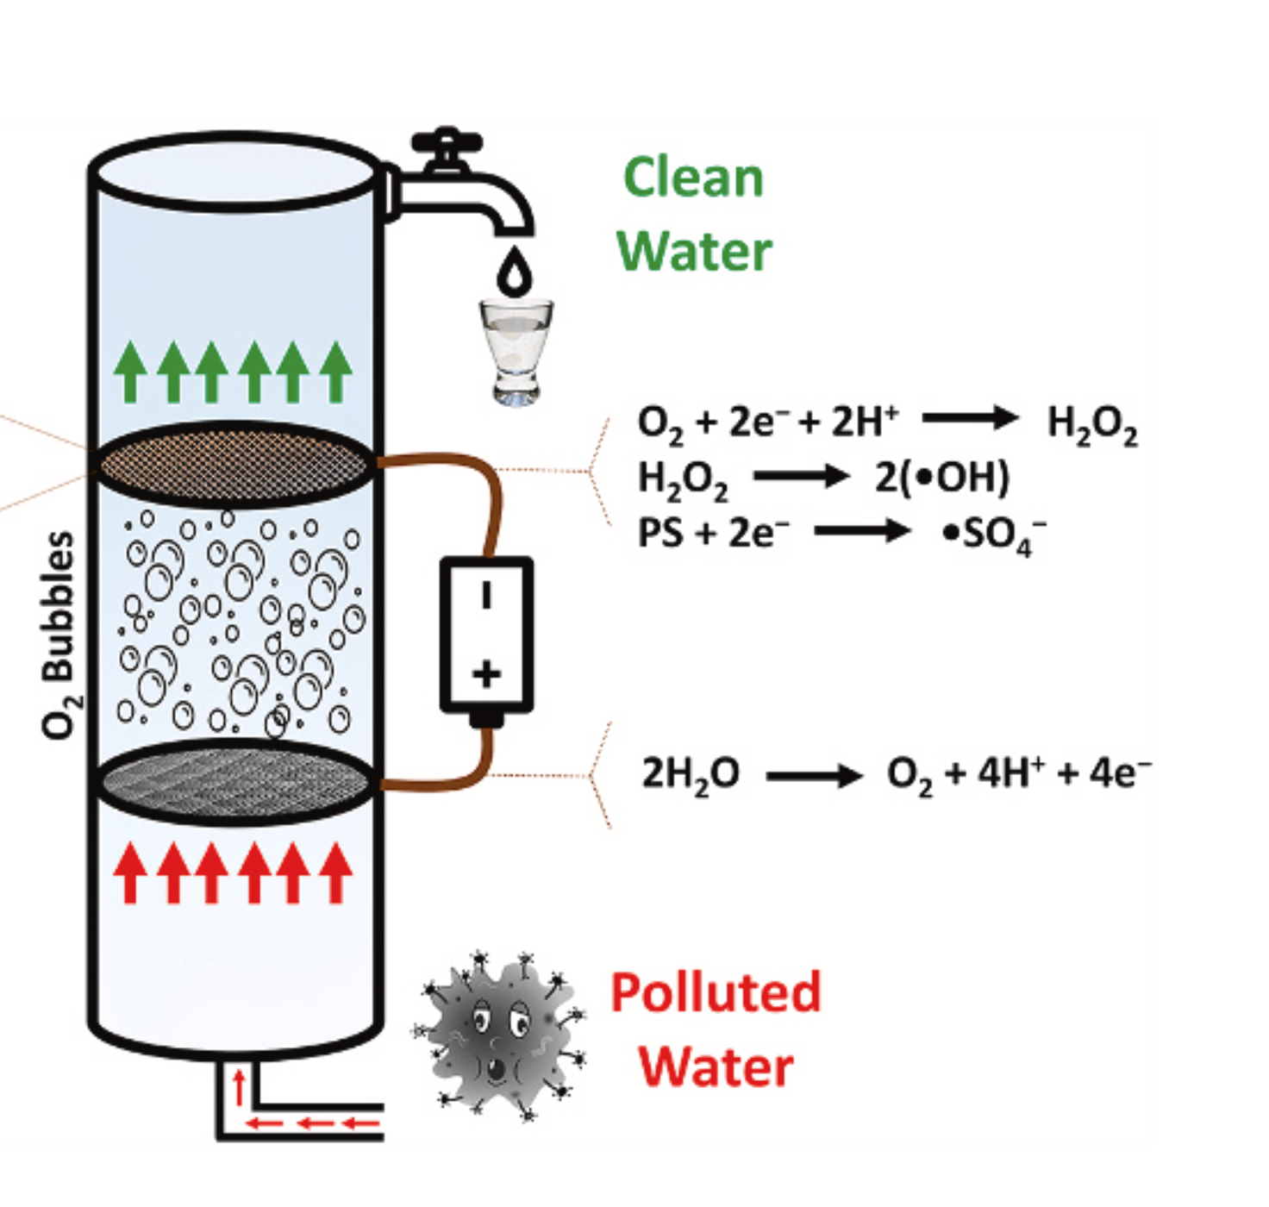
Hydrogen Peroxide Production
Oxygen is created at the anode
Oxygen interacts with cathode
2 electron oxidation reduction reaction
H₂O₂ produced at cathode surface
H₂O₂ breaks down emerging contaminants
in drinking water
O₂ + 2H⁺ + 2e⁻ → H₂O₂
Figure 17: H₂O₂ Samples
Figure 19: Diagram depicting reactor chemistry
Synthesis and Characterization of Biomass-Derived Functional Carbon for Electrochemical Water Treatment
NEU Young Scholars Program June 22, 2026 - July 30, 2026

Slide 11
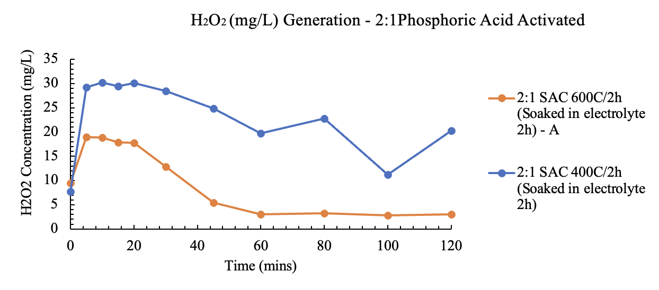
Sargassum Electrochemical System: Results and Conclusion
Figure 20: H₂O₂ Generation - 2:1 Activated Phosphoric Acid
Synthesis and Characterization of Biomass-Derived Functional Carbon for Electrochemical Water Treatment
NEU Young Scholars Program June 22, 2026 - July 30, 2026
Notes:
Significant H2O2 production, maximum at 30 ppm for 2:1 SAC produced at 600°C for 2h.

Slide 12
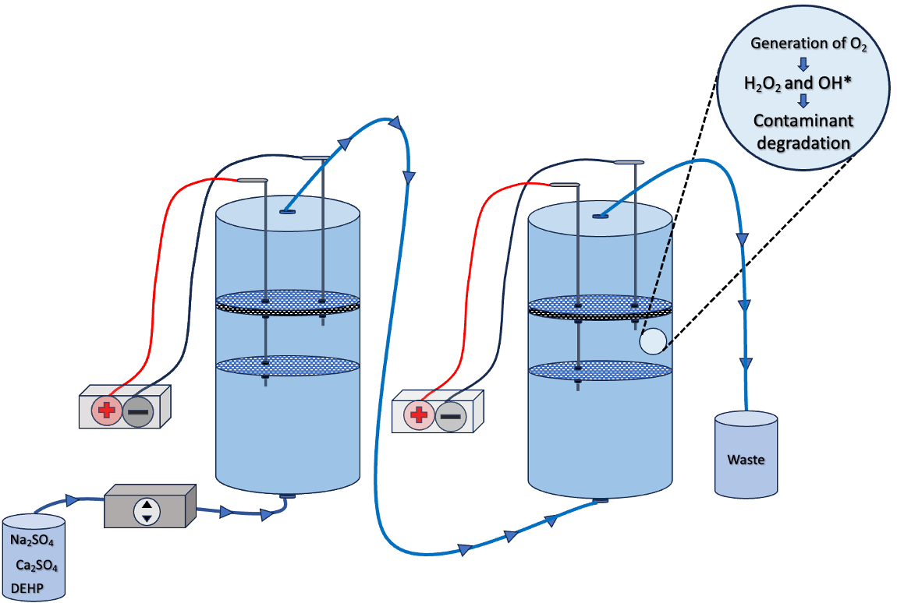
Future Steps
MB
Figure 21: Model of flow through electrochemical setup
Repeat MB experiment with sargassum
Repeat H₂O₂ experiment with bamboo
Flow-through experiments and model reactor
Polarity reversal → desorb contaminants from system
Figure 4: Electrochemical flow through
reactor column
Synthesis and Characterization of Biomass-Derived Functional Carbon for Electrochemical Water Treatment
NEU Young Scholars Program June 22, 2026 - July 30, 2026

Slide 13
Acknowledgements
Center for STEM Education
Claire Duggan: Executive Director
Jennifer Love: Associate Director
Kenneth Rene Santizo Carabal, Frances Corcell, and Ahmed Othman: YSP Coordinators
Nicolas Fuchs: Program Manager
Mary Howley: Administrative Officer
PROTECT Research Center at CEE Department
National Institute of Environmental Health Sciences’ Superfund Research Program
Civil and Environmental Engineering Department
Professor Akram Alshawabkeh
Amanda Thomas, Nima Sakhaee, Fahad Ehsan, Senior Research Scientist: Project Mentors
Synthesis and Characterization of Biomass-Derived Functional Carbon for Electrochemical Water Treatment
NEU Young Scholars Program June 22, 2026 - July 30, 2026

Slide 14
Works Cited
ABC News. (2026). Climate change. ABC News. https://abcnews.com/immersive/puerto-rico?id=98587020
About PROTECT. (2024). In PROTECT. https://protect.sites.northeastern.edu/about-protect/
Can You Drink the Water in Puerto Rico - Olympian Water Testing, LLC. (2025, July 11). Olympian Water Testing. https://olympianwatertesting.com/can-you-drink-the-water-in-puerto-rico/
Carbonwave. (2023). Sargassum seaweed 101 - carbonwave. In Carbonwave. https://carbonwave.com/blog/sargassum-seaweed-101/
Francoeur, M., Yacou, C., Jean-Marius, C., Chérémond, Y., Jauregui-Haza, U., & Gaspard, S. (2022). Optimization of the synthesis of activated carbon prepared from Sargassum (sp.) And its use for tetracycline, penicillin, caffeine and methylene blue adsorption from contaminated water. Environmental Technology & Innovation, 28, 102940. https://doi.org/10.1016/j.eti.2022.102940
Furness, D. (2025). Study reveals dramatic decline in some historic sargassum populations. In Usf.edu. https://www.usf.edu/marine-science/news/2025/study-reveals-dramatic-decline-in-some-historic-sargassum-populations.aspx
Jim. (2023, December 27). El yunque national forest: Rainforest trails and waterfalls in Puerto Rico. Roaming Together - so Much World, so Little Time. https://roamingtogether.com/el-yunque-national-forest/
Mahmood, T., Momin, S., Ali, R., Naeem, A., & Khan, A. (2022). Technologies for Removal of emerging contaminants from Wastewater. In www.intechopen.com. IntechOpen. https://www.intechopen.com/chapters/81623
Moreno, O., Alvarado-Flores, J., & Rutiaga-Quinones, J. (2025). Feasibility and properties of activated carbons obtained from Sargassum spp. Algal Research, 91(91), 104219. https://doi.org/10.1016/j.algal.2025.104219
Synthesis and Characterization of Biomass-Derived Functional Carbon for Electrochemical Water Treatment
NEU Young Scholars Program June 22, 2026 - July 30, 2026

Slide 15
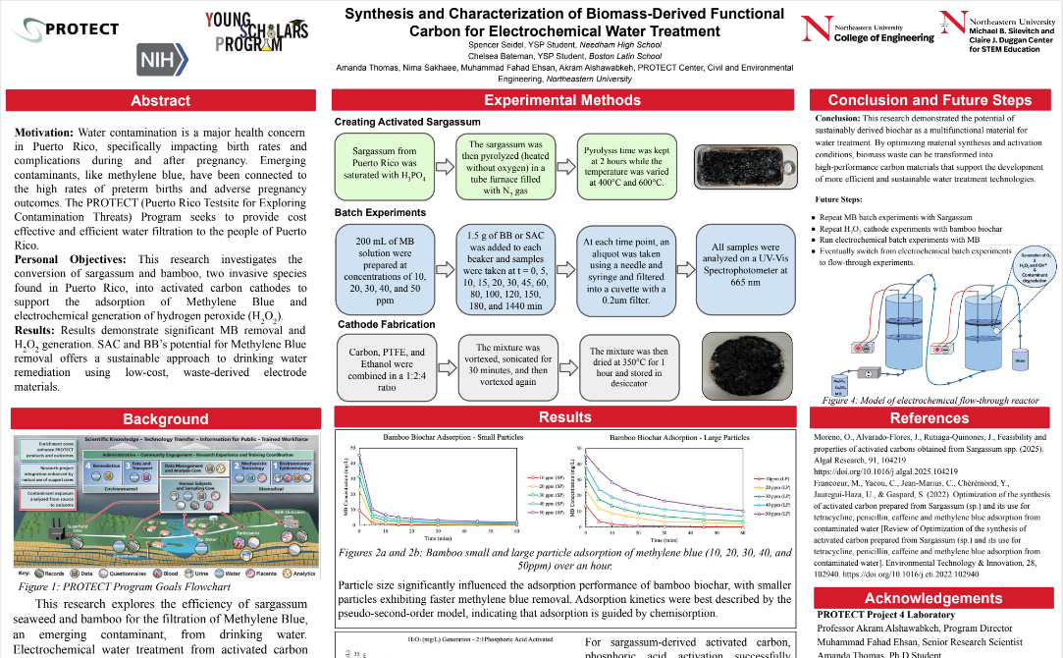
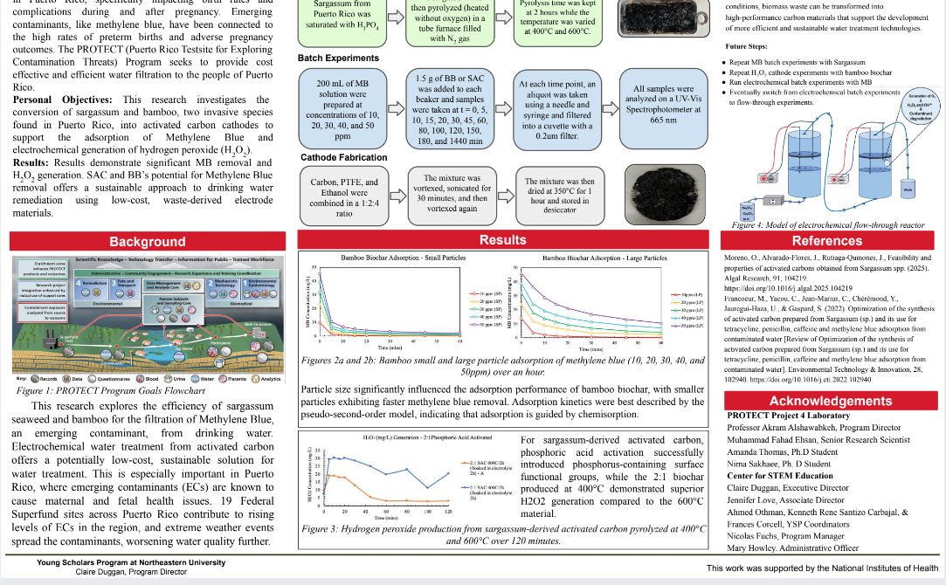
Notes:
15
The loose GAC removed MB at a faster rate, but the cathodes (#1 and #2), removed more MB percentage-wise within the time frame.

